Slide 1
DAWAI TRACK
Smart Medicine Platform with Expired Medicine Take-Back System

Slide 2
📌 Overview
DawaiTrack is a healthcare platform that combines online pharmacy services, medicine lifecycle management, and an expired medicine take-back system.
The platform enables users to purchase medicines, track orders, and safely return expired medicines. Pharmacies collect expired medicines using QR verification, and administrators ensure proper biomedical disposal.
This system promotes safe medicine usage, environmental sustainability, and responsible healthcare practices.

Slide 3
🎯 Project Motivation
Expired medicines stored at home can cause:
Accidental consumption
Environmental contamination
Unsafe disposal practices
Most pharmacy platforms only focus on medicine delivery. They lack structured mechanisms for tracking expired medicines and disposing them safely.

Slide 4
🚀 Key Features

Slide 5
👤 User Features
User registration and login
Medicine browsing and search
Add to cart and checkout
Order history
Expired medicine return request
QR code generation for pickup verification

Slide 6
🏥 Pharmacy Panel
Medicine management
Batch-based inventory management
FEFO stock deduction (First Expiry First Out)
Order management
Expired medicine request verification
QR code scanning for collection

Slide 7
🛠 Admin Panel
Dashboard analytics
Audit logging system
Disposal management
Disposal method tracking

Slide 8
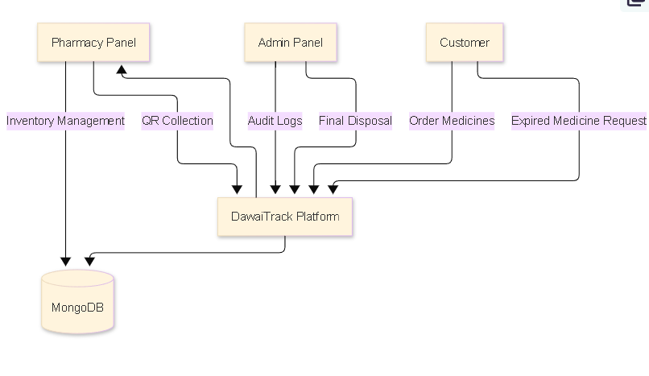
SYSTEM Architecture

Slide 9
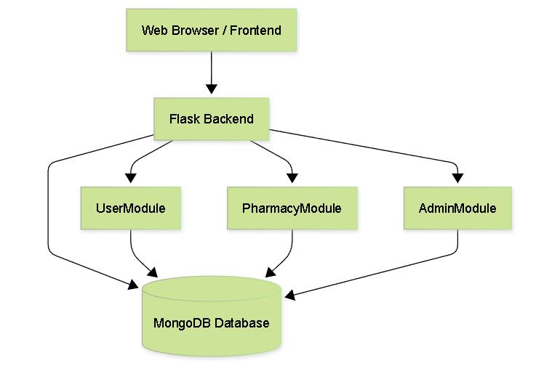
HIGH LEVEL ARCHITECTURE (HLD)

Slide 10
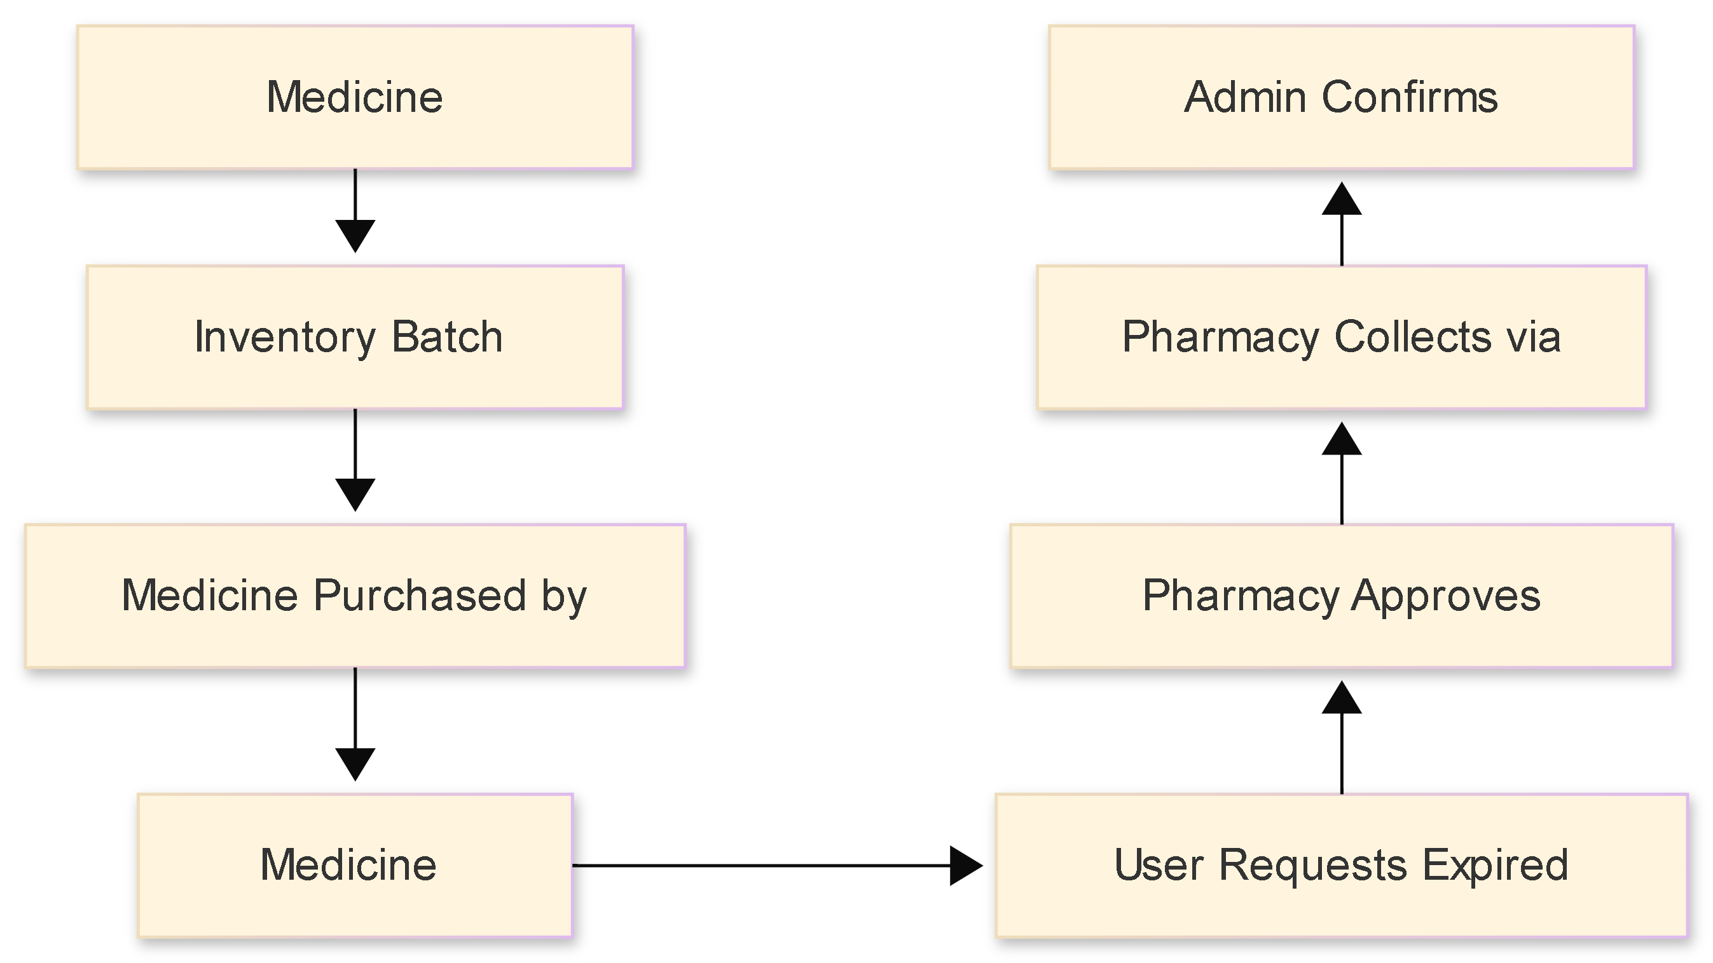
MEDICINE LIFECYLE

Slide 11
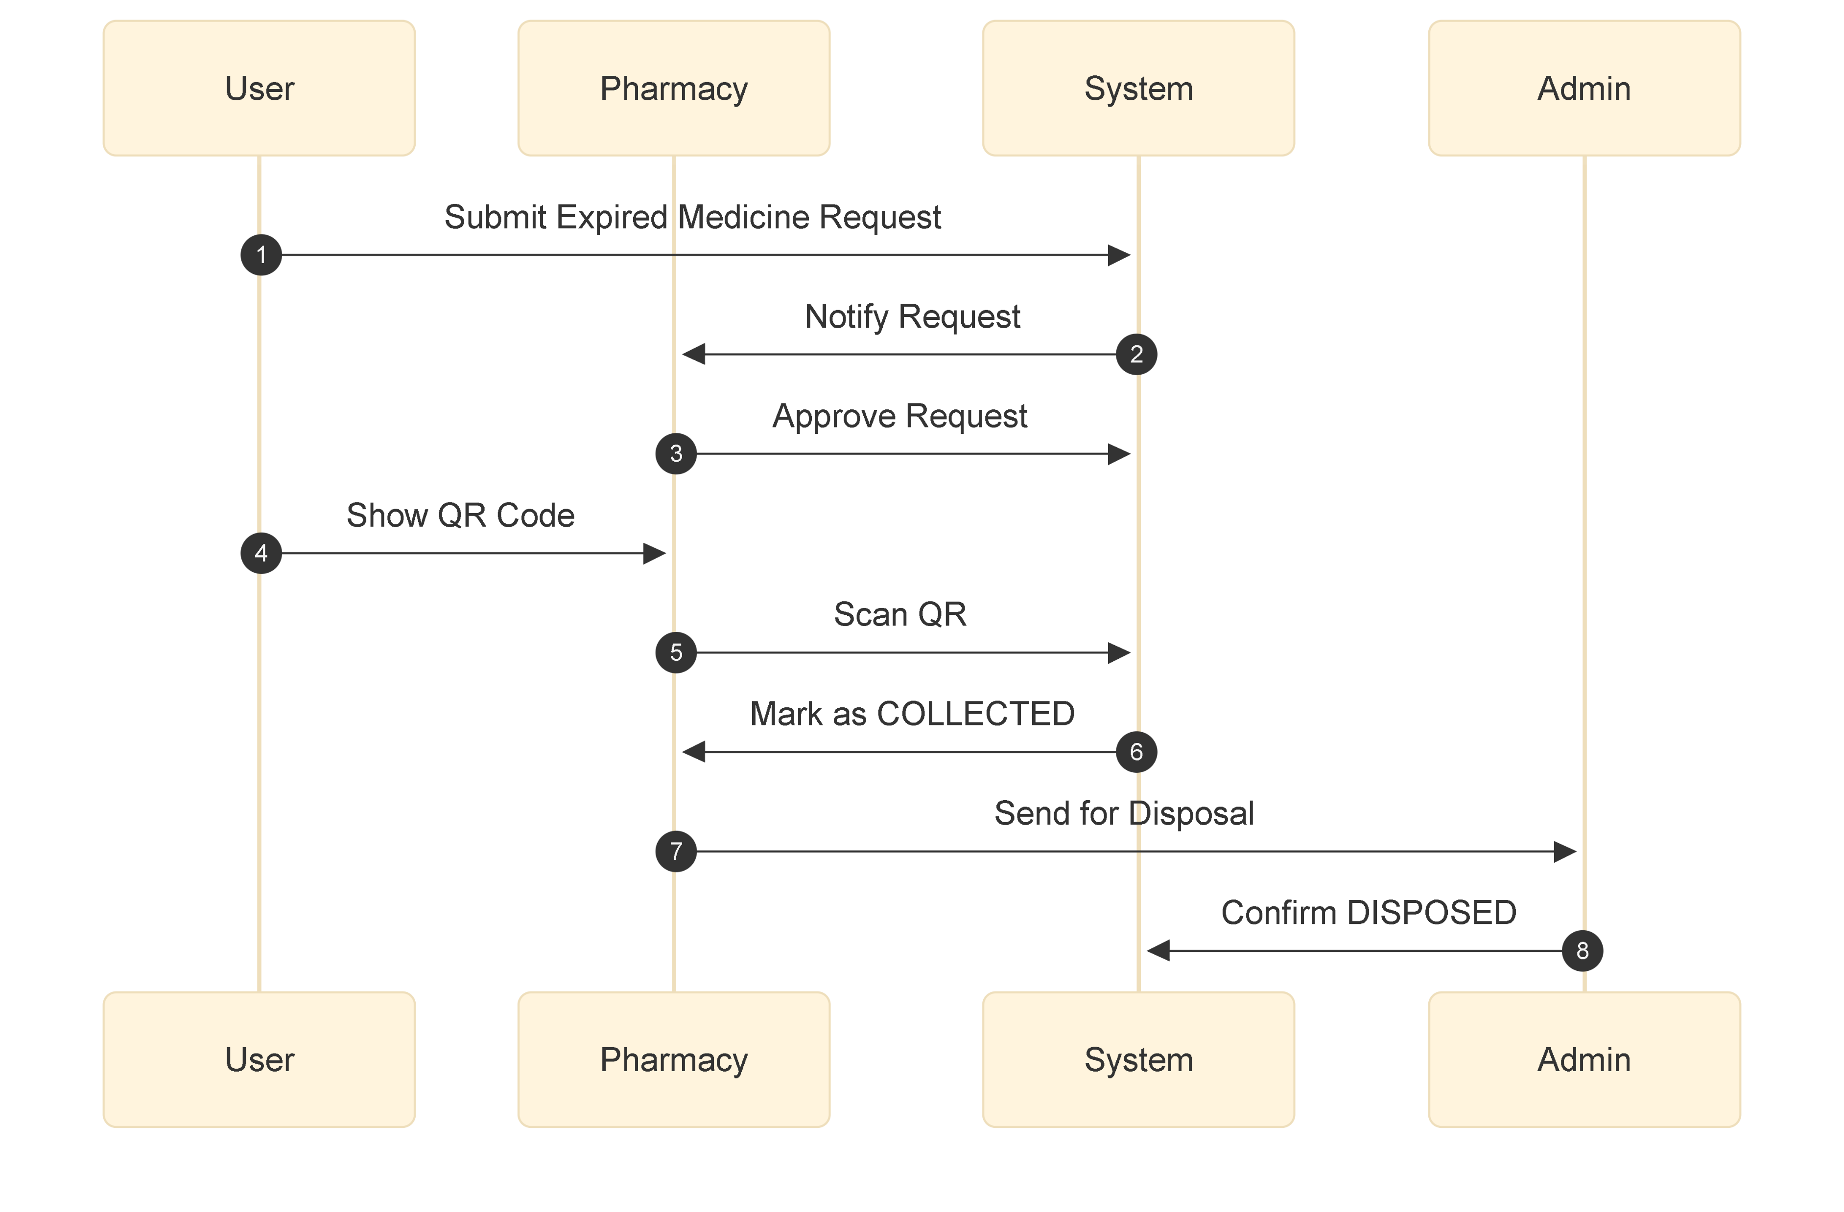
Expired Medicine Collection Flow

Slide 12
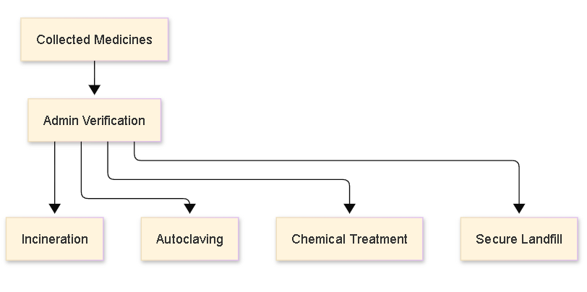
Disposal Workflow

Slide 13
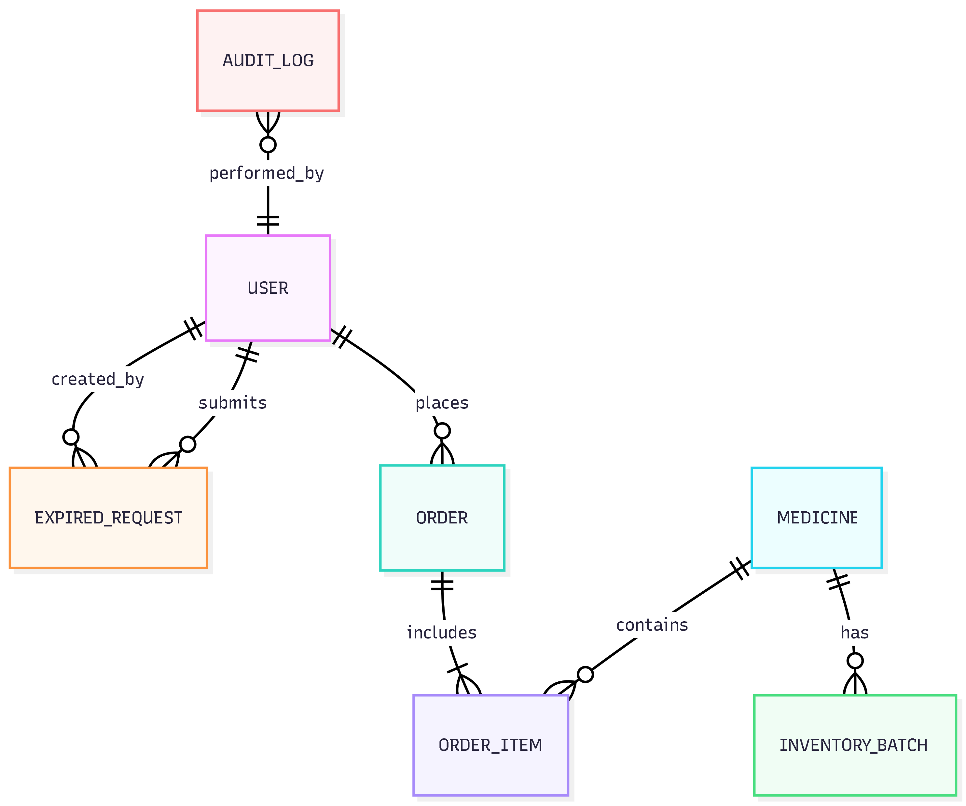
Database E.R. Diagram

Slide 14
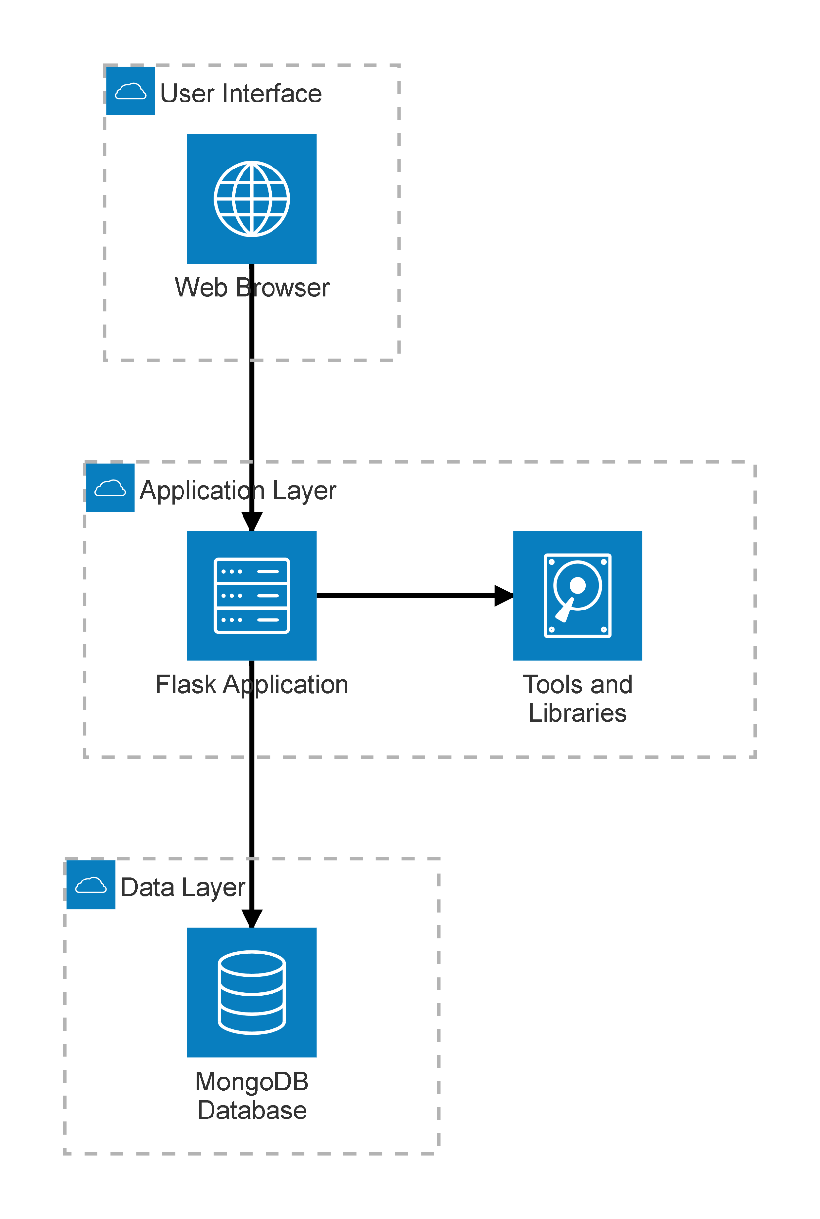
Architecture diagram

Slide 15
Few Screenshots

Slide 16
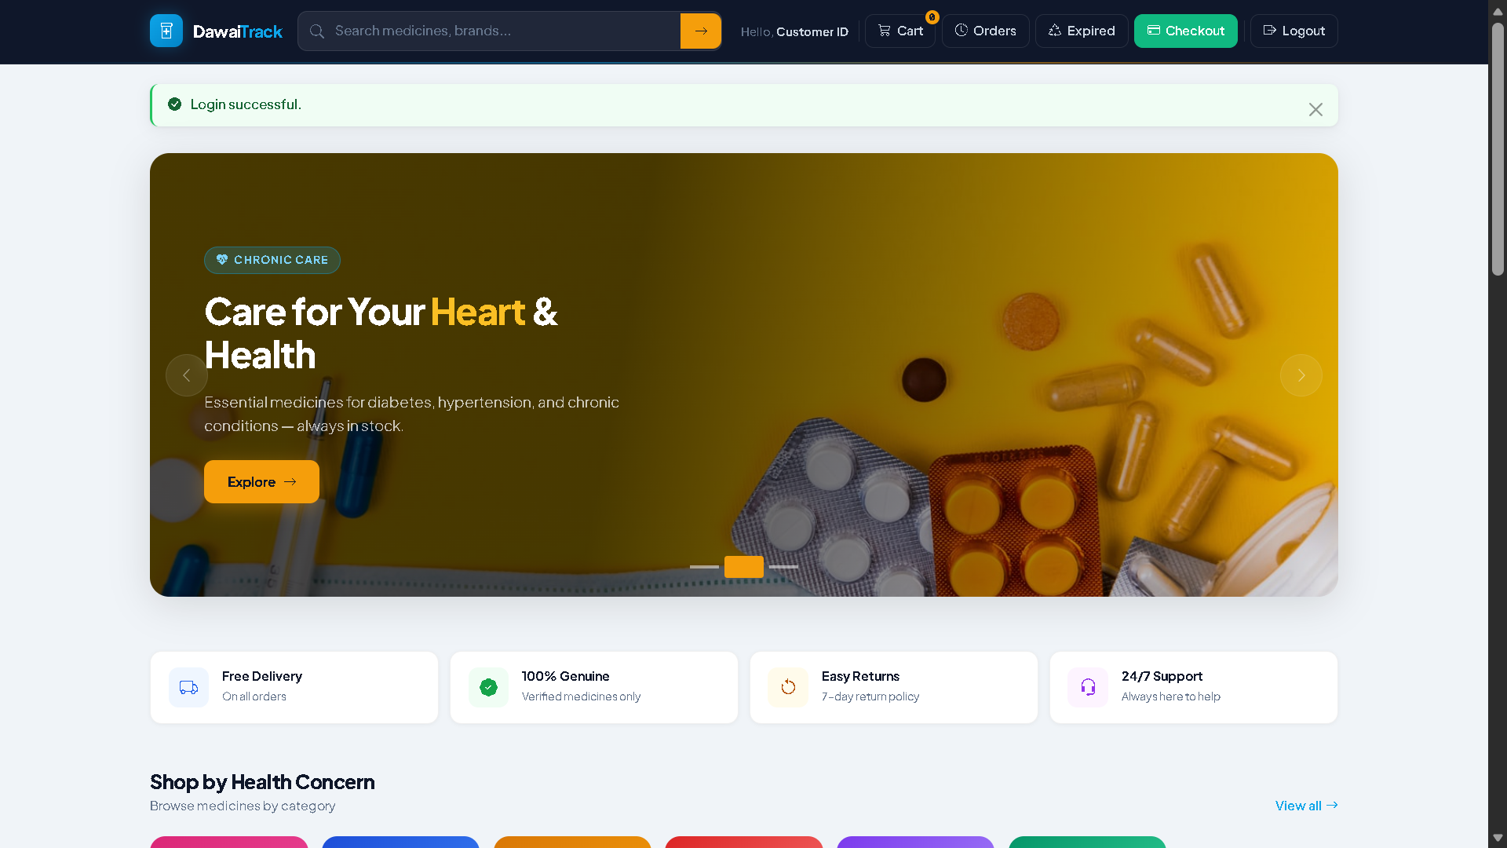

Slide 17
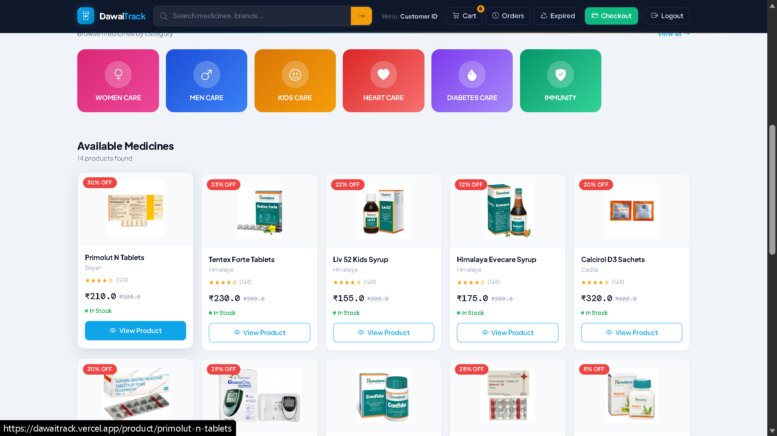

Slide 18
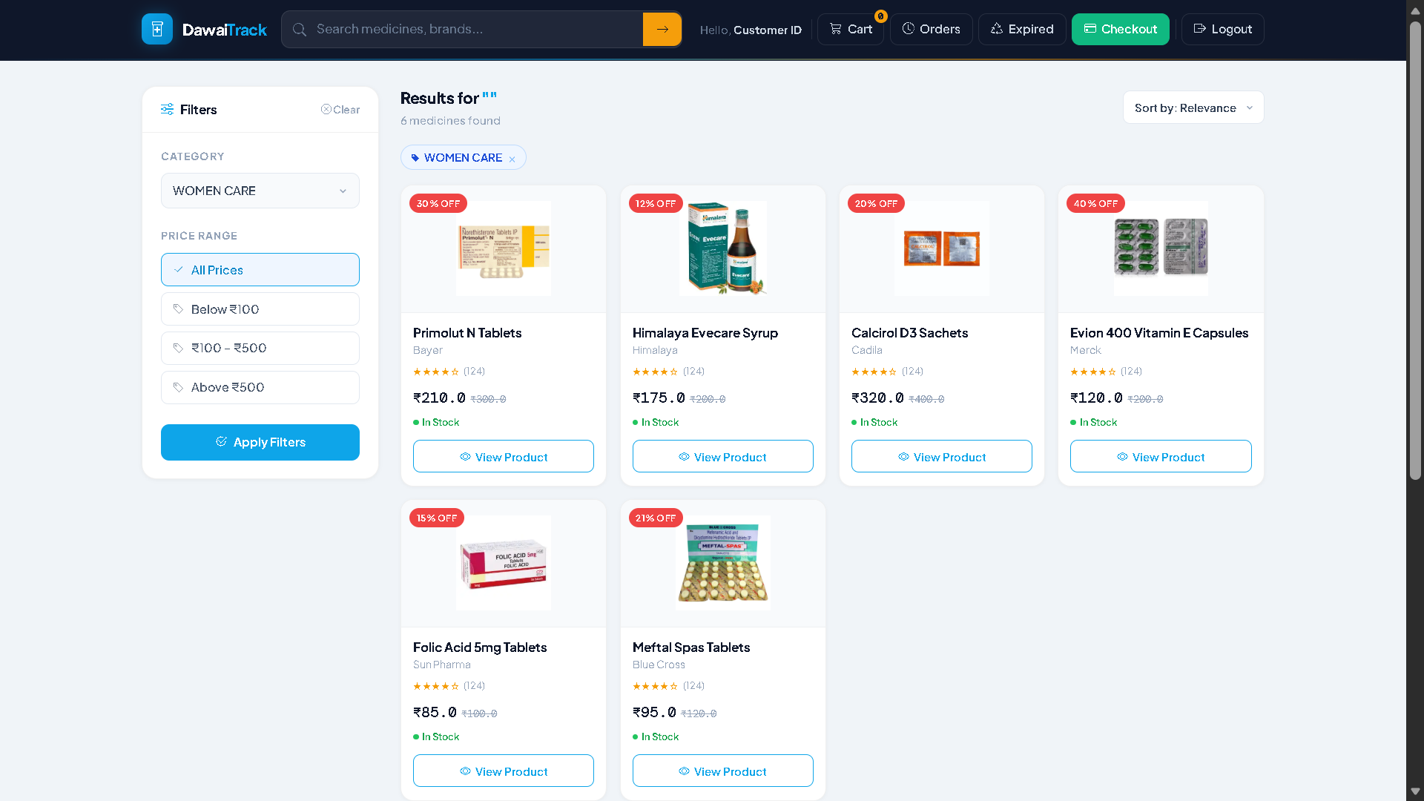

Slide 19
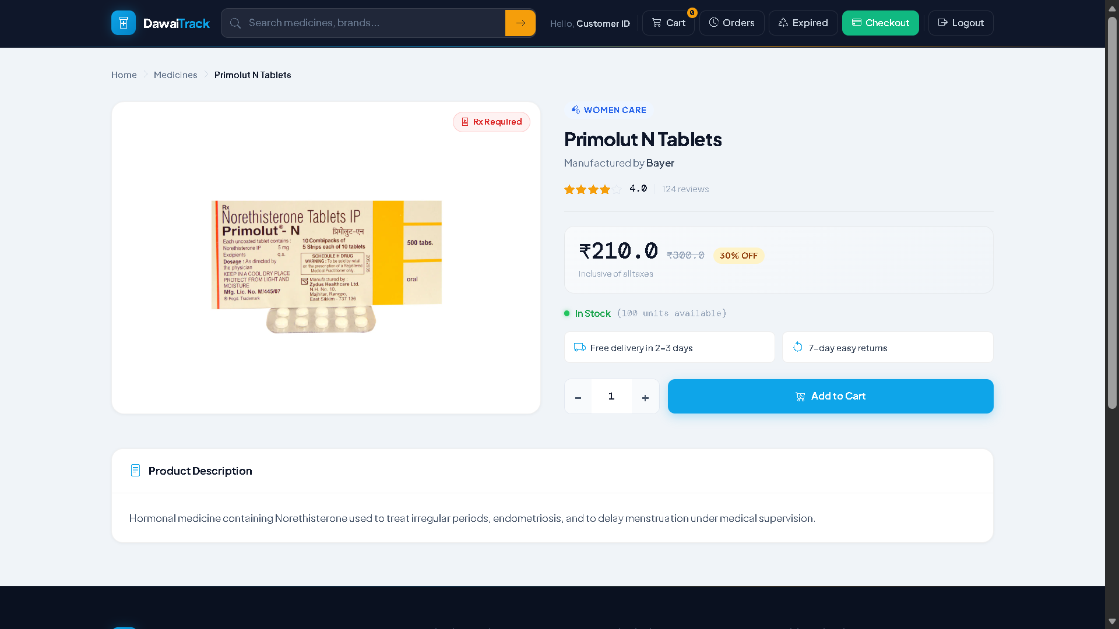

Slide 20
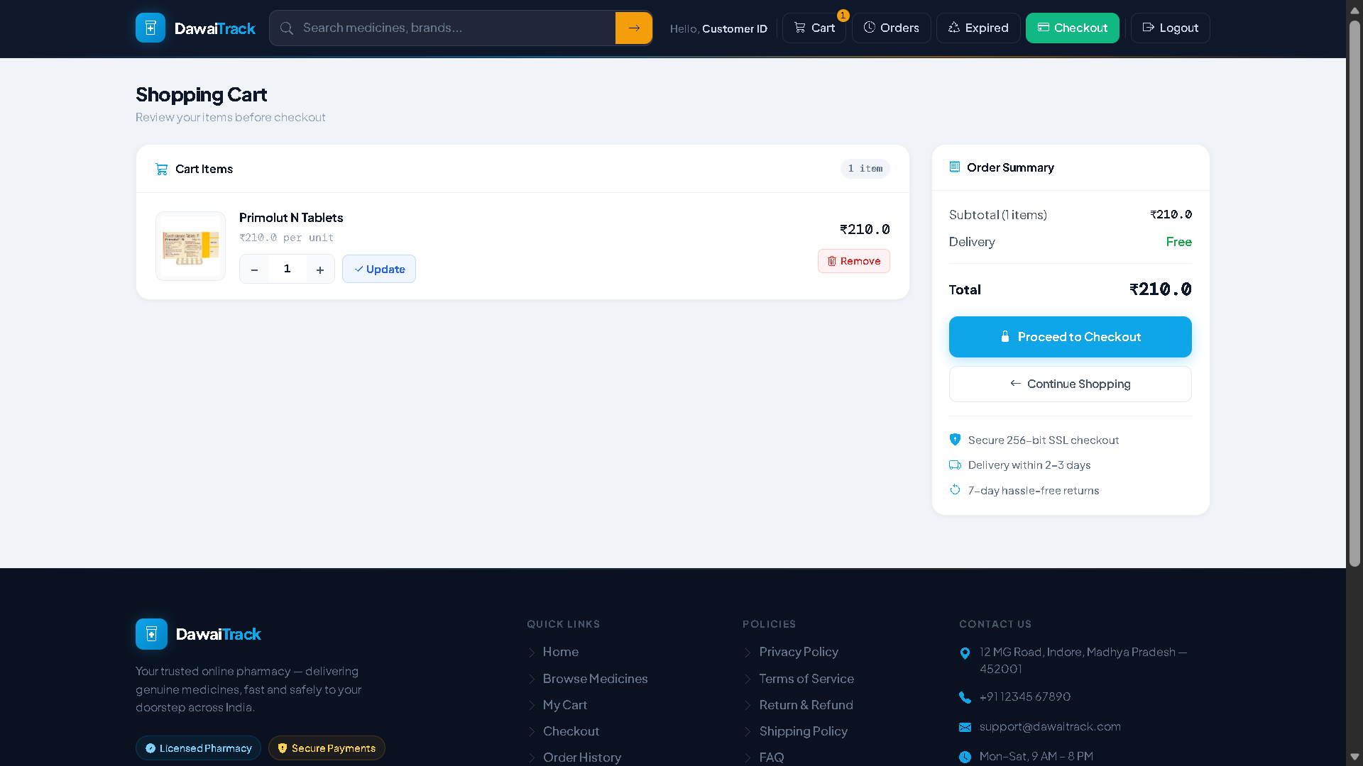

Slide 21
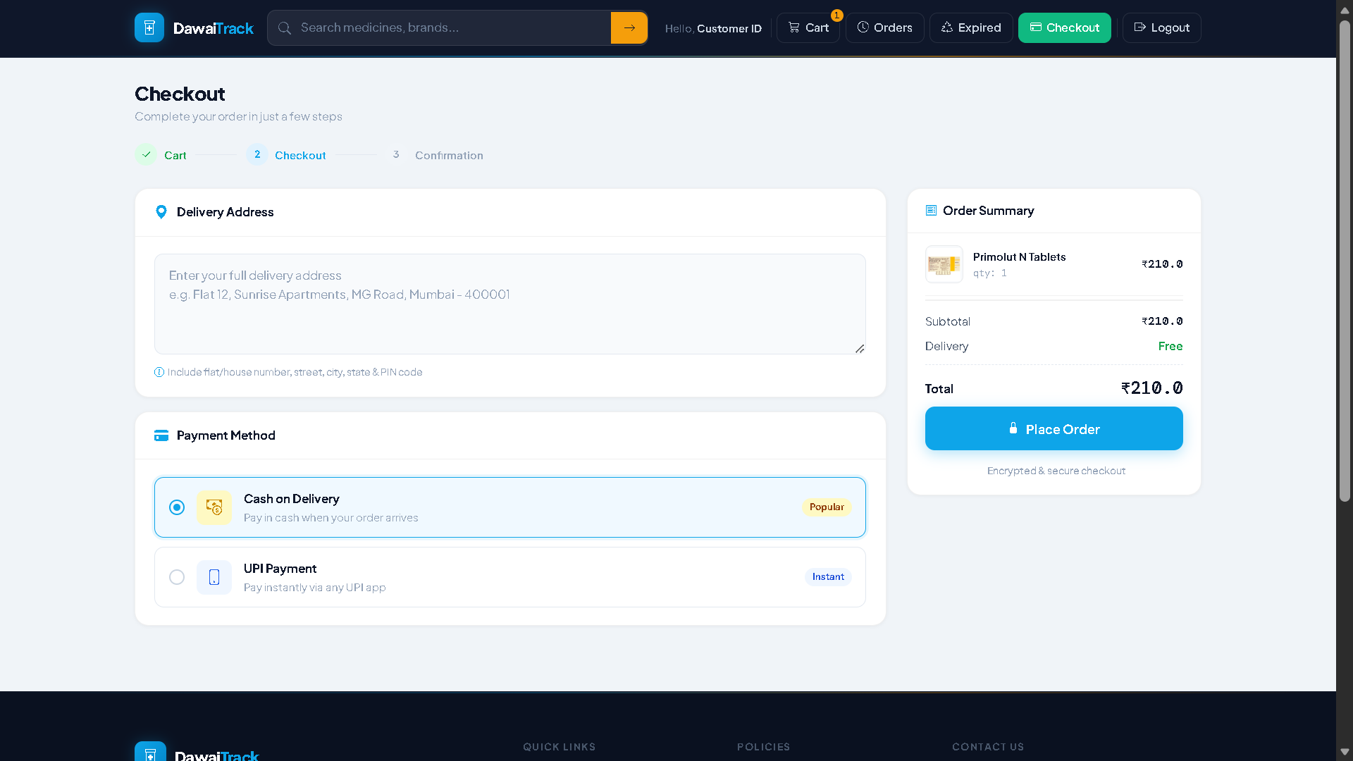

Slide 22
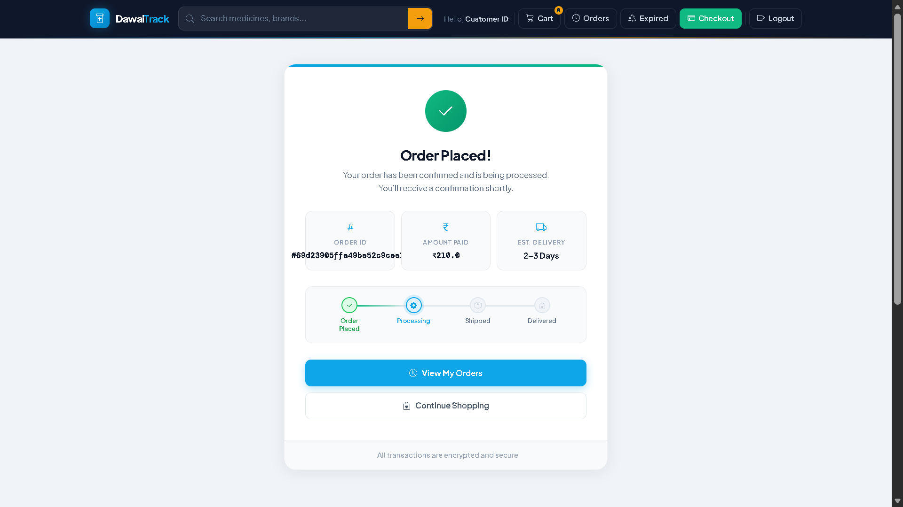

Slide 23
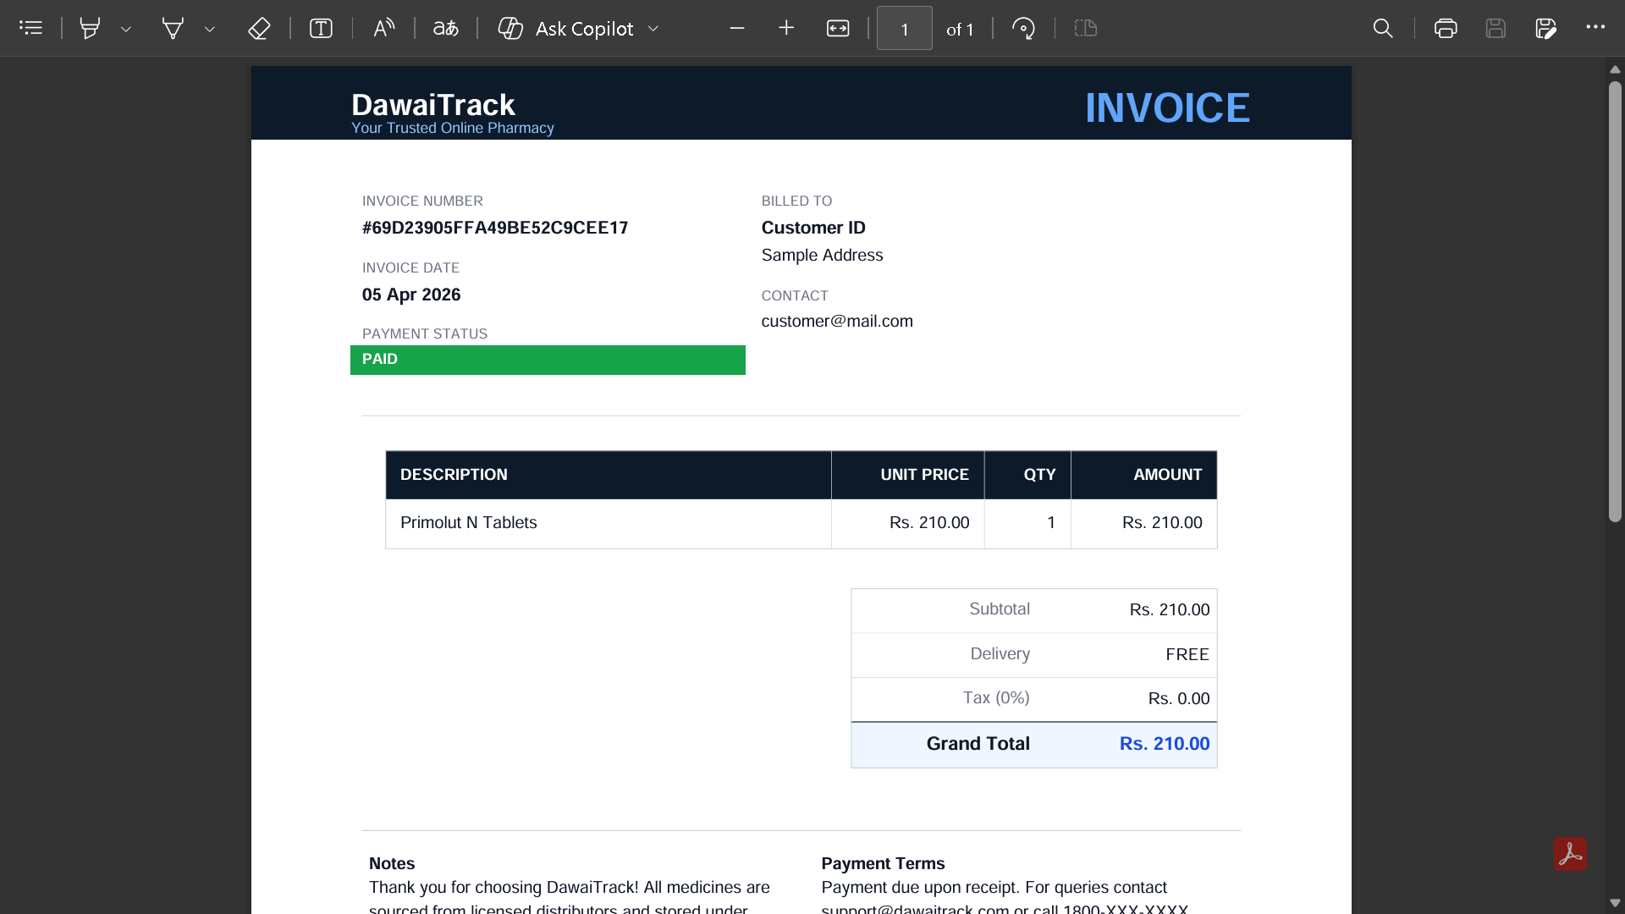

Slide 24
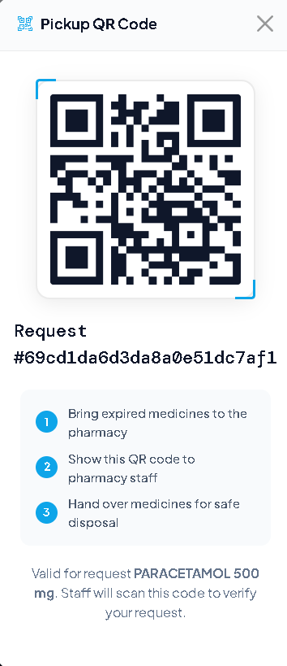
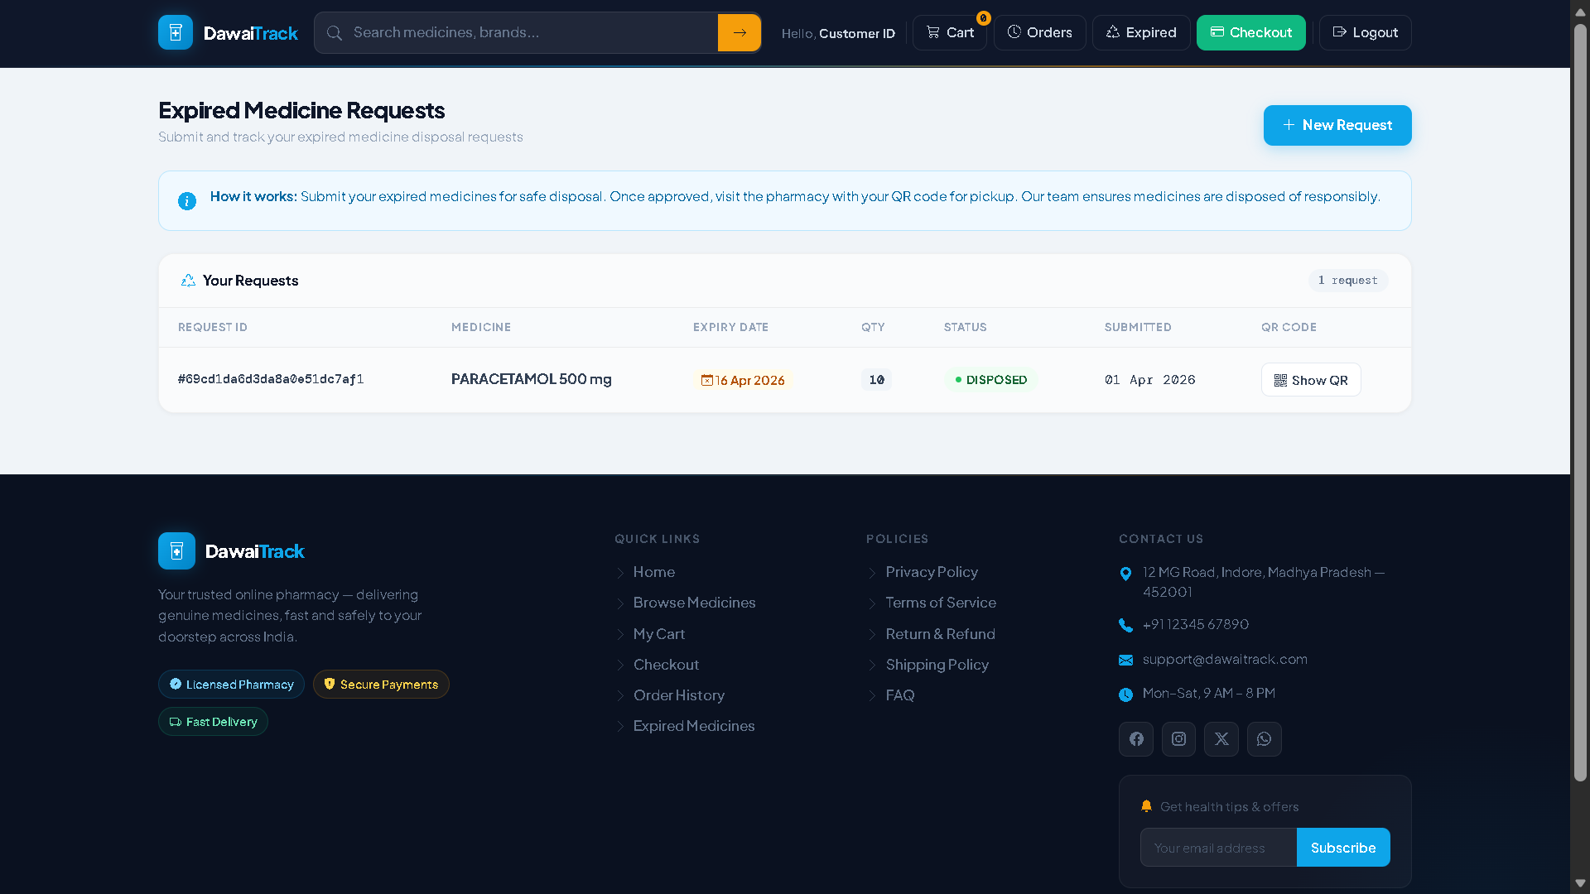

Slide 25
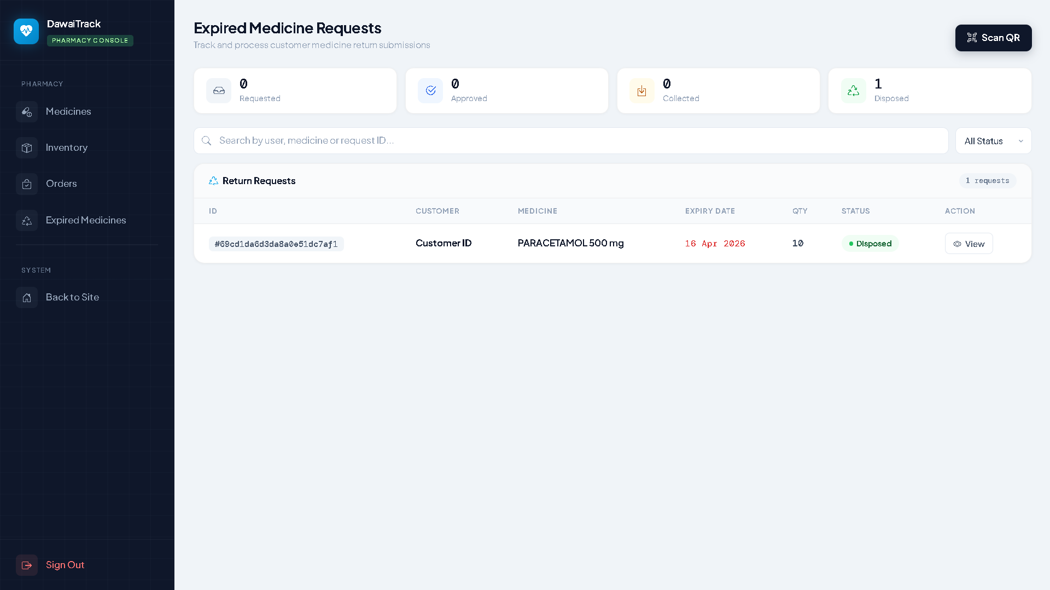

Slide 26
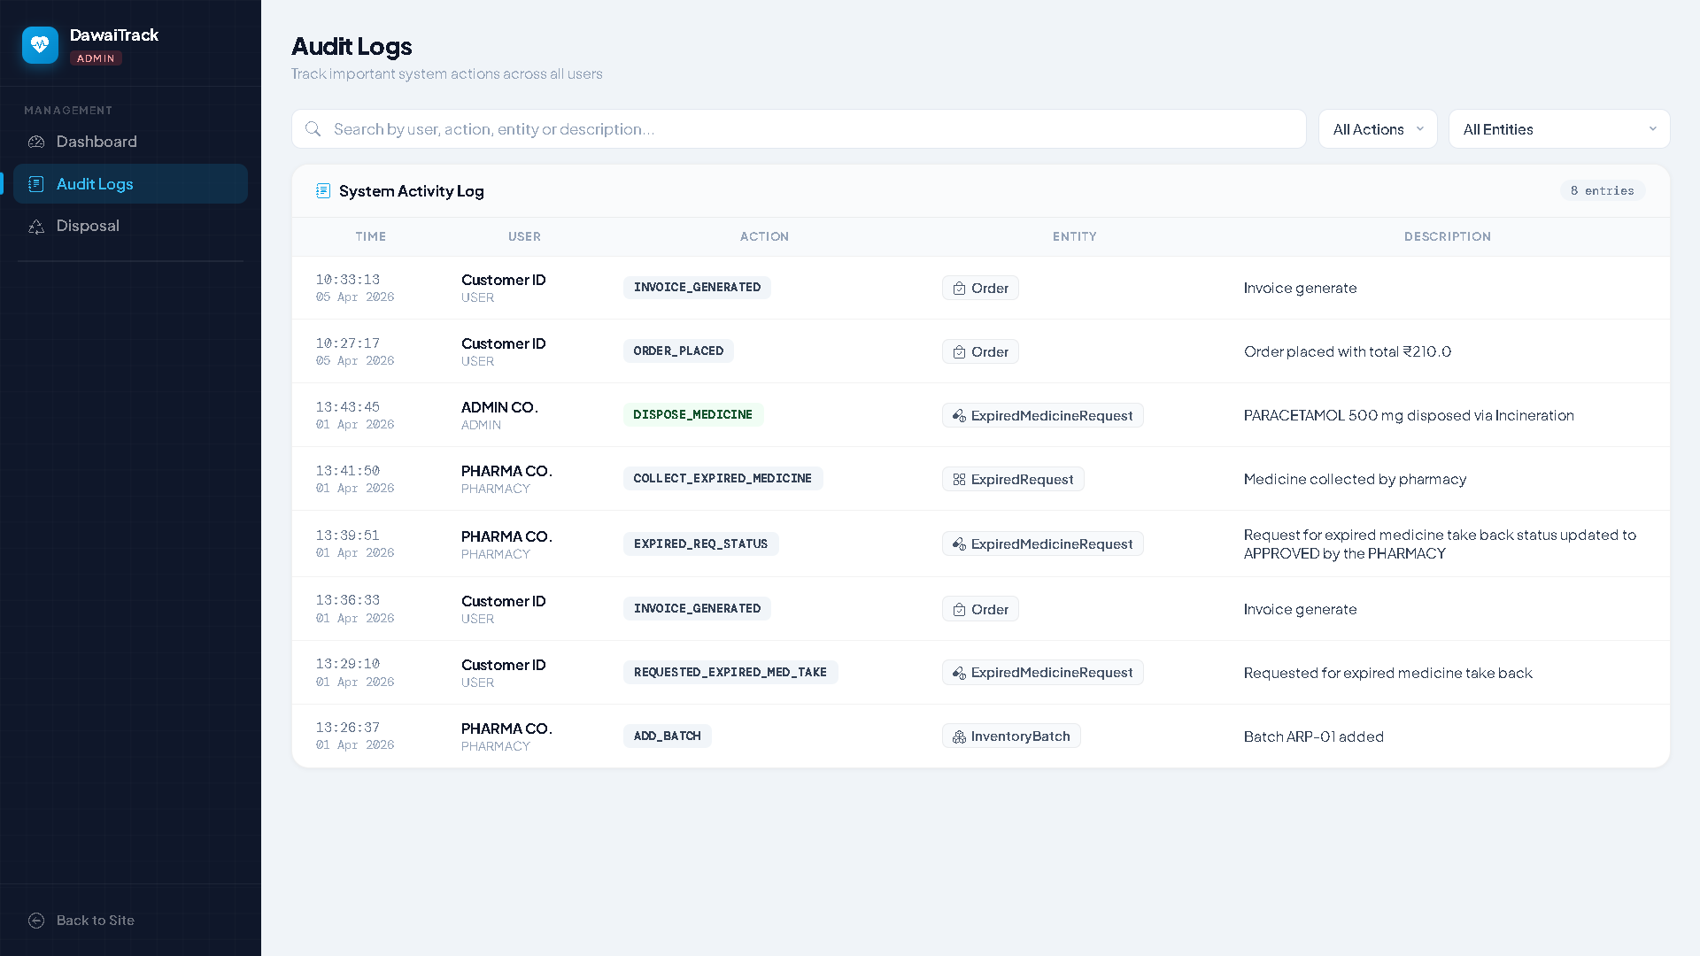

Slide 27
THANK YOU

