Slide 1
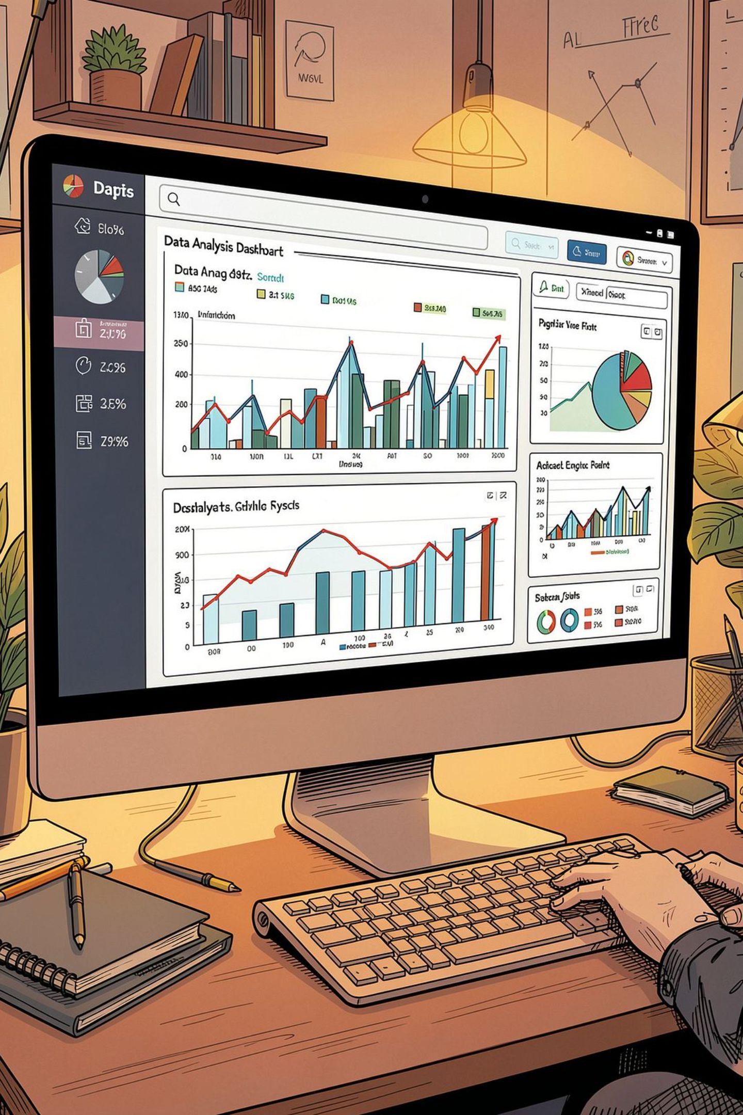
Customer Shopping Behavior — Overview
Analysis of 3,900 purchases to reveal spending, segments, product & subscription insights.

Slide 2
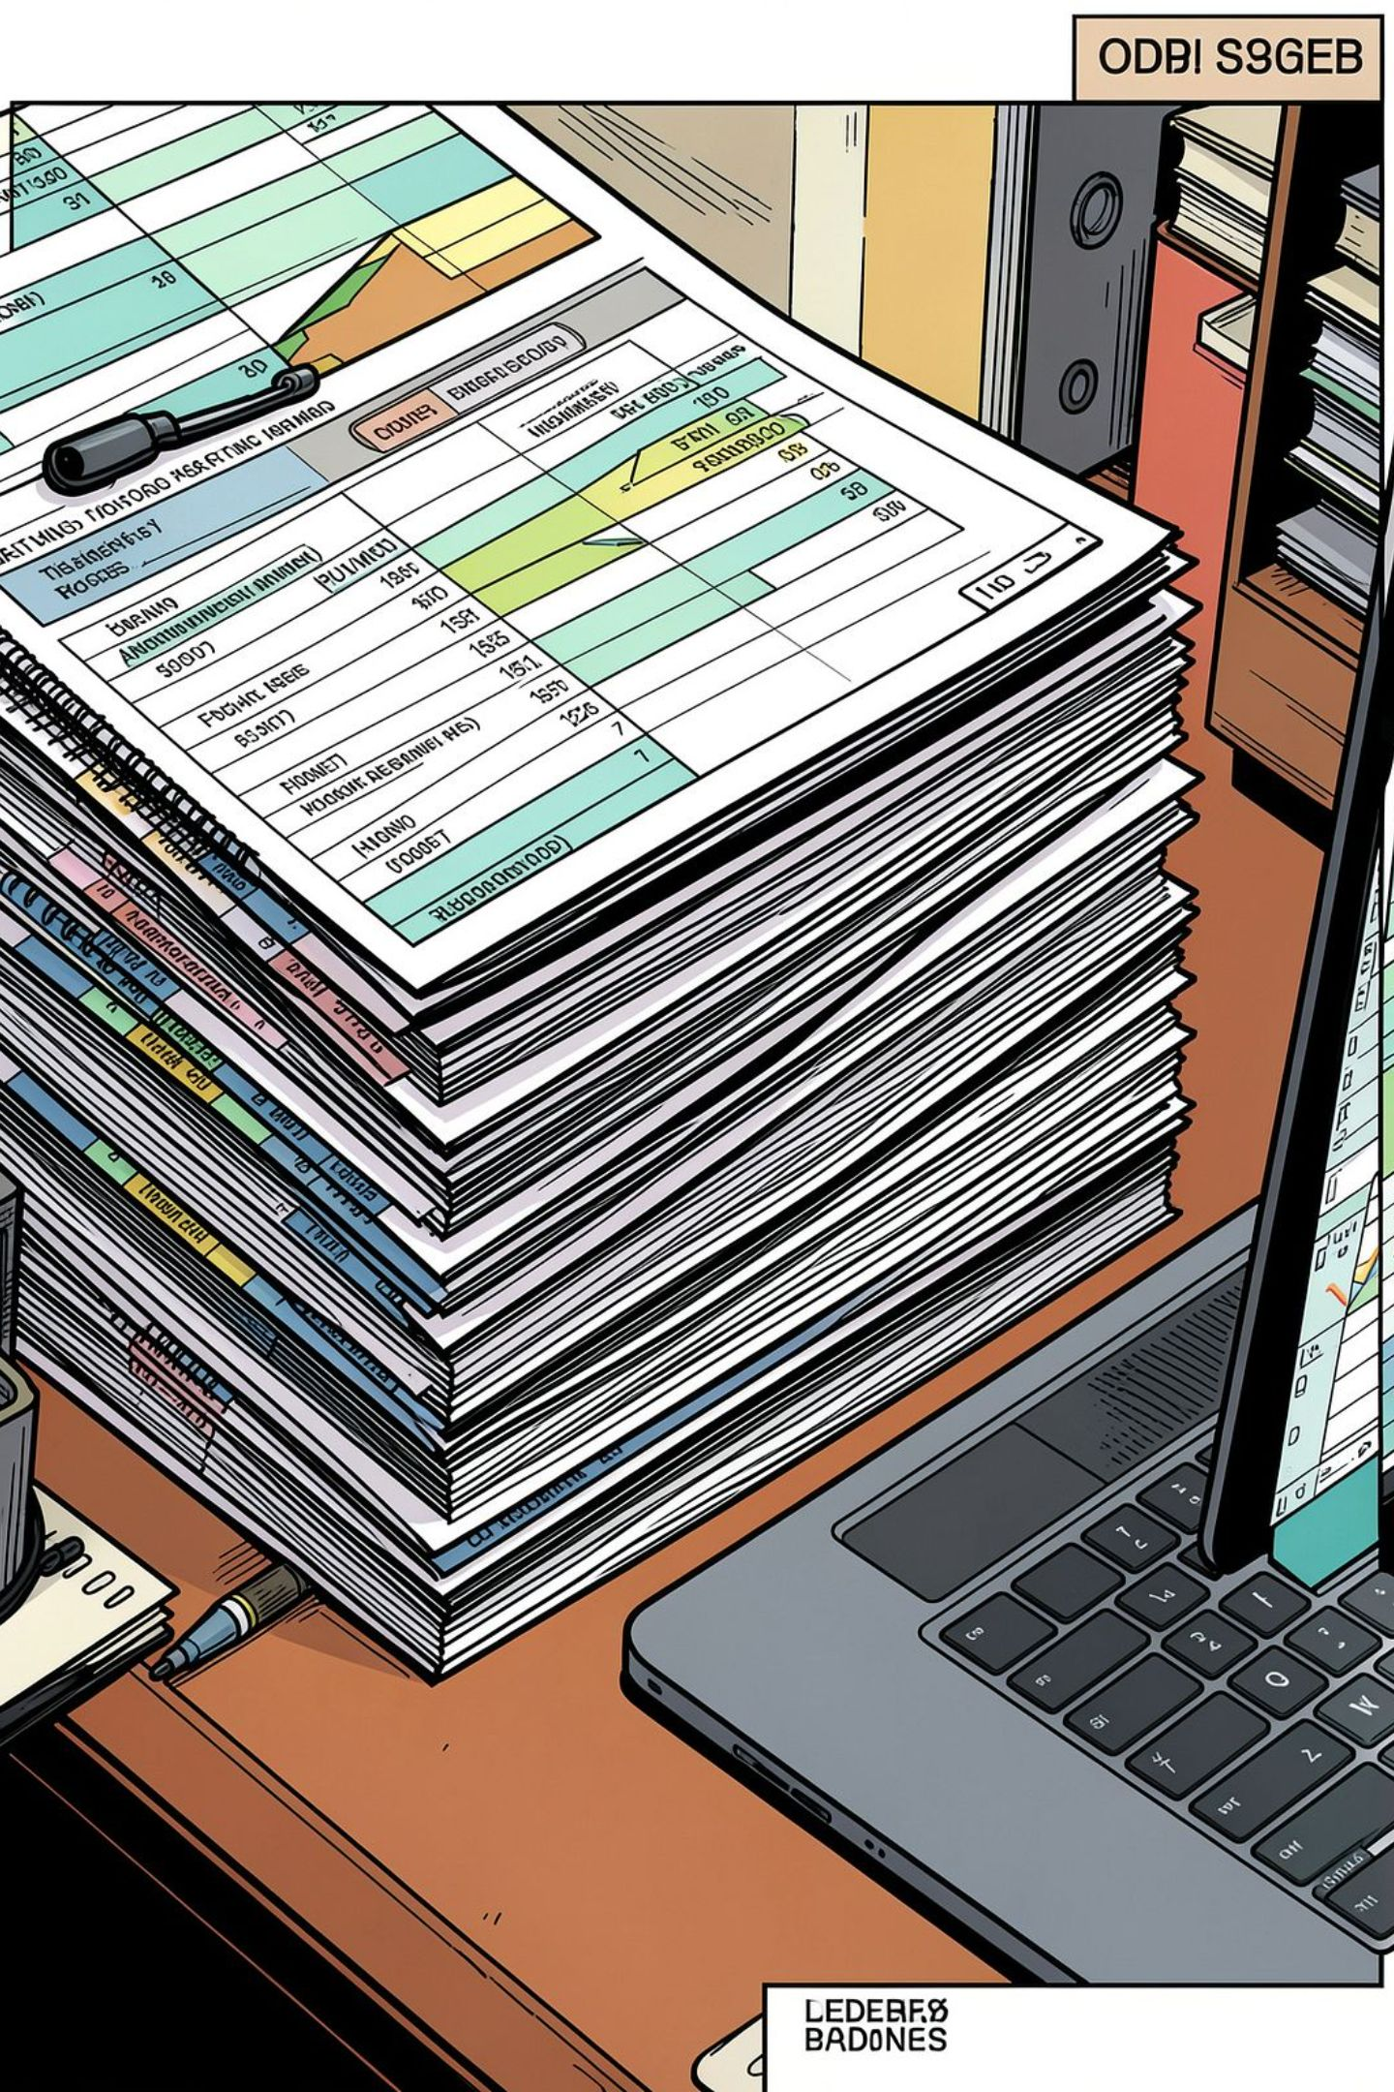
Dataset Snapshot
Size
Key Features
Rows: 3,900 · Columns: 18
Demographics, Purchase details, Behavior, Shipping
Missing Data
Review Rating: 37 nulls (imputed by category median)

Slide 3

Data Prep (Python)
01
Load & Explore
df.info(), .describe()
02
Clean & Impute
Median imputation for review ratings
03
Engineer
age_group, purchase_frequency_days
04
Standardize
snake_case column names

Slide 4
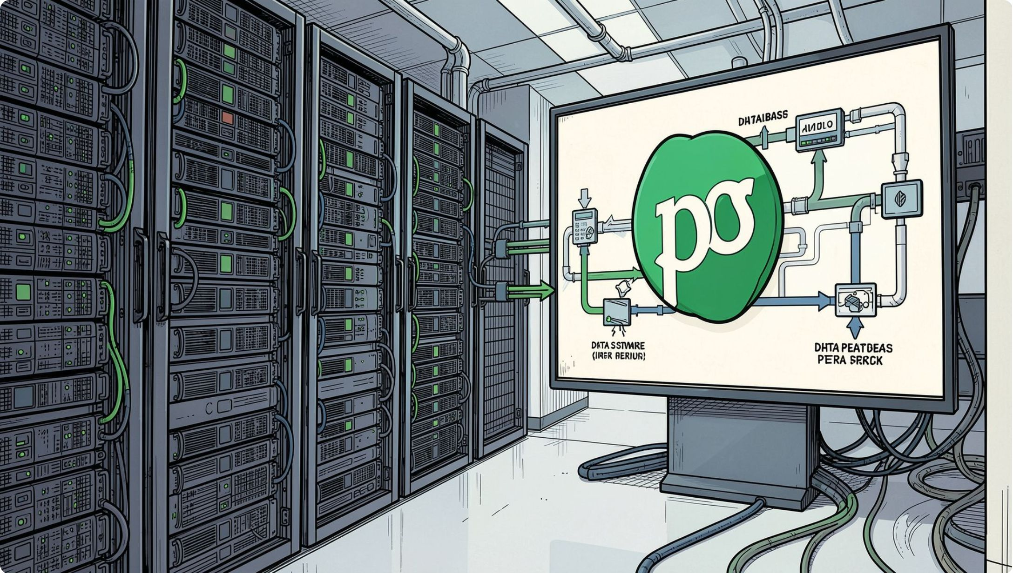
Database Integration
Cleaned DataFrame loaded to PostgreSQL for SQL-based business analysis.
Dropped redundant promo_code_used field after consistency checks.

Slide 5
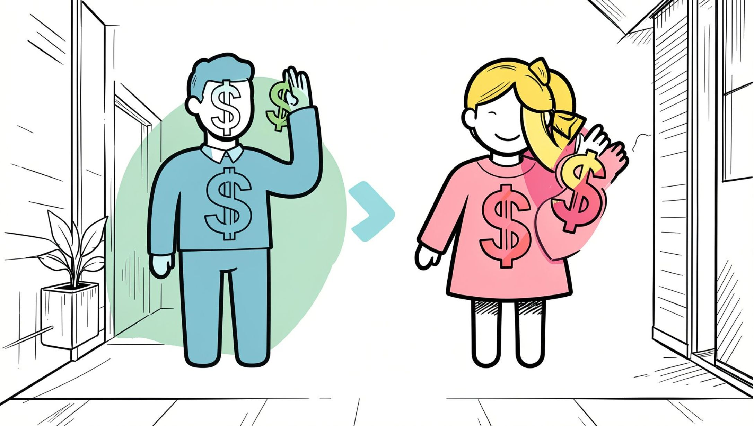
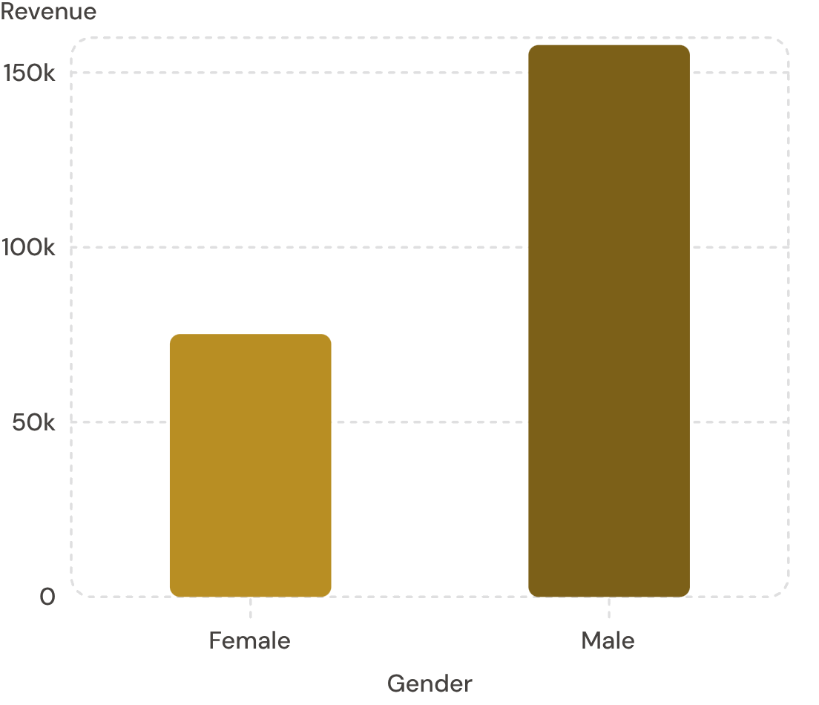
Revenue by Gender
Male customers generated higher total revenue in this dataset.

Slide 6
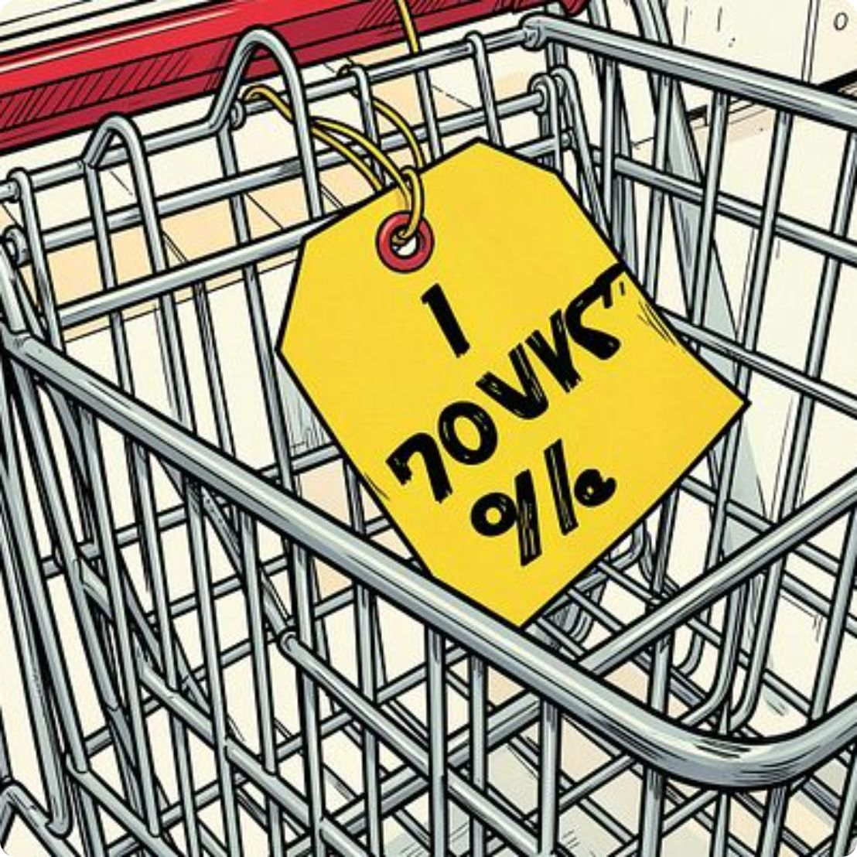
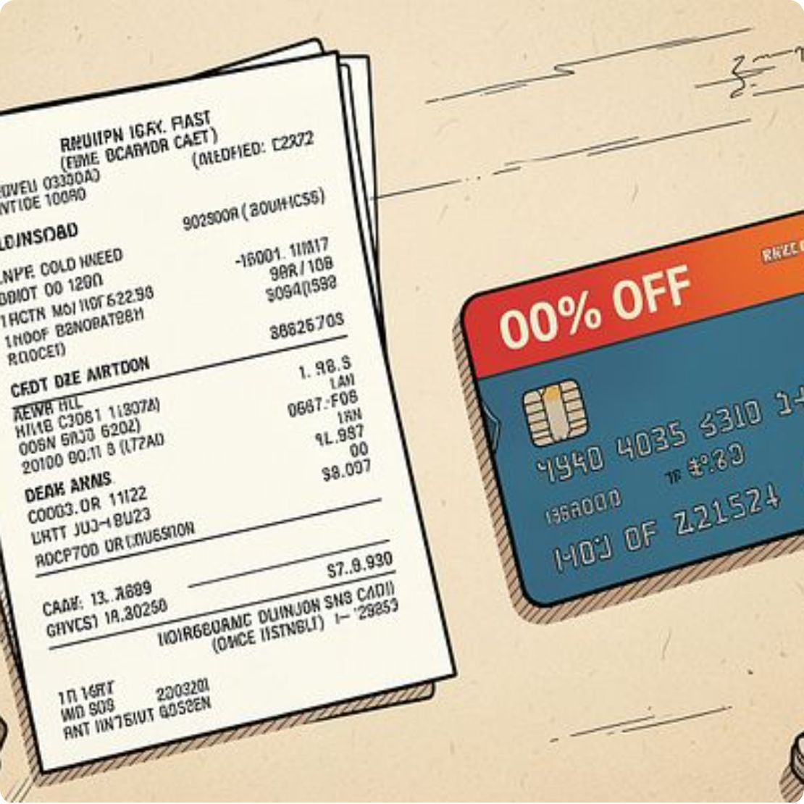
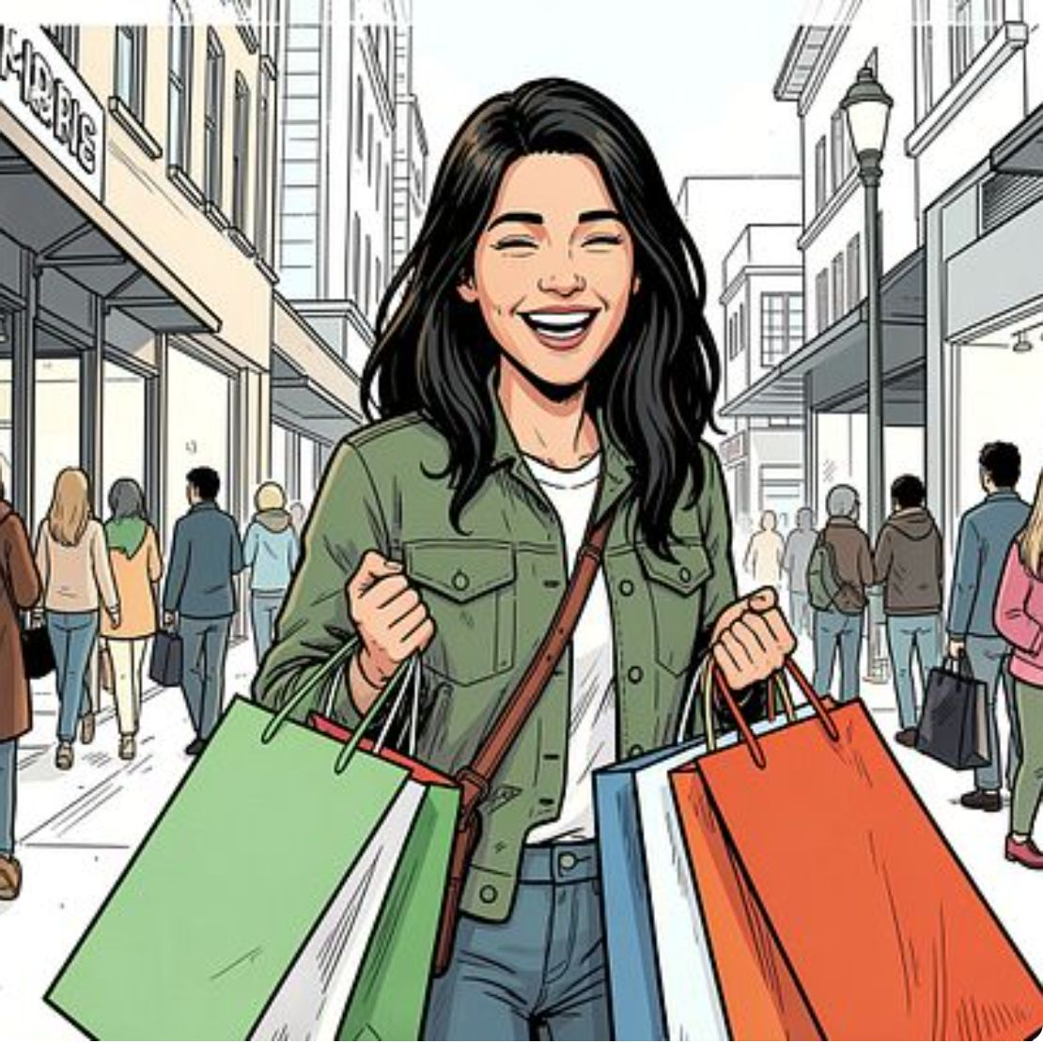
High-Spending Discount Users
839 rows of discount users who spent above average — examples include customers with purchases: 64,73,90,...

Slide 7


Top Products & Discount Dependency
Top by Rating
Discount-Dependent
Gloves (3.86) · Sandals (3.84) · Boots (3.82)
Hat 50% · Sneakers 49.66% · Coat 49.07% · Sweater 48.17% · Pants 47.37%

Slide 8
Segments, Subscribers & Repeat Buyers
3.9K
$59.76
3.75
Customers
Avg Purchase
Avg Rating
Segments: Loyal 3,116 · Returning 701 · New 83
Subscribers: Yes 1,053 (total rev $62,645) · No 2,847 (total rev $170,436)
Repeat buyers (>5 purchases): Yes 958 · No 2,518

Slide 9
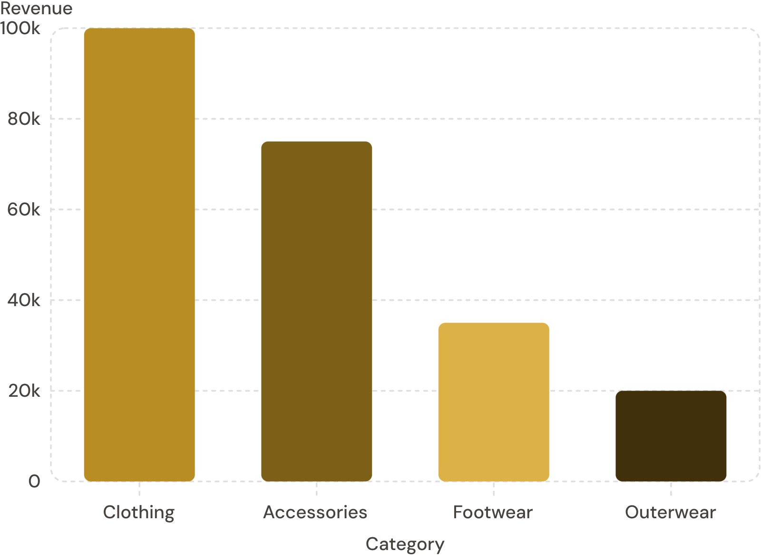
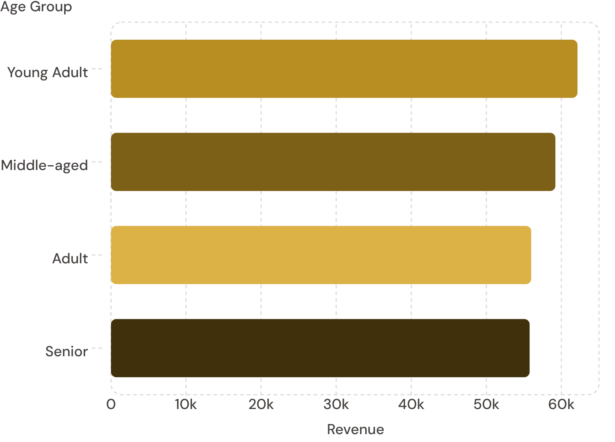
Category & Age Insights

Slide 10




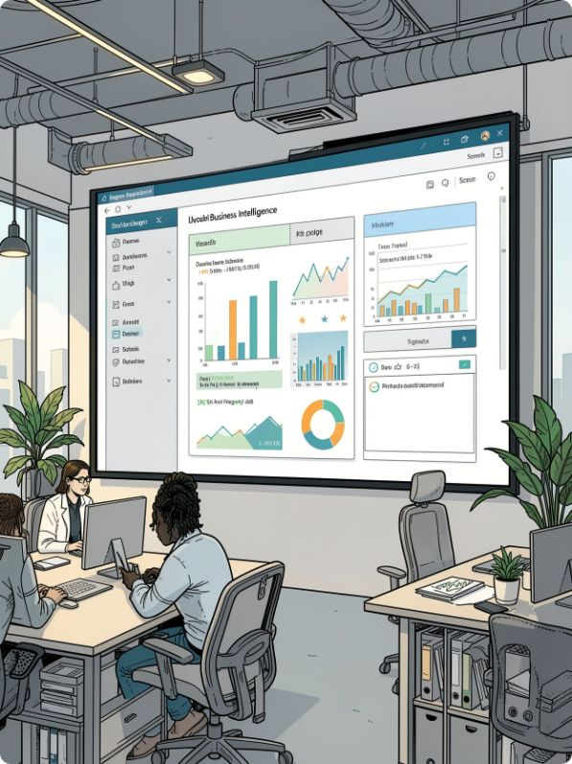
Recommendations
Boost Subscriptions
Loyalty Programs
Discount Policy
Product Positioning
Balance promotional lift with margin control.
Promote exclusive subscriber benefits.
Reward repeat buyers to grow Loyal segment.
Feature top-rated & best-selling items.
Targeted Marketing
Focus on high-revenue age groups & express-shipping users.
Dashboard built in Power BI for interactive exploration.

