Slide 1
Lending Club Case Study
Data Understanding
The aim is to find the loan applicants that defaulted or not based on the past history . In this case we need to consider “loan_status”
Dataset has around 40K entries with 111 features .We need to remove the columns which are not impacting loan status .
Check the data types for better understanding .
Check the data dictionary to understand the columns .
Loan status has 3 values “Current”,”Fully paid” and “Charged off”, since we are not sure on the current status if they will pay up or not , we will ignore them and consider only full paid and charged off status.

Slide 2
Data cleaning
Drop columns containing all null value, max null values ,unique value etc .
Filter rows with missing values
Change the data types for the columns whereever required eg : float64,int64 etc
Convert certain column values to numeric variables for better analysis such as remove % or year etc .

Slide 3
Data Analysis
Derived Columns
Univariate Analysis
Segmented Univariate Analysis
Bivariate Analysis
Multivariate Analysis

Slide 4
Derived Metrics
Derive columns for Month and Year from column “issue_d”
Derive column for “loan_amnt” to “annual_inc” ratio as ” ratio_loan_to_income”
Create new column loan_status_code with 0 and 1 values based on loan_status column where 0=“Fully Paid” and 1=“Charged off”
Creating different groups for interest rate
Combine “Source Verified” and “Verified” into “Verified”
Create Group annual_income

Slide 5
Univariate Analysis
Categorical variables
Ordered categorical data
Grade
Sub grade
Term (36 / 60 months)
Employment length
Loan issue year
Loan issue month
Un-ordered categorical data
State
Loan purpose
Home Ownership
Loan status
Quantitative
Interest rate group
Annual income group
Loan amount
Funded amount
Loan amount to annual income ratio

Slide 6
Univariate and Segmented Univariate analysis
Grade A and B are given more loans compared to other grades
Sub Grade A4, B3, A5, B5, B4 are given more loans compared to other grades
term shows 36 months loans are issued more compared to 60 months loan
employees with 10 years and above are given loan comapred with lesser experience
year shows maximum loans were taken in the year 2011 and is in increasing trend since 2007
Maximum loans were given in the month of Oct, Nov, Dec
14% of the total loans are charged off and 86% are fully paid
States CA, NY, FL ,TX ,NJ are the top 5 states where maximum loans been issued .
Maximum loans are given for debt consolidation .
People who are in Rented house or Mortgate have availed maximum loans
Funded amount is ranging from 500 to 35000 USD
Installment amount is ranging from ~15 to 1300 USD
The loan amount to income ratio mean is around 0.18
Interest rate range 10 to 15 is the range where maximum loans have been issued
20 - 25% is the range where minimum loans have been issued

Slide 7
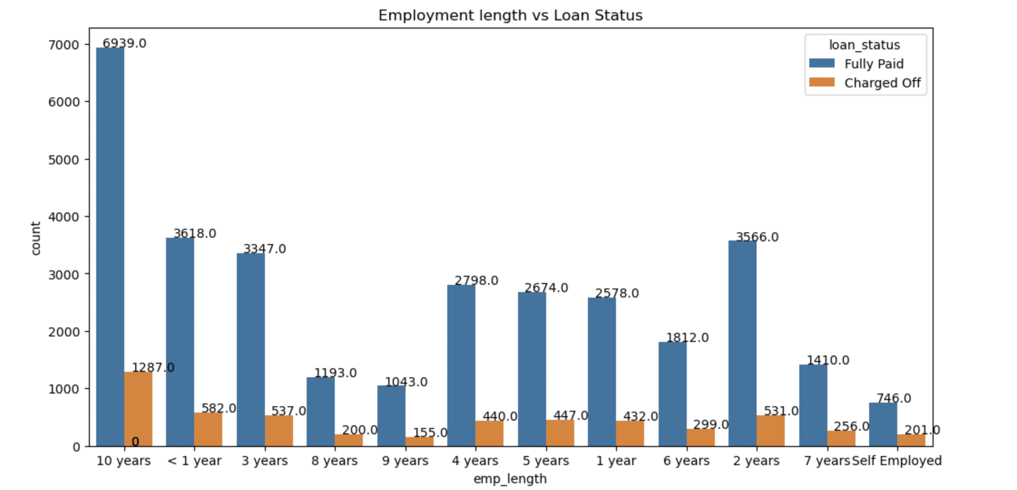

Slide 8
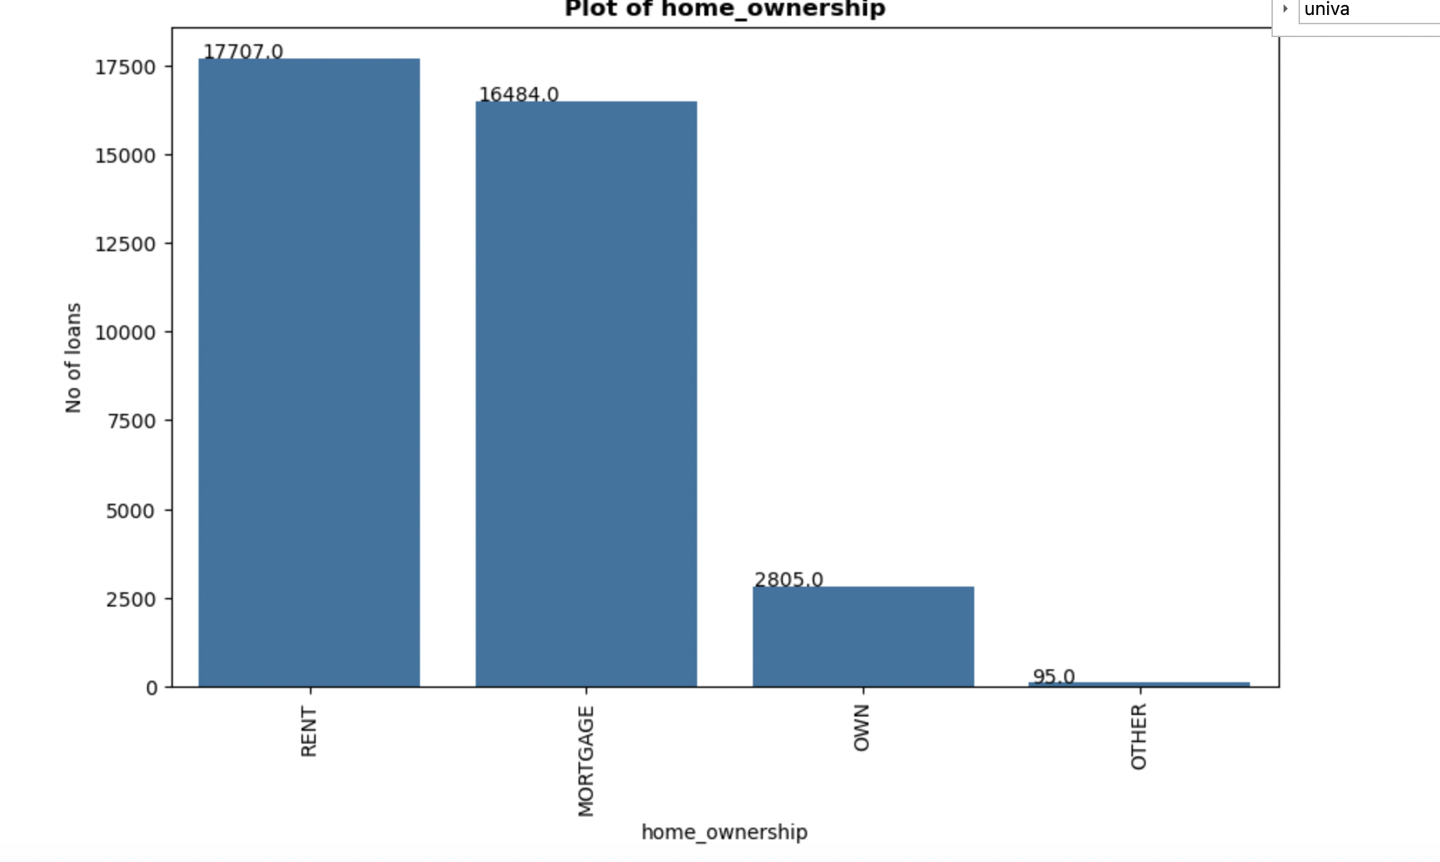

Slide 9
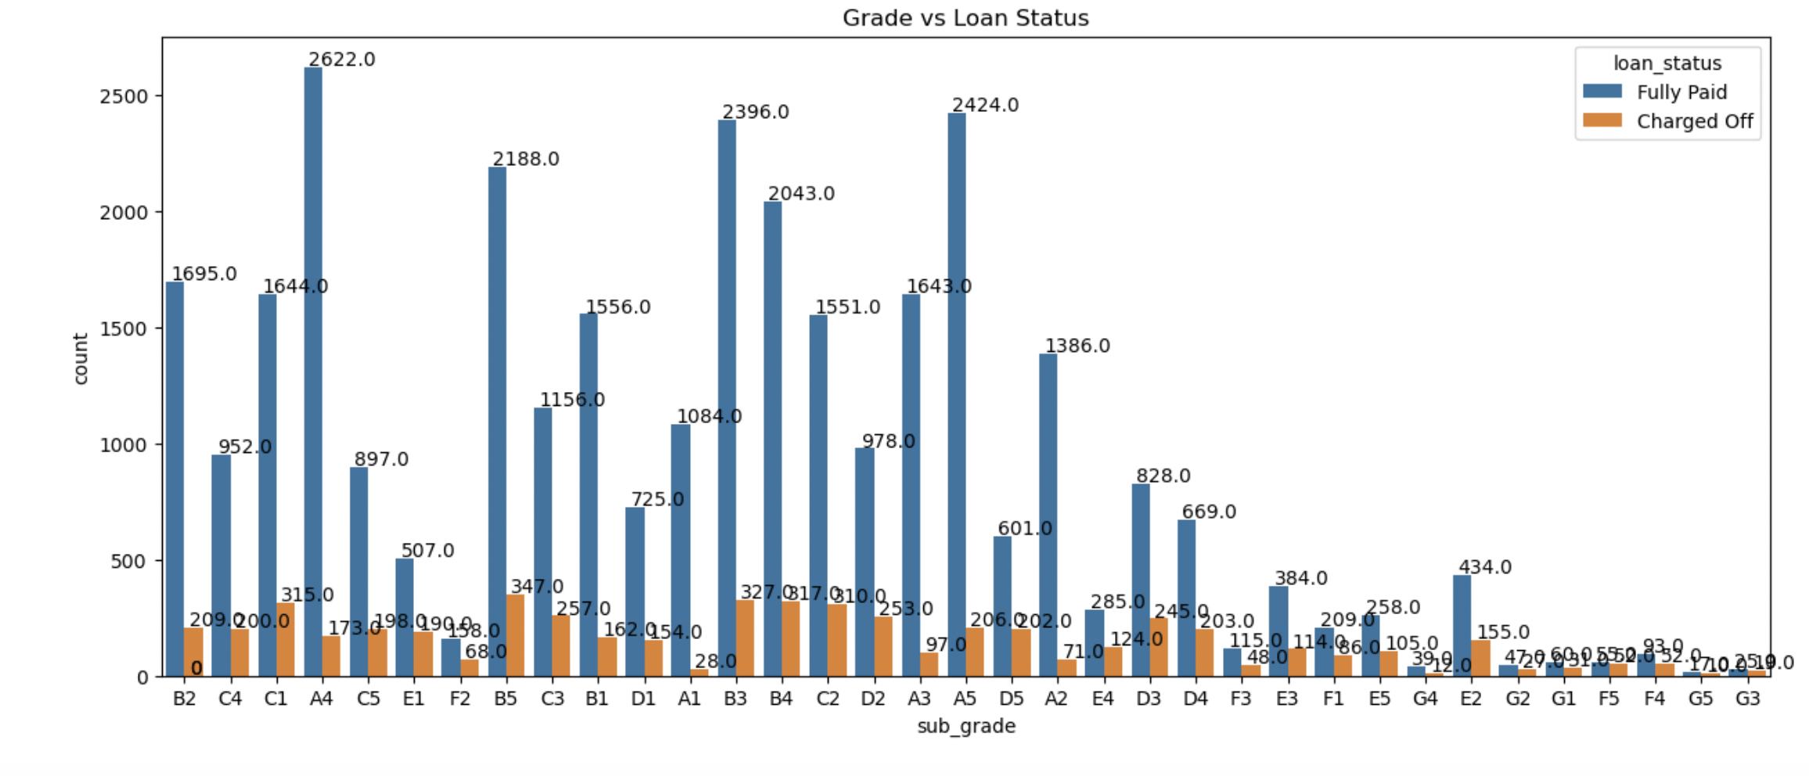

Slide 10
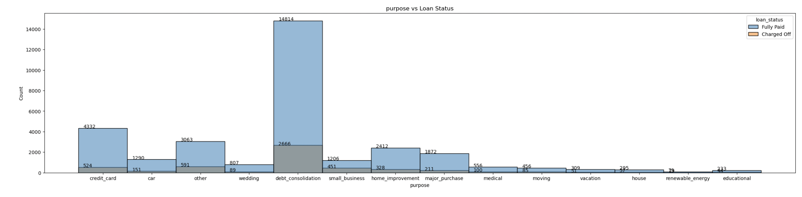

Slide 11
Summary of Bivariate Analysis
Based on the counts, Grade B, C and D are top three in Charged Off
A,B have have also very good numbers of paying it off fully
Based on the counts sub grades C1,B5,C3,B3,B4,C2 and D2 have higher charged off count
Maximum loans were issued to 10 or above category and the charged off is also highest in this category
Defaulters are more in 36 months category
In 2011 the defaulters are more
Don’t find any conclusive answer looking at the numbers for months.
The defaulters are more when the purpose is debt_consolidation .
People of RENT or MORTGAGE failed to pay
The verified loans are charged off more than Not verified
Employment above 10 years have got more loans and more defaulters too
States from CA,FL and NY have more defaulters .
The median of 10 years and more is highest
6,7,8 and 9 having almost same median value .
The median is more in case of defaulter .
The IQR is more in case of charged off

Slide 12
Summary of Multivariate Analysis
Higher the interest rate higher charged off ratio
Higher the annual income higher the loan amount slightly.
increase in number of charged off with increase in year.
interest rate is increasing with loan amount increase

