Slide 1
Masked Patches
Image Classification by Anshuman Singh Matriculation - 5431362

Slide 2
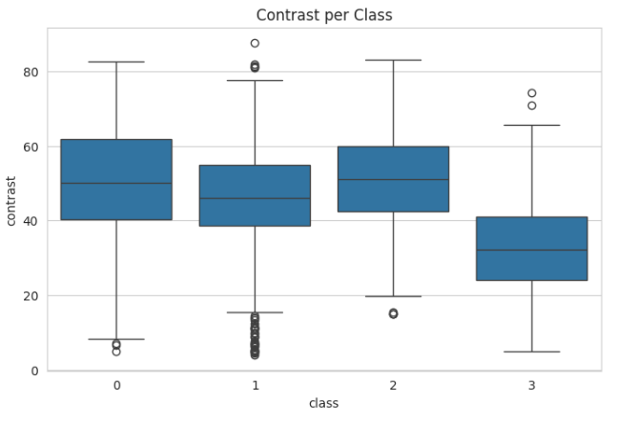
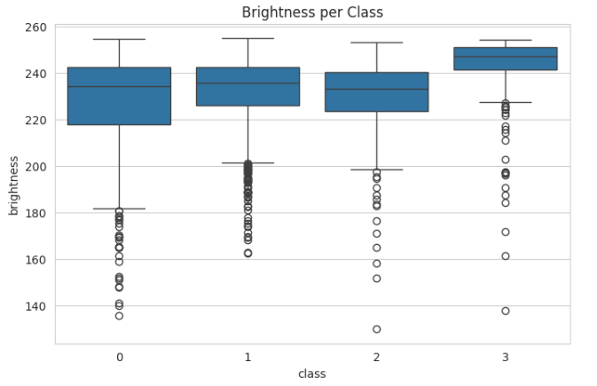
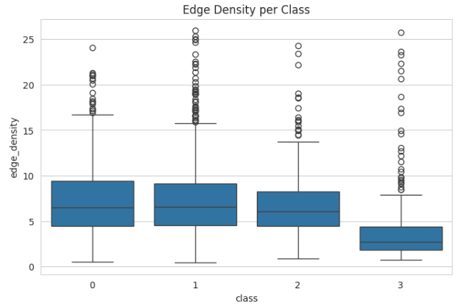
EDA
Brightness = average pixel intensity
Contrast = standard deviation of pixel intensity.
Higher contrast → strong edges / strong variation.
More edges → more texture complexity Less edges → smoother surface
Notes:
Dataset separates classes mainly by:
Lighting + Texture complexity
NOT purely by shape.
Classes 0,1,2 overlap heavily
Their boxes overlap almost completely

Slide 3
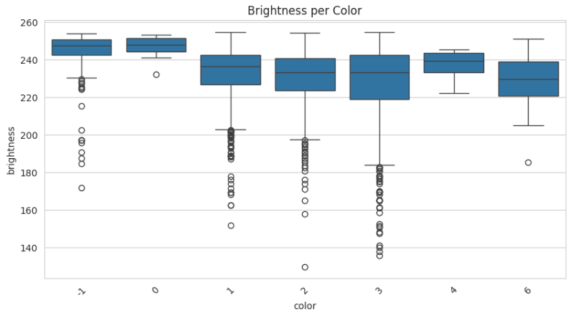
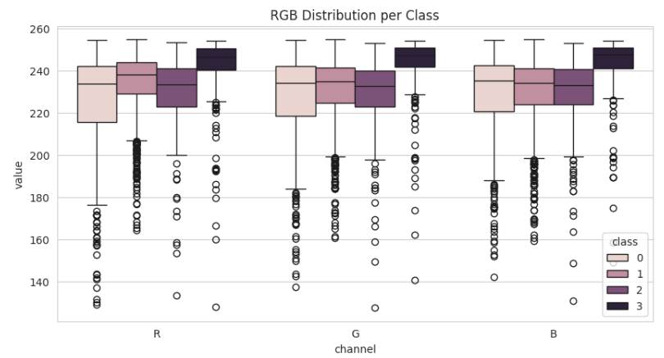
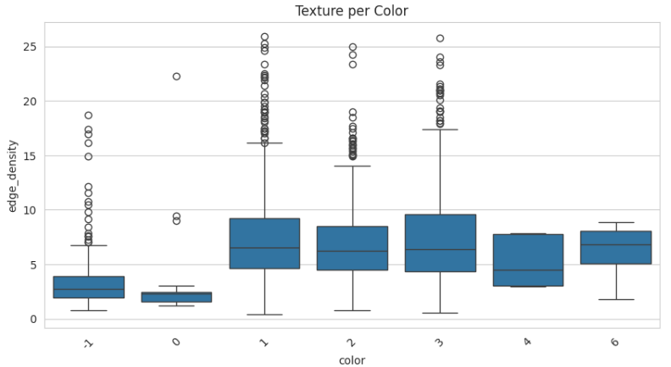
EDA
Class 0 vs Class 1 RGB almost coincide
Brightness- many low outliers (~130–180) meaning shadows.
Brightness variation depends more on color ID than class. Texture varies strongly within class depending on color.

Slide 4
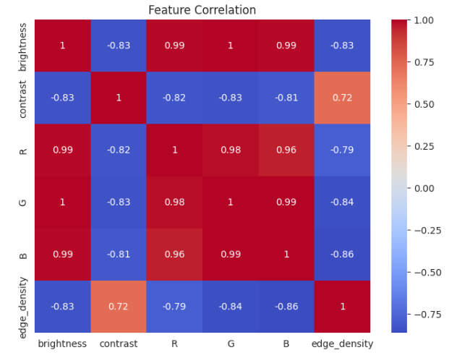
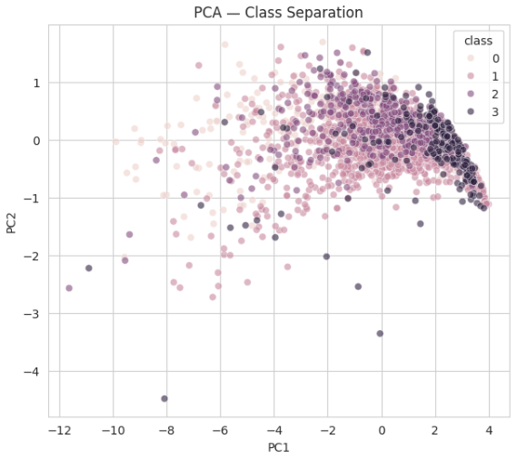
Brighter images tend to have lower contrast, darker images often contain sharper intensity variation. Edge Density vs Brightness, Bright images → fewer edges. Edge Density ↔ Contrast, More edges ⇒ more intensity variation ⇒ higher contrast. In PCA Classes strongly overlap -There are no clearly separated clusters.

Slide 5
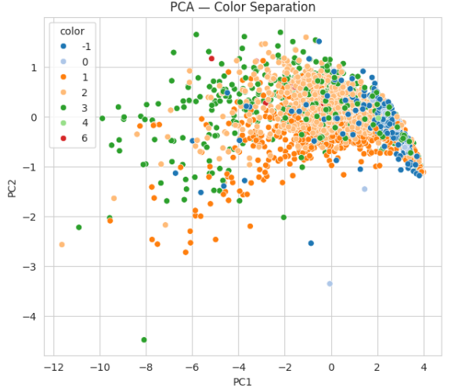
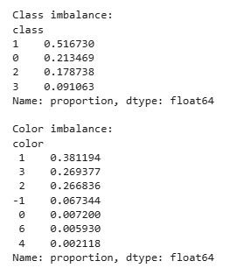
In PCA, Some color groups form local regions. Still strong overlap → color alone does not define image structure. Class Imbalance – class 1 is dominant Also color imbalance there are various rare colours.

Slide 6
DataSet Division
class 0= 1 + 494 + 3 + 5 + 1 = 504 images
class 1= 9 + 870 +1 + 263 + 75 + 2 = 1220 images
class 2 = 1 + 360 + 35 + 26 = 422 images
class 3 = 3 + 6 + 1 + 16 + 32 + 157 = 215 images
Ratio 8:1:1
1920 : 240 : 240
train :test:validation
There is overlap of images between train , test and validation and also within the color sets respectively. Precautions were taken for this while dividing dataset.

Slide 7
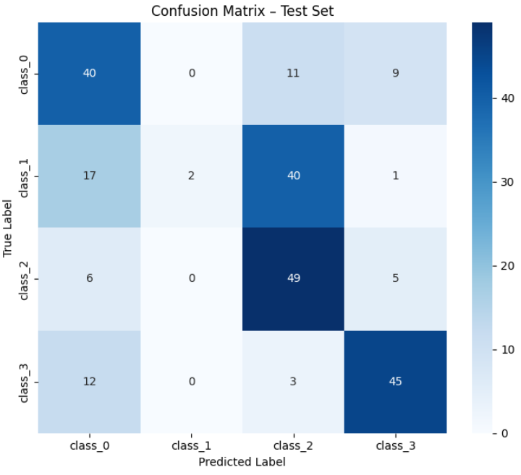
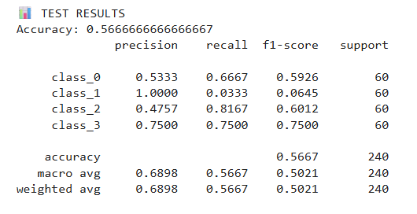
Results from CNN model
class_names = ["Slate", "Clay", "Cement", "Flat_roof_coverings"]

Slide 8
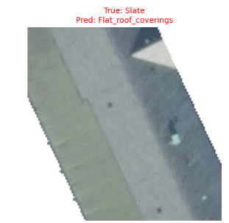
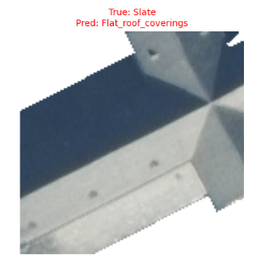
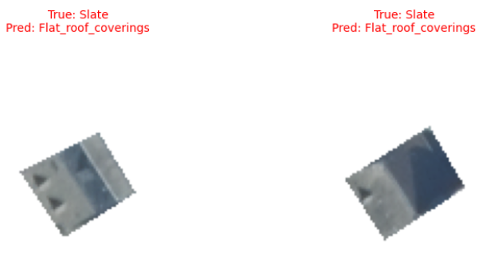
Classification Results
Shape and Height that means not flat roof covering.

Slide 9
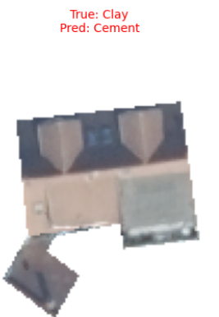
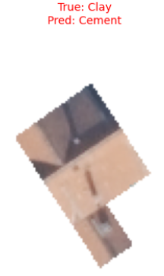
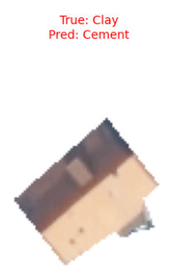
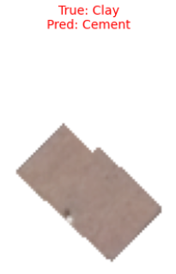
Classification Results
Many clay are classified as cement.

Slide 10
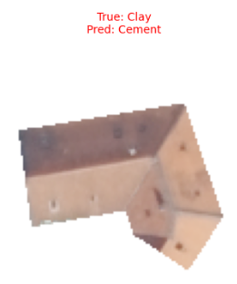
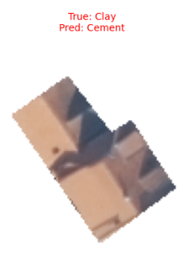
Classification Results
Why Yellowish roof are classified as cement ?

Slide 11
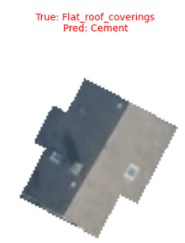
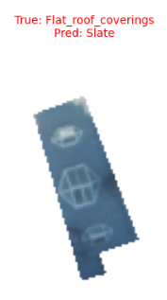
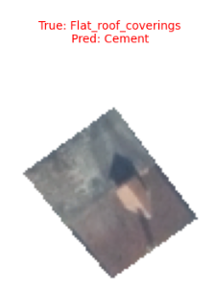
Classification Results
4. Problem in Ground truth data-(Flat roof covering has wrong image)

Slide 12
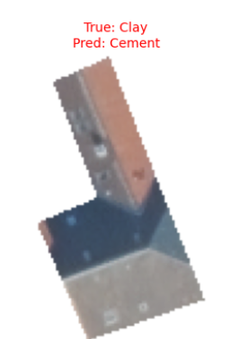
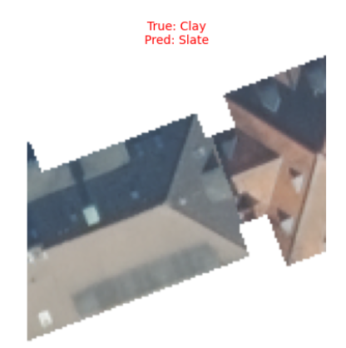
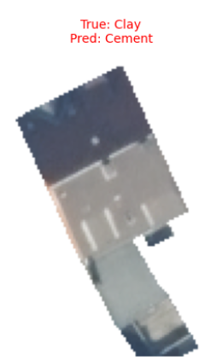
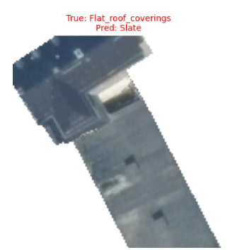
Classification Results
5. Two roof in a single image.(Possibilities in vector data)

Slide 13
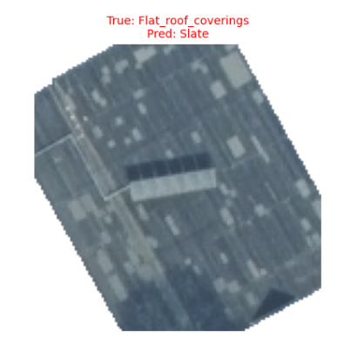
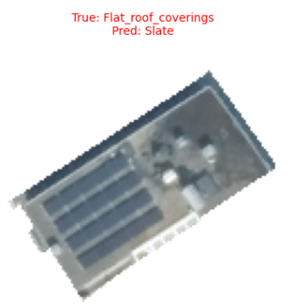
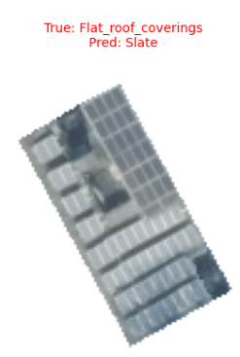
Classification Results
6. Very Challenging samples (roof cannot visible has many solar panels) Flat roof covering

