Slide 1
Style a Basic Webpage
Apply CSS styles to a personal webpage to enhance its appearance
Name: Anshuman Chaudhary Roll no:2300290100063
Branch: CSE Section: A

Slide 2
Purpose
Apply CSS styles to a personal webpage to enhance its appearance
In this presentation, I’ll walk you through the structure of my webpage, the technologies I used, and the design choices that bring my project to life.

Slide 3
Technologies Used
HTML (HyperText Markup Language):
Fundamental building block of web pages, providing the structure and layout.
It uses a series of elements or tags to define content types.
CSS (Cascading Style Sheets):
CSS is used for styling HTML elements, controlling the layout and appearance of the
webpage.
Enhances user experience by making the website visually appealing and easy to
navigate.
Google Fonts:
Google Fonts provides a wide selection of fonts that can be easily integrated into
web pages.

Slide 4
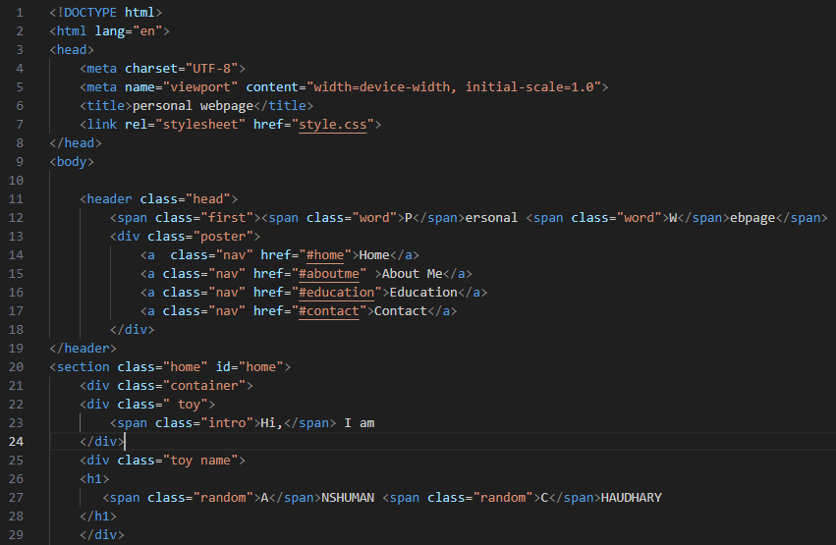
HTML Structure

Slide 5
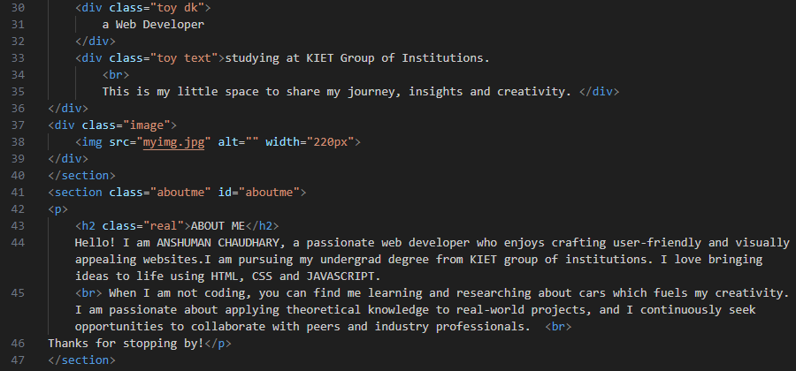
HTML Structure

Slide 6
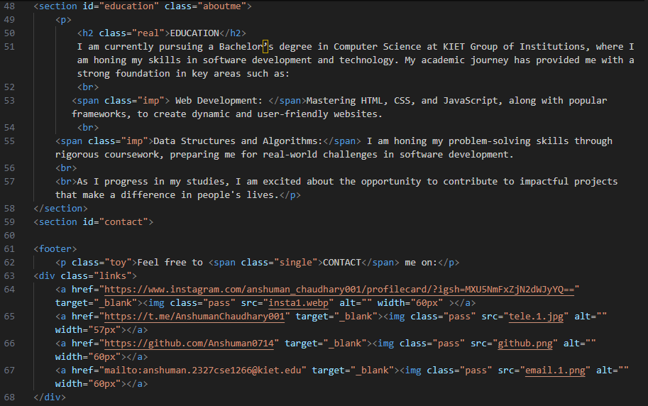
HTML Structure

Slide 7

HTML Structure

Slide 8
HTML Structure
The webpage is organized into distinct sections, each serving a specific purpose to engage visitors effectively:
Header Section
Purpose: Introduces the webpage and provides navigation.
Content: Includes the title "Personal Webpage" and navigation links to Home, About Me, Education, and Contact. This structure promotes easy navigation and enhances user experience.
Home Section
Purpose: Welcomes visitors and introduces author and give brief inroduction.
Content:A friendly greeting, “Hi, I am ANSHUMAN CHAUDHARY,” establishes a personal connection with visitors.
A brief description highlights his role as a web developer and academic affiliation with KIET Group of Institutions, making the introduction engaging.
A professional image adds a visual element, humanizing the content.

Slide 9
HTML Structure
About Me Section
Purpose: Provides insight into Author’s background and personality.
Content: A narrative about passion and interests of authors.
Education Section
Purpose: Details Author’s academic background and relevant skills.
Content: Contains description of author’s degree and his skills of web development and data structure and algorithm.
Education Section
Purpose: Details Anshuman’s academic background and relevant skills.
Content:
Links to social media accounts and an email link, facilitating easy contact.

Slide 10
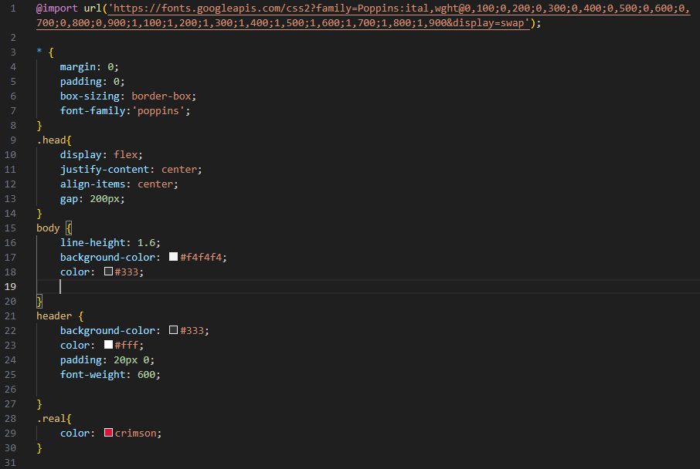
CSS Styling

Slide 11
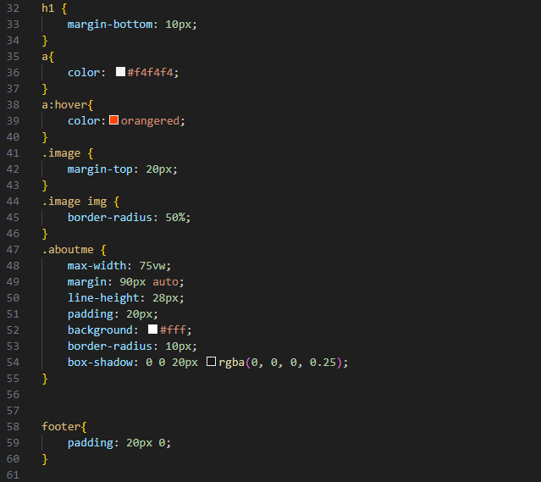
CSS Styling

Slide 12
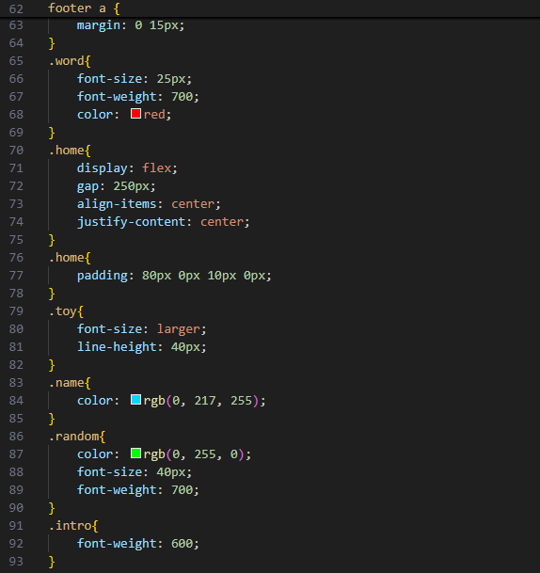
CSS Styling

Slide 13
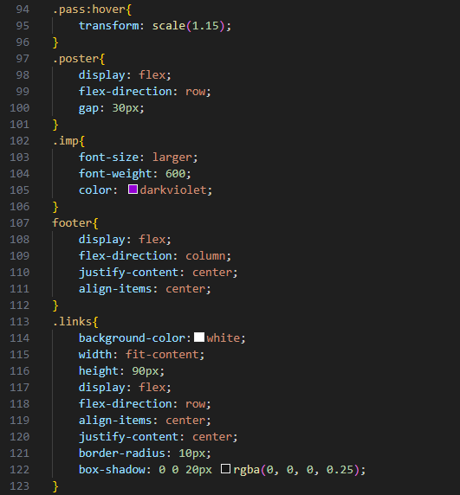
CSS Styling

Slide 14
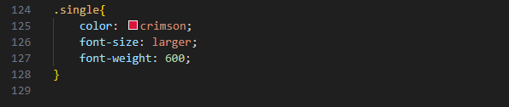
CSS Styling

Slide 15
CSS Styling
CSS Styling
The accompanying CSS file enhances the visual presentation and usability of the webpage through thoughtful design choices:
1. General Styles
A global reset for margins and padding ensures consistent spacing across different browsers, promoting a clean layout.
The Poppins font enhances readability and contributes to a modern aesthetic.
2. Layout Design
Flexbox: Employed for flexible and responsive layouts, ensuring elements adjust gracefully on various screen sizes.
Sections are designed to be visually distinct yet cohesive, with clear separation to enhance readability.
3. Color Scheme and Visual Effects
A vibrant color palette (crimson for headings, orangered for hover effects) adds visual interest and guides user attention.
Subtle hover effects on links and images enhance interactivity, encouraging user engagement

Slide 16
CSS Styling
4. Container Styles: Max width, margin, and padding.
5.Box Shadow: For a lifted effect.
6.Responsive Design Considerations
Basic responsive design is implemented through Flexbox; future enhancements with media queries will optimize the experience for mobile users.

Slide 17
Future Enhancements
Additional Features: Blog section and project gallery can be added.
Improving SEO: Optimize content for search engines.
Responsiveness: To make it more responsive, media queries can be added in future for more efficient display of content.

Slide 18
Conclusion
Through the careful integration of HTML and CSS, I've created a space that showcases my skills and experiences, while also providing an engaging user experience.

