Slide 1
Create a Simple Calculator
Develop a calculator application that performs basic arithmetic operations using JavaScript
Name: Anshuman Chaudhary Roll no:2300290100063
Branch: CSE Section: A

Slide 2
Purpose
To create a simple, functional calculator that performs basic arithmetic operations.
To practice and demonstrate skills in web development using HTML, CSS, and JavaScript.
To provide an interactive and user-friendly interface for users.

Slide 3
Technologies used
HTML (HyperText Markup Language):
Fundamental building block of web pages, providing the structure and layout.
It uses a series of elements or tags to define content types.
CSS (Cascading Style Sheets):
CSS is used for styling HTML elements, controlling the layout and appearance of the
webpage.
Enhances user experience by making the website visually appealing and easy to
navigate.
Google Fonts:
Google Fonts provides a wide selection of fonts that can be easily integrated into
web pages.
JavaScript:
For adding interactivity and functionality, allowing users to perform calculations.

Slide 4
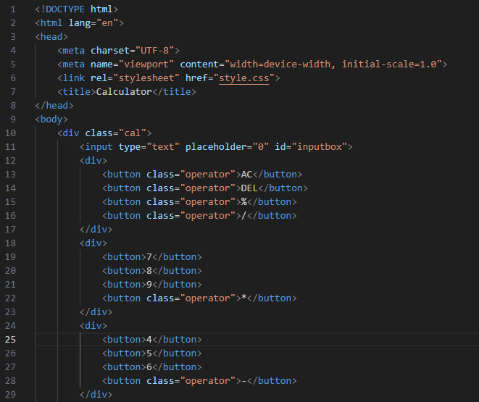
HTML Structure

Slide 5
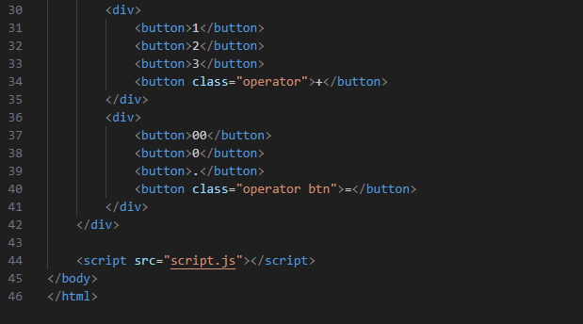
HTML Structure

Slide 6
HTML Structure
The page contains different <div> tags in which buttons are organized.
The buttons are categorized into different classes, the arithmetic opeators are given operator class, the equal to button has class operator btn.
The Calculator Container (<div class="cal">) acts A wrapper for the calculator elements.
Each row of buttons is grouped in a <div> for layout purposes.

Slide 7
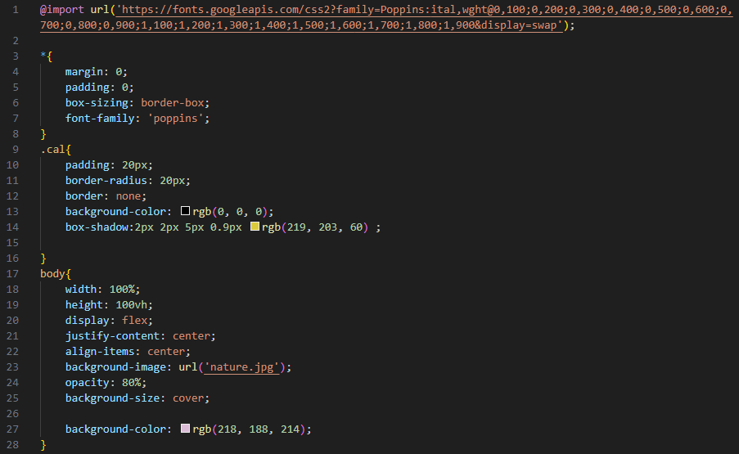
CSS Styling

Slide 8
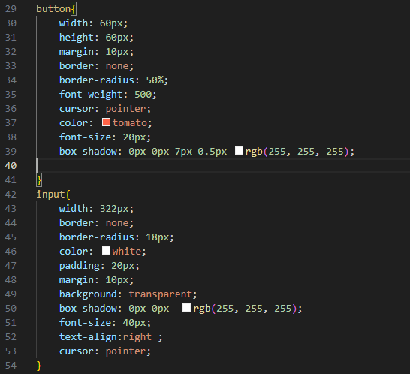
CSS Styling

Slide 9
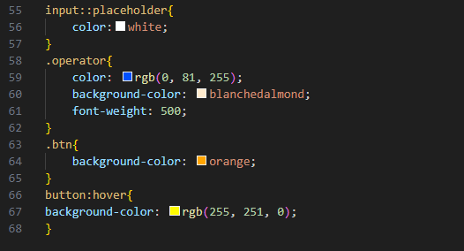
CSS Styling

Slide 10
CSS Styling
CSS Styling
The accompanying CSS file enhances the visual presentation and usability of the webpage through thoughtful design choices:
1. General Styles
A global reset for margins and padding ensures consistent spacing across different browsers, promoting a clean layout.
The Poppins font enhances readability and contributes to a modern aesthetic.
2.Calculator Container:
Padding & Border Radius: Provides spacing and rounded corners for a polished appearance.
Background & Shadow: Uses a black background with a soft shadow to create depth.
3.Body Styles:
Flexbox Layout: Centers the calculator in the viewport.
Background Image: Enhances aesthetics with a nature-themed image.

Slide 11
CSS Styling
Button Design:
Size & Shape: Circular buttons for a friendly, approachable design.
Hover Effects: Changes background color on hover for interactivity.
Input Field:
Transparent Background: Integrates seamlessly with the background image while ensuring readability.
Text Alignment: Right-aligned text mimics traditional calculator design.
Operator Button Styles: Distinct colors for operators enhance usability and recognition.

Slide 12
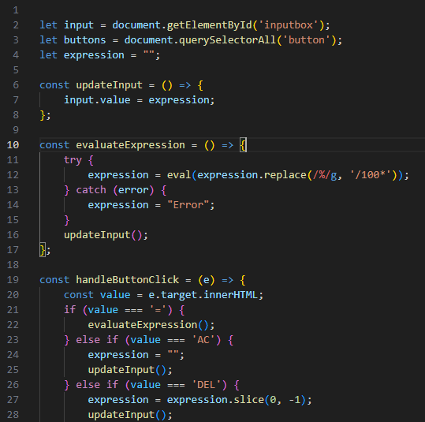
JavaScript Functionality

Slide 13
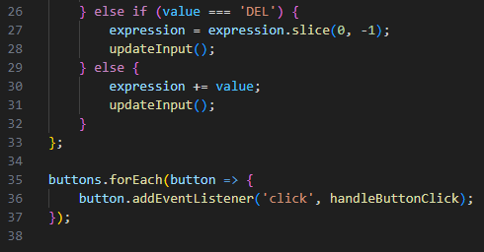
JavaScript Functionality

Slide 14
JavaScript Functionality
Element Selection:
Uses document.getElementById and querySelectorAll to access the input field and buttons.
Dynamic Input Handling:
Maintains an expression string to track user input.
Updates the input field in real-time with the current expression.
Evaluation Logic:
The evaluateExpression function uses eval() to compute the result of the expression.
Handles percentage calculations by converting % into a fraction.

Slide 15
JavaScript Functionality
Button Interaction:
Event listeners on buttons trigger actions based on user clicks:
Equals (=) button evaluates the expression.
Clear (AC) resets the input field.
Delete (DEL) removes the last character from the expression.
User-Friendly Features:
Provides error handling to display "Error" if the evaluation fails.
Supports input for numbers, operators, and decimal points seamlessly.

Slide 16
Future Enhancements
Advanced Functions like performing more complex calculations (square root, exponent) and trigonometric functions can be added.
Enhancement in error handling to provide user-friendly messages for different error types can be done.
Accessibility Features like Implement keyboard shortcuts for easier navigation and operation can be added.
Memory Functions can be implemented for storing and recalling values.

Slide 17
Conclusion
This project is a practical example of integrating HTML, CSS, and JavaScript to create a functional web application.
By integrating a clean user interface with dynamic input handling and robust evaluation logic, the calculator provides an intuitive experience for users.

