Slide 1

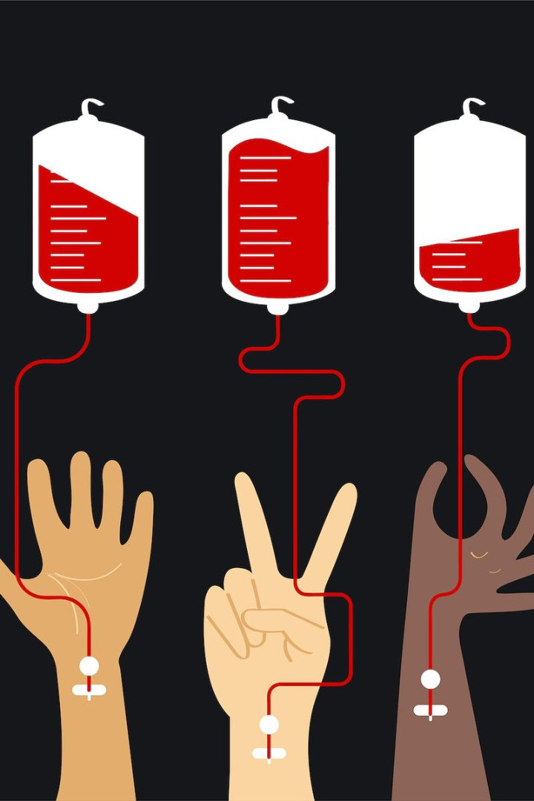
Introduction to DonorSphere
Introducing DonorSphere, the innovative platform linking patients with blood donors within a 2km radius. Seamlessly connecting those in need with life-saving support, while also facilitating remote appointments with top medical professionals.

Slide 2
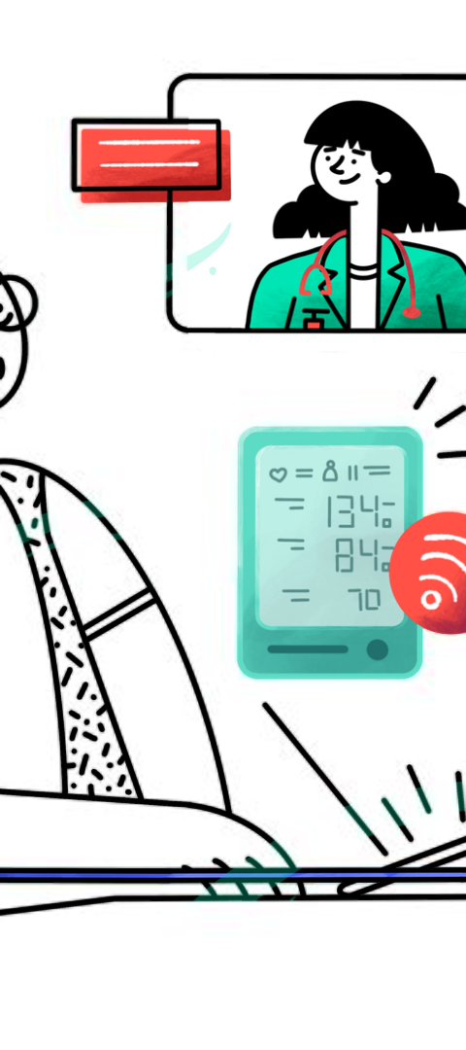
CHALLENGES IN BLOOD DONATION
Blood donation is a critical process that saves millions of lives each year.
According to the National Health Profile 2019, published by the Central Bureau of Health Intelligence in India, the annual blood requirement in the country is estimated to be around 12 million units.
Out of the annual blood requirement, only 10 million units are collected.
Blood banks can only comply 2.5 units of blood per 1000 eligible people.
This number has dipped even lower due to the impact of COVID-19.
3 major problems in blood donation are:
Donor Recruitment
Donor Retention
Donor Safety

Slide 3
How DonorSphere Works
Blood Donation Requests:
Patients submit blood donation requests specifying their blood type and location.
DonorSphere identifies eligible donors within a 2km radius and notifies them.
Donor Engagement:
Donors receive alerts about nearby blood requests matching their blood type.
They can choose to accept the request and schedule a donation appointment.
Appointment Booking:
Remote patients can book appointments with specialized doctors through the platform.
DonorSphere facilitates seamless communication and scheduling between patients and doctors.
Efficient Bridge:
DonorSphere serves as an efficient bridge between patients and blood donors, ensuring timely support.
It streamlines the process of connecting patients with medical experts for remote consultations.
Community Impact:
By leveraging technology, DonorSphere fosters a sense of community and support among donors and patients.
It promotes proactive healthcare engagement and lifesaving contributions within local neighborhoods.

Slide 4

Benefits of Using DonorSphere
Timely Blood Donation:
Rapid matching of blood donors with patients in need within a 2km radius ensures timely access to life-saving blood transfusions.
Efficient Coordination:
Streamlined communication and coordination between donors and patients enhance the efficiency of blood donation processes.
Expanded Donor Reach:
DonorSphere expands the reach of blood donation efforts by connecting donors with nearby patients, maximizing the chances of finding suitable matches.
Remote Consultations:
Patients can access top medical professionals remotely through DonorSphere's appointment booking feature, ensuring quality healthcare regardless of location.
Community Support:
Facilitates a sense of community support by fostering connections between donors and patients, promoting solidarity in healthcare efforts.
Emergency Preparedness:
Enhances emergency preparedness by providing a reliable platform for swift response to urgent blood donation needs during crises.

Slide 5
Market Analysis:
Blood Donation Industry:
The global blood donation market is driven by increasing demand for blood transfusions due to rising incidences of accidents, surgeries, and chronic diseases.
DonorSphere taps into this growing market by providing a convenient platform for blood donors and patients to connect efficiently.
Healthcare Technology Sector:
The healthcare technology sector is witnessing rapid growth with the adoption of digital platforms for improving patient care and operational efficiency.
DonorSphere aligns with this trend by leveraging technology to streamline blood donation processes and facilitate remote consultations.
Market Impact:
Improved Blood Donation Ecosystem:
DonorSphere enhances the blood donation ecosystem by providing a centralized platform for matching donors with patients, thereby improving the efficiency of blood donation processes.
Community Engagement:
DonorSphere fosters community engagement by bringing together donors and patients within local neighborhoods, promoting solidarity and support for healthcare initiatives.
Healthcare Accessibility:
The platform improves healthcare accessibility by enabling remote patients to connect with specialized doctors for consultations, overcoming geographical barriers to healthcare access.
Emergency Response Preparedness:
DonorSphere enhances emergency response preparedness by facilitating swift and organized responses to urgent blood donation needs during crises or natural disasters.
Market Growth Potential:
As awareness and adoption of DonorSphere increase, it is poised to contribute to the growth of the blood donation market and the broader healthcare technology sector, driving innovation and efficiency in healthcare delivery.

Slide 6
SWOT ANALYSIS
Strengths:
Efficient Blood Donation Matching:
DonorSphere's algorithm facilitates rapid matching of blood donors with patients within a 2km radius, ensuring timely access to blood transfusions.
Technology Integration:
The platform leverages advanced technology to streamline blood donation processes and appointment scheduling, enhancing overall efficiency.
Community Engagement:
DonorSphere fosters a sense of community engagement by connecting donors and patients within local neighborhoods, promoting solidarity and support.
Weaknesses:
Dependence on Technology:
DonorSphere's effectiveness heavily relies on technology infrastructure and internet connectivity, which may pose challenges in areas with limited access to technology.
Geographical Limitations:
The platform's effectiveness is limited to a 2km radius for blood donation matching, which may result in difficulties for patients in remote or sparsely populated areas.
Opportunities:
Expansion into New Markets:
DonorSphere can explore opportunities to expand its reach into new geographic regions and tap into untapped markets where blood donation infrastructure is underdeveloped.
Diversification of Services:
The platform can diversify its services beyond blood donation, such as offering additional healthcare-related features or partnering with other healthcare providers to offer a comprehensive suite of services.
Threats:
Competitive Pressure:
The emergence of competing platforms or traditional blood donation systems may pose a threat to DonorSphere's market share and growth potential.
Regulatory Challenges:
Regulatory changes or compliance requirements in the healthcare industry could pose challenges to DonorSphere's operations and expansion efforts.
Data Security Risks:
The handling of sensitive patient information poses risks related to data breaches and privacy concerns, which could undermine user trust and reputation.

Slide 7
Strengths:
Efficient Blood Donation Matching:
DonorSphere's algorithm facilitates rapid matching of blood donors with patients within a 2km radius, ensuring timely access to blood transfusions.
Technology Integration:
The platform leverages advanced technology to streamline blood donation processes and appointment scheduling, enhancing overall efficiency.
Community Engagement:
DonorSphere fosters a sense of community engagement by connecting donors and patients within local neighborhoods, promoting solidarity and support.
Weaknesses:
Dependence on Technology:
DonorSphere's effectiveness heavily relies on technology infrastructure and internet connectivity, which may pose challenges in areas with limited access to technology.
Geographical Limitations:
The platform's effectiveness is limited to a 2km radius for blood donation matching, which may result in difficulties for patients in remote or sparsely populated areas.
Opportunities:
Expansion into New Markets:
DonorSphere can explore opportunities to expand its reach into new geographic regions and tap into untapped markets where blood donation infrastructure is underdeveloped.
Diversification of Services:
The platform can diversify its services beyond blood donation, such as offering additional healthcare-related features or partnering with other healthcare providers to offer a comprehensive suite of services.
Threats:
Competitive Pressure:
The emergence of competing platforms or traditional blood donation systems may pose a threat to DonorSphere's market share and growth potential.
Regulatory Challenges:
Regulatory changes or compliance requirements in the healthcare industry could pose challenges to DonorSphere's operations and expansion efforts.
Data Security Risks:
The handling of sensitive patient information poses risks related to data breaches and privacy concerns, which could undermine user trust and reputation.

Slide 8
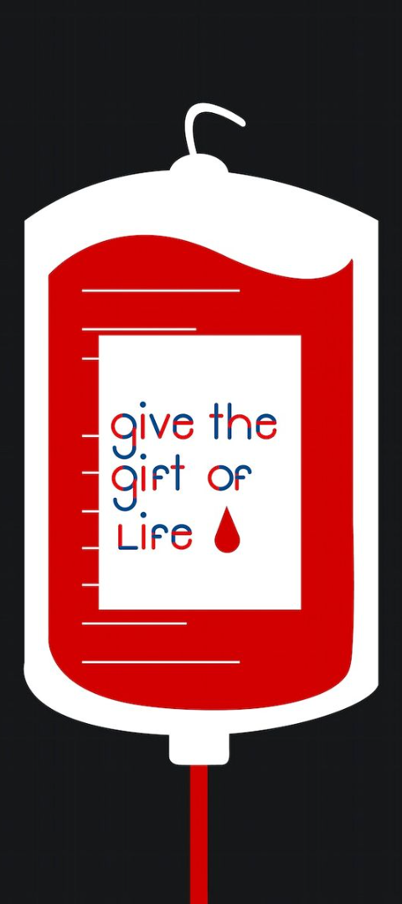
Strategy:
Price:
Aim: Address the price disparity in the Indian blood market by standardizing a single price for all blood sources.
Approach: Serve as a platform for all blood sources to offer their blood online.
Impact: Enhance transparency and accessibility in the blood market, ensuring fair pricing for all stakeholders.
Place:
Target Location: Major cities of Delhi NCR.
Objective: Capture 10 to 12% of the blood product market within the first year of launch.
Approach: Focus initial efforts and resources on establishing a strong presence and customer base in the targeted region.
Impact: Establish a foothold in a key market, paving the way for future expansion and growth opportunities.
Promotion:
Partnerships: Collaborate with approximately 300 hospitals and path labs across the NCR.
Marketing Channels: Utilize standees, pamphlets, and social media advertising across all platforms for promotion.
Impact: Increase brand visibility and awareness among target audiences, drive user engagement, and generate interest in the platform's services.

Slide 11
OUR FIELD STUDY
REAL FIELD KNOWLEDGE AND ANALYSIS OF MARKET CAN BE DONE THROUGH RESEARCH. OUR TEAM CONDUCTED A SURVEY IN DIFFERENT HOSPITALS AND NGOs LIKE DAKSHINA FOUNDATION.
WE FOUND THAT DIFFERENT PRIVATELY OWNED DO NOT SUPPORT BLOOD PRICE SUSTAINABILITY AND PROVIDE BLOOD AT A UNREASONABLE HIGH COST DEPENDING ON THE BLOOD GROUP.
TALKING ABOUT PRIVATE HOSPITALS, THEY FOLLOW ECHANGE PROCESS TO MAINTAIN THEIR BLOOD STOCK.
THERE IS VERY LESS NO. OF BLOODBANKS FOR A LARGE POPULATION DENSITY. WHICH GIVES POWER TO BLOODBANKS TO MANIPULATE PRICE.
IF WE TALK ABOUT RURAL AREAS OF THE NATION THERE ARE VERY FEW NO. OF BLOOD BANKS AS COMPARED TO THE URBAN AREAS.
THIS MARKET HAS HUGE POTENTIAL AND HAS VERY LESS KEY PLAYERS ALSO.

Slide 12
Thank you for your attention and support!
"Together, let's make a difference in healthcare. Join DonorSphere: Bridging Lives, Saving Futures."

