Slide 1


Major Project - II
Title: PedestriGuard AI – Intelligent Pedestrian Detection and Behavior Analysis System
Presented by:
R2142221543 - ANSHUMAN AGARWAL
R2142221275 - ADIT JAIN
R2142220747 - PARITOSH DHINGRA
R2142221075 - MUKESH SIHAG
Mentored By :
M/s Vinamrata Rani

Slide 2
Introduction
Introduction:
Rapid urbanization has increased the need for intelligent pedestrian monitoring systems.
Traditional systems focus only on basic detection and lack behavioral understanding.
Real-world environments involve crowd density, occlusion, and dynamic movement.
There is a need for a smart system that can detect, track, and analyze pedestrians in real time.
PedestriGuard AI aims to provide a unified solution for safer and smarter urban ecosystems.

Slide 3
Introduction
Motivation:
Increasing pedestrian accidents and safety concerns in urban areas.
Limitations of traditional surveillance systems (only detection, no deeper analysis).
Need for real-time fall detection and abnormal activity monitoring.
Growing demand for smart city and autonomous navigation solutions.
Importance of data-driven decision-making using behavioral and demographic insights.

Slide 4
Introduction
Problem Statement:
Existing pedestrian monitoring systems primarily focus on basic object detection and lack deeper analytical capabilities. They struggle in crowded and occluded environments, fail to maintain consistent identity tracking, and do not provide behavior or demographic insights. Therefore, there is a need for a unified, real-time intelligent system that integrates detection, tracking, behavior analysis, and demographic estimation into a single framework.

Slide 5
Objective
Main Objective:
Develop a robust real-time pedestrian detection system
Implement reliable tracking and re-identification across frames
Integrate pose estimation for activity and fall detection
Extract demographic insights such as age and gender
Build a unified, scalable system for smart city and safety applications

Slide 6
Introduction
Technical Concepts used:
Deep Learning & Computer Vision for intelligent visual analysis
YOLOv8 for real-time pedestrian detection
DeepSORT for multi-object tracking and identity preservation
HRNet + LSTM/Transformer for pose estimation and behavior recognition
CNN-based Multi-task Learning for age and gender estimation
ONNX & TensorRT Optimization for real-time deployment

Slide 7
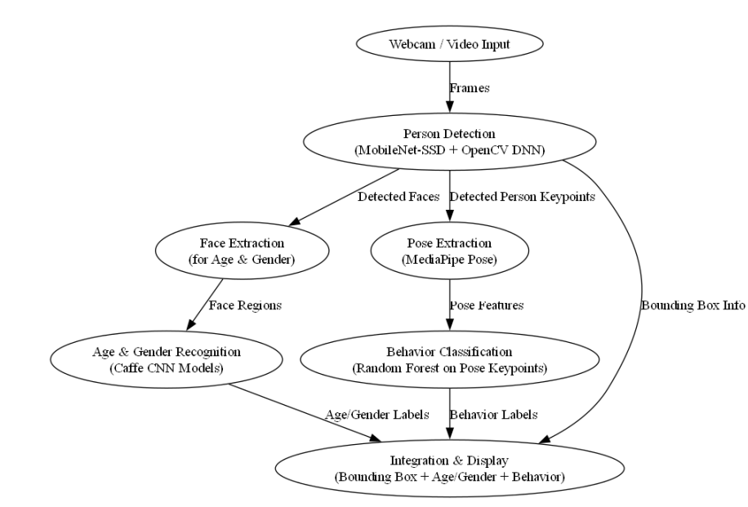
Introduction
Technical Diagram:

Slide 8
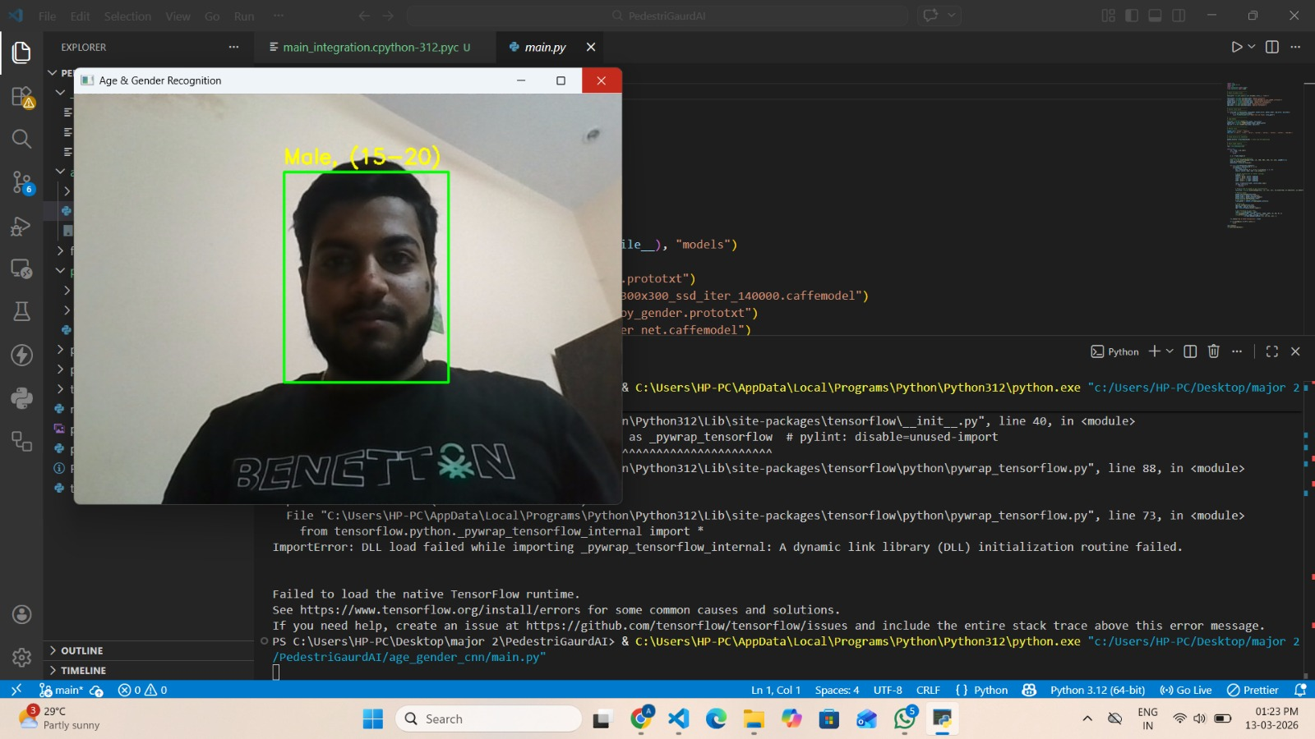
RESULTS
Age Gender Detection:

Slide 9
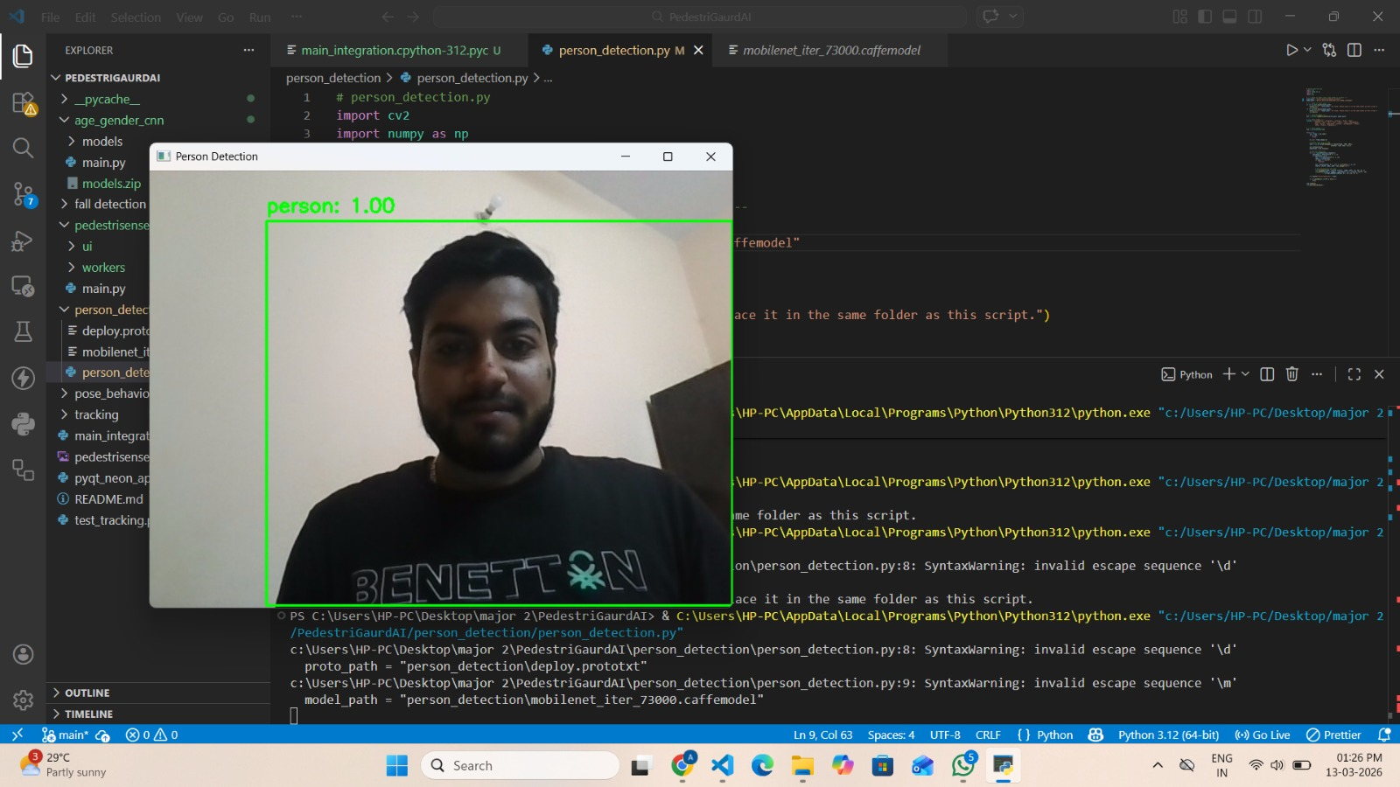
RESULTS
Person Detection:

Slide 10
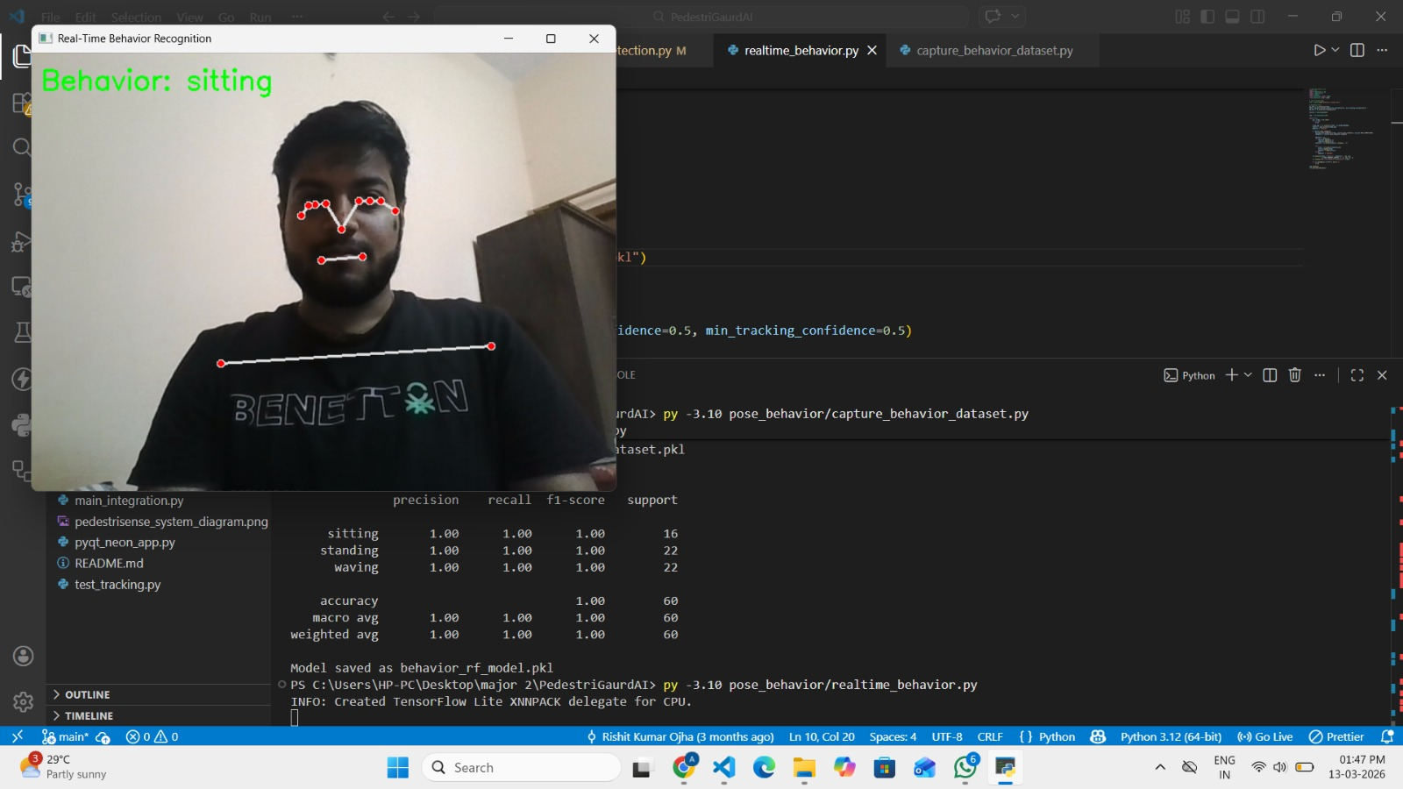
RESULTS
Pose Detection:

Slide 11
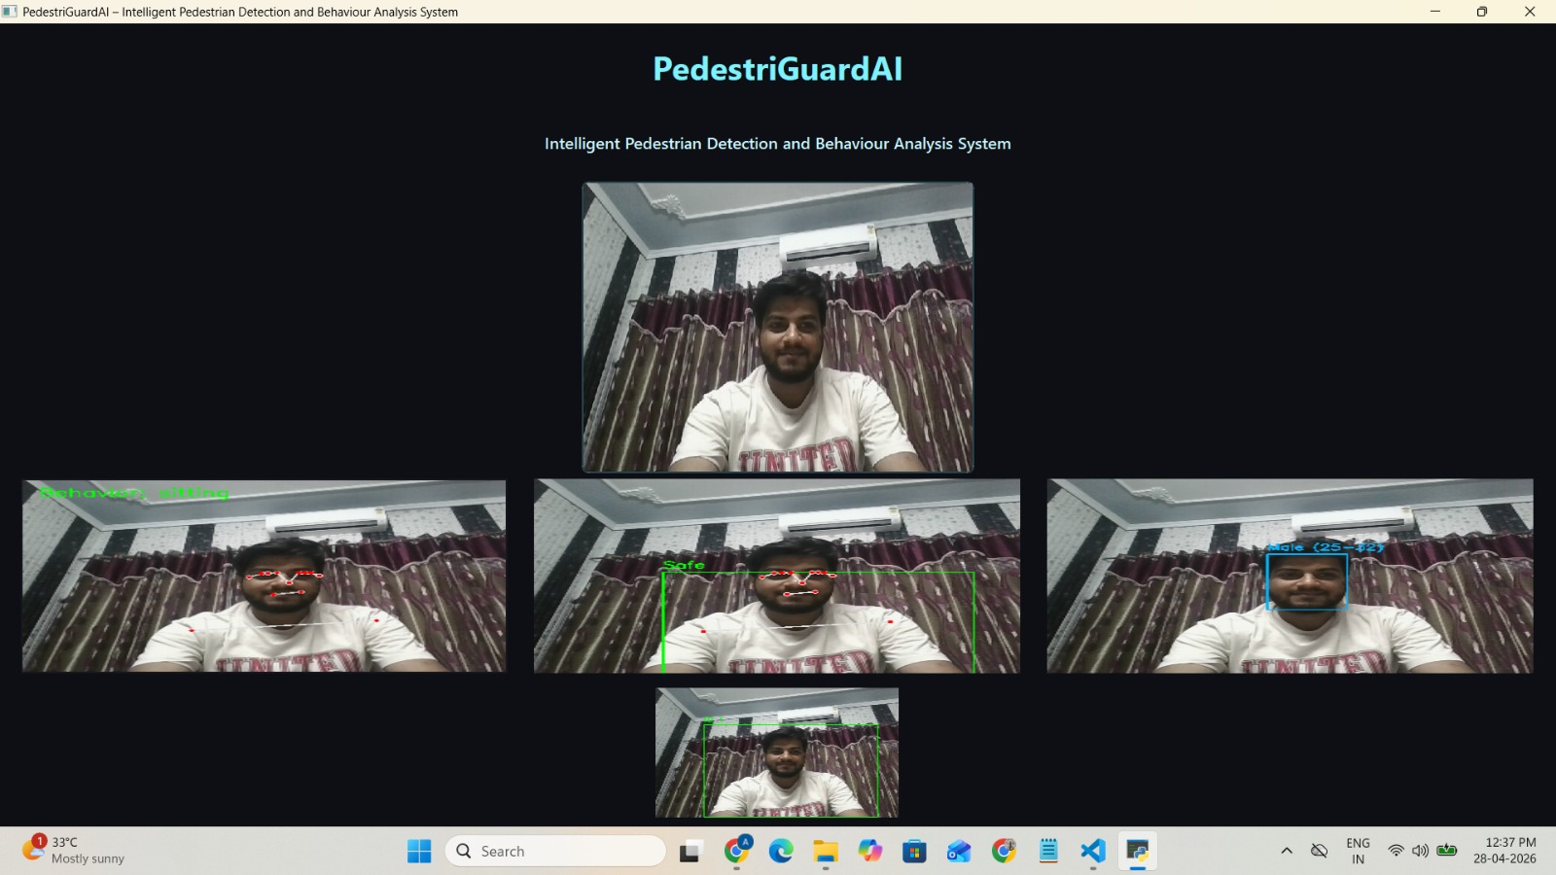
RESULTS
Final Output:

Slide 12
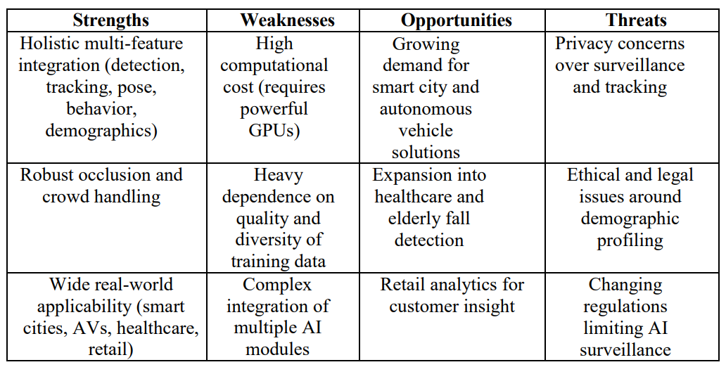
Literature Review
SWOT Analysis:

Slide 13
Introduction
Area of Application:
Smart Cities – Crowd monitoring and pedestrian safety management
Surveillance & Security – Real-time anomaly and fall detection
Autonomous Vehicles – Safe navigation through accurate pedestrian tracking
Healthcare & Elderly Care – Remote fall detection and activity monitoring
Retail Analytics – Demographic insights and customer footfall analysis

Slide 14
Literature Review
Cite Related work:
Deep learning–based pedestrian detection studies addressing occlusion and scale challenges
DeepSORT for improved multi-object tracking and identity preservation
OpenPose and HRNet for real-time human pose estimation
Research on pose-based fall detection using deep learning
Person re-identification techniques for cross-camera tracking
Studies highlighting age and gender bias in detection algorithms

Slide 15
Reference
[1] Zhang et al. (2017) Deep Learning for Pedestrian Detection - Guided robust detection model selection.
[2] Wojke et al. (2017) DeepSORT - Improved multi-object tracking and identity preservation.
[3] Cao et al. (2017) OpenPose - Foundation for pose-based activity recognition.
[4] Sun et al. (2019) HRNet - Enhanced accurate keypoint estimation for behavior analysis.
[5] Zheng et al. (2019) Person Re-Identification - Supported cross-camera identity tracking.
[6] Li et al. (2021) Deep Learning Fall Detection - Enabled reliable fall detection using pose analysis.
[7] Brandão (2019) Bias in Detection Algorithms - Highlighted fairness in age and gender estimation.

Slide 16
Thank You

