Slide 1



Custom Transaction Report
Presented by :
Name1 : Mr. Amit kumar Yadav.
Name2 : Mr. Anshuman singh.
Name3 : Ms. SHITAL Jitakar.
Date : 8 August 2022.
Page 1

Slide 2
Introduction
Allows a merchant to view detailed reports. Reports are filtered through a set of filters to filter transactions based on various parameter
The Transaction Detail Report gives a breakdown of transactions entered on work orders for a specified reporting period and includes information such as the work order description, transaction description, quantity, and unit cost of labor materials.
Page 2

Slide 3
Approach
Understanding the problem.
Think on the problem .
Build the idea and Approach to solve problem.
Designed the classes with the help of spring boot & implement the idea in real word using angular.
Page 3

Slide 4
Learning
We learnt how to have real world implementations of problem statements.
We learnt how to make more realistic and align it with the real world practices.
Apart from technical things we learnt about better discussion of idea and why is it good to have things done in sequential manner
Researching the available options and taking actions to achieve goals
Page 4

Slide 5
Challenges
How to make our project resemble more to real world scenario.
Encountering critical problem solving.
Practicing and understanding new programming languages.
Page 5

Slide 6
Technologies Used
Spring Boot
MySQL
HTML & CSS
Angular
Page 6

Slide 7
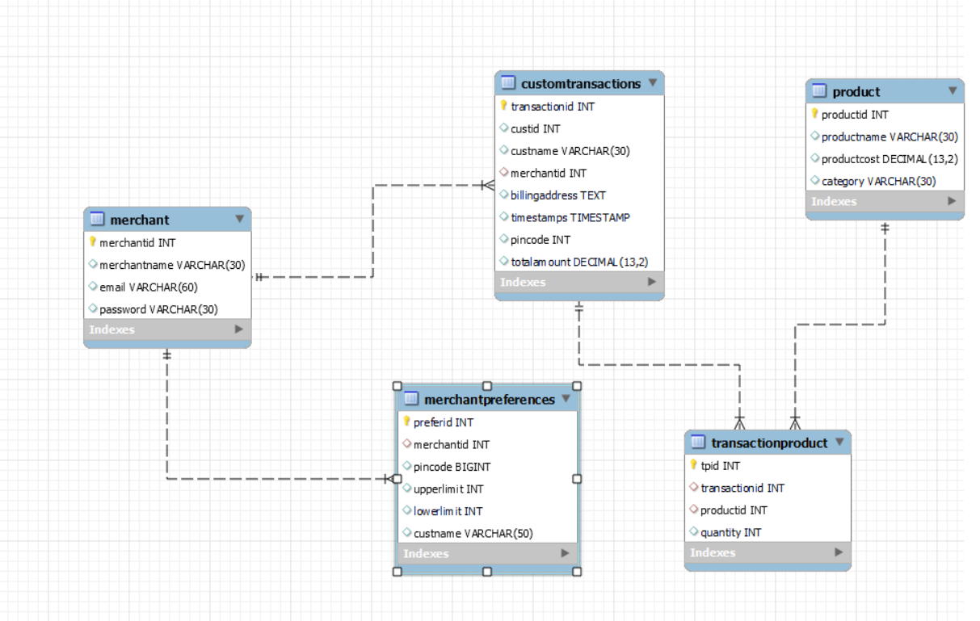
ER Diagram
.
Page 7

Slide 8
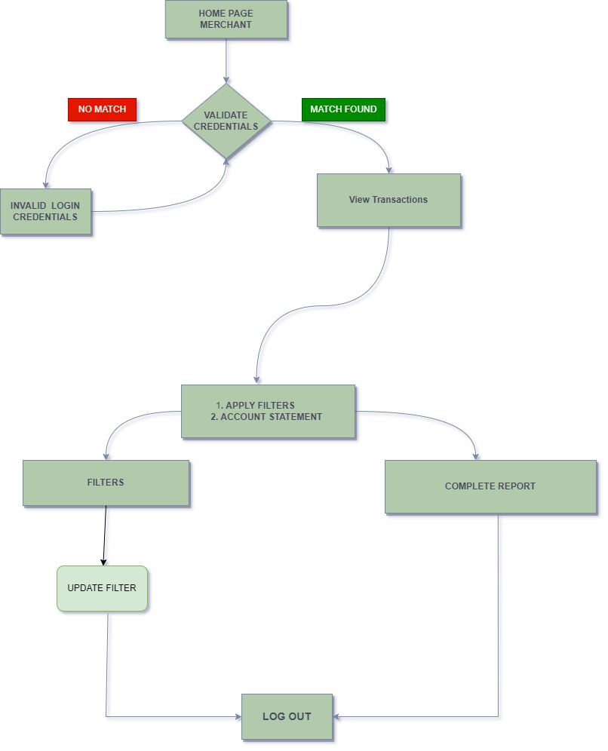
Data Flow Diagram
Page 8

Slide 9
Modules View
Homepage
Login page of Merchant
Transactions list page
Update Filters
Generate Account Reports
Page 9

Slide 10
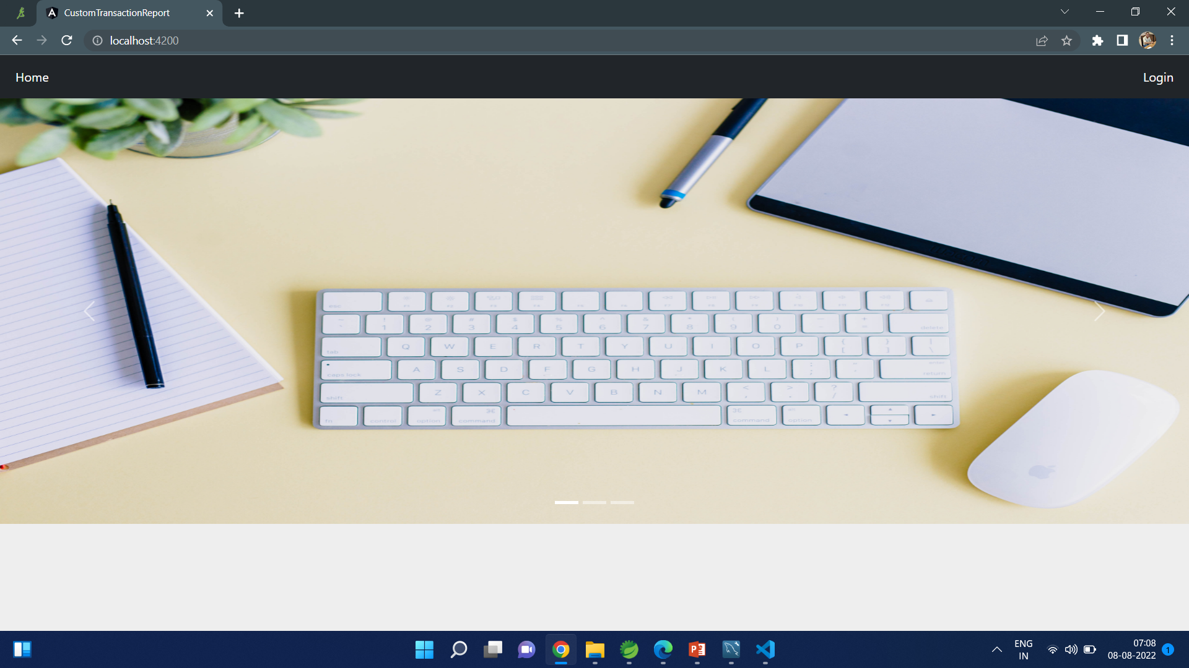
Front Page
Page 10

Slide 11
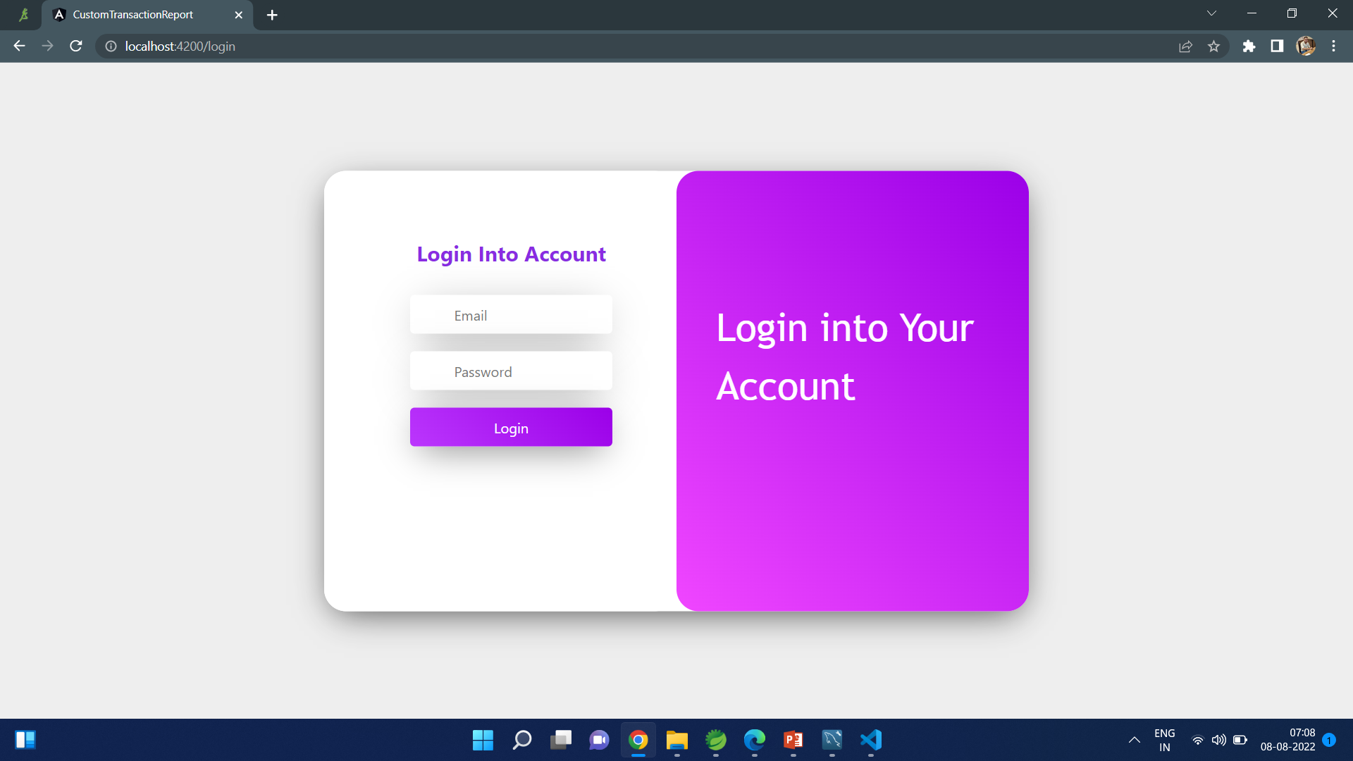
Login Page
Page 11

Slide 12
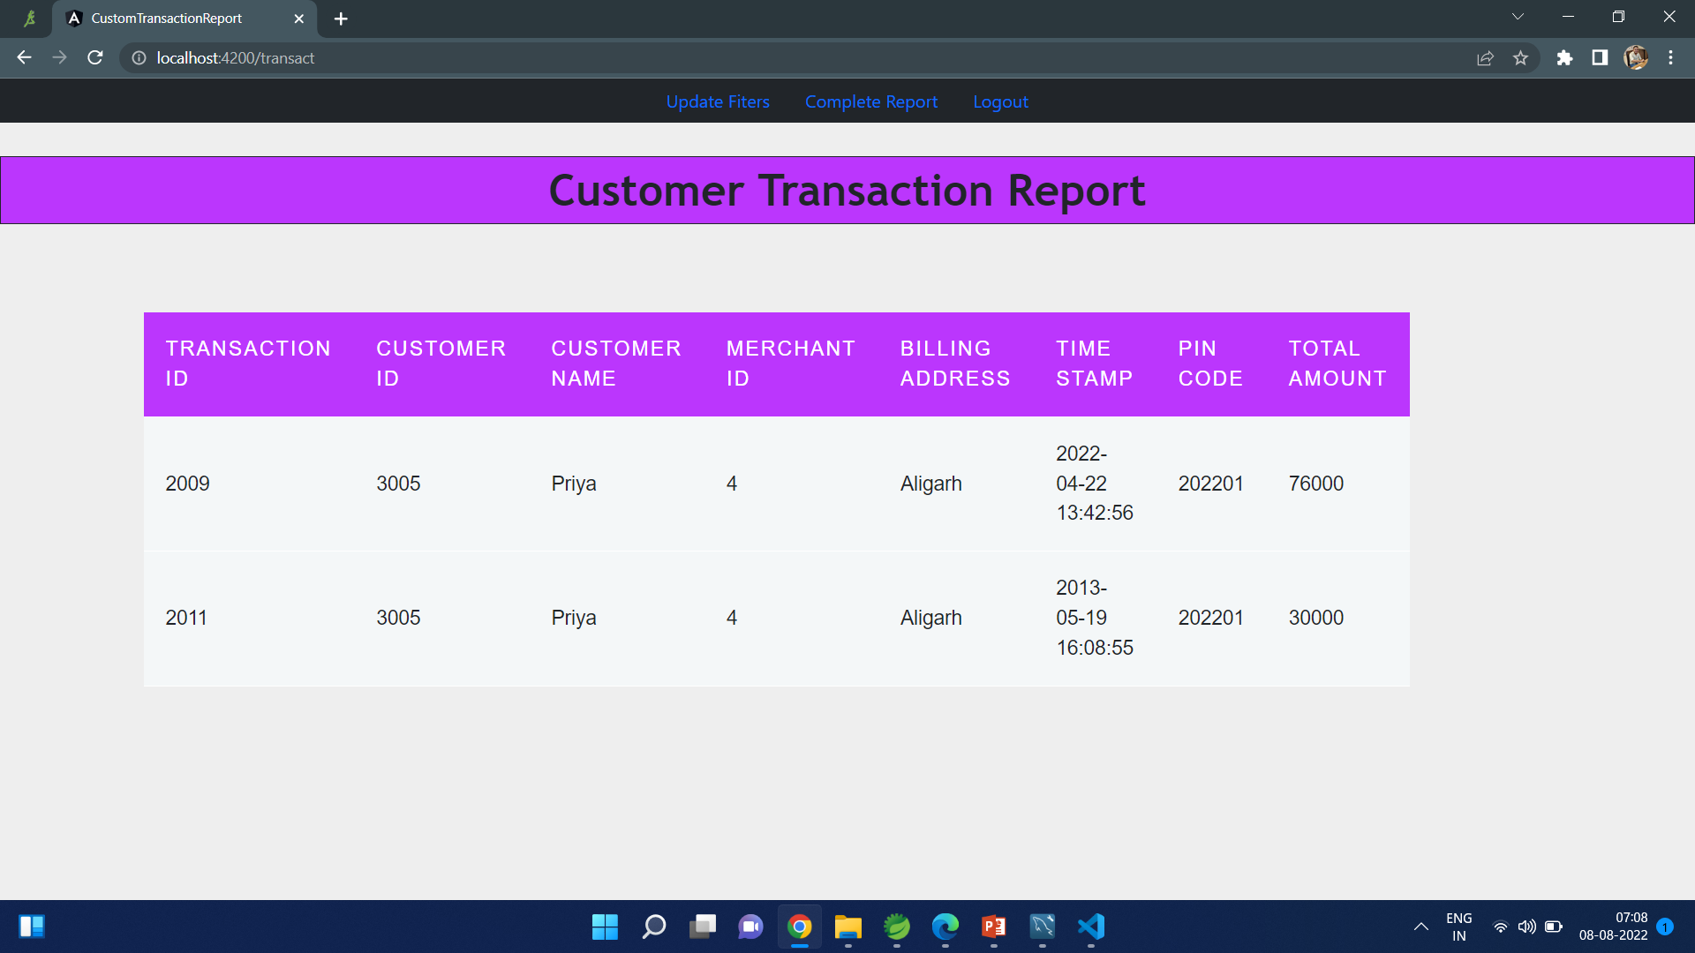
Customer Transaction Report
Page 12

Slide 13
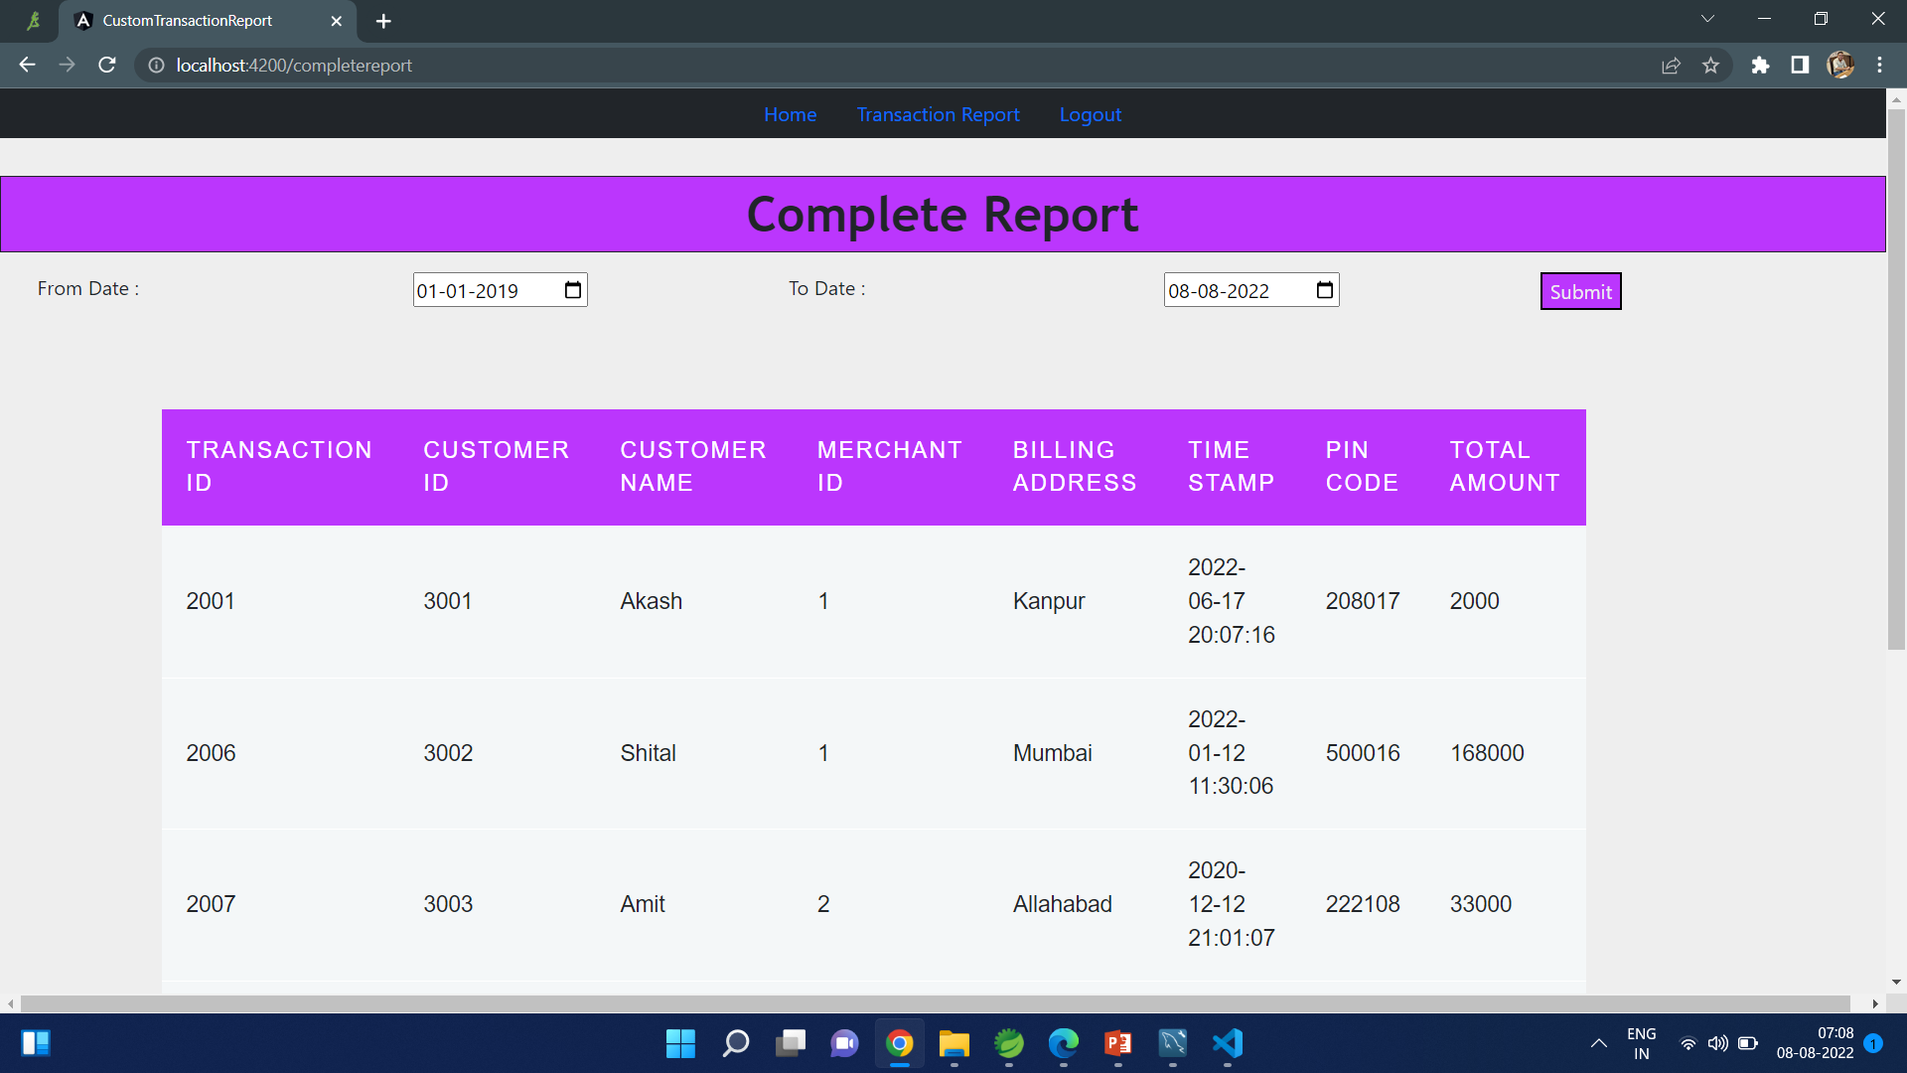
Complete Report
Page 13

Slide 14
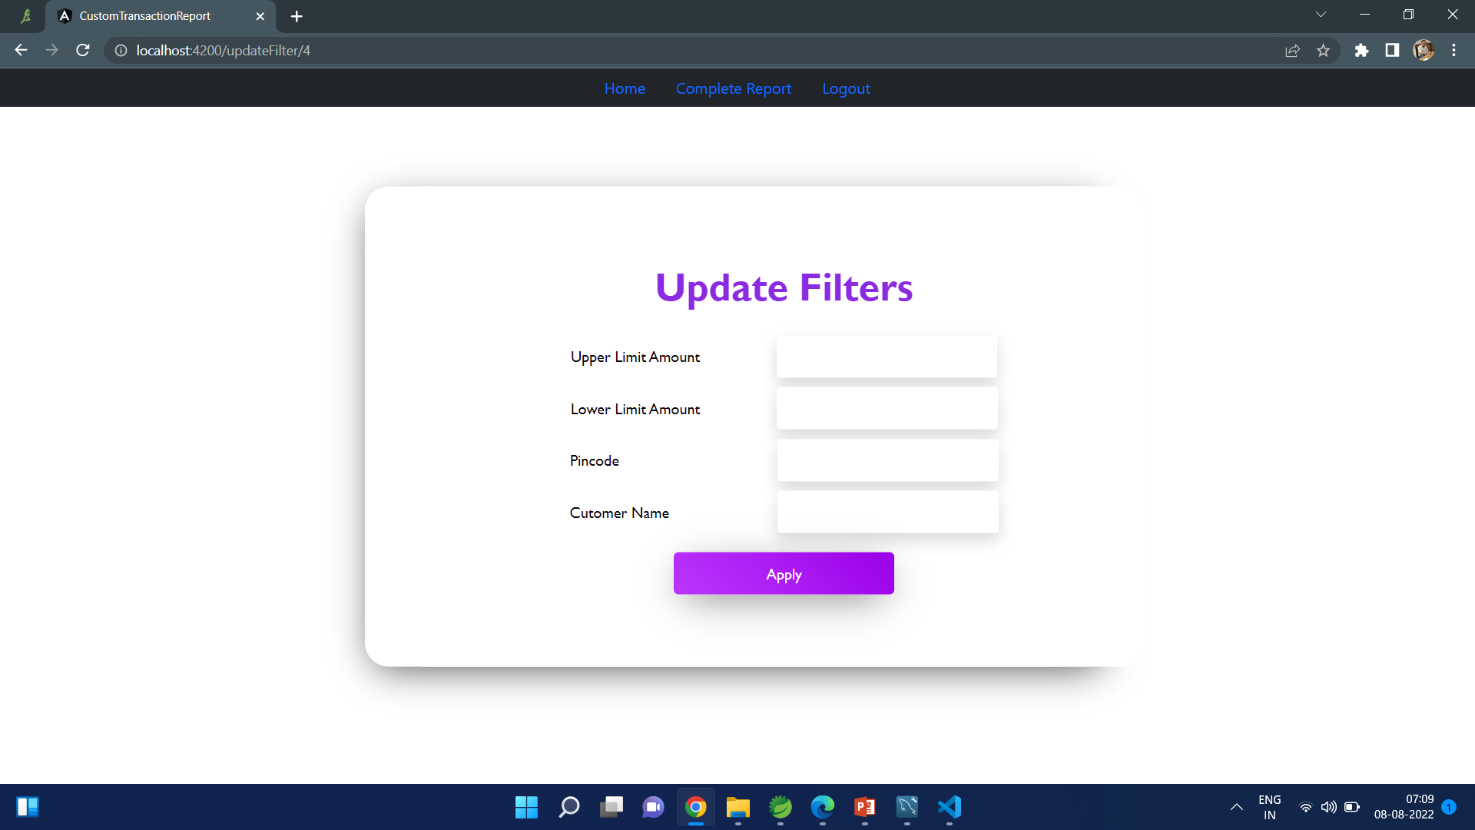
Update Filter
Page 14

Slide 15

Thank You …!
Do you have any Questions ???
Page 15

