Slide 1

Foundations of Data Science
BCSE206L
Project Review: Fertility Dynamics and Indicator Statistics in modern families
Anshuman Aryan
22BCE0219
30 October 2025

Slide 2


Project roadmap
Step 01
Step 02
Step 03
Step 04
Problem Description
Dataset Understanding
Discussion
Initial Clustering and Analysis of Principal Components
Step 05
Quantitative and Qualitative Analysis

Slide 3
Problem Description
The study of population dynamics is central to understanding societal structure, economic growth, and future resource allocation.
Fertility, as one of the three primary components of these dynamics, directly influences population growth, composition, and age structure.
In recent decades, a significant and persistent global trend has emerged: declining fertility rates.
This phenomenon has profound implications for societies worldwide.
Problem Statement: Given a set of demographic, familial, and employment-related characteristics of families with two children, can we accurately predict their decision to have more children? Furthermore, can we quantify the relative importance of these characteristics and understand the complex relationships that drive this family decision?

Slide 4
Dataset Understanding
Variables involved:
morekids (target variable): binary categorical, to have more children ('yes' or 'no')
gender1: categorical, gender of the first child ('female' or 'male')
gender2: categorical, gender of the second child ('female' or 'male').
age: numerical variable, age indicator (21 to 35 years)
afam: binary categorical, identifying as African American ('yes' or 'no')
hispanic: binary categorical, identifying as Hispanic ('yes' or 'no')
other: binary categorical, identifying with another ethnicity ('yes' or 'no')
work: numerica, number of weeks worked in the past year (0 to 52)
rownames: row index column

Slide 5
Dataset Understanding
Challenges:
Some of the features like ‘hispanic’ are unevenly distributed – about 94% negative and 6% positive.
The standard deviation of the feature ‘work’ is very high - 21.94 weeks, with the mean of 19.2 weeks.

Slide 6
Discussion
Objectives Of The Project:
To conduct a thorough exploratory data analysis of the given dataset to understand its underlying distributions and characteristics and prepare a model for understanding the chances of a family having another child given certain parameters.
To explore the relative dependencies of the involved features from the data and try to model how they follow each other.
To compare the model performance based on how many features are taken from the given dataset and determine the ones that are most significant in determining the chances of the family having another child.

Slide 7
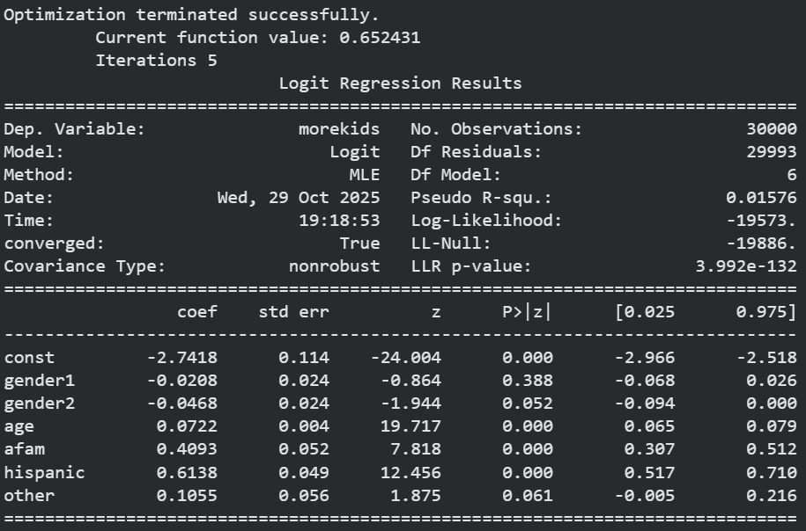
Discussion

Slide 8
Discussion
Variable distribution:
With 95% confidence, ‘age’, ‘afam’, ‘hispanic’ have a P-value less than 0.05, hence are most statistically significant.
The variable ‘age’ has the least standard error.Variable distribution:
With 95% confidence, ‘age’, ‘afam’, ‘hispanic’ have a P-value less than 0.05, hence are most statistically significant.
The variable ‘age’ has the least standard error.

Slide 9
Discussion
Objectives Of The Project:
To conduct a thorough exploratory data analysis of the given dataset to understand its underlying distributions and characteristics and prepare a model for understanding the chances of a family having another child given certain parameters.
To explore the relative dependencies of the involved features from the data and try to model how they follow each other.
To compare the model performance based on how many features are taken from the given dataset and determine the ones that are most significant in determining the chances of the family having another child.

Slide 10
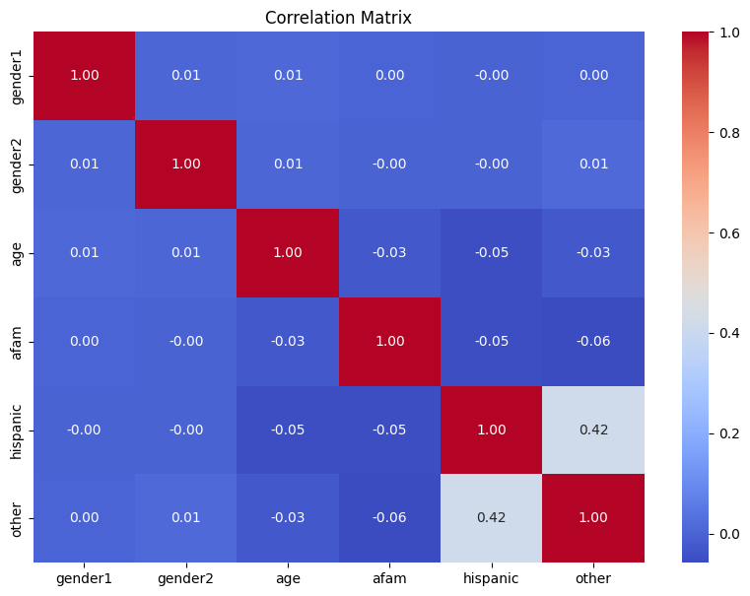
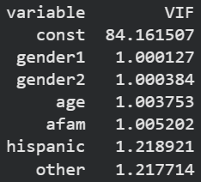
Discussion
Multicollinearity:
The variables appear to be mostly independent of each other. The values for ‘hispanic’ and ‘other’ rely on each other more than other variables, which is explainable because of the relation between the questions.

Slide 11
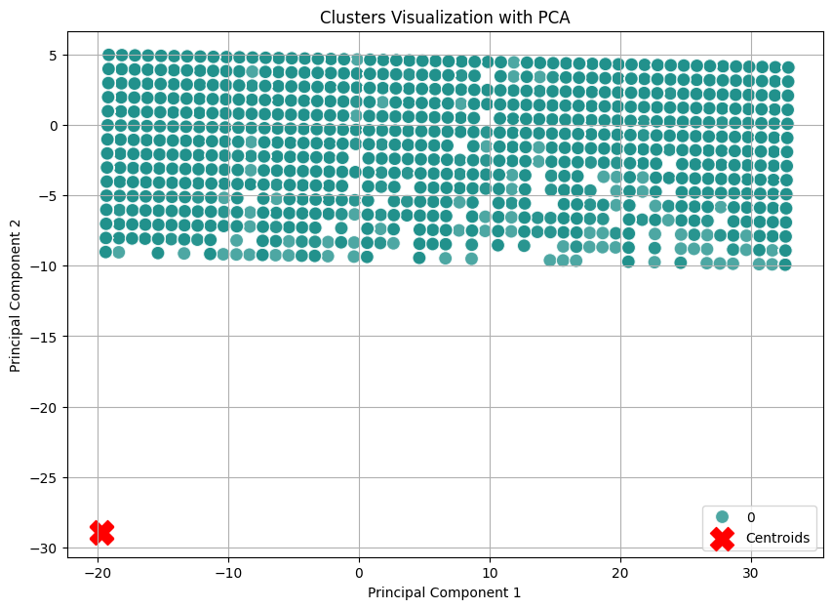
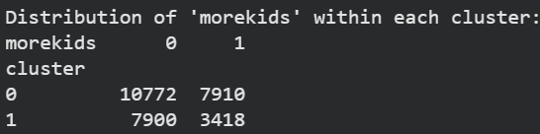
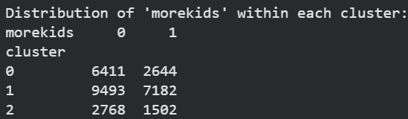
Initial Clustering and Analysis of Principal Components
The data does not appear to fit suitably for unsupervised learning (making clusters). Hence, clustering is not suitable for the analysis for the given dataset.

Slide 12
Qualitative and Quantitative Analysis
The data is suitable for a logistic regression model because the target variable ‘morekids’ is binary.
The natural distribution of datapoints (from space containing all features) does not reflect the distribution of the target variable.
There exists no hidden grouping of the variables, as exposed by the clustering and PCA experiments.

Slide 13
Qualitative and Quantitative Analysis
There exist no statistically significant ‘regulators’ of the decision of having more kids, from the given feature set.
The variables of age and community/ethnicity are the sole important factors in deciding the above.
The gender of first two kids is apparent noise in the dataset.

Slide 14
Qualitative and Quantitative Analysis
age (increasing), afam= yes, hispanic = yes
More families belonging to these communities tend to have more than 2 kids.
Stimulators
Fertility Dynamics: Decision to have more kids?
Regulators
Not present in any statistical significance
Other factors
gender1, gender2, other
These do not affect the target variable significantly.

Slide 15
Qualitative and Quantitative Analysis
Final Verdict: The only significant variables affect the target positively, and the ones that inhibit (gender1, gender2) are not significant enough to consider, while the variable 'other' even though positively impacting, is still not significant.

