Slide 1



EVENTPULSE
EVENT-DRIVEN CONGESTION — PLANNED & UNPLANNED
THE PROBLEM STATEMENT
When the city gathers, traffic breaks — and nobody saw it coming
Political rallies, festivals, sports events, construction activity, and sudden gatherings all create localized traffic breakdowns across Bengaluru. Some are scheduled weeks in advance; others happen with no warning at all. Either way, the response today depends on whoever happens to be on shift — not on what six months of incident history already says will happen.
Impact isn't quantified in advance
Deployment is experience-driven
No post-event learning system
PROTOTYPE ROUND 2 SUBMISSION · 2026
01

Slide 2





PROPOSED SOLUTION — PART 1
Five tools, one historical record
EventPulse is trained on a real, anonymized 6-month Bengaluru Traffic Police event export — 8,173 records across 21 corridors — and turns it into five working tools.
Forecast & Map
Upcoming Outlook
Historical Insights
Score a planned or unplanned event before it happens: Severity Index, duration, personnel, barricades, and a named diversion.
A 7-day statistical projection of likely hotspots, plus a week planner with automatic conflict detection.
Six months of patterns: cause breakdown, the hourly dual-peak, top corridors, and the planned-vs-unplanned trend.
Model Validation
Live Ops Triage
Learning Loop
Two real, cross-validated ML models with their honest holdout metrics and benchmarks published, not asserted.
Already-known incidents triaged directly by their own priority and closure flags — a different problem from forecasting.
Resolved events compared against their own forecast, building a running accuracy score in real time.
EVENTPULSE
02

Slide 3
PROPOSED SOLUTION — PART 2
How this answers the brief, point by point
“Impact isn't quantified in advance”
The Forecast and Outlook tools quantify it before the event starts: a Severity Index, a duration range, and a personnel count, scaled by expected event size.
“Deployment is experience-driven”
Manpower and barricade recommendations are grounded in this cause's and corridor's actual historical record, not a flat default or individual judgment.
“No post-event learning system”
The Learning Loop compares each resolved event's actual outcome against its forecast, building a running accuracy score that closes the gap directly.
EVENTPULSE
03

Slide 4







TECHNICAL ARCHITECTURE — WORKFLOW
Three layers, zero servers
OFFLINE — RUN ONCE, IN PYTHON
Raw Event CSV
data_pipeline.py
train_models.py
Anonymized B-TRAC
export, 8,173 rows
pandas — aggregates,
map grid, junctions
scikit-learn — Logistic
Regression + Ridge, validated
model_data.json
~360 KB · aggregates + learned model coefficients + validation metrics — the only artifact that crosses from Python to the browser
CLIENT — SIX STATIC PAGES, RUNS ENTIRELY IN THE BROWSER
app.js + Leaflet
engine.js
6 HTML pages
Map, charts, form
wiring (Chart.js too)
Sigmoid + linear dot-
products — the ML, inline
Forecast, Outlook, Insights,
Models, Live Ops + Overview
No server. No database. No API keys. Deploys as static files to GitHub Pages or Netlify in minutes.
EVENTPULSE
04

Slide 5
TECHNICAL ARCHITECTURE — MODELS & TRAINING
Two real, validated models — and the honest numbers
CLOSURE RISK MODEL
Logistic Regression
DURATION MODEL
Ridge Regression
0.76
0.77
0.76
1.82h
0.08
3.7%
HOLDOUT AUC
5-FOLD CV AUC
RF BENCHMARK
HOLDOUT MAE
5-FOLD CV R²
VS NAIVE MEDIAN
Predicts P(road closure required) for a cause + corridor + time-of-day + planned/unplanned combination — trained on 8,173 events, never on priority (see right). Base rate: 8% of historical events required a closure.
Duration is the noisiest signal in this dataset — even the Random Forest benchmark only reaches R²=0.09. Rather than overclaim, the duration is always shown as a range, never a single false-confidence number.
Cause
46%
Corridor
36%
Corridor
24%
Cause
32%
Planned?
20%
Time of Day
19%
Time of Day
10%
Planned?
9%
Feature importance (Random Forest benchmark)
Trained on 7,402 events with a valid duration
EVENTPULSE
05

Slide 6
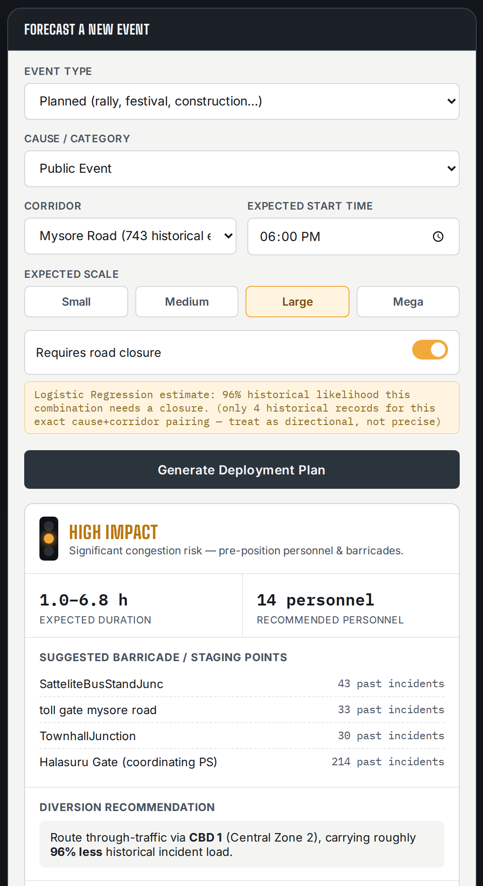
INSIDE THE APPLICATION
Forecast & Map — score an event before it happens
A Large public event on Mysore Road, with a road closure: High Impact, a duration range, a personnel count, the corridor's own highest-incident junctions, and a named diversion — all on forecast.html.
EVENTPULSE
06

Slide 7
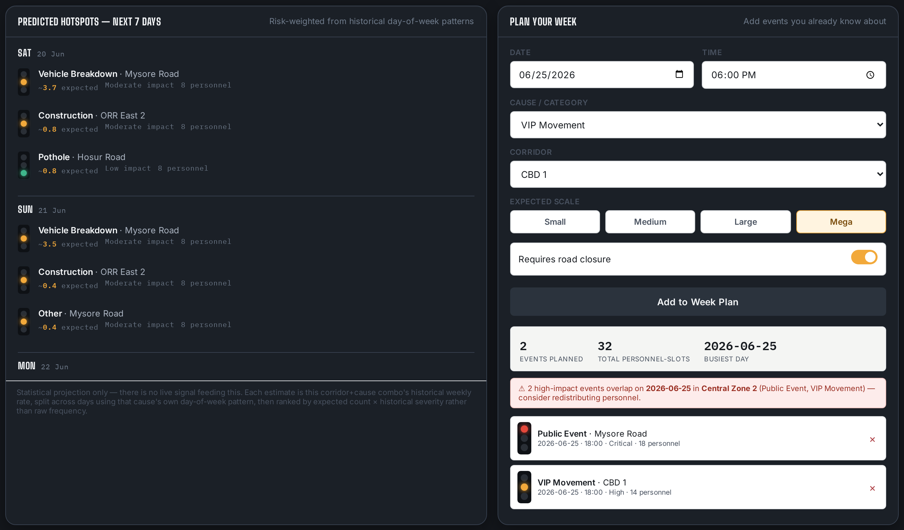
INSIDE THE APPLICATION
Upcoming Outlook — what's coming, not just what's named
Left: a 7-day statistical projection of unplanned hotspots from historical patterns. Right: known events added by hand get the same forecast, plus automatic conflict detection — here, two high-impact events on the same date and zone.
EVENTPULSE
07

Slide 8
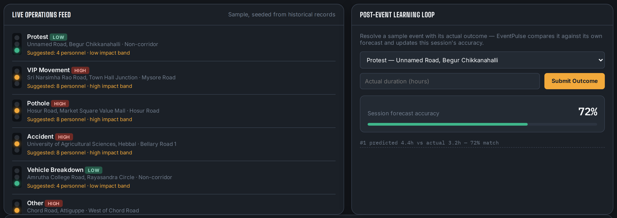
INSIDE THE APPLICATION
Live Ops & Learning Loop — closing the feedback gap
Live incidents are triaged by their own known priority and closure flags, not predicted. Resolving one with its actual outcome updates a running session accuracy score — 72% here after one submission.
EVENTPULSE
08

Slide 9




CONCLUSION & FUTURE SCOPE
From hackathon prototype to control-room pilot
EventPulse is a fully working, deployable prototype today, built on real anonymized B-TRAC data, with two validated ML models and no backend to provision. The fastest way to know if it earns its place in the control room is to point it at one corridor's live events and watch it forecast.
Live signal ingestion
Real road-graph routing
A field app for officers
B-TRAC / dispatch integration
Real-time GPS/traffic-API feeds so the map reflects the city right now, not just history.
Replace the corridor-load heuristic with an actual shortest-alternate-path engine.
Push the deployment plan straight to the assigned team's phone, one-tap acknowledgement.
Ingest permit filings and live incident tickets automatically — no manual re-entry.
THEME · EVENT-DRIVEN CONGESTION — PLANNED & UNPLANNED
EVENTPULSE
09

