Slide 2

Introduction to Git, GitHub and CI/CD
Anshuman Fauzdar
[Alpha Microsoft Learn Student Ambassador]

Slide 3



Topics to be covered today:
Git
What is version control?
Why git?
How to download and possible problems
Basic commands
Pro tips
GitHub
What is GitHub?
Why WE need it?
Navigation basics
Basic tools
Become PRO user
Additional features
CI/CD
What is continuous integration and deployment?
Why WE need it?
How to setup?
GitHub Actions

Slide 4
Git Version Control System
A version control system (VCS) is a program or set of programs that tracks changes to a collection of files.
Git is a fast, versatile, highly scalable, free, open-source VCS.
Its primary author is Linus Torvalds, the creator of Linux.
Basic Terminology used with Git:
Working tree/directory
Repository [Repo]
Hash
Commit
Branch
Remote
Basic Commands
Website : Git (git-scm.com)

Slide 5
Demo
Slides.com

Slide 6
GitHub Cloud Platform
GitHub is a cloud platform that uses Git as its core technology.
GitHub simplifies the process of collaborating on projects and provides a website, more command-line tools, and overall flow that developers and users can use to work together.
Key features of GitHub:
Issues
Discussions
Pull Requests
Notifications
Actions
Forks
Projects
Website : github.com

Slide 7
Demo

Slide 8
CI/CD DevOps Practice
Continuous integration (CI) is the practice of automating the integration of code changes from multiple contributors into a single software project.
Continuous Deployment (CD) is a software release process that uses automated testing to validate if changes to a codebase are correct and stable for immediate autonomous deployment to a production environment.

Slide 9
Continuous Integration
A CI process is a process in which software is developed by multiple sources and is automatically integrated via an established procedure.
The flow might go something like this:
Push to Git
A process is triggered
The relevant branch is pulled, the app is built, and tests are run
The results of this process are sent to whom it concerns

Slide 10
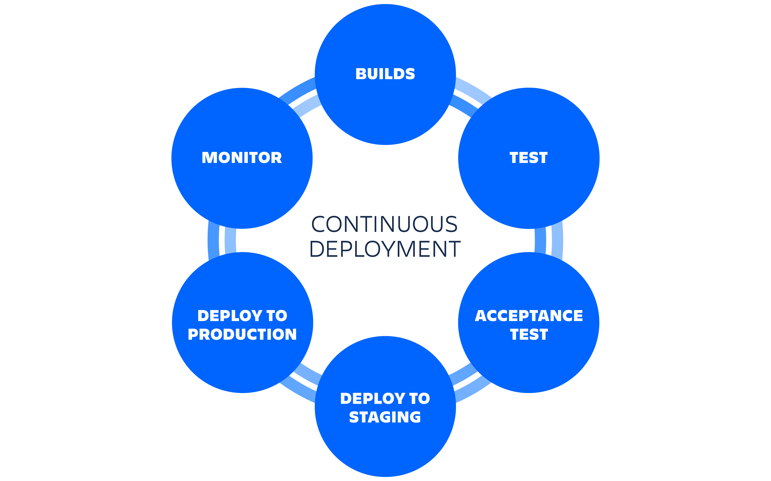
Continuous Deployment
A CD process is a process that usually follows the merge process.
It takes the newly merged version and usually does the following:
Runs tests [End-to-End]
Creates an artifact and stores it
Deploys to production
Runs post-production E2E tests

Slide 11
Demo
Slides.com

Slide 12
To get your certificates please fill out the form provided in the chat Feel free to ask doubts in chat section ☺

Slide 13
To retrieve resources and additional resources of this event please refer to github.com/AnshumanFauzdar/MLSA-Events

Slide 14
Thank You 🎉

