Slide 1
Google Play Store App Analysis
Optimization & Performance Analytics
Business-focused insights to improve app visibility, pricing, size strategy, and recommendation decisions.
10,841
13
4.3
raw app records
dataset attributes
median rating
Notes:
Open the presentation by framing the analysis as a business decision-support exercise, not a technical code walkthrough. The goal is to understand what makes apps visible, trusted, and promotable in a marketplace.

Slide 2
Problem Statement
What business issue is being addressed?
Business Problem
Why It Matters
App discovery is difficult in a crowded marketplace.
Platform curators need reliable criteria to highlight promising apps.
Developers need practical guidance on size, pricing, and audience targeting.
Poor recommendations reduce user trust and engagement.
Weak launch choices can lower ratings and installs.
Clear thresholds help teams prioritize apps with stronger market potential.
Notes:
Explain that the Play Store environment creates a visibility problem for both users and developers. The analysis supports a recommendation framework based on app performance signals.

Slide 3
Objective
Business goals and questions answered by the analysis
1.
Identify factors linked to strong app ratings and market penetration.
Key Business Questions
What rating should qualify an app for recommendation?
Does larger app size improve user satisfaction?
How does paid pricing affect user ratings?
Which audience groups show higher rating risk?
2.
Find safe thresholds for app rating, size, and paid pricing.
3.
Understand how audience segments and genres influence rating risk.
4.
Translate EDA patterns into recommendation and launch decisions.
Notes:
This slide defines the project as an analysis-to-decision flow. Keep the focus on business questions: quality thresholds, product optimization, pricing, and risk management.

Slide 4
Dataset Overview
Google Play Store app listing data used for analysis
10,841
9,359
13
Data Scope
initial records
clean records
key variables
Mobile applications across multiple categories and genres.
Focus on ratings as the main quality signal.
Includes market signals such as installs and review volume.
Update-year trend view available for 2011–2018.
Key Variables
App, Category, Genres
Rating, Reviews, Installs
Size, Type, Price
Content Rating, Last Updated, Version fields
Notes:
Mention that the data provides enough variety to compare quality, adoption, monetization, audience targeting, and update trends. The cleaned dataset is used for all final insights.

Slide 5
Data Cleaning & Preparation
Steps taken to make the analysis reliable
Preparation Actions
Quality Controls
Dropped rows with missing ratings because ratings are the target quality signal.
Removed one invalid rating anomaly above 5.0.
Converted Price, Reviews, and Installs into numeric fields.
Imputed missing Android version and current version with the most common value.
Removed 7 rows where reviews exceeded installs.
Rating range validated between 1.0 and 5.0.
Free apps checked to ensure price equals $0.
Logical consistency checked between reviews and installs.
Final analysis based on 9,359 valid app records.
Notes:
Do not explain the code. Emphasize that cleaning improved trust in the findings by removing missing target values, invalid ratings, and logical anomalies.

Slide 6
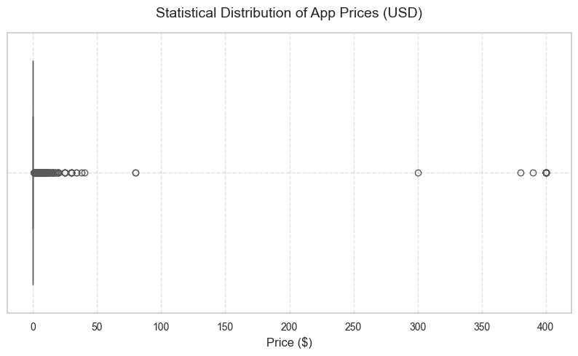
Price Outlier Analysis
EDA visualization with stakeholder interpretation
Finding
Most paid apps are low-priced, but 15 apps are priced above $100, including $399–$400 status apps.
Insight
Extreme premium apps distort normal pricing patterns.
Business Impact
Pricing strategy should be assessed without non-functional status-symbol outliers.
Decision
Separate functional paid apps from novelty outliers before defining pricing thresholds.
Recommendation
Use standard paid tiers for business decisions and treat $100+ apps as exceptions.
Notes:
This chart shows price dispersion. Explain that the visible outliers represent unusual apps that should not drive mainstream pricing decisions.

Slide 7
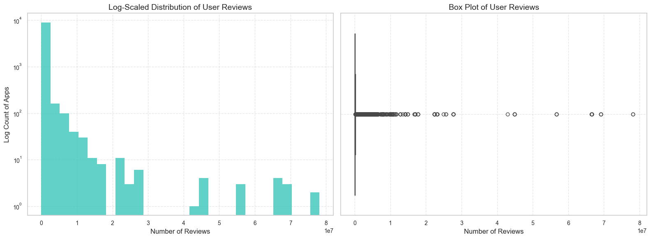
Reviews Volume Distribution
EDA visualization with stakeholder interpretation
Finding
Review volume is heavily skewed; the 99th percentile reaches about 9.88M reviews.
Insight
A small number of viral apps dominate engagement signals.
Business Impact
Raw review count alone can over-favor already dominant apps.
Decision
Use review velocity or category-adjusted review metrics for recommendation ranking.
Recommendation
Prioritize fast-growing review momentum rather than only total review count.
Notes:
Explain that review volume is important, but the skew makes raw counts unfair for newer or niche apps.

Slide 8
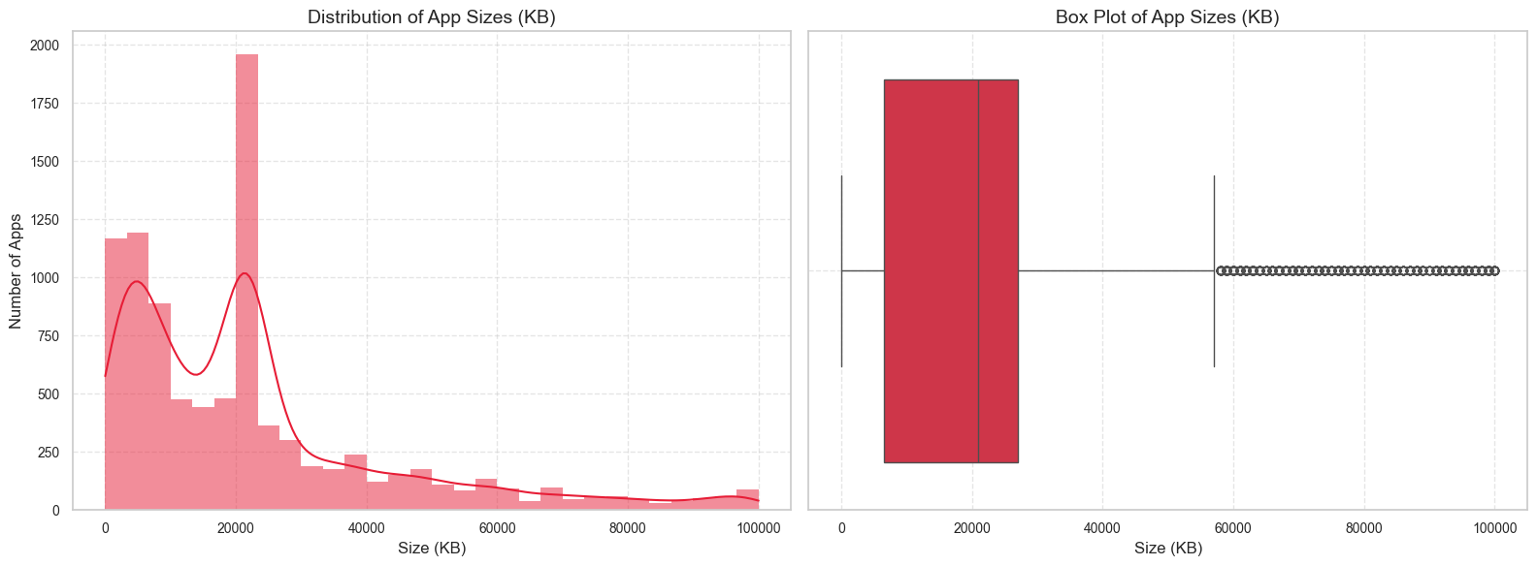
App Size Distribution
EDA visualization with stakeholder interpretation
Finding
Median app size is about 20.51 MB; the 90th percentile is about 51.76 MB.
Insight
Most apps remain in a moderate download-size range.
Business Impact
Very large apps may increase download friction and storage concerns.
Decision
Set a practical size budget for apps intended for broader promotion.
Recommendation
Encourage optimization before launch and monitor rating impact for large builds.
Notes:
Position app size as a user experience variable, not only an engineering metric.

Slide 9
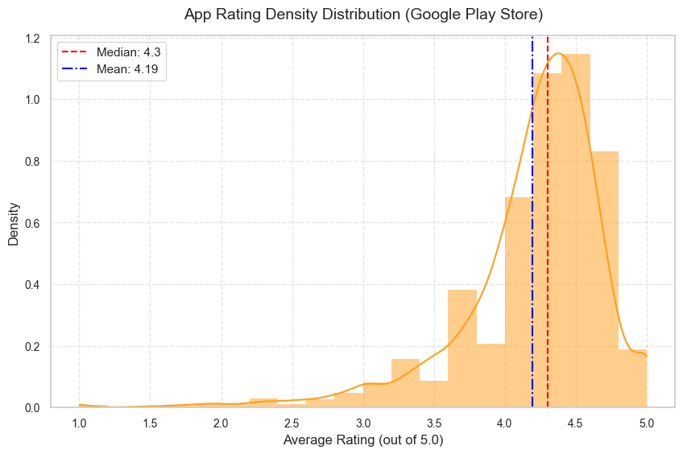
Rating Distribution
EDA visualization with stakeholder interpretation
Finding
Ratings cluster around 4.0–4.5 with a median of 4.3; the 25th percentile is 4.0.
Insight
A rating below 4.0 places an app in the bottom quartile of the analyzed store data.
Business Impact
Recommendation sections should not promote apps below a clear quality floor.
Decision
Use 4.0 as a minimum rating threshold for recommendation eligibility.
Recommendation
Treat apps below 4.0 as improvement candidates before promotion.
Notes:
This is one of the most important slides. Make clear that 4.0 is not merely good; it is the lower boundary for acceptable recommendation quality.

Slide 10
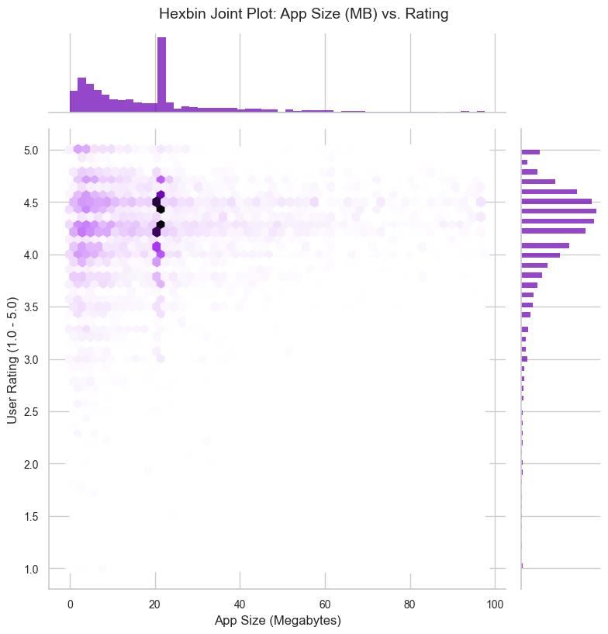
App Size vs. User Rating
EDA visualization with stakeholder interpretation
Finding
High-rated density is concentrated around roughly 10–40 MB.
Insight
Both very small and very large apps show more rating volatility.
Business Impact
Feature depth and download friction both influence user satisfaction.
Decision
Avoid assuming bigger apps perform better; optimize for a balanced size range.
Recommendation
Target approximately 15–35 MB where feasible, unless product requirements justify otherwise.
Notes:
Explain the size sweet spot as a balance between functional value and download/device friction.

Slide 11
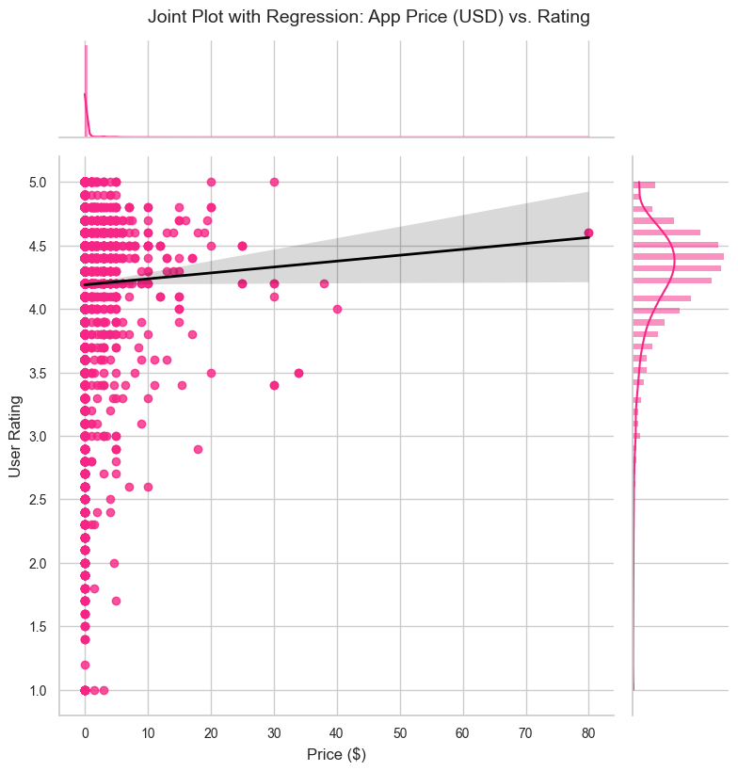
Paid App Pricing vs. Rating
EDA visualization with stakeholder interpretation
Finding
The regression trend shows a mild negative relationship between price and rating.
Insight
Users are stricter when they pay for an app.
Business Impact
Premium pricing increases expectation risk and can reduce rating tolerance.
Decision
Approve higher price points only when the app offers clear, differentiated value.
Recommendation
Keep standard paid apps in the $0.99–$2.99 range where possible.
Notes:
Discuss that paid apps need stronger quality assurance and sharper positioning than free apps.

Slide 12
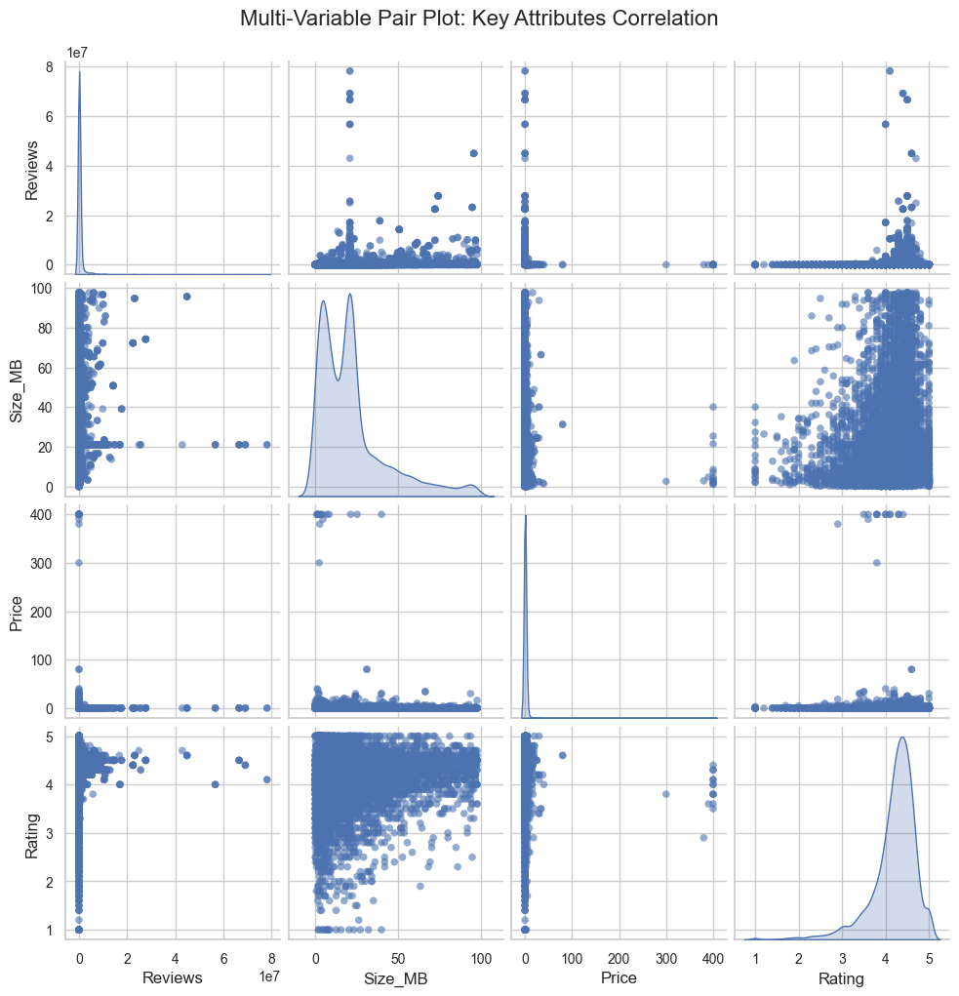
Multi-Variable Relationship View
EDA visualization with stakeholder interpretation
Finding
Reviews, size, price, and rating show non-linear and skewed relationships.
Insight
No single variable explains app quality by itself.
Business Impact
Recommendation decisions should combine quality, engagement, pricing, and size signals.
Decision
Use a multi-factor scoring approach rather than a one-metric rule.
Recommendation
Build a weighted recommendation score with safeguards for rating and size risk.
Notes:
Use this as a bridge slide: the analysis supports a combined decision framework rather than isolated metrics.

Slide 13
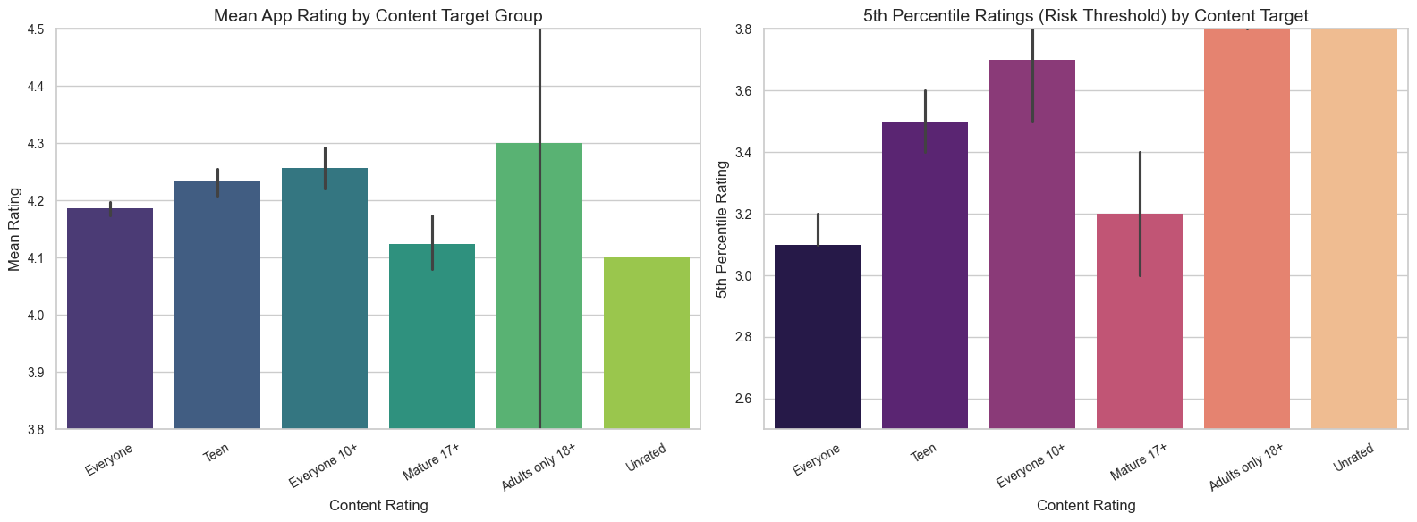
Target Audience vs. Rating Risk
EDA visualization with stakeholder interpretation
Finding
Mean ratings are broadly close, but lower-tail risk differs by content rating group.
Insight
Audience segment affects rating stability and downside risk.
Business Impact
Some segments require stronger monitoring before recommendation placement.
Decision
Include content rating as a risk adjustment in recommendation decisions.
Recommendation
Apply stricter post-launch quality checks for higher-variance audience segments.
Notes:
Focus on lower-tail risk, not just averages. The 5th percentile shows where bad user experience is more likely.

Slide 14
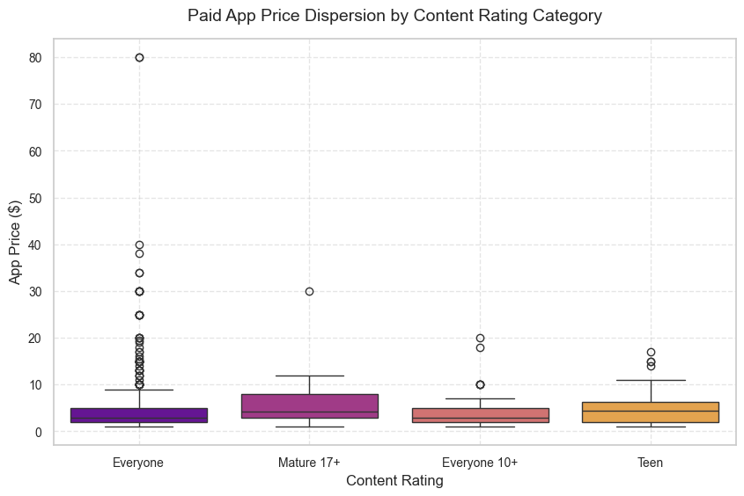
Paid App Price by Audience
EDA visualization with stakeholder interpretation
Finding
Paid app pricing varies by content rating category.
Insight
Audience targeting can influence how much users tolerate paying.
Business Impact
Some segments may be more exposed to premium pricing risk.
Decision
Validate pricing against audience expectations before launch.
Recommendation
Test pricing by audience segment and avoid broad one-size-fits-all pricing.
Notes:
Explain that this graph supports segment-aware pricing rather than blanket pricing rules.

Slide 15
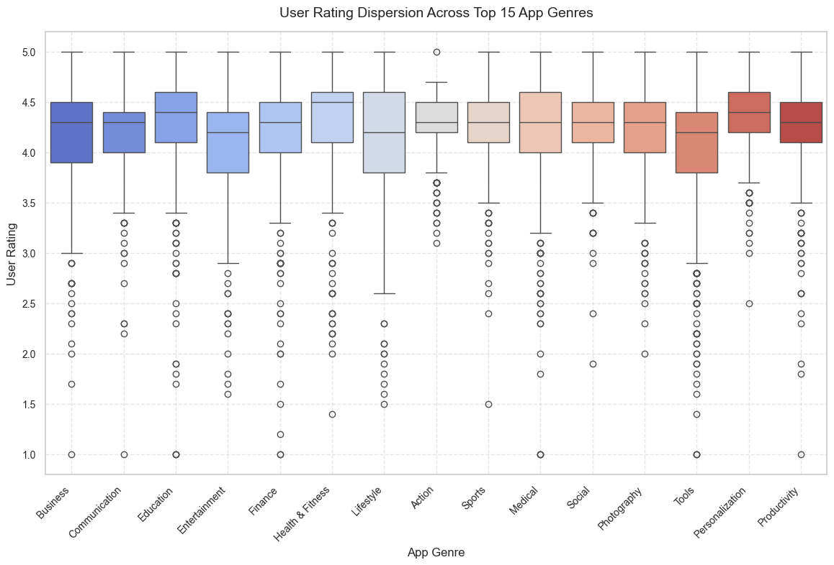
Top Genres by User Ratings
EDA visualization with stakeholder interpretation
Finding
Rating distributions vary across the top 15 app genres.
Insight
Genre context matters when comparing app quality.
Business Impact
A rating may be strong in one genre but average in another.
Decision
Benchmark apps against genre peers for fair promotion decisions.
Recommendation
Use genre-specific rating thresholds in recommendation ranking.
Notes:
Explain that category/genre benchmarking helps avoid unfair comparisons between very different app types.

Slide 16
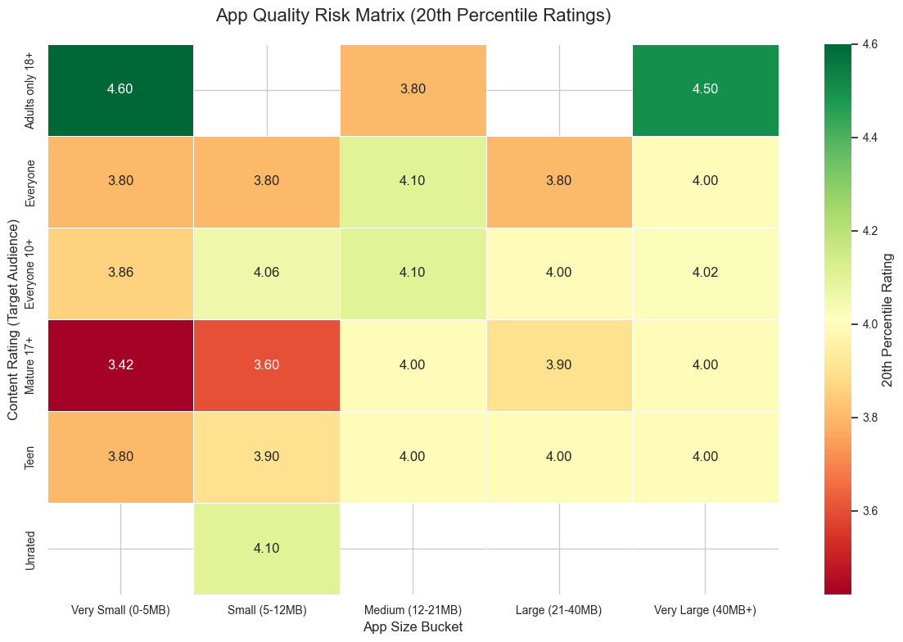
App Quality Risk Matrix
EDA visualization with stakeholder interpretation
Finding
The 20th percentile rating varies across app size buckets and content-rating groups.
Insight
Medium and large-but-not-extreme size ranges are generally safer.
Business Impact
Certain audience-size combinations carry higher quality risk.
Decision
Use the matrix to flag risk before recommending apps.
Recommendation
Prioritize medium-size apps and require extra validation for risky segments.
Notes:
This slide turns the EDA into an operational decision tool. Use the heatmap as a risk-screening matrix.

Slide 17
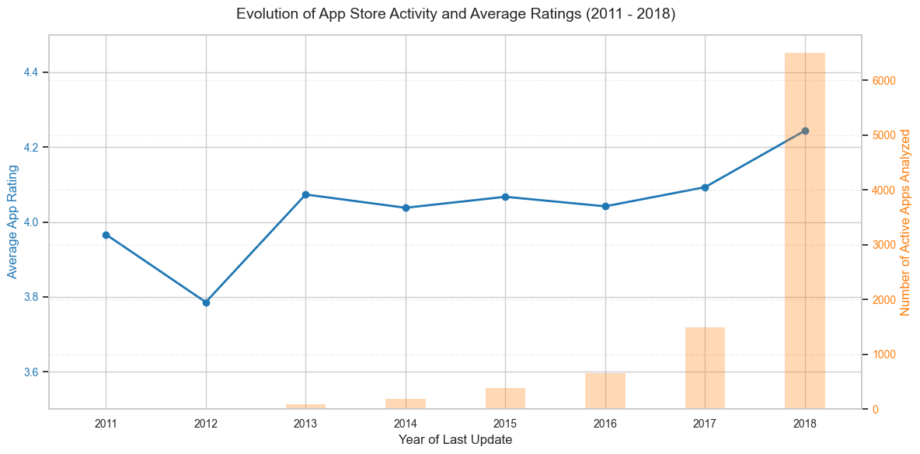
Update Trend Analysis
EDA visualization with stakeholder interpretation
Finding
Average ratings trend upward from 2011 to 2018 while app activity grows strongly.
Insight
The market appears to mature over time, with higher technical and review quality expectations.
Business Impact
Older or rarely updated apps may face quality perception risk.
Decision
Factor recency of updates into promotion eligibility.
Recommendation
Encourage regular updates and monitor rating shifts after releases.
Notes:
Explain that update recency can be used as a proxy for active maintenance and market relevance.

Slide 18
Key Findings
Summary supported by the notebook analysis
A 4.0 rating is the practical quality floor; apps below it fall into the bottom 25%.
The strongest rating density appears around a moderate app size range, roughly 10–40 MB.
Very high review counts are dominated by a small number of mega-scale apps.
Higher paid prices show stricter user expectations and a mild negative rating trend.
Audience segment and genre both affect rating stability and risk.
Apps updated in recent years show better average rating performance in the analyzed period.
Notes:
This slide should be used to recap evidence, not introduce new claims. Keep the language direct and grounded in the earlier charts.

Slide 19
Business Insights
Converting findings into stakeholder meaning
Observation
Impact
Opportunity / Risk
Apps below 4.0 are weak candidates for promotion.
Moderate-sized apps show stronger rating concentration.
Paid users are stricter when prices increase.
Genres and audience groups have different rating-risk profiles.
Recommendation quality directly affects user trust.
Oversized apps can create download and storage friction.
Premium pricing raises customer expectations.
Single global thresholds may unfairly rank some categories.
Use a rating floor to protect promoted sections.
Guide developers toward balanced app packages.
Validate value before approving high price points.
Introduce category-aware scoring for fairer ranking.
Notes:
Walk through this slide as a management interpretation layer. It reframes the analysis into trust, user experience, pricing, and fairness decisions.

Slide 20
Data-Driven Decisions & Recommendations
Recommended actions based on the analysis
Decision
Recommended Action
Expected Outcome
Use ≥4.0 rating for core recommendation eligibility.
Set an app-size optimization target around 15–35 MB.
Keep standard paid apps near $0.99–$2.99 unless clearly differentiated.
Use a multi-factor ranking model instead of one metric.
Apply segment risk checks for high-variance combinations.
Filter weak apps before promotion.
Review and compress large packages before launch.
Validate premium price-value fit with user feedback.
Combine rating, reviews, genre, size, and update recency.
Review risky groups before featuring them.
Higher user trust in recommendation sections.
Lower download-friction and quality risk.
Better price acceptance and fewer rating penalties.
Fairer visibility for promising apps.
Reduced exposure to low-quality promoted experiences.
Notes:
This is the action slide. Highlight that every recommendation ties back to a measured chart: rating floor, size range, pricing trend, multi-factor relationship, and segment risk.

Slide 21
Conclusion
Final stakeholder takeaway
The analysis identifies practical rules for app promotion and developer guidance.
The most important quality signal is the 4.0 rating threshold, supported by the rating distribution.
The strongest product opportunity is size and pricing discipline: moderate app size and justified paid pricing.
Recommendation decisions should use a combined scoring framework rather than one metric.
Overall, the Play Store team can improve recommendation quality by balancing user satisfaction, adoption signals, segment context, and product maintainability.
Notes:
Close with the idea that the analysis is actionable: improve marketplace trust, guide developers, and make recommendation sections more consistent.

Slide 22
Future Scope
Next steps to improve decision quality
Add user-retention and uninstall data to validate long-term satisfaction.
Measure review velocity after launch and after major updates.
Build category-specific recommendation thresholds instead of a single global rule.
Test pricing bands through A/B experiments for paid apps.
Monitor app crash rate and performance metrics alongside ratings.
Notes:
Use this only if the audience wants next steps. Frame these as practical extensions that require more data, not assumptions made in the current analysis.

