Slide 1


Introduction to Easy Way Website
Discover the one-stop solution for all your home service needs. With a seamless online platform, Easy Way brings together trusted professionals to deliver exceptional services at your doorstep.

Slide 2

Team Member
Anshu (University Roll.No. 2200290140035)
Anshuman Patek (Roll.No. 2200290140036)
Arpita Vaish (Roll.No. 2200290140038)

Slide 3

Our Services
1
Extensive Offerings 🏡
From home cleaning to repairs and maintenance, our versatile services cover all aspects of household management.
2
Professional Expertise 🌟
Trained professionals to handle their fields service, ensuring the highest quality standards and attention to detail.
3
Convenient Booking And Requesting ⏰
With a user-friendly interface designed for ease, booking your service is just a few clicks away by just requesting for that service.

Slide 4
Project Objective
The Project focuses on developing a service portal that enhances user experience by streamlining service requests and providing efficient service management.
The project aims to replace traditional manual processes with an automated, user-friendly solution, leveraging advanced technologies to improve functionality and user satisfaction.

Slide 5
How it Works
1
Browse Services 🖥️
2
Select & Request 🔍
Easily browse through our wide range of service categories to find what you need.
Select your desired service and request for the service with the specific provider.
3
Professional Visit 🚪
4
Rating & feedback
Sit back and relax while the professional arrives at your doorstep to deliver the service.
Rate the service provider and write the feedback for the provider and the platform.

Slide 6



Modules in the application
❤️
Admin module
Can Login to the application and manages the entire system i.e. users, workers, services, ratings and feedback.
User Module
User can login and search for their required services and can request to specific provider for the service.
Worker module
Worker can register themselves according to their expertise and takes the request from the users.

Slide 7



Customer Testimonials
Heartwarming Stories ❤️
Exceptional Ratings ⭐
Satisfied Customers 😊
Discover what our satisfied customers have to say about their experience with Easy Way.
Read inspiring stories of how our services have made a positive impact on our customers' lives.
Find out why our services consistently receive high ratings and positive feedback from our customers.

Slide 8

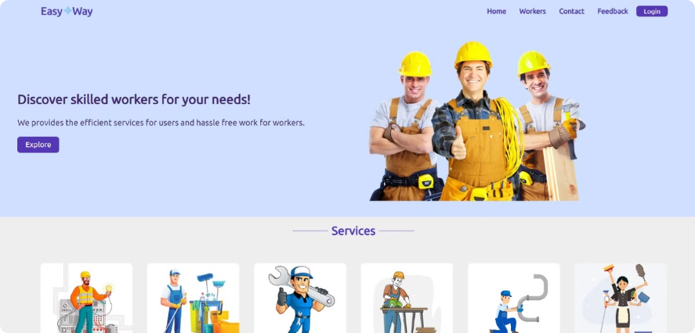
Project Output
The final deliverable showcases the collaborative effort of our cross-functional team. Through their expertise and dedication, we have developed a comprehensive solution that addresses the client's key requirements.

