Slide 1
Abstract
Unauthorized access to your precious files and folders can be carried out remotely as well as physically. By Physical access, we mean an intruder can attempt to exploit your private information stored in your personal computer in your absence. The attacker can even get hold of your hardware through your files. Through the Folder a locker we aim to achieve our goal of providing the user with layers of physical security.
Keywords: Security, Intruder, Physical security

Slide 2
INTRODUCTION
App locks have been designed for android based device such as phones but such app locks are currently not available for the windows. This product would be beneficial to an individual as much as to an organization. People generally store their work related documents on their personal computer’s. Hence they would feel much secure if their valuable information is stored in a secure vault. People really struggle to come up with strong passwords that can prevent basic brute force and Dictionary attacks. By implementing ciphers we can help the user to generate passwords with high entropy measure. Also we will be implementing innovative as well as secured password retrieval as well as intruder all mechanisms, to make our product as useful as possible.

Slide 3
INTRODUCTION
We have come up with the idea by keeping the following parameters in our mind:-
1. Assessing the risks
2. Identifying the viable assets
3. Providing solutions

Slide 4
INTRODUCTION
a.)Assessing the risks Organizations and individuals sometimes underestimate the importance of keeping their offices and equipment physically secure. Even those who take steps to protect hardware like computers and backup storage devices from theft, severe weather and other physical threats often fail to document these steps in a written security policy. As discussed above our main aim is to prevent an intruder from physically exploiting our personal as well as professional files.
b.)Identifying the viable assets Information regarding the employees, assets, customer, and new products are very essential to the organization. Any loss to this data will result into financial loss to the company. This type of data can be stored in the simplest form possible that is text files.
c.) ProvidingSolutions We can provide the user with a mechanism that provides him ways of generating stronger passwords. For this we can use trivial encryption methods. Another way of making the file or folder secure is by providing with an option of hiding the file or the folder.

Slide 5
PROBLEM STATEMENT
As we all are from the cyber security domain we feel obliged to contribute to the same domain. Hence we were highly motivated to work on a concept concerned with the field of cyber security. “Folder and File Protection” is a topic of high conflict.
Folders are used to organize information.In the DOS and UNIX world ,folders are called directories. Folder protection software is a security tool.
Locking folders effectively protects you from malicious programs, such as viruses, worms, and Trojans. Locking is the best way to guarantee that nobody accidentally or intentionally gets access to your financial, health, private, and confidential information.This software acts like a shield And because locking your folders makes them inaccessible, they cannot be deleted, damaged, or harmed in any other way.

Slide 6
LITERATURE REVIEW
As this is our first minor project we haven’t worked on any formal project but we have implemented some Cryptographic algorithms in c language, they are as follows :-
a.) Caesar Cipher
The Caesar Cipher technique is one of the earliest and simplest method of encryption technique. It’s simply a type of substitution cipher, i.e., each letter of a given text is replaced by a letter some fixed number of positions down the alphabet. For example with a shift of 1, A would be replaced by B, B would become C, and so on. The method is apparently named after Julius Caesar, who apparently used it to communicate with his officials.Thus to cipher a given text we need an integer value, known as shift which indicates the number of position each letter of the text has been moved down. The encryption can be represented using modular arithmetic by first transforming the letters into numbers, according to the scheme, A = 0, B = 1,…, Z = 25. Encryption of a letter by a shift n can be described mathematically as.
FOR ENCRYPTION:- E(x) =(x+n)mod 26 FOR DECRYPTION:- D(x)=(x-n)mod 26

Slide 7
b.) Vignere Cipher
Vigenere Cipher is a method of encrypting alphabetic text. It uses a simple form of polyalphabetic substitution. A polyalphabetic cipher is any cipher based on substitution, using multiple substitution alphabets .The encryption of the original text is done using the Vignere Table.
● The table consists of the alphabets written out 26 times in different rows, each alphabet shifted cyclically to the left compared to the previous alphabet, corresponding to the 26 possible Caesar Ciphers.
● At different points in the encryption process, the cipher uses a different alphabet from one of the rows.
● The alphabet used at each point depends on a repeating keyword.
For encryption:- First a keyword is decided according to which the alphabets in the plaintext are to be shifted. We pair each letter of the plaintext with the corresponding
Letter of the keyword.
For decryption:- Decryption is performed by going to the row in the table corresponding to the key, finding the position of the ciphertext letter in this row, and then using the column’s label as the plaintext.

Slide 8
C) HASHING
Hashing is generating a value or values from a string of text using a mathematical function. Hashing is one way to enable security during the process of message transmission when the message is intended for a particular recipient only. A formula generates the hash, which helps to protect the security of the transmission against tampering. Hashing is also a method of sorting key values in a database table in an efficient manner.
Hash Table and Hash Function
Earlier when this concept introduced programmers used to create “Direct address table”. Direct address table means, when we have “n” number of unique keys we create an array of length “n” and insert element “i” at ith index of the array. That array is called Hash Table. But due to this method even we have 10 elements of each range 1 lack, we should create table of size 1 lack for only 10 elements. Which is going to be waste of memory.
To avoid this problem we fix the size of hash table (array) and map our elements into that table using a function, called Hash function. This function decides where to put a given element into that table. If we want to search also first apply hash function decide whether the element present in hash table or not

Slide 9
OBJECTIVE
The objective of this project is to create a folder locker to maintain the Confidentiality and integrity of data present inside the folder in the form of text files and encrypt and decrypt confidential files using RSA Algorithm

Slide 10
METHODOLOGY
Creating user friendly interface
Implement RSA algorithm
Encryption and Decryption of text files.
Locking and Unlocking Confidential Folders.

Slide 11
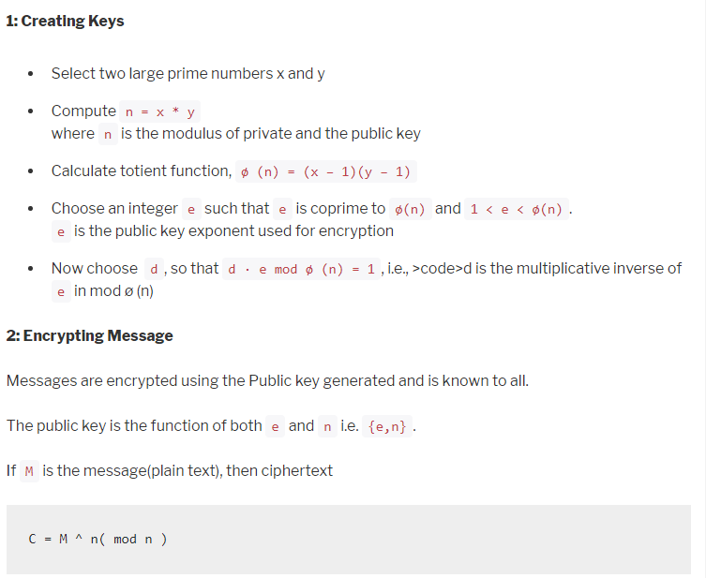
Research Work

Slide 12
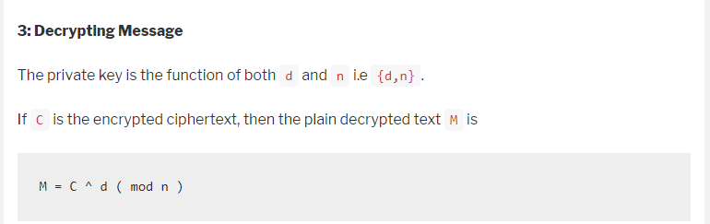

Slide 13
SOFTWARE REQUIREMENTS:-
1.) Microsoft Visual Studio 2.) GCC(Gnu C Compiler)
Hardware Requirements:-
1.) 2Ghz Processor 2.) 4Gb Ram
Programming Language used:-
C

Slide 14
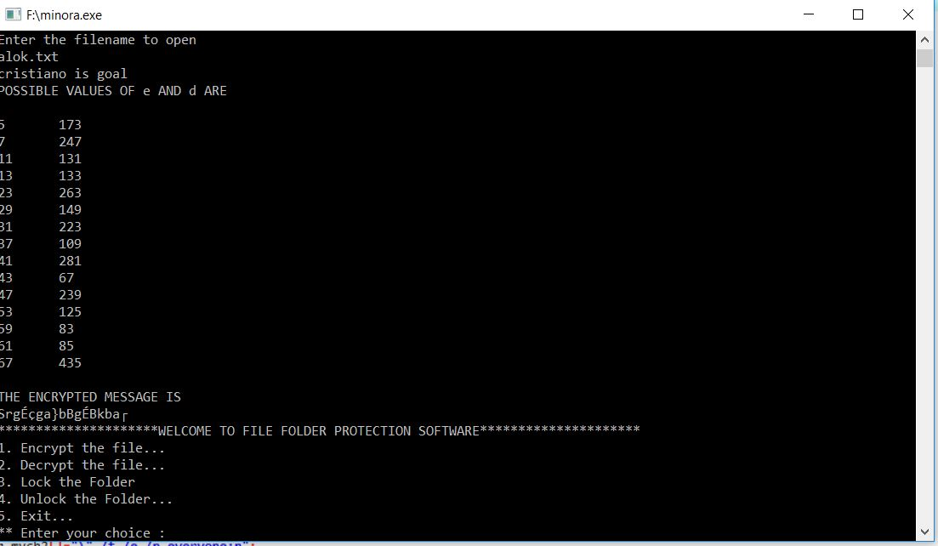
RESULT
RSA ALGORITHM IMPLEMENTATION

Slide 15
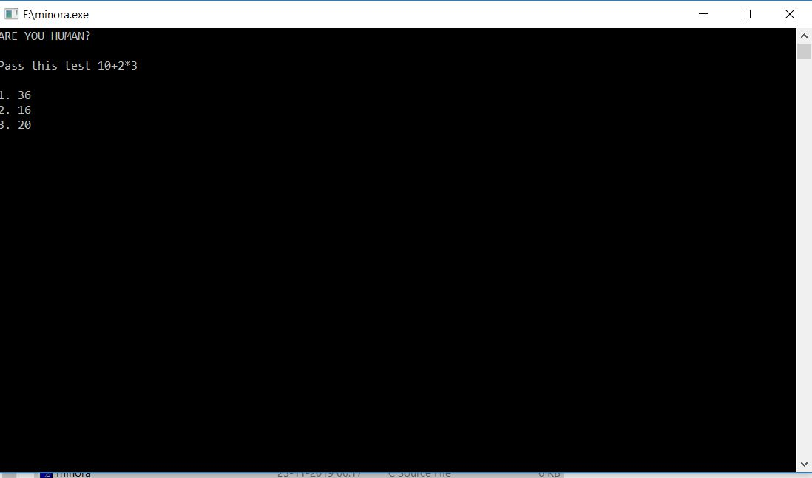
RECOGNIZING HUMAN?

Slide 16
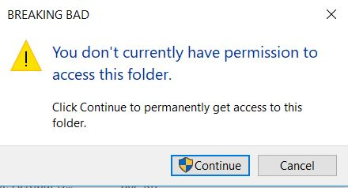
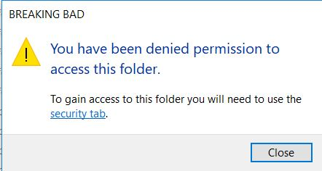
FILE/FOLDER PROTECTION UI

Slide 17
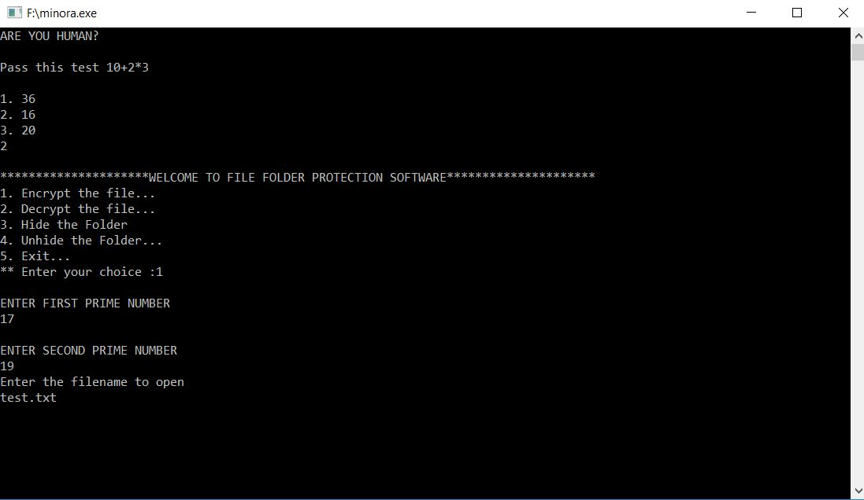
Encrypting the File

Slide 18
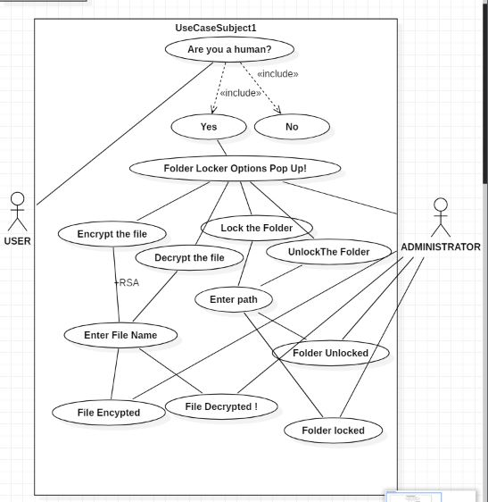
USE CASE DIAGRAM

Slide 19
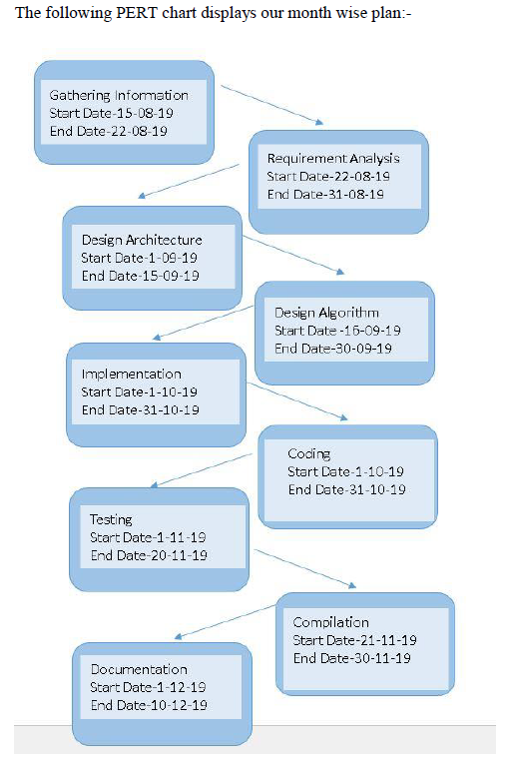
PERT CHART

