Slide 1

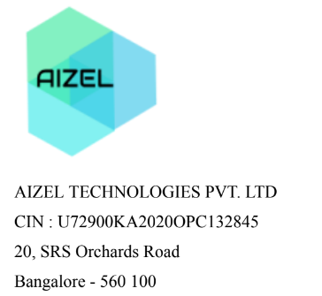
VIRTUAL ASSISTANT TEACHER USING THE SPEECH TO TEXT AND VICE-VERSA
NATIONAL INSTITUTE OF TECHNOLOGY PATNA
Ashok Rajpath, Mahendru Patna(Bihar)
Department of Computer Science and Engineering
Group no- 21
Contribution by-
ANSHU KUMARI- 2006039

Slide 2
CONTENT OUTLINE
CONTENT TITLE | SLIDE NUMBER
INTRODUCTION | 3
MOTIVATION OF OUR WORK | 4
TOOLS USED TO MAKE THIS PROJECT | 5
METHODOLOGY | 6
RESULTS | 7-9
LIMITATIONS OF GOOGLE DRIVE AND GOOGLE SHEET | 10
AWS Bucket | 11
Advantage of AWS Bucket over Google drive | 12

Slide 3
CONTENT OUTLINE Cont……
CONTENT TITLE | SLIDE NUMBER
AWS DynamoDB | 13
Why AWS DynamoDB | 14
PROPOSED Model | 15
METHODOLOGY | 16
RESULTS | 17-20
Conclusion | 21
Future work | 22
Reference | 23

Slide 4
INTRODUCTION-
We want to build a Virtual assistant teacher using the Speech to Text and vice versa which would interact with users to help them with the studies as does a teacher in a real life scenario.

Slide 5
Motivation of our Work-
To achieve our goal we are working on following modules
1. Hindi to English Translation - Native style grammar/pattern based more suitable to Indian standard
2. To use existing text to speech and integration
3. Dynamic Question generation based on the input/test cases report
4. Deep Analysis of NCERT Books

Slide 6
Tools Used to make this project happen
VS Code(To run the project)
HTML,CSS, JavaScript (For Front-End)
Google Drive, Google Sheet(to store audio and text with link- For Back-End)
Python (For implementation of all function)
Django (to integrate all the functions)
GitHub (update all the record)

Slide 7
METHODOLOGY
1. Google Sheets and Drive Initialization:
The script initializes Google Sheets using the gspread library and Google Drive using the googleapiclient.discovery module.
It uses service account authentication with JSON key files (sheet.json.json and drive.json.json) to access the Google APIs
2. Searching a word in website
User will search a word in website
3. If word is Present in Database( G_Sheet)
(i) Downloading Audio from Drive
(ii) Playing Audio
4. If word is NOT present in Database(G_Sheet)
(i)Record the audio
(ii) Saving the audio on google drive
(iii) Update the Google sheet with name of word and link of the audio

Slide 8
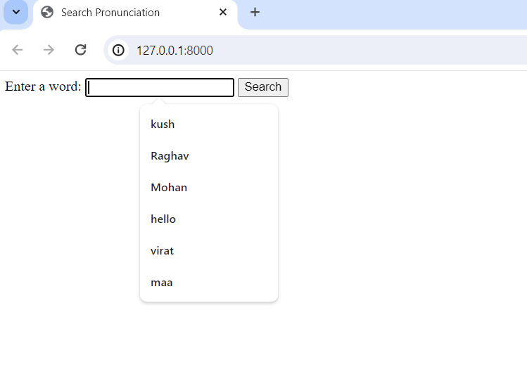
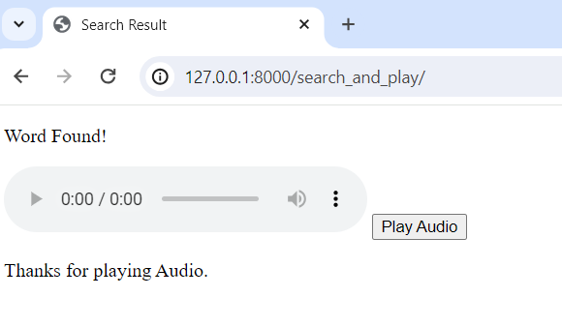
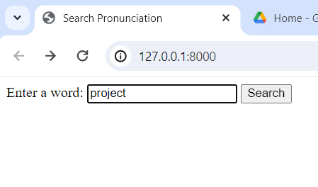
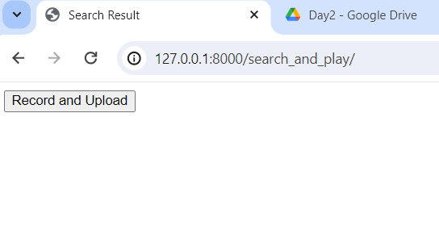
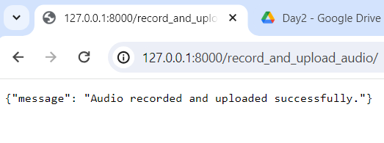
Results

Slide 9
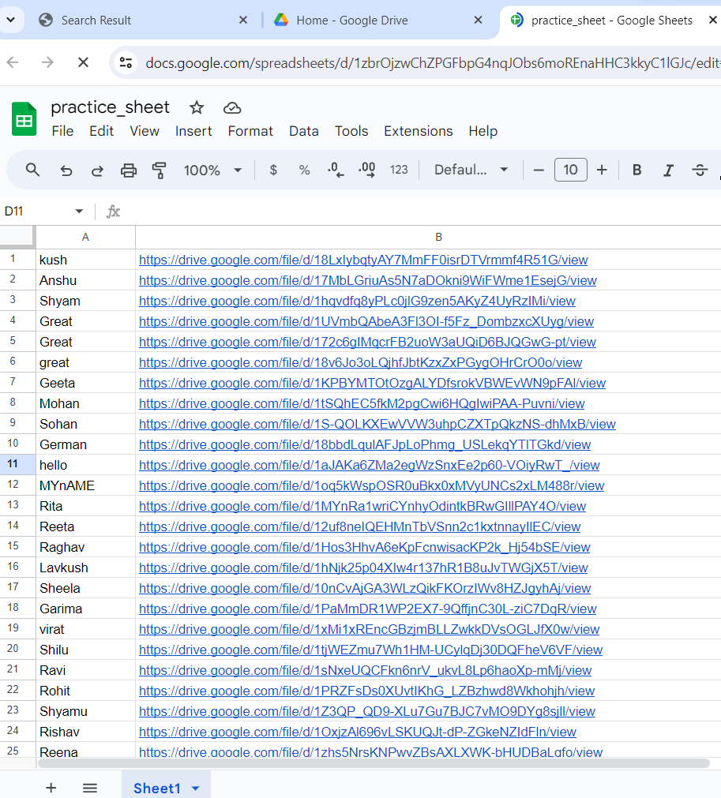
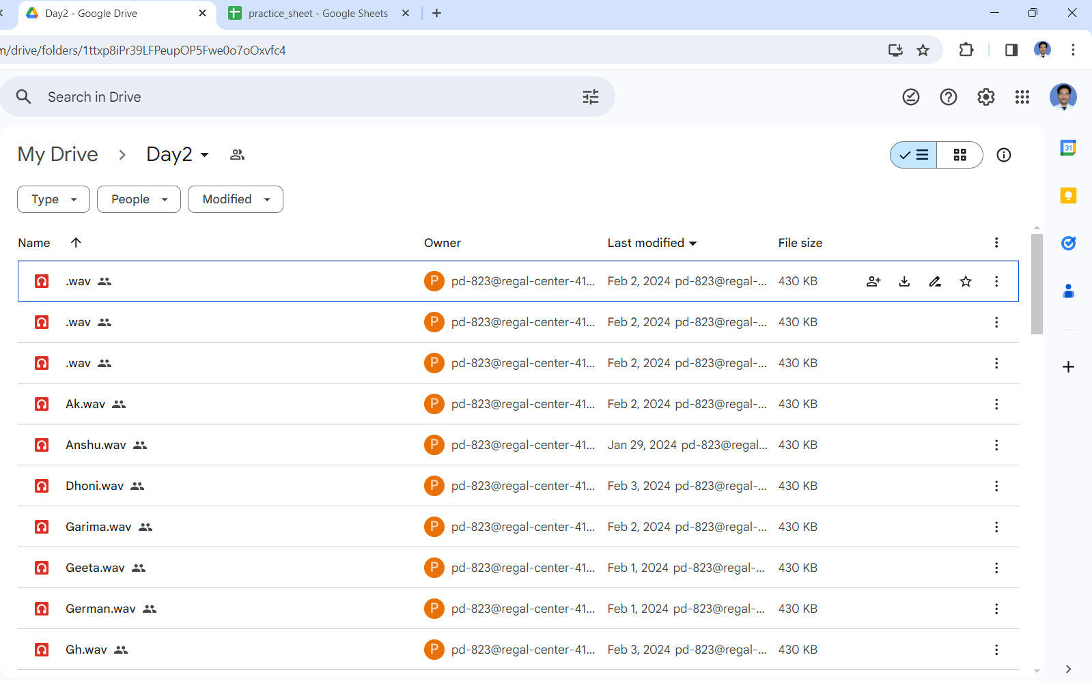
Results Cont..

Slide 10
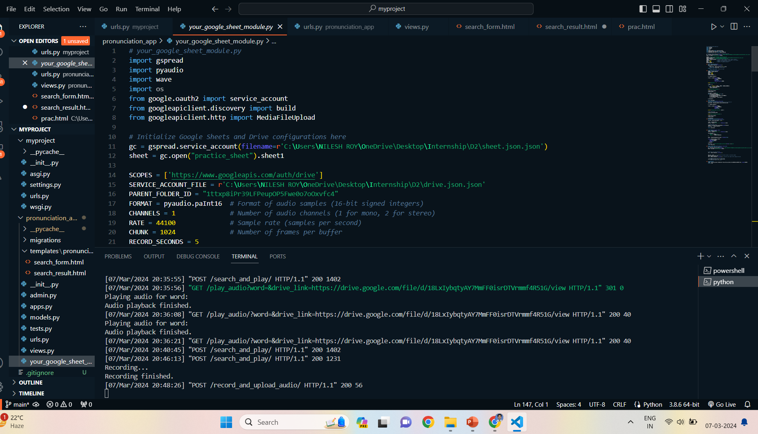
Results Cont..

Slide 11
We developed a website in which user can search a word. If word is found in database then pronunciation of word is being played and if it is not found then record the pronunciation of word and upload the audio on drive and update the sheet as well.

Slide 12
LIMITATIONS OF GOOGLE DRIVE AND GOOGLE SHEET
Google Drive provides a limited amount of free storage (typically 15 GB per user) with options to purchase additional storage.
For organizations with large storage needs, this limit can become a constraint. So, we need to think some other storage which is highly scalable and performance, capable of handling virtually unlimited amounts of data and concurrent requests.

Slide 13
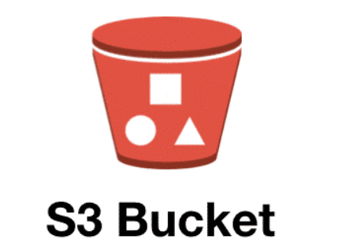
AWS BUCKET
An Amazon S3 bucket is a public cloud storage resource available in Amazon Web Services (AWS) Simple Storage Service (S3) platform.
It provides object-based storage, where data is stored inside S3 buckets in distinct units called objects instead of files.
Amazon S3 buckets are similar to file folders and can be used to store, retrieve, back up and access objects.
Each object has three main components -- the object's content or data, a unique identifier for the object and the descriptive metadata, including the object's name, URL and size.
Amazon S3 buckets have no official limit on the amount of data or number of objects that can be stored in them. However, the size limit for individual objects stored in a bucket is 5 terabytes (TB).

Slide 14
Advantage of AWS BUCKET over Google drive
Scalability : Amazon S3 is designed for high scalability and performance, capable of handling virtually unlimited amounts of data .
Durability and Availability: Amazon S3 provides 99.999999999% durability of objects stored in the service, along with multiple redundancy options to ensure data availability and resilience against failures. It also offers service-level agreements (SLAs) for durability and availability.
While Google Drive provides reliable storage for personal and small-scale use, it may not offer the same level of durability and SLA-backed availability as Amazon S3, especially for mission-critical or compliance-sensitive workloads.
Security and Compliance: Amazon S3 offers a wide range of security features, including encryption at rest and in transit, access control through AWS Identity and Access Management (IAM), bucket policies, and access logging for audit trails. It also supports compliance certifications such as HIPAA, PCI DSS, and GDPR.

Slide 15
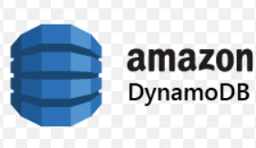
AWS DynamoDB
DynamoDB is a key-value NoSQL database that delivers single-digit millisecond performance at any scale.
We can create database tables that can store and retrieve any amount of data and serve any level of request traffic.
It's a fully managed, multi-region, multi-master, durable database with built-in security, backup and restore, and in-memory caching for internet-scale applications.
DynamoDB can handle more than 10 trillion requests per day and can support peaks of more than 20 million requests per second.
DynamoDB supports a flexible schema-less data model, allowing developers to store and query structured, semi-structured, or unstructured data without predefined schemas. This flexibility makes it suitable for a wide range of use cases, from key-value stores to document databases.

Slide 16
Why AWS DynamoDB?
Scalability and Performance: DynamoDB is designed for high scalability and performance, capable of handling large volumes of data and concurrent requests with low latency. whereas Google Sheets may struggle to handle large datasets efficiently and may not offer the same level of performance for real-time data access.
Flexible Data Model: DynamoDB offers a flexible schema-less data model, allowing you to store and query structured, semi-structured, or unstructured data without predefined schemas. whereas Google Sheets follows a tabular structure, which may not be as flexible for storing different types of data or evolving schemas.
Security and Compliance: DynamoDB offers robust security features, including encryption at rest and in transit, access control through AWS Identity and Access Management (IAM). It also supports compliance certifications such as HIPAA, PCI DSS, and GDPR. While Google Sheets provides basic sharing and permission settings, it may not offer the same level of granular control and security features as DynamoDB

Slide 17
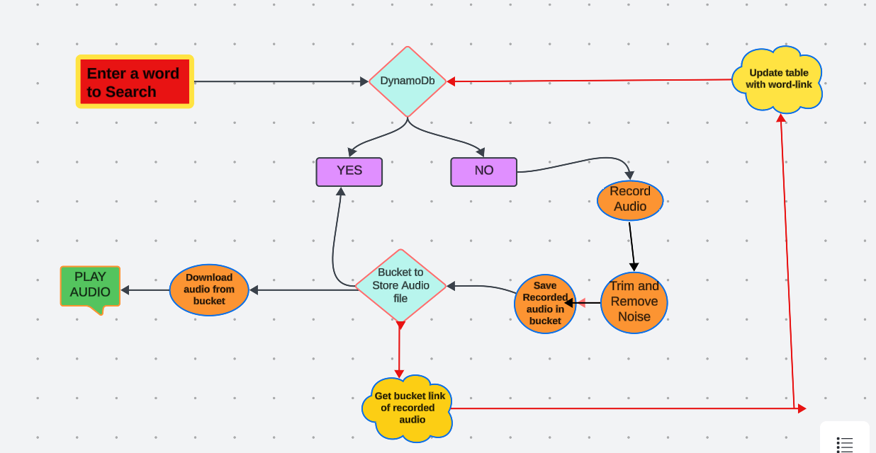
PROPOSED MODEL

Slide 18
METHODOLOGY
1.Create a AWS Bucket(aizel-pronunciation-bucket ) and word-link table in DynamoDB
2. Searching a word in website
User will search a word in website
3. If word is Present in Database(DynamoDB)
(i) Downloading Audio from bucket with help of word link from DynamoDB
(ii) Playing Audio
4. If word is NOT present in Database(DynamoDB)
(i)Record the audio
(ii)Trim and Remove the noise from recorded audio
(ii) Saving the audio on AWS BUCKET
(iii) Update the DynamoDB with name of word and link of the audio

Slide 19
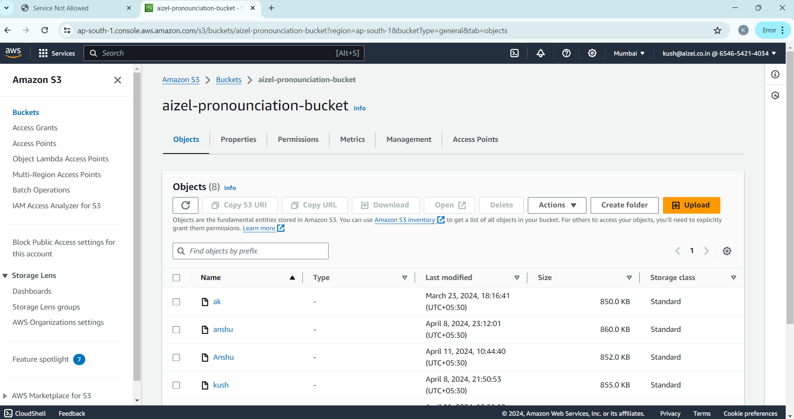
RESULT

Slide 20
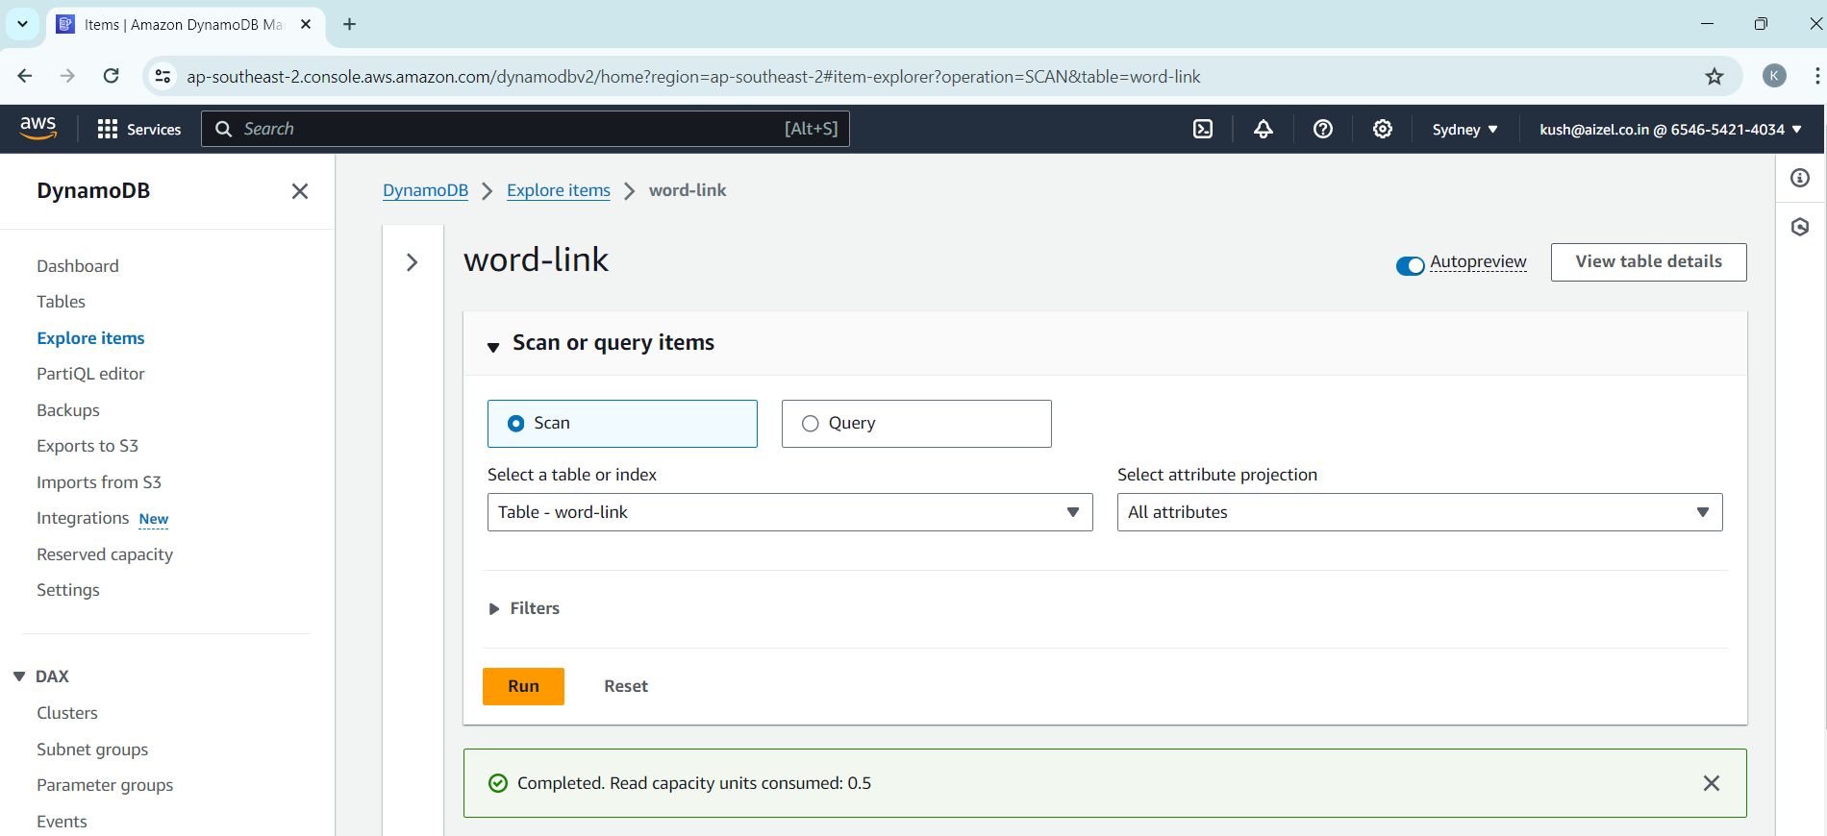
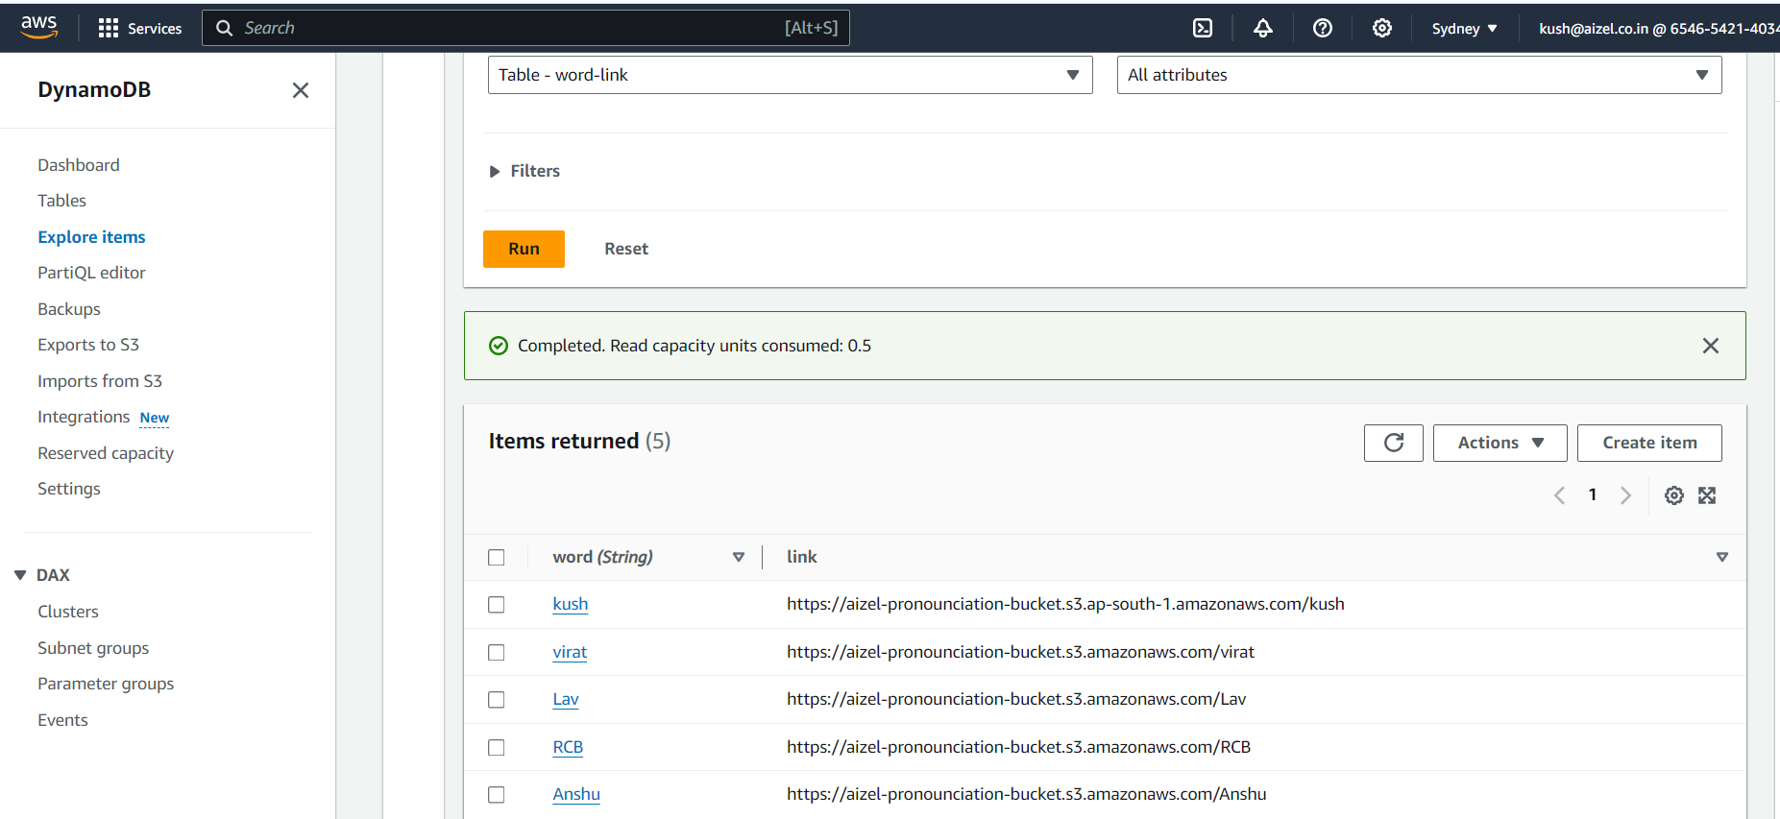
RESULT Cont..

Slide 21
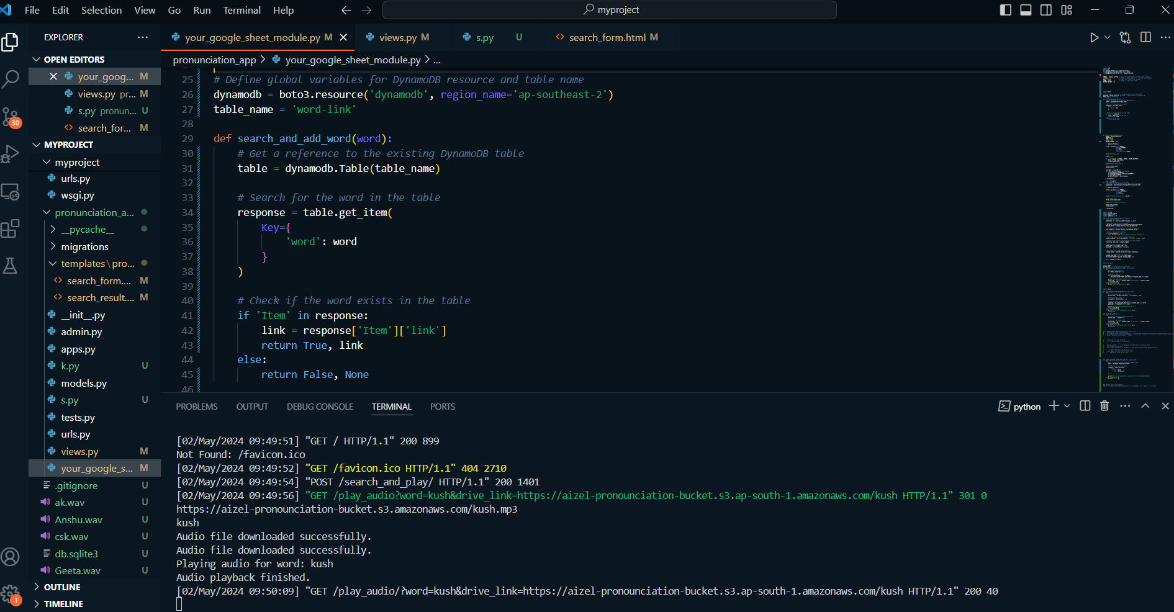
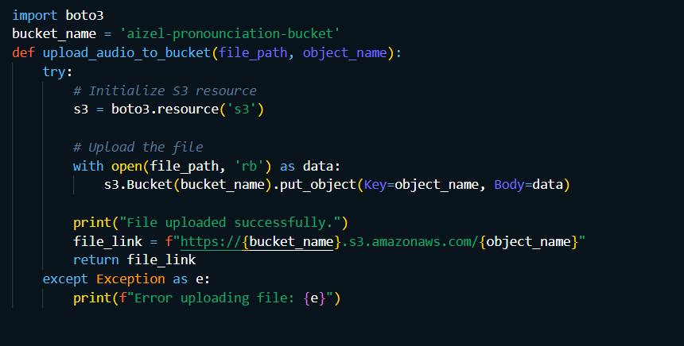
RESULT Cont..

Slide 22
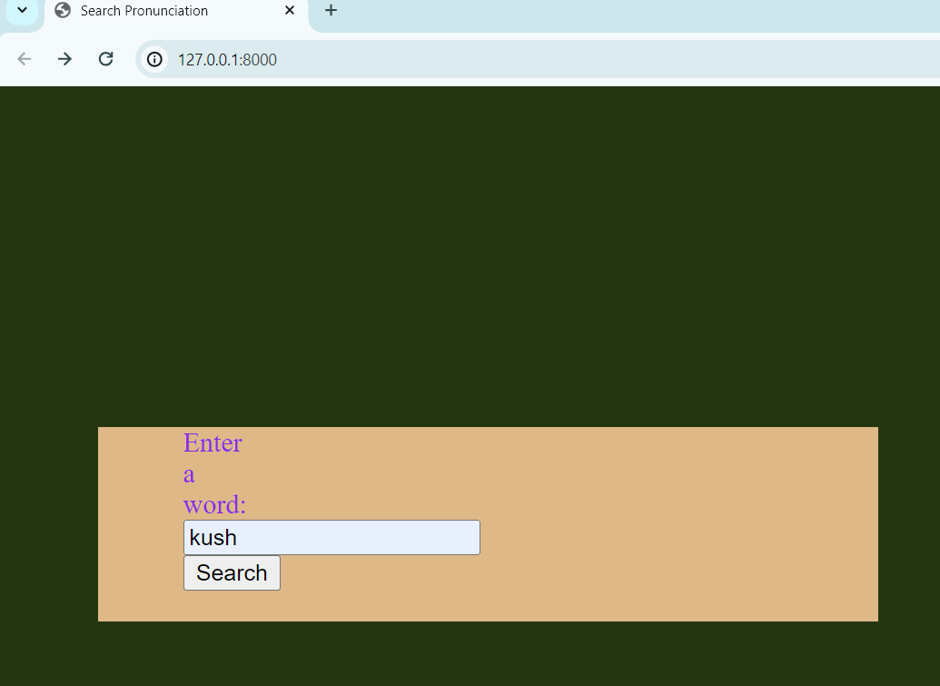
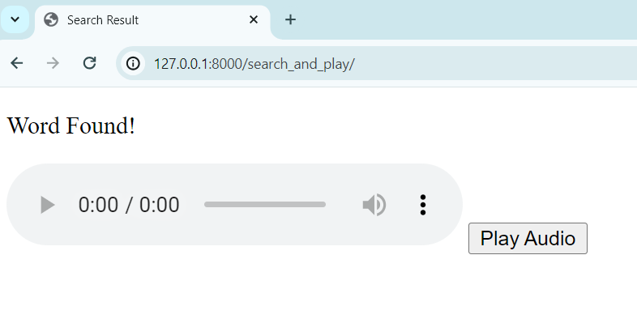
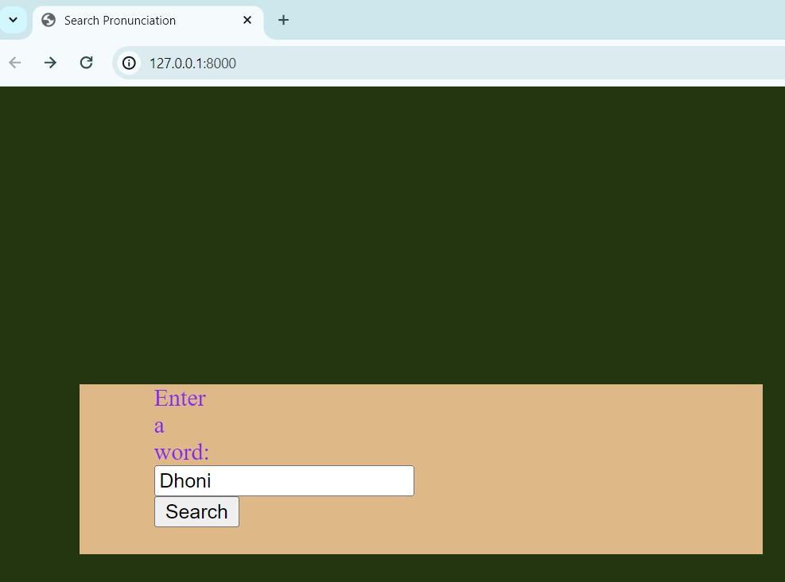
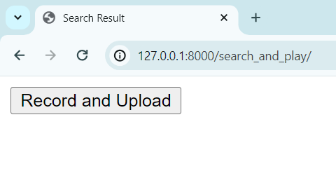
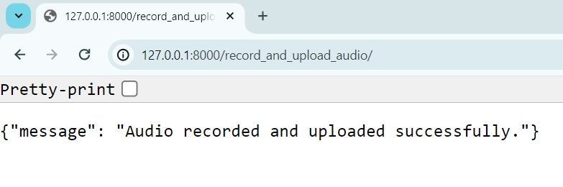
RESULT Cont..

Slide 23
CONCLUSION
We developed a website in which user can search a word. If word is found in database then pronunciation of word is being played and if it is not found then record the pronunciation of word and upload the audio on drive and update the sheet as well.
It is scalable for high volume of data and more secured as compared to Google sheet and drive database.
This database of word to audio can be used in Translation website (I.e. Translation from Hindi to English or English to Hindi Efficiently and virtual teacher assistant.

Slide 24
Future Work-
The idea is to make a voice assistant that can understand native Hindi language and English and help users in the field of education, ultimately acting as a virtual assistant teacher for students

Slide 25
Refrences
Forums like Stack Overflow or communities related to Python, AWS, or Google Cloud Platform.
Google APIs Documentation:
Google Sheets API: Documentation for integrating with Google Sheets to update data.
Google Drive API: Documentation for managing files and folders in Google Drive.
AWS Documentation:
Amazon S3: Documentation for storing and retrieving files from Amazon S3.
Amazon DynamoDB: Documentation for NoSQL database operations using DynamoDB.

Slide 26
Thank you

