Slide 1
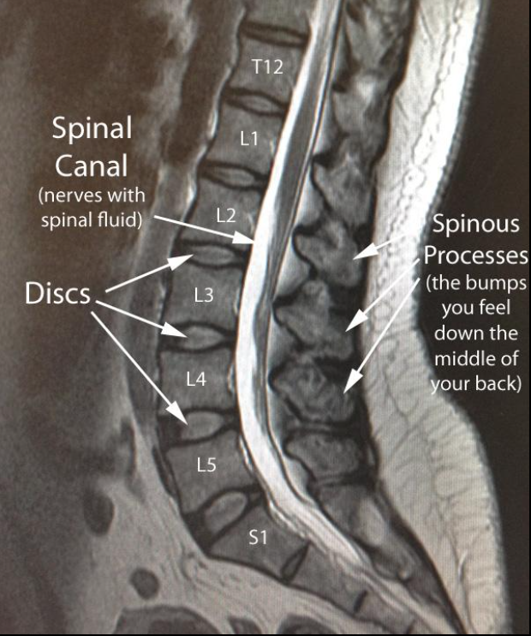

Slide 2
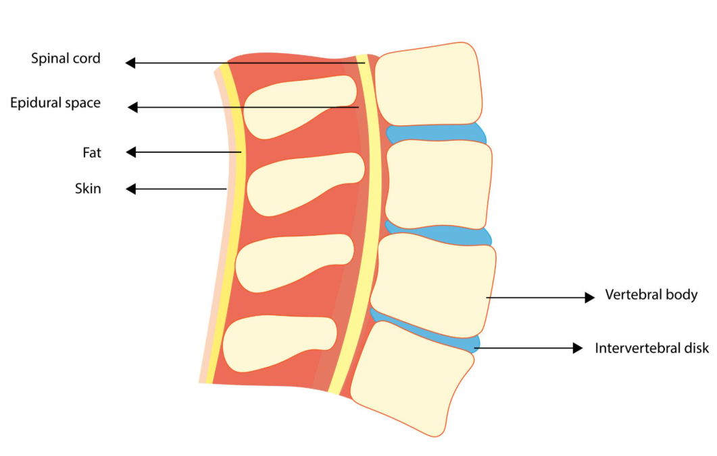

Slide 3
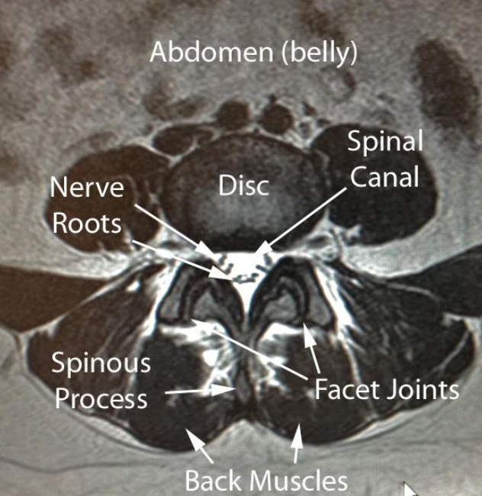
Axial view

Slide 4
How MRI Works (Intuition first)
The idea
Your body is full of hydrogen (water & fat). In a strong magnetic field:
Alignment – hydrogen nuclei line up with the magnet
Excitation – a radio pulse “tips” them out of alignment
Relaxation – they return to equilibrium and emit signals
Detection – the scanner measures those signals and forms an image
Two key “return-to-normal” processes create contrast:
T1 relaxation (longitudinal recovery)
T2 relaxation (transverse decay)
Different tissues (fat, water, edema, CSF) relax at different rates → different brightness on images.

Slide 5
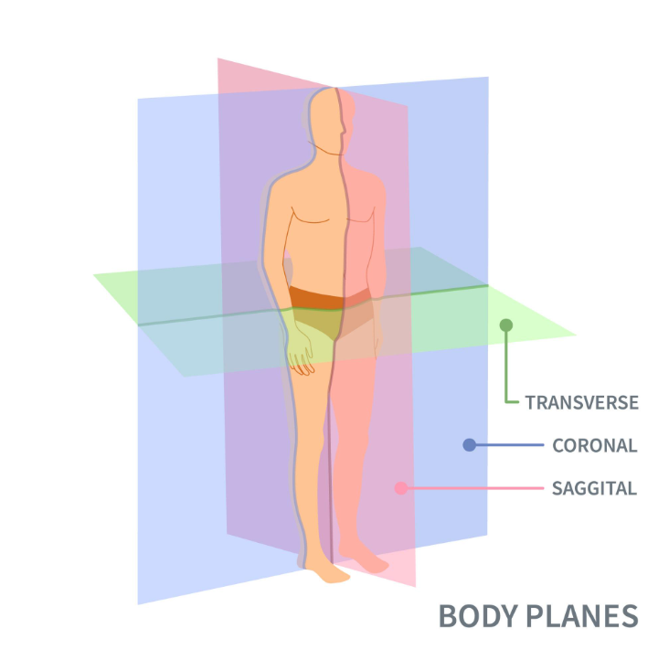
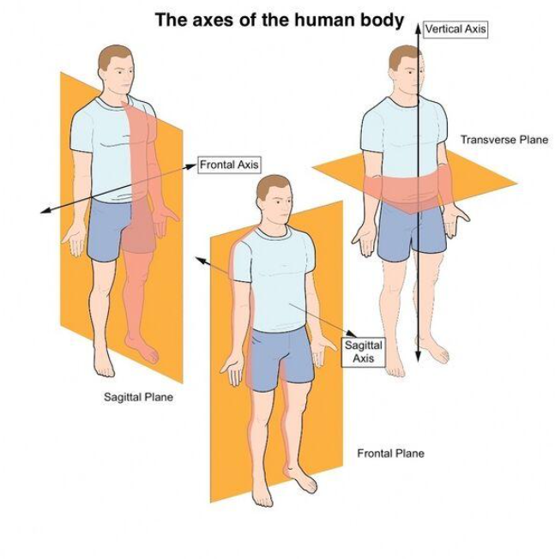
Axis and planes of human body

Slide 6
Sagittal (side view)
Axial (top down view)
Cross section slices
Best for:
Spinal Canal
Nerve roots
Compression
Cuts body into left and right
Best for spine alignment, discs, vertebral bodies

Slide 7
