Slide 1

Credit Card Fraud Detection

Slide 2
Introduction

Slide 3
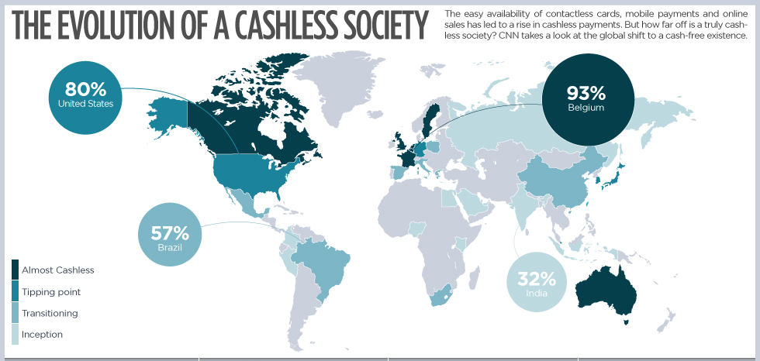

Slide 4
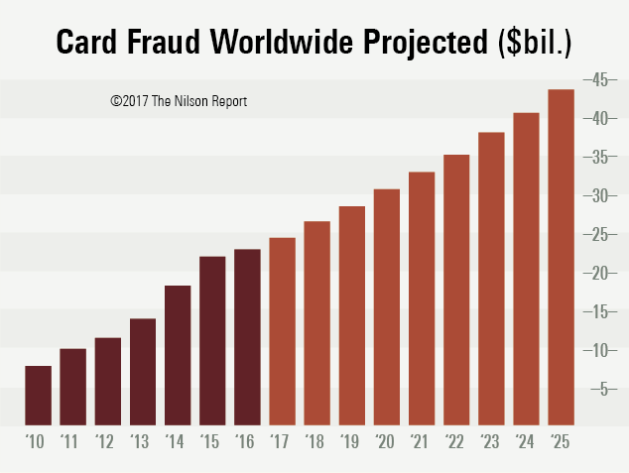
Digital Economy -> More Frauds

Slide 5

Problem Statement
Credit Card Companies should be able to recognize fraudulent credit card transactions so that customers are not charged for items that they did not purchase.

Slide 6
About the Data

Slide 7
Description
Transactions made by credit cards in September 2013 by European cardholders in two days.
There were 492 frauds out of 284,807 transactions.
Contains only numerical input variables (V1 – V28) which are the result of a PCA transformation, the only features which have not been transformed with PCA are 'Time' and 'Amount'. Due to confidentiality issues, original features and more background information about the data are not provided.

Slide 8
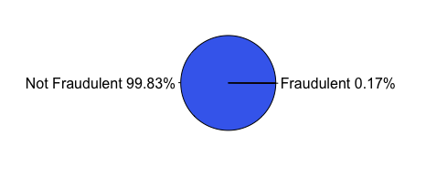
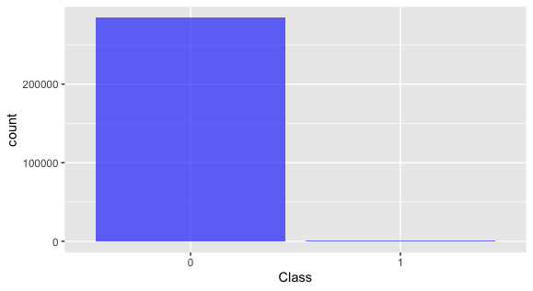
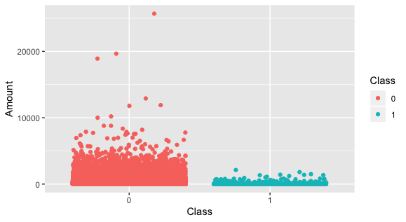
Class Distributions

Slide 9
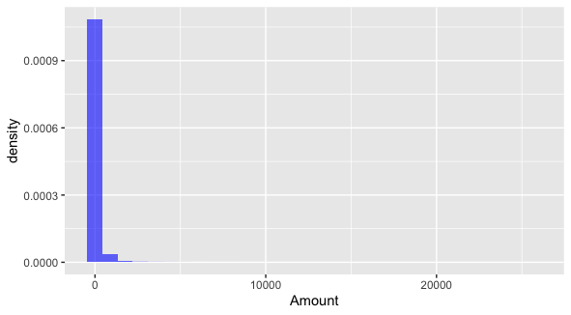
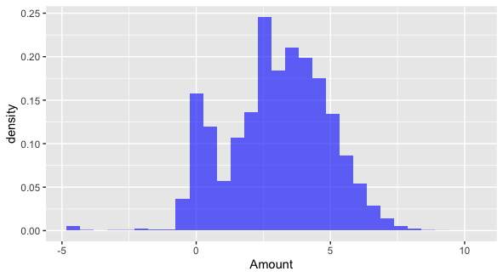
Data Transformation
Log Transformation -> Normal Curve

Slide 10
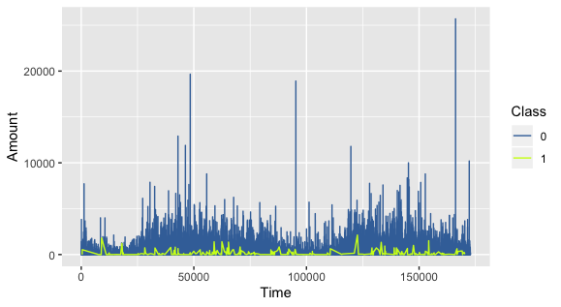
Relationship with time

Slide 11
Why is balancing necessary?
Imbalanced data can be a serious problem for building predictive models, as it can affect our prediction capabilities and mask the fact that our model is not doing so good.
Machine learning algorithms tend to favor the class with the largest proportion of observations (known as majority class), which may lead to misleading accuracies. Particularly problematic when we are interested in the correct classification of a “rare” class (also known as minority class) but we find high accuracies which are actually the product of the correct classification of the majority class (ie, are the reflection of the underlying class distribution).

Slide 12
Methodology I - Undersampling

Slide 13
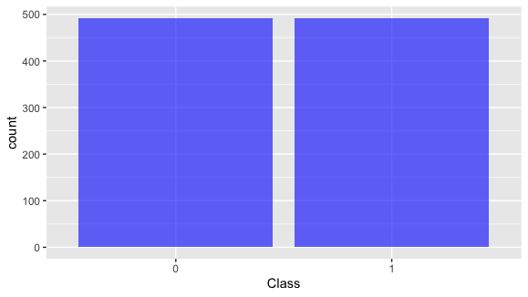
Class Distributions
Selecting 492 random observations from non-fraudulent and creating a new dataset with 492 fraudulent ones.

Slide 14
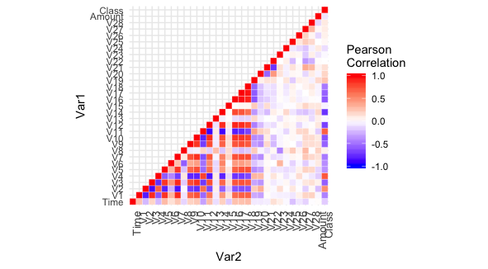
Correlation with Class
Variables V2, V4, V11 - high positive correlation
Variables V14, V12, V10 - high negative correlation

Slide 15
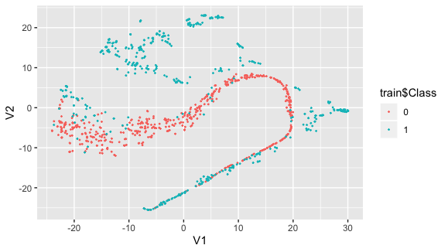
t-SNE

Slide 16
Modeling

Slide 17
Models used
Logistic Regression
K- Nearest Neighbor
Decision Tree Classifier

Slide 18
Model Comparison
Model | Accuracy | Precision | Recall | F1 Score
Logistic Regression | 90.03% | 91.87% | 96.58% | 94.17%
KNN | 94.31% | 95.12% | 72.67% | 82.39%
Decision Trees | 93.09% | 92.94% | 91.05% | 92.94%

Slide 19
Methodology II - Oversampling

Slide 20

Class Distributions
1:1 balance between both classes. Total of 1968 observations.

Slide 21
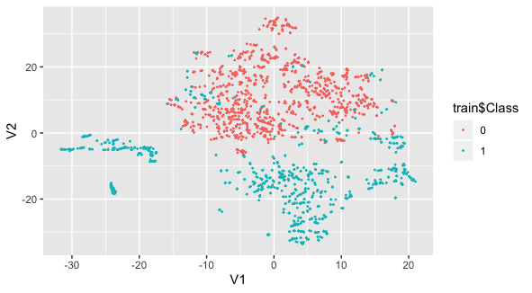
t-SNE
Clearer Clusters - Gives us an indication that further predictive models will perform well in separating fraud cases from non-fraud cases.

Slide 22
Modeling

Slide 23
Model Comparison
Model | Accuracy | Precision | Recall | F1 Score
Logistic Regression | 96.44% | 97.50% | 95.33% | 96.40%
KNN | 100.00% | 95.12% | 82.39% | 72.67%
Decision Trees | 94.05% | 92.98% | 95.02% | 93.99%

Slide 24

Why Recall is the most important metric?
$$Recall= \frac{True Positive}{True Positive+False Negative}$$
Recall calculates how many of the Actual Positives our model capture through labeling it as Positive (True Positive). Recall is the model metric used to select our best model when there is a high cost associated with False Negative. If a fraudulent transaction (Actual Positive) is predicted as non-fraudulent (Predicted Negative), cause for heavy loss.

Slide 25
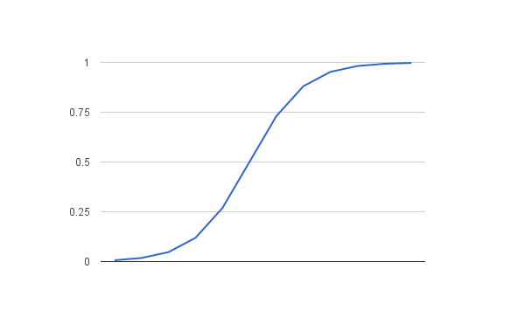
Model Selected – Logistic Regression (SMOTE)

Slide 26
Limitations
SMOTE (Synthetic Minority Over-sampling Technique) can cause over-fitting
Under-sampling can cause loss of important information

Slide 27
Thank you!

