Slide 1
JanSunwai AI
AI-Powered Civic Grievance Resolution Platform
"Your Voice Matters. We Make It Heard."
TEAM NAME
PROBLEM STATEMENT
TEAM LEADER
JanSunwai AI
AI Civic Grievance Resolution
[Your Name]
AWS AI for Bharat Hackathon 2025

Slide 2
Brief About the Idea
2.8 Cr
Pending civic grievances across India
JanSunwai AI is an end-to-end, AI-powered civic grievance resolution platform for Indian citizens.
It transforms the broken complaint redressal system by combining multimodal complaint filing (web form + Hindi voice agent), AI-driven classification & routing, automated 5-level escalation, and public transparency dashboards.
A citizen in rural India can call and speak in Hindi to file a complaint — no forms, no literacy barrier. AI automatically classifies the issue, scores severity, detects duplicates, routes it to the right department, and generates legal rights awareness for the citizen.
Built for scale: 10+ Indian languages, PostGIS ward-level routing, and an hourly auto-escalation cron that ensures every single complaint reaches resolution.
45 Days
Average resolution time for complaints
67%
Citizens unaware of their legal rights
Voice-First
AI Classification
Auto-Escalation
Public Dashboards
Legal Awareness
Hindi/English voice complaint filing
Gemini-powered category + severity
5-level SLA-enforced escalation ladder
Ward-level heatmaps & scorecards
12+
AI-generated rights & RTI support
Departments with zero communication

Slide 3
How is it Different? How Does it Solve the Problem?
Aspect
Existing Systems
JanSunwai AI
Filing Method
Web forms only
Voice Agent (Hindi) + Web Form + 10 Languages
Classification
Manual / keyword-based
AI-powered (Gemini 2.0 Flash + Vision)
Routing
Manual department assignment
Auto-route to dept + ward officer (PostGIS)
Escalation
None / manual follow-up
5-level auto-escalation with SLA tracking
Transparency
Opaque — no public data
Public heatmaps + ward scorecards
Legal Rights
None
AI-generated legal summaries per category
Duplicates
None
Semantic + geographic community clustering
Accessibility
Requires literacy + internet
Voice-first — works for low-literacy citizens
USP
The only platform that combines AI voice filing in Indian languages, automated severity-based escalation, and public ward-level accountability dashboards — making civic grievance resolution accessible, intelligent, and transparent.

Slide 4
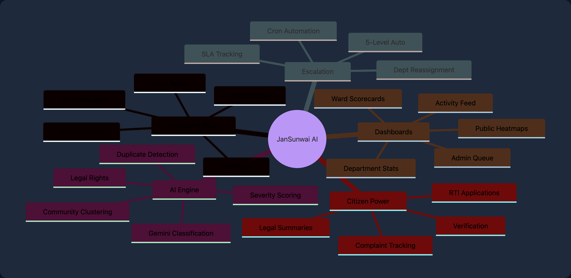
Key Features
Multi-Modal Filing
Web wizard + Hindi voice agent + photo upload
AI Intelligence Engine
Gemini classification, vision, severity scoring
Smart Routing
Auto-assign to dept + ward officer via PostGIS
5-Level Escalation
Auto-escalate to Commissioner if SLA breached
Public Dashboards
Ward heatmaps, category stats, scorecards
Admin Portal
Role-based queue, timelines, manual controls
Legal Awareness
AI-generated rights summaries + RTI drafting
Citizen Verification
SMS/WhatsApp verify + satisfaction scoring

Slide 5
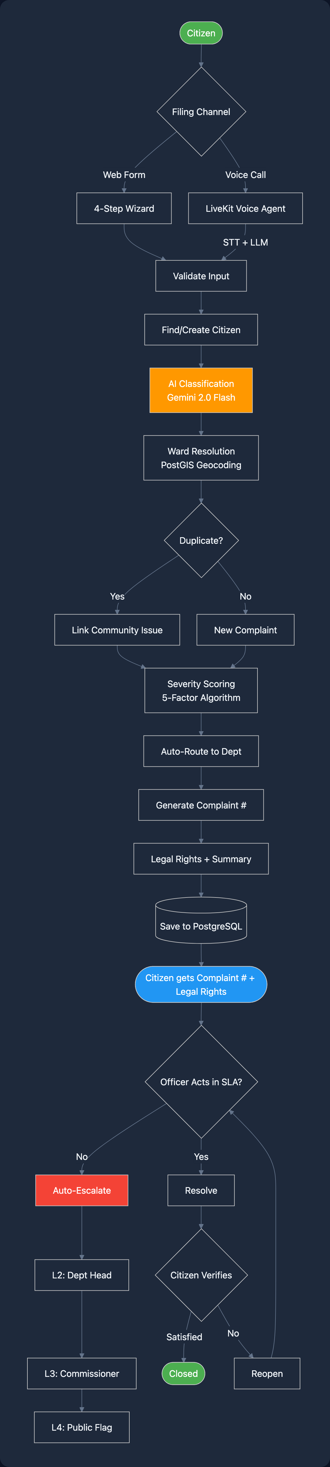
Process Flow — Grievance Lifecycle
1
Citizen files via Web or Voice
12 Categories
2
AI classifies + scores severity
water, roads, electricity...
3
PostGIS resolves ward
0-100 Score
4
Duplicate detection + clustering
5-factor severity algorithm
5
Auto-route to department
6
5 Levels
Generate complaint # + legal rights
Ward Officer → Commissioner
7
Officer acts within SLA
8
Auto-escalate if breached
10+ Languages
9
Citizen verifies resolution
Hindi-first, multilingual

Slide 6
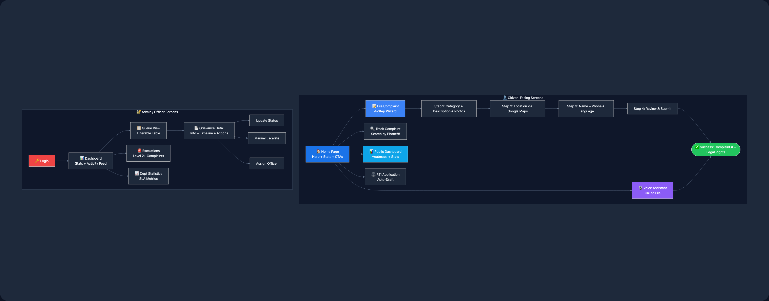
Wireframes & Screen Flow
Home Page
File Complaint
Voice Assistant
Public Dashboard
Track Complaint
Admin Queue
Grievance Detail
Hero, live stats counter, 3 CTAs, feature cards, language selector
4-step wizard: category grid, photo dropzone, map, review
Mic button, connection status, live transcript, call timer
Google Maps heatmap, filter chips, stats bar, ward scorecards
Search by phone/#, status card, timeline, legal rights
Filterable table, severity badges, SLA countdown, pagination
Split: complaint + photos | timeline + actions

Slide 7
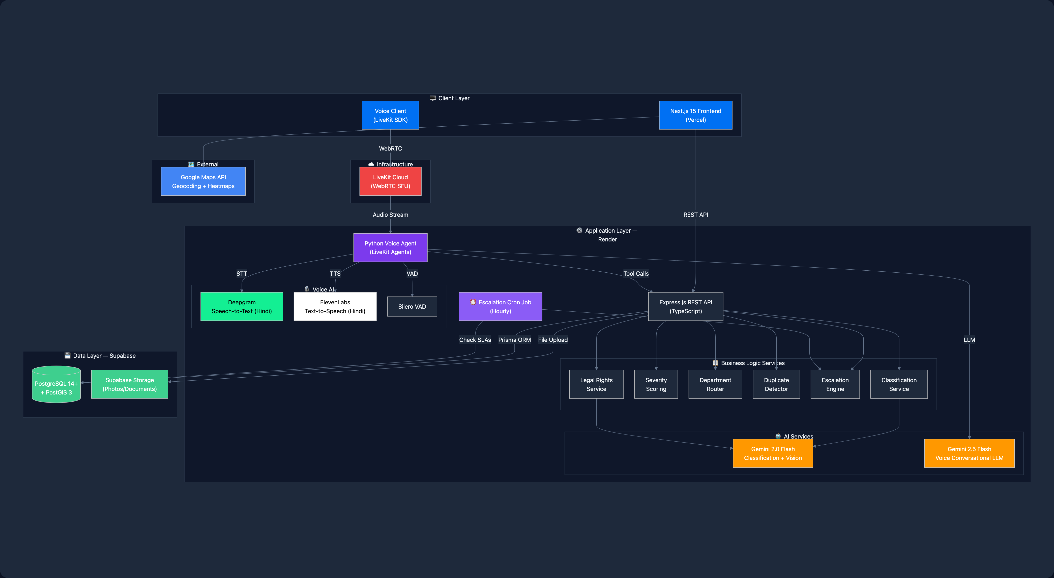
System Architecture

Slide 8
Technologies Used
Frontend
Backend
AI / ML
Voice Agent
Infrastructure
Next.js 15 (App Router)
Express.js
Gemini 2.0 Flash
LiveKit Agents (Python)
Vercel (Frontend)
React 19
Prisma ORM
Gemini Vision (Photos)
Deepgram STT (Hindi)
Render (API + Agent)
Tailwind CSS 4
PostgreSQL 14+
Gemini 2.5 Flash (Voice)
ElevenLabs TTS (Hindi)
Supabase (DB + Storage)
TypeScript
PostGIS 3
5-Factor Severity Algo
Silero VAD
LiveKit Cloud (WebRTC)
LiveKit Client SDK
Zod Validation
Semantic Deduplication
Multilingual Turn Detection
npm Workspaces (Monorepo)
Google Maps JS API
Node-Cron
Legal Rights Generation
NextAuth.js
Helmet + CORS
AWS Services Mapping
Gemini → Amazon Bedrock
Deepgram → Amazon Transcribe
ElevenLabs → Amazon Polly
Supabase DB → Amazon RDS
Supabase Storage → Amazon S3
Vercel → AWS Amplify
Render → App Runner / ECS
LiveKit → Amazon Chime SDK

Slide 9
Estimated Implementation Cost (AWS)
AWS Service
Usage Estimate
Cost / Month
Scaling Projections
Amazon Bedrock (AI)
~50K classifications/mo
$150 - $300
Pilot (1 City)
Amazon Transcribe (STT)
~500 hrs audio/mo
$120
10K users · 5K complaints
Amazon Polly (TTS)
~2M characters/mo
$8
~$500/mo
Amazon RDS + PostGIS
db.t3.medium, 100GB
$70
Amazon S3 (Storage)
50GB + transfers
$5
Regional (1 State)
AWS Amplify (Frontend)
Standard hosting
$15
100K users · 50K complaints
AWS App Runner (API)
2 vCPU, 4GB RAM
$50
~$2,500/mo
Amazon Chime SDK (Voice)
~10K minutes/mo
$30
Amazon Location Service
~100K geocoding requests
$50
National (Pan-India)
EventBridge + CloudWatch
Cron + monitoring
$11
1M+ users · 500K+ complaints
TOTAL ESTIMATED (Pilot — 1 City)
$509 - $659/mo
~$15,000/mo
Cost Optimization
Bedrock batch inference
S3 Intelligent Tiering
RDS Reserved Instances (40% off)
Lambda for cron (pay-per-use)

Slide 10
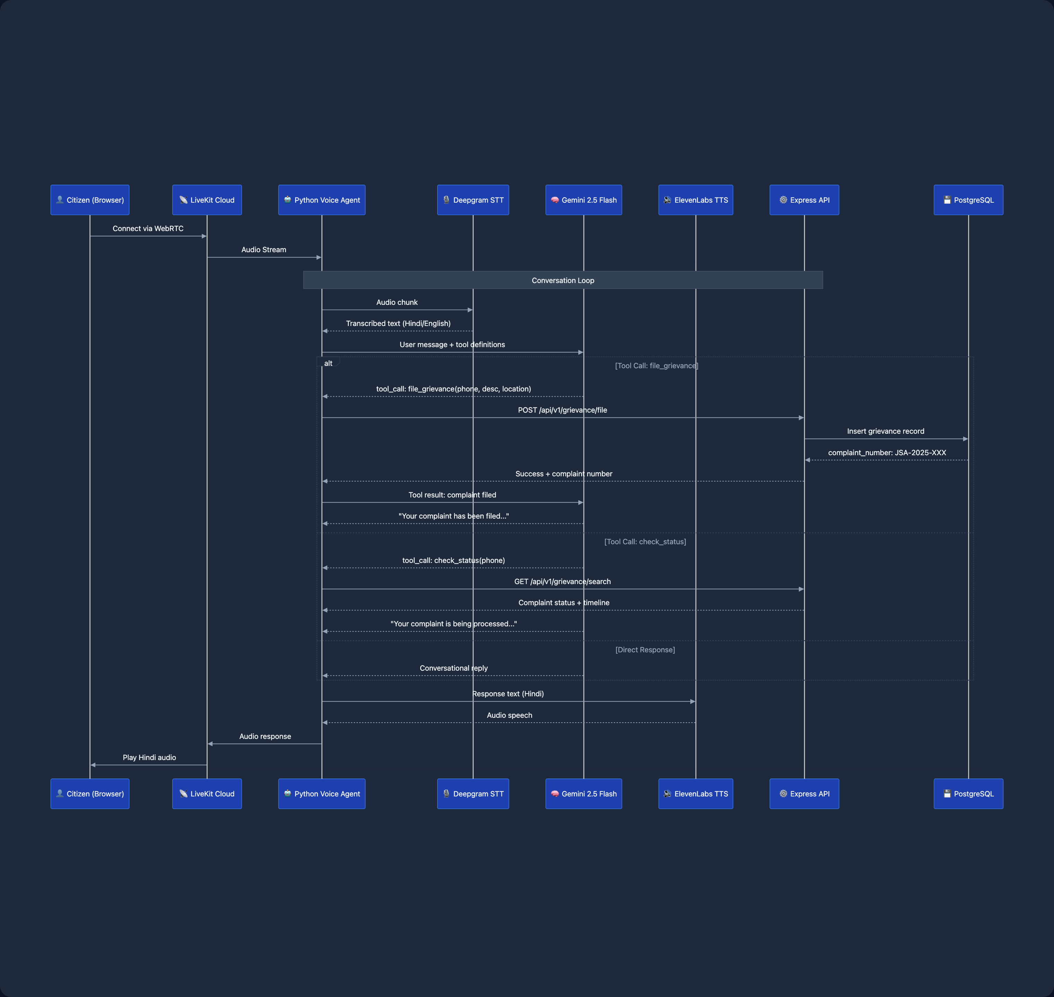
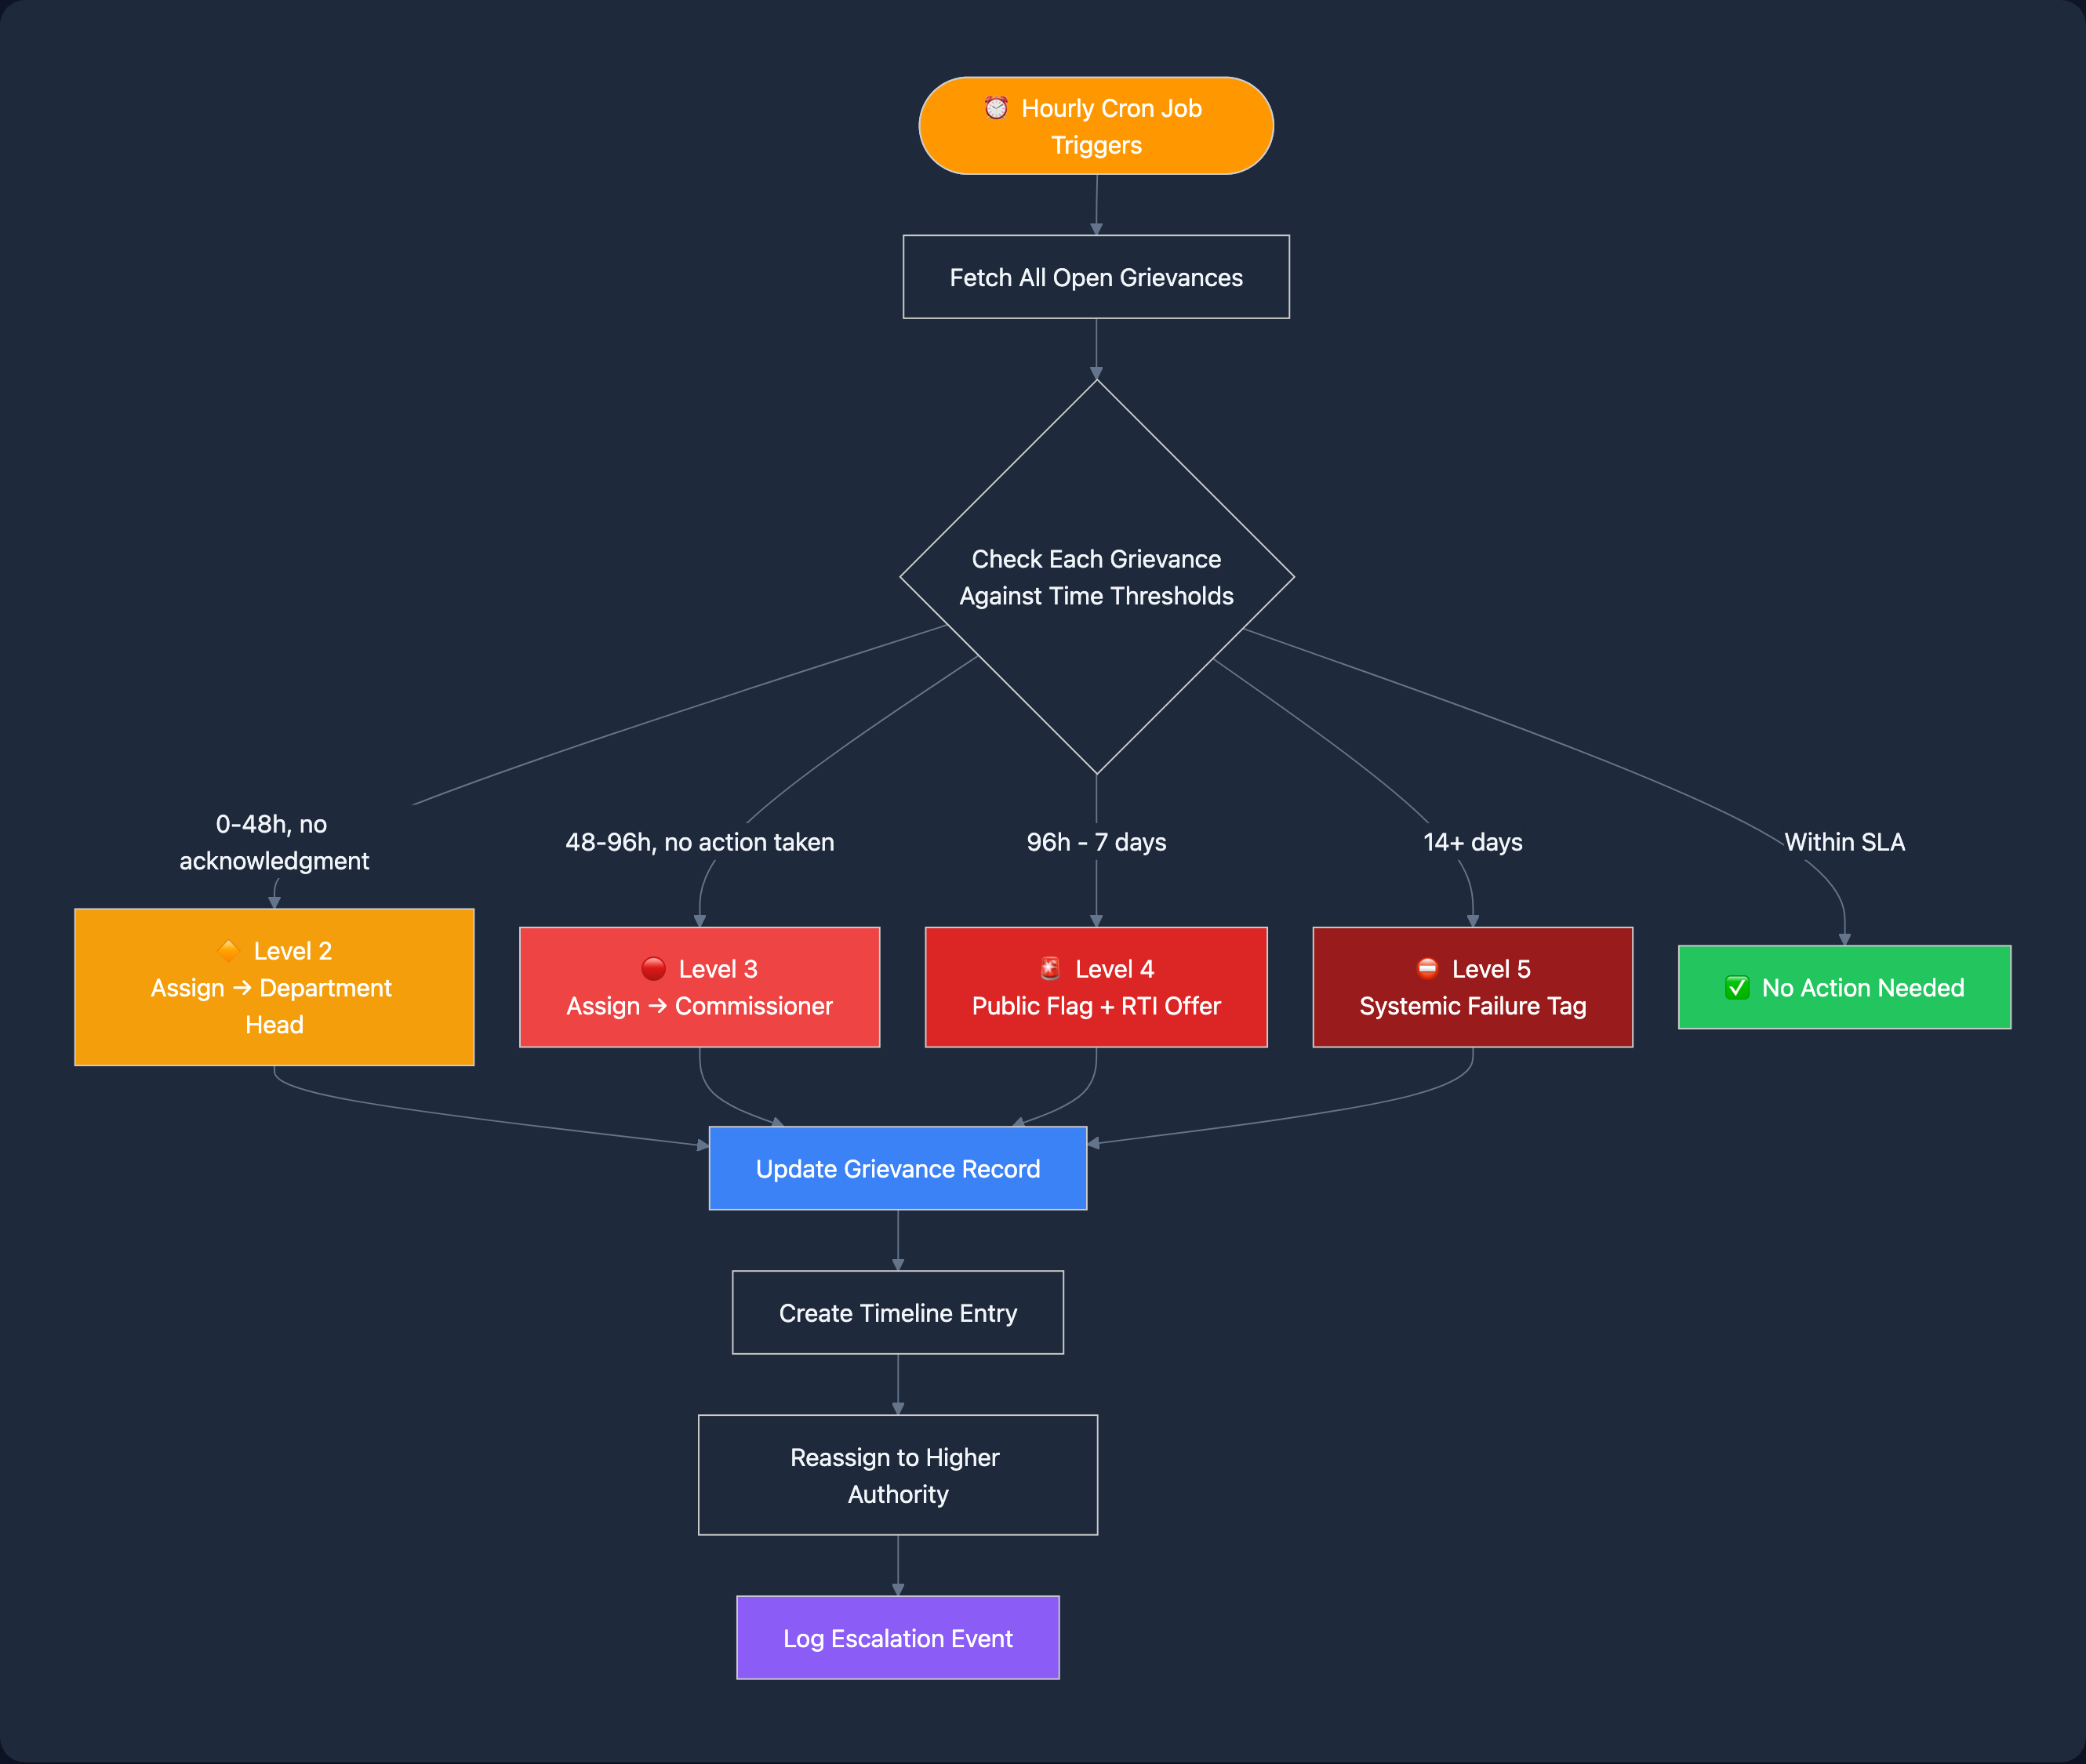
Deep Dive: Voice Agent & Escalation Engine
Voice Agent — Sequence Diagram
Auto-Escalation Engine

Slide 11
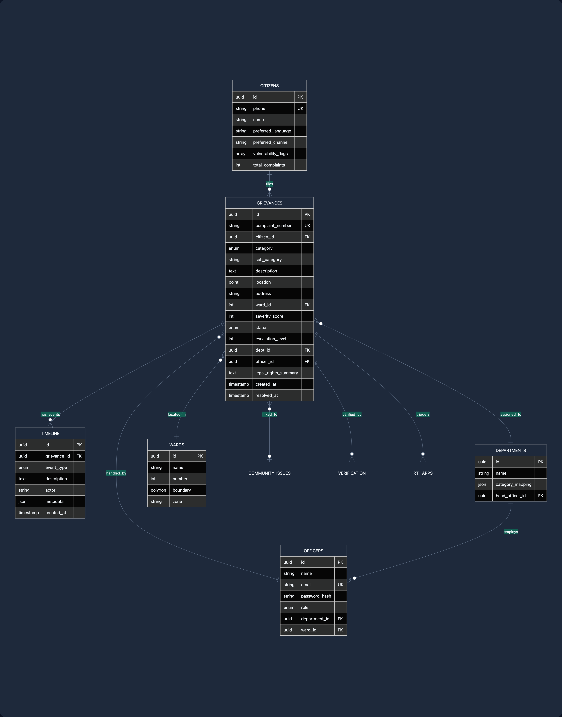
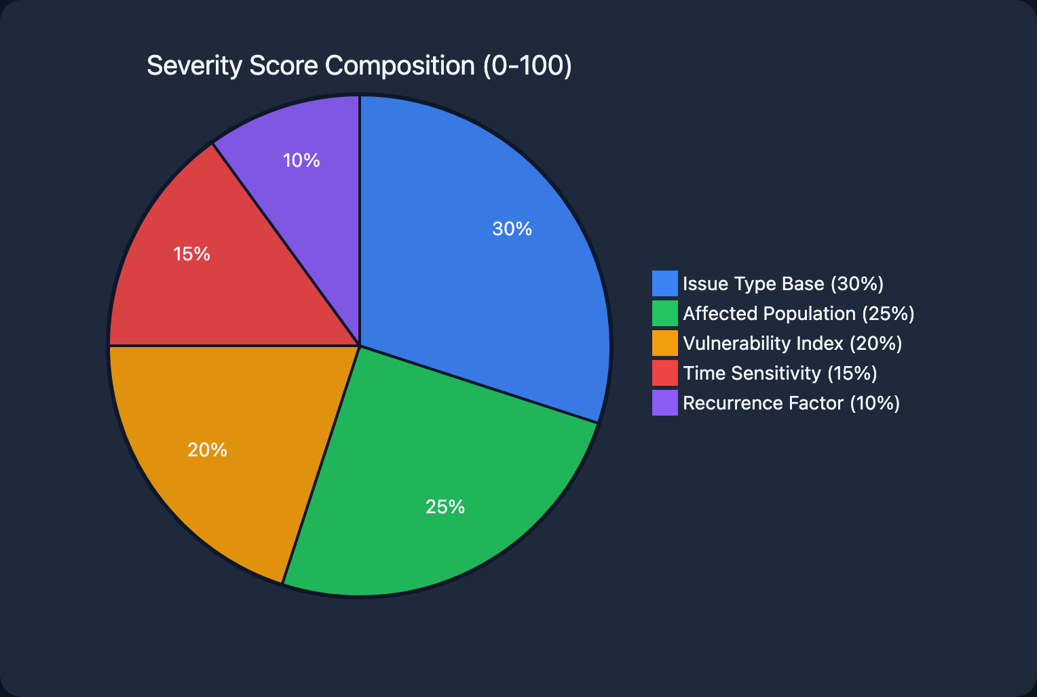
Database Schema & Severity Scoring
Entity Relationship Diagram
Severity Score Algorithm (0-100)
Issue Type Base
30%
Affected Population
25%
Vulnerability Index
20%
Water, sewage, roads get higher base scores
Community issues and duplicate count
Elderly, disabled, BPL, pregnant
Time Sensitivity
15%
Recurrence
10%
Seasonal urgency and health risks
Same issue reported multiple times

Slide 12
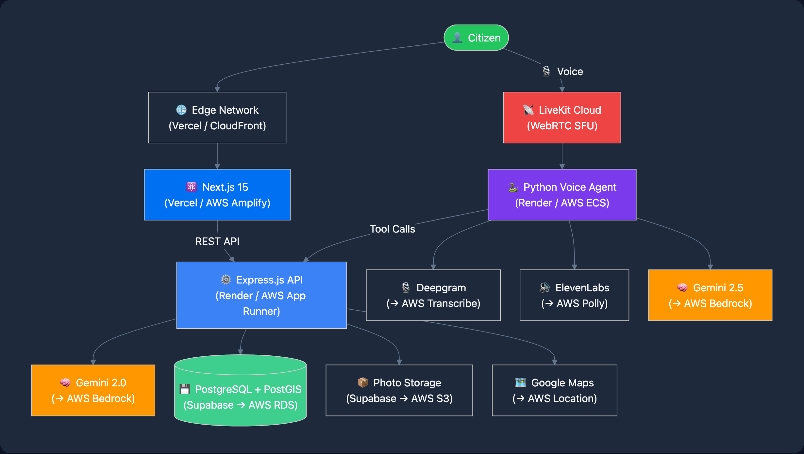
Impact Metrics & Deployment
Projected Impact
Deployment Architecture
Resolution Time
45 days → 7-14 days
Citizen Awareness
67% unaware → 90%+ informed
Misrouted Complaints
~40% → <5%
Duplicate Complaints
~30% → <10%
Dept Accountability
Near zero → 100% tracked
Low-Literacy Access
Excluded → Fully included
Government Alignment
Digital India
CPGRAMS
Smart Cities Mission
RTI Act 2005
Article 21

Slide 13
JanSunwai AI
"Your Voice Matters. We Make It Heard."
An AI-powered platform transforming how 1.4 billion Indians resolve civic grievances — making government accountable, citizens empowered, and cities smarter.
Next.js 15
Express.js
Gemini AI
LiveKit
PostGIS
AWS-Ready
Thank You! | AWS AI for Bharat Hackathon

