Slide 1

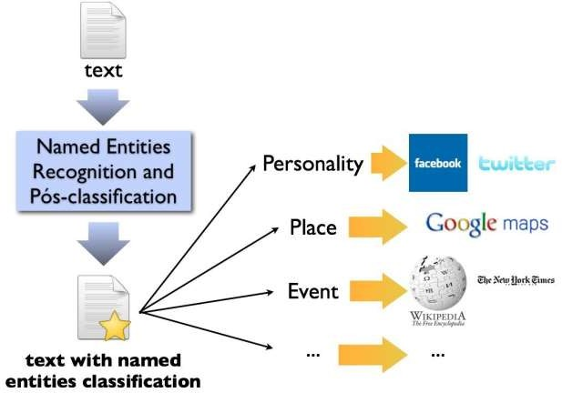

An Automated Named Entity Recognition System from Text
INTRODUCTION
INTRODUCTION
Usage areas of NER can be classified under these categories:
Usage areas of NER can be classified under these categories:
Usage areas of NER can be classified under these categories:
Anshu Kumar | Prof. Anupam Mondal | Institute of Engineering & Management
INTRODUCTION
FEATURES OF NER
What is NER?
A named entity recognition (NER) tool is a program which seeks to locate and classify named entities in text into pre-defined categories such as:
  Person
  Location
  Expression of Time
  Monetary Value
  Organization
LIST LOOK UP FEATURES
  General Dictionary
  Words that are of Typical Organization Names
  On the List Look Up Techniques
WORD LEVEL FEATURES
  Digit Pattern
  Common Word Ending
  Functions Over Words
  Patterns
DOCUMENT AND CORPUS FEATURES
  Multiple Occurrences and Multiple Casing
  Document Meta – Information
  Statistics For Multiword Units
OBJECTIVE
NER is an important task for future processes intended to extract a syntactic and semantic representation of a text.
Where to use?
Usage areas of NER canbe classified under these categories:
Machine Translation
Question Answering
Sentiment Analysis
* Main goal of the project is to be the state-of-the-art in Automated NER without any language dependent feature.
TYPES OF NAMED ENTITIES
  GENERIC NE:
Includes names of persons , organizations,
etc.
For Example, any general requirement consisting of names of persons, organization
, URLs, Location and so on.
DOMAIN SPECIFIC NE: Consists of entities related to domains For example,
In a medical domain, names of diseases , names of medicines form the entities whereas
In a manufacturing domain names of products , manufacturers , attributes of products form the named entities.
DATASET
APPLICATION OF NER
{"document":"Jim went to Stanford University, Tom went to the University of Washington.
They both work for Microsoft."}
INFORMATION EXRACTION
PARSING AND MACHINE TRANSLATION
METHOD
PROVIDES QUICK OPERATION
USED IN BIO-MEDICAL SECTORS
SENTENCE SLPITTER
PART OF SPEECH TAGGER
PRIMARILY USED FOR GENRALS AND ARTICLES
TOKENIZER
NOW EXTENDED TO WEB BLOGS, TWITTER,FACEBOOK ETC.
FUTURE SCOPE
ORTHO- MATCHER
SEMANTIC TAGGER
GAZETTEER
AUTOMATIC RETRIEVAL OF DATA
RETRIEVAL OF RELEVANT DATA FROM THE WEB
OPTIMIZE CRF AS IT HAS THE ENTROPHY OVERHEAD
REFERENCES
PAPERS
NAMED ENTITY RECOGNITION TECHNIQUES FOR ENGLISH LANGUAGE
MACHINE LEARNING TECHNIQUES FOR NAMED ENTITY RECOGNITION
PDFs
SURVEY ON TECHNIQUES OF NAMED ENITY RECOGNITION LITERATURE SURVEY ON NAMED ENTITY RECOGNITION EVALUATION OF EXISTING SYSTEMS OF NER
URLs
https://pythonprogramming.net/named-entity-recognition-nltk-python/ http://www.albertauyeung.com/post/python-sequence-labelling-with-crf/ https://www.crummy.com/software/BeautifulSoup/bs4/doc/

