Slide 1

An Automated Named Entity Recognition System from Text
Presented by
Anshu Kumar
Enrollment no: 12017002002022
Under the Supervision of
PROF. ANUPAM MONDAL
Department of Computer Science & Engineering
Institute of Engineering & Management
West Bengal, India
2020-21

Slide 2
TABLE OF CONTENTS
What is NER?
NER I/P and O/P
TYPES OF NE
INTRODUCTION
LITERATURE SURVEY CRF ALGORITHM LIMITATIONS FUTURE SCOPE CONCLUSION REFERENCES
REQUIREMENTS
TECHNIQUES
EXPLANTION
MATHEMATICAL MODEL
ADVANTAGES and DISADVANTAGES

Slide 3


Slide 4
BACKGROUND OF NER
OBJECTIVES
OUTCOMES
PROBLEM

Slide 5

WHAT IS NER?
Sub-domain under NLP (Natural Language Processing)
A part of IE (Information Extraction)
Automatic identification and counting of occurrences of named entities in a collection of information.
Associating the named entities to their
appropriate types

Slide 6
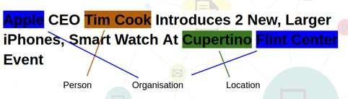
BUT WHAT BASICALLY IS A NAMED ENTITY?
Word or Phrase that identifies one item from a set of items that have similar attributes
Semantic elements that carry a meaning
Named Entities with their labels are recognized as follows:
ENAMEX : Person(Tim Cook) , Organization (Apple , Flint Center), Location(Cupertino)
TIMEX : Date , Time
NUMEX : Money , Percentage , Quantity
o Named Entities are either dependent on the Proper Names tagging or on the Part Of Speech (POS ) tagging.

Slide 7

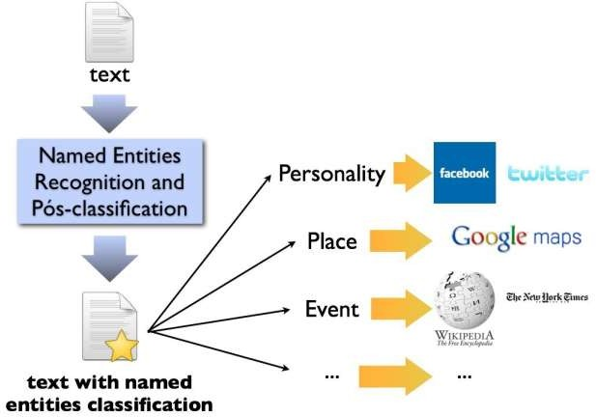
TYPES OF NAMED ENTITIES
GENERIC NE:
Includes names of persons , organizations,
etc.
For Example, any general requirement consisting of names of persons, organization
, URLs, Location and so on.
DOMAIN SPECIFIC NE: Consists of entities related to domains For example,
In a medical domain, names of diseases , names of medicines form the entities whereas
In a manufacturing domain names of products , manufacturers , attributes of products form the named entities.

Slide 8
INPUT AND OUTPUT OF NER
OUTPUT
[ [ [ "Jim", "PERSON" ],
[ "Stanford", "ORGANIZATION" ],
[ "University", "ORGANIZATION" ], [ "Tom", "PERSON" ],
[ "University",
"ORGANIZATION" ],
[ "of", "ORGANIZATION" ],
[ "Washington", "ORGANIZATION" ] ],
[ [ "Microsoft", "ORGANIZATION" ] ] ]
INPUT
{"document":"Jim went to Stanford University, Tom went to the University of Washington.
They both work for Microsoft."}

Slide 9

LITERATUE SURVEY

Slide 10
Literature Survey
Named Entity Recognition was one of the tasks defined in Message Understanding Conference(MUC) 6.
A survey on Named Entity Recognition was done by David Nadeau (2007).
Techniques used include:
- rule based technique by Krupka (1998)
- using maximum entropy by Borthwick (1998)
- using Hidden Markov Model by Bikel (1997)
- bootstrapping approach using concept based seeds (Niu et al., 2003)
- hybrid approaches such as rule based tagging for certain entities such as date, time, percentage and maximum entropy based approach for entities like location and organization (Rohini et al.,2000)
4) The Stanford NER software (Finkel et al., 2005), uses linear chain CRFs in their NER engine. Here they identify three classes of NERs viz., Person, Organization and Location. IIIT Summer School

Slide 11
FEATURES OF NER
WORD LEVEL FEATURES
Digit Pattern
Common Word Ending
Functions Over Words
Patterns
LIST LOOK UP FEATURES
General Dictionary
Words that are of Typical Organization Names
On the List Look Up Techniques
DOCUMENT AND CORPUS FEATURES
Multiple Occurrences and Multiple Casing
Document Meta – Information
Statistics For Multiword Units

Slide 12
WHAT ACTUALLY HAPPENS!
PART OF SPEECH TAGGER
SENTENCE SLPITTER
TOKENIZER
ORTHO- MATCHER
SEMANTIC TAGGER
GAZETTEER

Slide 13
TECHNIQUES OF NER
RULE BASED
SUPERVISED
SEMI-SUPERVISED
UNSUPERVISED
DICTIONARIES
REGULAR EXPRESSIONS
CONTEXT FREE GRAMMARS
HIDDEN MARKOV MODEL
MAXIMUM ENTROPHY BASED MODEL
SUPPORT VECTOR MACHINE MODEL
CONDITIONAL RANDOM FIELD MODEL
BOOTSTRAPP-
ING BASED
KNOW IT ALL

Slide 14


Slide 15
CONDITONAL RANDOM FIELD MODEL
It is a machine learning algorithm
Uses statistics and prediction
Evaluates the complete sequence of input data as one instance
It uses the states and transitions features
The input sequence decides the state to which the transition will be made

Slide 16
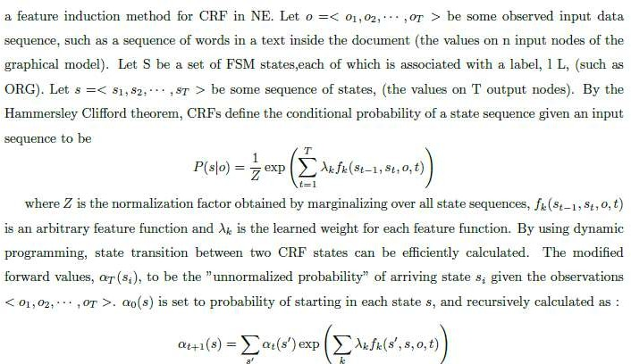
MATHEMATICAL MODEL

Slide 17
ADVANTAGES OF CRF
ADVANTAGE:
Does everything by its own
No need to provide any set data set(label bias problem avoided)
Evaluation is done based on POS tagging
Due to the conditional nature, independent assumptions can be evaluated
Heavily used in real time applications

Slide 18
IMPLEMENTING CRF IN PYTHON
COLLECTION OF DATA SETS
Annotated Corpus for Named Entity Recognition using GMB(Groningen Meaning Bank) corpus for entity classification with enhanced and popular features by Natural Language Processing applied to the data set.
This is the extract from GMB corpus which is tagged, annotated and built specifically to train the classifier to predict named entities such as name, location, etc.
import pandas as pd
import numpy as np
data = pd.read_csv("ner_dataset.csv", encoding="latin1")
data = data.fillna(method="ffill")
data.tail(10)
words = list(set(data["Word"].values))
n_words = len(words); n_words

Slide 19
OUTPUT IN THE FORM OF ENTITIES
OUTPUT
[ [ [ "Jim", "PERSON" ],
[ "Stanford", "ORGANIZATION" ],
[ "University", "ORGANIZATION" ], [ "Tom", "PERSON" ],
[ "University",
"ORGANIZATION" ],
[ "of", "ORGANIZATION" ],
[ "Washington", "ORGANIZATION" ] ],
[ [ "Microsoft", "ORGANIZATION" ] ] ]

Slide 20
POS
TOKENIZATION
Jim, went, to, Stanford, University, Tom, went, to, the, University, of ,Washington,
They, both,work ,for , Microsoft.

Slide 21
POS TAGS
[ [ [ "Jim", "PERSON" ],
[ "Stanford", "ORGANIZATION" ],
[ "University", "ORGANIZATION" ], [ "Tom", "PERSON" ],
[ "University",
"ORGANIZATION" ],
[ "of", "ORGANIZATION" ],
[ "Washington", "ORGANIZATION" ] ],
[ [ "Microsoft", "ORGANIZATION" ] ] ]

Slide 22
Challenges of NER in Indian Languages
Following are the major challenges encountering in Indian Languages.
• Agglutination
• Ambiguity
• Between Proper and common nouns
• Between named entities
• Lack of Capitalization IIIT Summer School
Agglutination In Dravidian languages, words consist of a lexical root to which one or more affixes are attached. Example in Tamil:
Ta: Ramanaiththavira (otherthan Raman)
Ta: Cevvaiyandru (On Tuesday)
Ta: Inthiyavilllula (In India)
Ta: KannanaippaRRikkondu (hold onto Kannan) IIIT Summer School
Example in Malayalam:
Ml: hemayiluNtaayirunna (that which Hema have)
Ml: Chennaiyilethunna (reach in Chennai)
Ml: arabikatalinaBimukhamaayi (towards the arabian sea) 4)
Ml: kaaSiyilekkozhukunna ( flowing towards kaaSi) IIIT Summer School

Slide 23
Challenges of NER in Indian Languages
• Ambiguity
• Comparatively Indian languages suffer more due to the ambiguity that exists between common & proper nouns and between named entities itself. In some cases same word can refer to different named entity types. Those instances can recognized by contextual information.
• Examples:
• Hi: Akash - Person name and Sky
• Hi: Sooraj - Person name and Sun
• Hi: Chaanth – Moon and Silver
• Hi: Aam – Mango and Common
• Ml: Roopa – Person name and Rupee
• Ml: Madhu – Person name and Honey
• Ml: Mala – Person name and Garland IIIT Summer School
• Ta: Thinkal - Day and Month
• Ta: Malar - Person name and Flower
• Ta: Chevvai - Day and planet
• Ta: Shakthi – Person name and Power
• Ta: MAlai – Evening and Garland
• Ta & Ml: Velli – Silver, Planet, Day IIIT Summer School

Slide 24
Challenges of NER in Indian Languages
Spell Variation: Due to the different writing styles same entity is represented in various word forms.
In Tamil, sanskirit letters such as “ja”, “sha”, “sri” “Ha” are replaced by “sa”,“ciri”, “ka”
Example: Roja can be written as Rosa Srimathi - cirimathi Raja - rasa ShajahAn - sajakAn IIIT Summer School
Lack of Capitalization :-
• In English and some other European languages capitalization is considered as the important feature to identify proper noun.
• It plays a major role in NE identification.
• Unlike English capitalization concept is not found in Indian languages. IIIT Summer School

Slide 25

APPLICATIONS OF NER

Slide 26
INFORMATION EXRACTION
PARSING AND MACHINE TRANSLATION
PROVIDES QUICK OPERATION
USED IN BIO-MEDICAL SECTORS
PRIMARILY USED FOR GENRALS AND ARTICLES
NOW EXTENDED TO WEB BLOGS, TWITTER,FACEBOOK ETC.

Slide 27


Slide 28
AUTOMATIC RETRIEVAL OF DATA
RETRIEVAL OF RELEVANT DATA FROM THE WEB
OPTIMIZE CRF AS IT HAS THE ENTROPHY OVERHEAD

Slide 29


Slide 30
PAPERS
NAMED ENTITY RECOGNITION TECHNIQUES FOR ENGLISH LANGUAGE
MACHINE LEARNING TECHNIQUES FOR NAMED ENTITY RECOGNITION
PDFs
SURVEY ON TECHNIQUES OF NAMED ENITY RECOGNITION LITERATURE SURVEY ON NAMED ENTITY RECOGNITION EVALUATION OF EXISTING SYSTEMS OF NER
URLs
https://pythonprogramming.net/named-entity-recognition-nltk-python/ http://www.albertauyeung.com/post/python-sequence-labelling-with-crf/ https://www.crummy.com/software/BeautifulSoup/bs4/doc/

