Slide 1
Behavioral Classification of Encrypted Malicious Network Traffic Using Flow-Based Metadata
A leakage-aware evaluation of flow-based intrusion detection on CICIDS2017 and CSE-CIC-IDS2018
Anshveer Singh (23BCE0703) · Gaurav Bakshi (23BCE0546) · Dev Acharya Menon (23BCE0717)
Supervisor: Dr Anto S · BCSE410L Cyber Security Project · SCOPE, VIT · October 2026
Notes:
Final review. The project evaluates how much of the near-perfect performance reported for flow-based intrusion detectors survives stricter evaluation protocols, and what the errors that appear under those protocols consist of.

Slide 2
Outline
1
Introduction
5
Experimental Setup and Output
2
Project Description and Goals
6
Result Analysis
3
Technical Specification
7
Conclusion and Future Works
4
Design Approach and Details
8
References

Slide 3
Flow metadata remains observable under encryption
01
INTRODUCTION
Payload inspection of encrypted sessions requires TLS interception, which breaks end-to-end confidentiality
A flow (addresses, ports, protocol, timeout) is summarised by CICFlowMeter into about 80 statistics: packet lengths, inter-arrival times, flags, directional ratios
Tree ensembles exceed 99% accuracy on CICIDS2017, yet audits document label errors and duplicated records
Open question: does the reported performance survive stricter evaluation, and what do the errors that appear consist of?
Starting point (Review II)
0.997
Random forest F1 trained and tested on CICIDS2017
0.002
Same model tested on CSE-CIC-IDS2018: was the collapse real or a pipeline error?
Notes:
Background and motivation. Flow statistics survive encryption. Benchmarks report near-perfect scores, but audits found errors and cross-dataset studies report failure. Our earlier phase saw 0.997 F1 in-dataset and 0.002 cross-dataset, which had to be explained.

Slide 4
Scope of the project
01
INTRODUCTION
In scope
Out of scope
• Payload-independent CICFlowMeter features (75–76 statistics)
• CICIDS2017 in full (2.83 M flows) and its timestamped release
• CSE-CIC-IDS2018, two days: DoS-Hulk, DoS-SlowHTTPTest, web attacks
• Binary detection and attack attribution (6 families, 12 types)
• Random forest and XGBoost
• Label-free mitigation of dataset shift
• Packet payloads and TLS handshake fields
• Raw packet captures and early-flow detection
• Deep sequence models
• Adversarial evasion experiments
• Online deployment
• Adaptation that uses target-dataset labels
Notes:
What is in and out of scope. Mitigations restricted to label-free transformations.

Slide 5
Literature: errors are documented, their effect is not
02
PROJECT DESCRIPTION AND GOALS
Work | Finding | Open point addressed here
Sharafaldin et al., 2018 | CICIDS2017 with 80+ CICFlowMeter features | Random-split evaluation only
Engelen 2021; Liu 2022; Lanvin 2023 | Label, capture and flow-construction errors | Effect of feature-level conflicts on metrics
Pekar & Jozsa, 2024 | Random forests robust to data-integrity defects | Temporal effect not isolated
Arp 2022; Pendlebury 2019 | Data snooping and temporal bias inflate security ML | No flow-level quantification
Moczkodan & Ragab, 2026 | Split protocol dominates; leakage-free FAR × 67 | What the errors of a time split consist of
Cantone et al., 2024 | 2017 → 2018 grouped binary F1 0.26–0.39 | No same-year reference or unit checks
Notes:
19 papers reviewed in the report. Key ones on the slide. Each leaves part of the evaluation question open.

Slide 6
Research gap and problem statement
02
PROJECT DESCRIPTION AND GOALS
Split errors
Label conflicts
Attribution
Transfer failure
Noise floor
Leakage and chronological ordering not separated; errors of time-aware splits not inspected
Identical vectors with different labels not counted
Attack type scored on true attacks only, not end to end
Reported, not diagnosed or mitigated
Seed variability rarely reported
Problem statement
(a) How much does measured performance depend on the protocol: leakage between correlated records or chronological ordering, and what do the extra errors consist of?
(b) How do duplicates and label conflicts change the evaluated population and the metrics?
(c) How much does attribution degrade once detection errors are included?
(d) Why does zero-shot transfer to CSE-CIC-IDS2018 fail, and does label-free normalisation repair it?
Notes:
Five gaps; the problem statement has four parts, all judged against a seed noise floor.

Slide 7
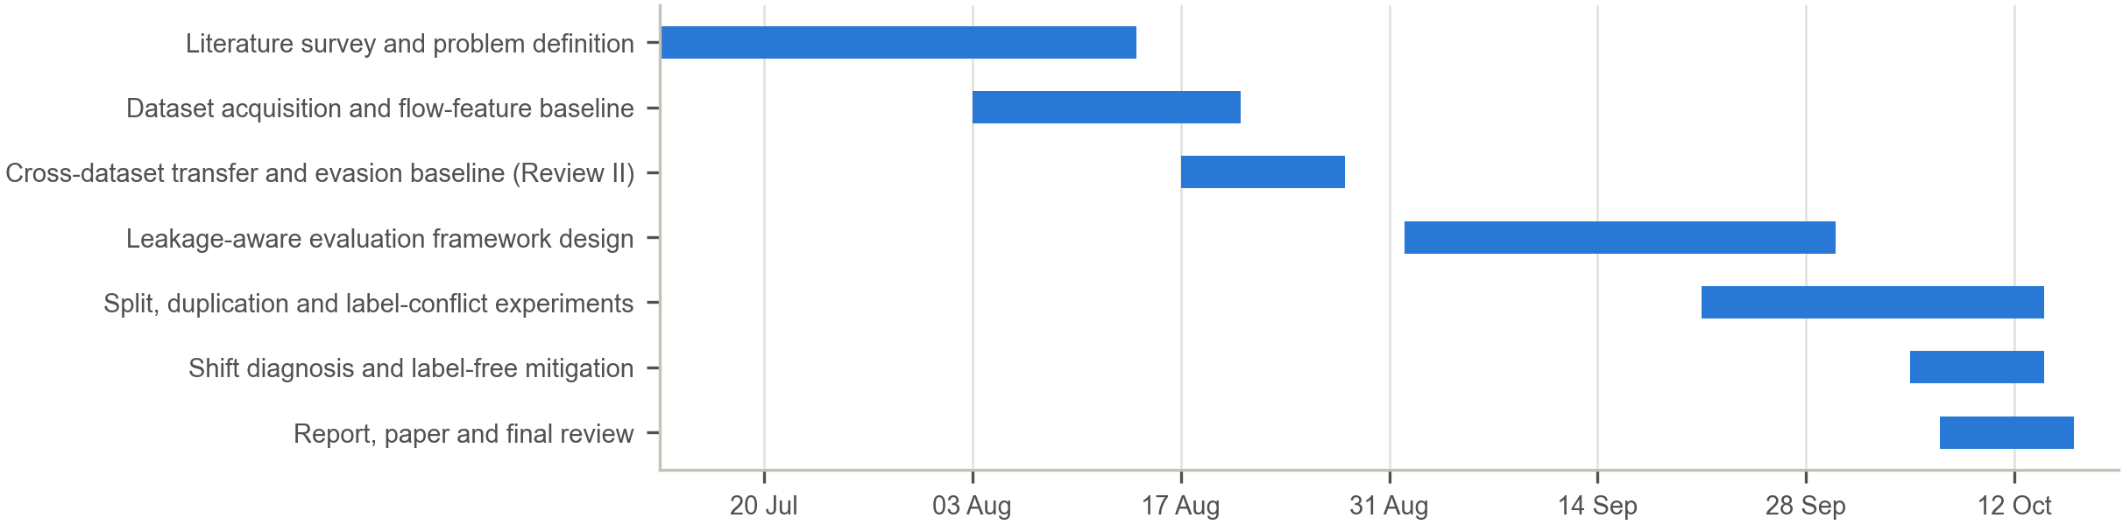
Objectives and project plan
02
PROJECT DESCRIPTION AND GOALS
O1 Reproduce the baseline exactly; verify 100% row alignment; five split protocols
O2 ≥ 2 seeds per protocol, 5 for the main comparison; audit the chronological-split errors
O3 Count duplicates and conflicts per class; compare four policies
O4 Attribution in three scoring views with Wilson intervals
O5 Matched-family transfer with reference, upper bound, reverse, controls
O6 ≤ 6 GB working set per experiment; finish before the final review
Notes:
Six SMART objectives; Gantt chart from mid-July to mid-October 2026.

Slide 8
Requirements
03
TECHNICAL SPECIFICATION
Functional
Non-functional
• Ingest both datasets and the timestamped release
• Canonicalise labels; align 2018 features to 2017 names
• Hash vectors; count duplicates and conflicts; apply a policy
• Generate five split protocols; audit false positives by endpoint and time
• Train Stage 1 and Stage 2; score three views
• Seed statistics, Wilson intervals
• Shift diagnosis and label-free mitigation
• Gates: feature order, label encoding, exact reproduction
• Reproducibility: configuration, seeds, code hash and data fingerprints recorded per run
• Memory: ≤ 6 GB working set; loader peak cut from 8.63 GB to 4.13 GB with bit-identical output
• Integrity: SHA-256 checks of code, data and baseline after every experiment
• Unattended execution: sequential runs, memory guard, incremental saving
• Privacy: no payload; addresses and ports are never features, only used to audit errors
Notes:
Functional requirements define the evaluation system; non-functional ones make results reproducible and trustworthy.

Slide 9
Feasibility and system specification
03
TECHNICAL SPECIFICATION
Technical
Economic
Social
Public datasets (1.8 GB); a random forest trains on 1.7 M flows in 2–3 min on 8 cores; no GPU needed
No licence cost; a few CPU-hours on an existing laptop; realistic FPR estimates reduce triage workload
Metadata only, no decryption; no new attack capability; improves comparability of published results
Hardware |  | Software
Processor | AMD Ryzen 7 7735HS, 8C/16T | OS | Windows 11 Home (26200)
Memory | 16 GB (peak use 4.1–5.7 GB) | Language | Python 3.13.1
GPU | RTX 4050 Laptop (not required) | Libraries | pandas 2.2.3, NumPy 2.2.6, scikit-learn 1.6.1
Storage | SSD, ~1.8 GB data |  | XGBoost 3.4.1, SciPy 1.15.3, Matplotlib 3.10.3
Notes:
Public data, open-source stack, CPU-only laptop; total compute a few hours.

Slide 10
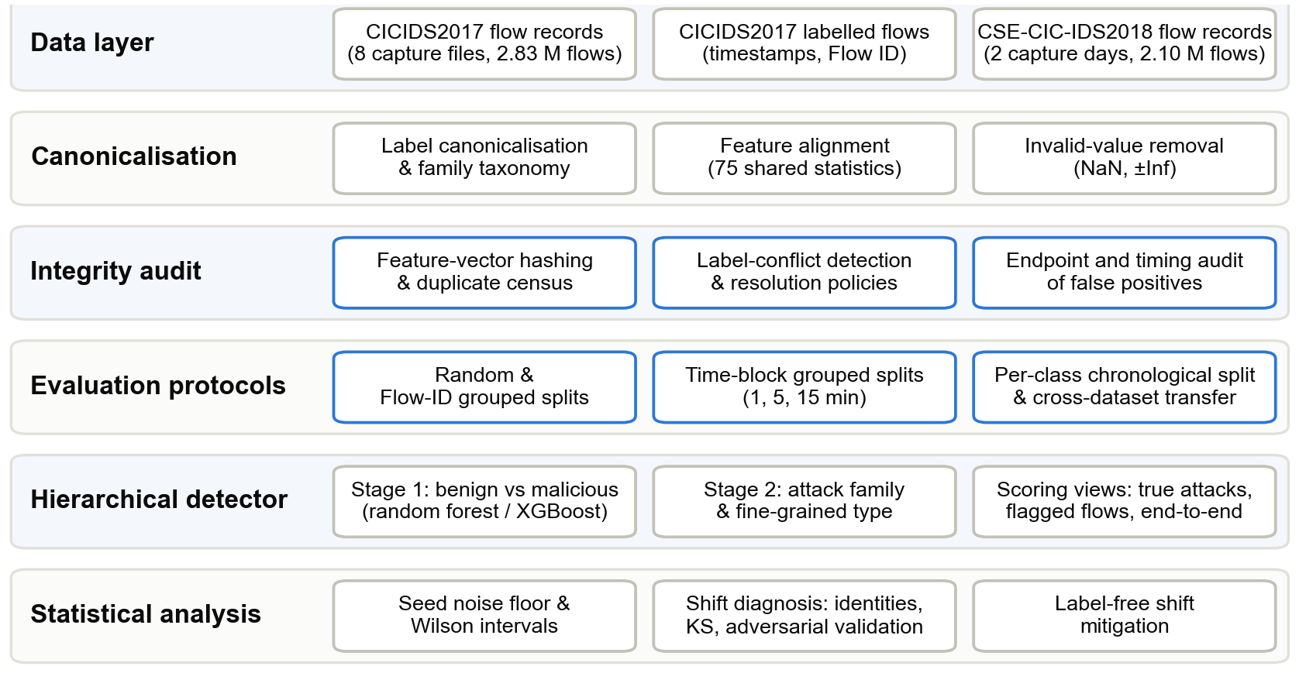
System architecture
04
DESIGN APPROACH AND DETAILS
Notes:
Six layers; each consumes only the layers above. Integrity audit and evaluation protocols are the components varied in the experiments.

Slide 11
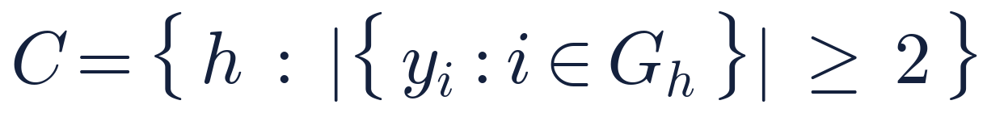


Algorithm 1: leakage-aware hierarchical evaluation
04
DESIGN APPROACH AND DETAILS
Remove records with missing or infinite values
Hash every feature vector; build duplicate groups and the conflict set C
Resolve duplicates with a policy: drop-conflicts, keep-first, majority or none
For each seed, split 80/20 per label: random, Flow-ID groups, time blocks, per-class chronological
Assert identical feature order at training and prediction
Train Stage 1 (benign vs malicious) and Stage 2 (attack family / type)
Score detection, and attribution on true attacks, on flagged flows and end to end
Report mean, SD and range over seeds; Wilson intervals per class
Conflict set
Chronological split and purge, per label
Time blocks
Hierarchical prediction
Material difference (noise floor 0.013)
Notes:
Hash every vector, build the conflict set, resolve with a policy, split per label, train two stages, score three views over seeds. The feature-order assertion rules out a column permutation that would mimic dataset shift.

Slide 12
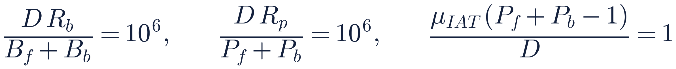
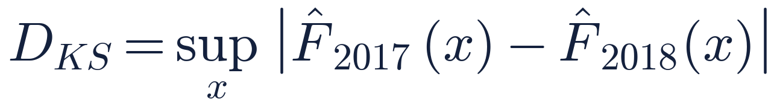
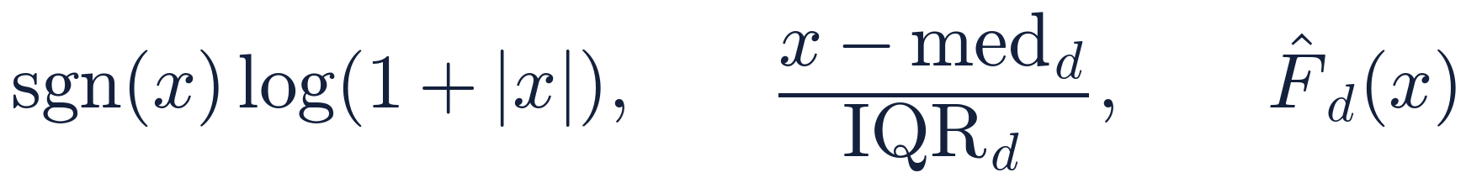
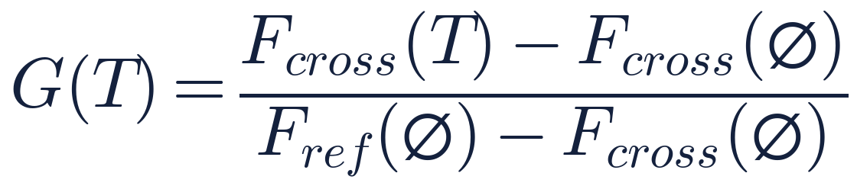
Algorithm 2: shift diagnosis and label-free mitigation
04
DESIGN APPROACH AND DETAILS
Align 2018 features to 2017 names (75 shared); map labels to Benign, DoS/DDoS, Web Attack
Verify the unit identities for Benign and DoS Hulk in both years
Compute the KS statistic per feature and class on 100 000-row samples
Adversarial validation: AUC of a classifier separating 2017 from 2018
For each transformation T, fit on 2017 training data and on unlabelled 2018 data
Train on T(2017), score on T(2017 test) and T(2018); compute G(T)
Controls: train and test on 2018; reverse 2018 → 2017; score 2018 without deduplication
Unit identities (µs, per second)
Per-feature shift
Label-free transformations
Share of the gap recovered
Notes:
Three diagnostics: unit identities, per-feature KS, adversarial validation. Then six transformations that use no 2018 labels, scored by the share of the gap they recover.

Slide 13
Experimental setup
05
EXPERIMENTAL SETUP AND OUTPUT
Item | CICIDS2017 | CSE-CIC-IDS2018
Valid flows | 2,827,876 | 2,091,539
Unique vectors | 2,198,624 | 1,420,222
Duplicate share | 22.25% | 32.10%
Conflicting vectors | 309 | 3
Features | 76 | 75 aligned
Exp. | Question | Runs | Peak RAM
E2 | Seed variability | 14 | 8.6 GB*
E3 | Matched-family transfer | 5 | ≥ 5.6 GB
E4 | Leakage vs chronology (5 protocols) | 14 | 4.4 GB
E5 | Duplicate policies | 9 | 5.5 GB
E6 | Shift diagnosis | 1 | 5.7 GB
E7 | Mitigation and controls | 30 | 5.5 GB
E8 | Test-set deduplication | 3 | –
E9–10 | Split composition; false-positive audit | 2 | –
Models
Random forest: 100 trees, depth 20, balanced weights
XGBoost: 300 trees, depth 6, learning rate 0.1
* before the memory-bounded loader, which reproduced every metric exactly at a 4.13 GB peak.
Notes:
Data after cleaning and the eight experiments. Timestamps verified: both 2017 releases agree on 100% of rows.

Slide 14
Output: only the chronological splits lower the scores
05
EXPERIMENTAL SETUP AND OUTPUT
≤ 0.004
Change in malicious F1 from duplicates, sessions or time blocks
0.903
Malicious F1 under the per-class chronological split (random split: 0.997)
Notes:
Grouped splits remove correlated records but keep training and test periods interleaved. Only the per-class chronological splits, by timestamp and by row order, lower the scores. Values are means of two seeds.

Slide 15
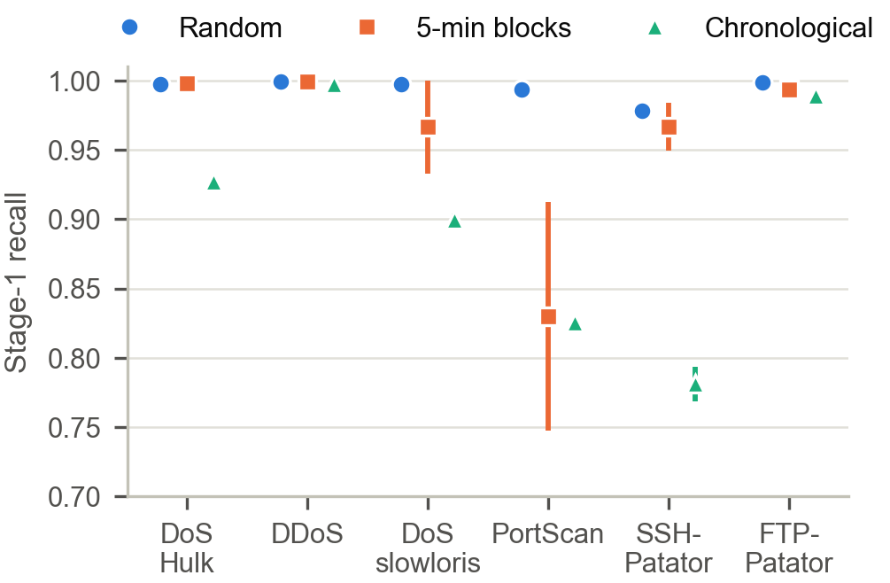
Output: the drop is benign false positives
05
EXPERIMENTAL SETUP AND OUTPUT
Stage-1 recall per attack (mean and range over two seeds)
Notes:
Precision falls from 0.996 to 0.856; recall from 0.997 to 0.956. Holding recall fixed, precision alone gives F1 0.921. FPR rises about 44-fold. PortScan is the exception: its recall drops already under 5-minute grouping, an adjacency effect. The next two slides examine the split and its false positives.

Slide 16
Output: no global cutoff is possible on CICIDS2017
05
EXPERIMENTAL SETUP AND OUTPUT
Global cutoff | Train share | Attack classes on both sides | Train only | Test only
Wed 10:57 (50th pct.) | 50% | 2 of 14 | 3 | 9
Wed 15:13 (60th pct.) | 60% | 1 of 14 | 6 | 7
Thu 13:10 (70th pct.) | 70% | 0 of 14 | 10 | 4
Fri 09:52 (80th pct.) | 80% | 1 of 14 | 11 | 2
Fri 15:22 (90th pct.) | 90% | 1 of 14 | 12 | 1
Fri 00:00 | 78% | 0 of 14 | 11 | 3
86%
of chronological test flows have at least one later training flow
39%
of attack training flows (DDoS, PortScan, Bot) lie inside the benign test window, Thu 16:23 to Fri 17:02
Cutoffs at percentiles of capture time; 14 attack labels after deduplication
Notes:
The chronological split cuts each class at its own time. It is therefore not a simulation of deployment after a fixed date: training flows of one class can be later than test flows of another. A single global cutoff would leave almost every attack class on one side only, because each attack runs in one interval of minutes to hours.

Slide 17
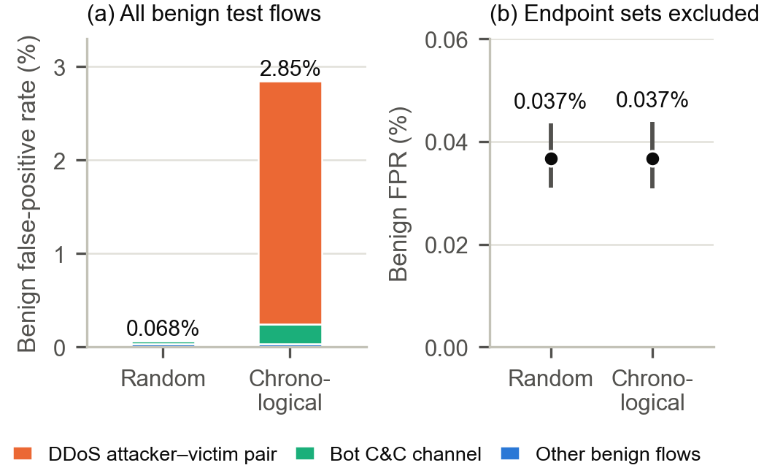
Output: the false positives are two attack sessions
05
EXPERIMENTAL SETUP AND OUTPUT
Endpoint audit (seed 42)
• DDoS victim ↔ attacker: 9,685 of 10,612 false positives; reverse direction, inside 15:56–16:16
• Bot C&C channel (port 8080): 802 false positives, after the last Bot label at 12:59
• Random split: 4 false positives among 7,620 benign flows on the same pair
• Both sets removed: FPR 0.037% vs 0.037%; F1 gap 0.092 → 0.020, recall only
98.8%
of chronological-split false positives lie on the two endpoint sets
Seed 42. (b) shows Wilson 95% intervals.
Notes:
Seed 42, both protocols reproduced exactly. 98.8% of the chronological false positives lie on two endpoint sets. The DDoS ones run from the victim back to the attacker during the 20-minute attack; every DDoS-labelled flow runs the other way. The Bot ones are infected hosts talking to the C&C server on port 8080 after the last Bot-labelled flow. The random split keeps most of these flows in training under their benign labels and learns them. With them removed from both test sets the false-positive rates are equal. The sets were found from the errors they explain, so this is a diagnostic, not a corrected benchmark.

Slide 18
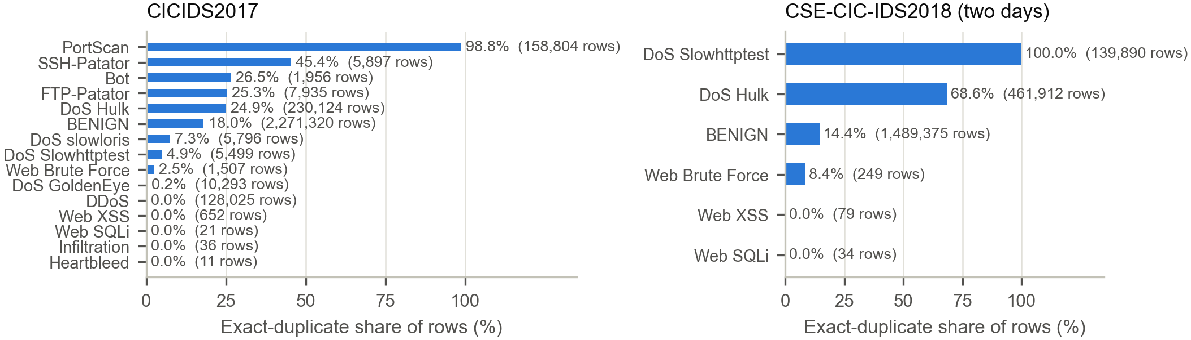
Output: duplicates and label conflicts
05
EXPERIMENTAL SETUP AND OUTPUT
309
98.8%
< 0.004
feature vectors with conflicting labels (82,704 rows), all involving BENIGN
of PortScan rows are exact duplicates (1,956 unique vectors)
change in malicious F1 across four resolution policies
Notes:
309 vectors carry conflicting labels, all involving benign traffic. Duplication is concentrated in probing attacks. Policy choice changes binary F1 by under 0.004 on a common test set but reshapes the test population.

Slide 19
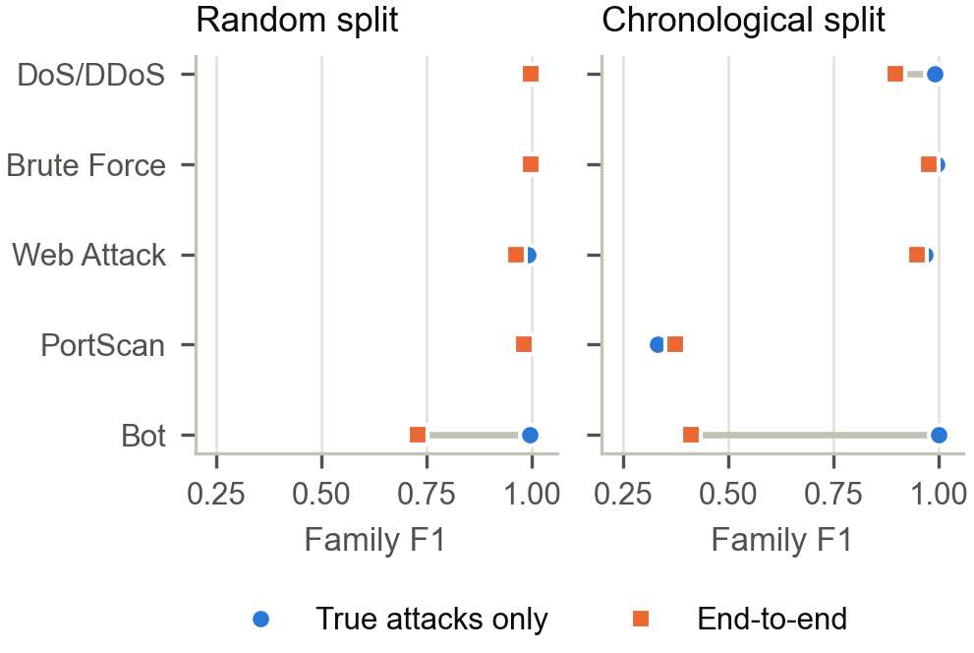
Output: attribution must be scored end to end
05
EXPERIMENTAL SETUP AND OUTPUT
Key numbers (5 seeds)
• Bot: 0.996 → 0.729 (random split)
• Bot: 1.000 → 0.411 (chronological), precision 0.259
• DoS/DDoS: 0.990 → 0.898 (chronological)
• These end-to-end losses are the benign-labelled flows on the DDoS pair and the Bot C&C channel
• Web brute force / XSS fine F1: 0.723 / 0.459 even with a random split
Notes:
Stage 2 on true attacks looks perfect for Bot; end to end it inherits Stage-1 false positives. Web brute force and XSS are hard to separate even under a random split.

Slide 20
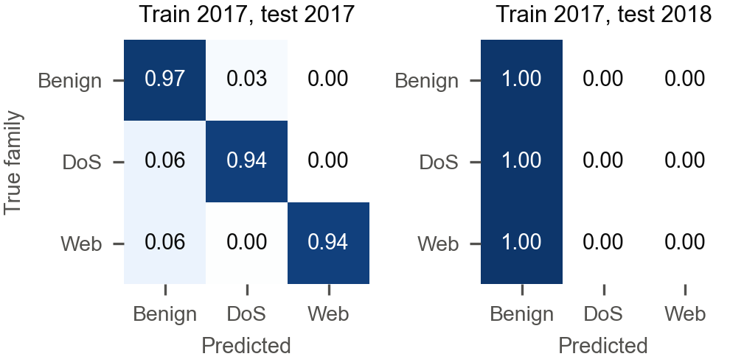
Output: zero-shot transfer collapses on matched families
05
EXPERIMENTAL SETUP AND OUTPUT
Row-normalised confusion, seed 42: 145,169 of 145,254 DoS flows labelled benign
Notes:
Same-year reference 0.949; transfer 0.322; 2018-trained model 0.949. Without deduplication malicious F1 is 0.0087 and SlowHTTPTest recall 0.000 over 139,890 rows. Reverse direction fails too.

Slide 21
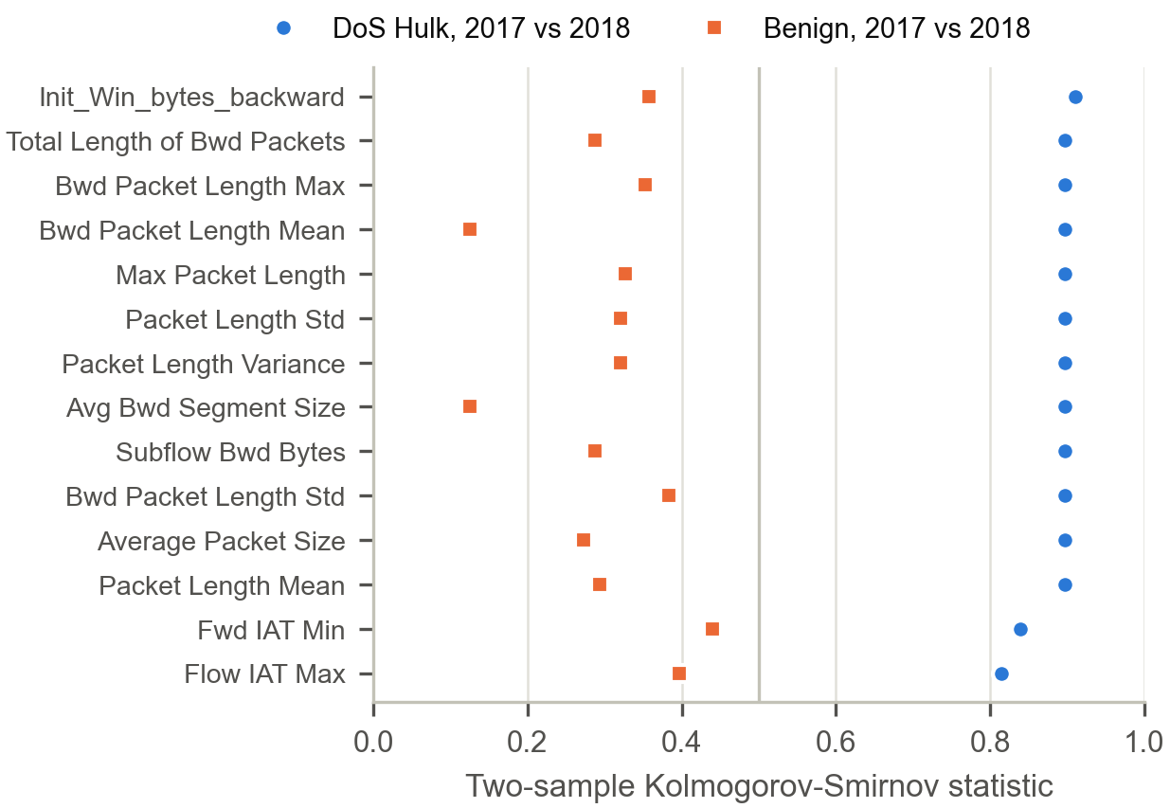
Output: units agree; DoS-Hulk traffic differs by year
05
EXPERIMENTAL SETUP AND OUTPUT
Diagnostics
• Unit identities: 1.000×10⁶, 1.000×10⁶, 1.000 in both years
• Adversarial AUC 2017 vs 2018: 0.9997 (benign only 0.9997)
• DoS Hulk: 50/75 features with KS > 0.5; Benign: 0/75 (max 0.445)
• Hulk flows with no backward payload: 9.5% (2017) → 82.3% (2018)
• Median Hulk duration: 86.4 s → 0.051 s
Notes:
Unit identities hold in both years, so no unit mismatch. Benign shifts mildly; DoS Hulk shifts strongly on backward-direction features. The features that separate Hulk from benign in 2017 are absent in most 2018 Hulk flows.

Slide 22
Output: label-free normalisation does not recover the gap
05
EXPERIMENTAL SETUP AND OUTPUT
≤ 0.5%
gap recovered by any label-free transformation (random forest, 3 seeds)
1.000
DoS recall when trained and tested on 2018: the features suffice within a year
Notes:
Random forest over three seeds recovers at most 0.5% of the gap. XGBoost with 10 features dropped recovers 15.5% (one seed), still with DoS recall 0. The globally shifted features are benign-driven; the Hulk-specific ones rank 35–46 and were never dropped.

Slide 23
Leakage is small; the chronological gap is mostly labels
06
RESULT ANALYSIS
≤ 0.004
98.8%
0.092 → 0.020
malicious-F1 change from duplicates, Flow-ID groups and 1–15 min blocks (within noise)
of chronological-split false positives lie on two attack endpoint sets
malicious-F1 gap to the random split once both sets are removed (seed 42)
On this dataset the chronological split acts mainly as an audit of labels: it moves flows the random split memorises into the test set
Residual effect: recall 0.997 → 0.957, 85% of it in DoS Hulk; its cause was not examined
Deduplication is still required for a correct test population; PortScan shows adjacency can dominate one class
Transfer failure is robust: 5 seeds, no-dedup control, reverse direction, XGBoost; not a unit artefact
Notes:
Decomposition summary. Exact duplicates, sessions and minute blocks: at most 0.004 malicious F1. The per-class chronological split costs 0.09 F1 and multiplies false positives by 44, which would ordinarily be read as drift. The audit shows that almost all of those false positives are benign-labelled flows of two attack sessions. After removing them from both protocols, the gap is 0.020 F1, entirely recall, mostly the last 11 minutes of DoS Hulk.

Slide 24
Comparison with existing systems
06
RESULT ANALYSIS
Aspect | Cantone et al. 2024 | Moczkodan & Ragab 2026 | Review II baseline | This work
Random-split binary score | Nearly perfect | – | F1 0.997 | F1 0.9966 ± 0.0000
Time-aware evaluation | – | FAR × 67 (Transformer) | No | F1 0.903, FPR × 44
Time-split errors inspected | – | – | No | 98.8% on 2 attack sessions
Label conflicts counted | No | – | No | 309 vectors, 82,704 rows
Attribution end to end | No | – | No | Bot 1.00 → 0.41
Transfer 2017 → 2018 | F1 0.26–0.39 (all attacks) | – | F1 0.002 | F1 0.0006 (matched families)
Cause of failure | Anomalies, attack configs | – | Hypothesised | Units verified; 50/75 Hulk features shift
Mitigation tested | No | No | No | 4 label-free: ≤ 0.5% recovered
Notes:
Settings differ, so this compares evaluation coverage and the direction of findings. Our transfer result is more severe than Cantone et al.; deduplication does not explain it; the attack-subset explanation is plausible but untested.

Slide 25
Conclusions and future work
07
CONCLUSION AND FUTURE WORKS
Conclusions
Future work
• Duplicates and correlated records explain at most 0.004 F1
• The chronological gap is mainly a label artefact: 98.8% of its false positives are benign-labelled attack-session flows; without them FPR is equal and only a recall loss remains
• A time-aware split needs an audit of its errors before its drop is called drift
• Attribution must be reported end to end
• 2017 → 2018 transfer fails; units hold, diagnostics point to changed attack traffic; label-free normalisation does not repair it
• Relabel the flows on the two endpoint sets and repeat the protocol comparison
• Extend transfer to all CSE-CIC-IDS2018 attack days
• Class-aware adaptation with a small labelled target sample
• Same protocols on TLS-metadata captures and sequence models
• More seeds for grouped protocols and the policy study
Notes:
Five conclusions, five directions for future work. The central one: the chronological gap on CICIDS2017 is mainly a label artefact, so a time-aware split needs an audit of its errors before its drop is called drift.

Slide 26
Key references
08
REFERENCES
[1] I. Sharafaldin, A. H. Lashkari, A. A. Ghorbani, "Toward generating a new intrusion detection dataset and intrusion traffic characterization," ICISSP, 2018.
[2] G. Engelen, V. Rimmer, W. Joosen, "Troubleshooting an intrusion detection dataset: the CICIDS2017 case study," IEEE SPW, 2021.
[3] L. Liu, G. Engelen, T. Lynar, D. Essam, W. Joosen, "Error prevalence in NIDS datasets: CIC-IDS-2017 and CSE-CIC-IDS-2018," IEEE CNS, 2022.
[4] M. Lanvin et al., "Errors in the CICIDS2017 dataset and the significant differences in detection performances it makes," CRiSIS 2022, Springer, 2023.
[5] A. Pekar, R. Jozsa, "Evaluating ML-based anomaly detection across datasets of varied integrity," Computer Networks, 2024.
[6] M. Cantone, C. Marrocco, A. Bria, "On the cross-dataset generalization of machine learning for network intrusion detection," IEEE Access, vol. 12, 2024.
[7] Z. Moczkodan, H. Ragab, "Do transformers actually help intrusion detection? A temporal sequence evaluation on CIC-IDS2017," arXiv:2606.11098, 2026.
[8] D. Arp et al., "Dos and don'ts of machine learning in computer security," USENIX Security, 2022.
[9] F. Pendlebury et al., "TESSERACT: Eliminating experimental bias in malware classification across space and time," USENIX Security, 2019.
[10] B. Anderson, D. McGrew, "Identifying encrypted malware traffic with contextual flow data," ACM AISec, 2016.
[11] L. Breiman, "Random forests," Machine Learning, 45(1), 2001; T. Chen, C. Guestrin, "XGBoost," ACM SIGKDD, 2016.
Notes:
Full list of 25 references in the report.

Slide 27
Thank you
Questions and discussion
Anshveer Singh · Gaurav Bakshi · Dev Acharya Menon | Supervisor: Dr Anto S

