Slide 1

Hibernate – Part 1 What is Hibernate?
CIT 360
Dan Hively

Slide 2


What is Hibernate?
Not this

Slide 3

What is Hibernate?
Object
Relational
Mapping
ORM
Created by Gavin King in 2001

Slide 4
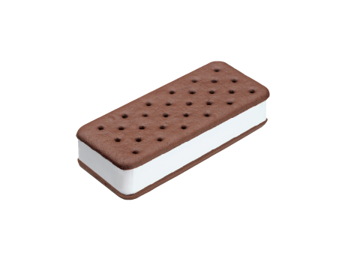
What is Hibernate?
Think of an Ice Cream Sandwich
Hibernate is the delicious ice cream center

Slide 5
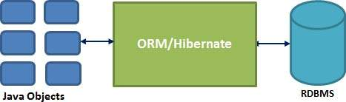
What is Hibernate?
Allows mapping from Java classes to database tables
Allows mapping from Java data types to SQL data types
Sits between Plain Old Java Objects (POJOs) & database
Persists objects i.e. in a database table

Slide 6
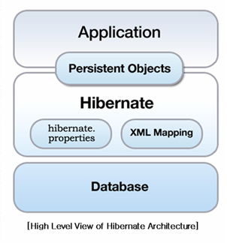
What is Hibernate?
Another view

Slide 7
What is Hibernate?
Object / Relational mapping (ORM) and persistence / query framework
i.e. It does even more stuff for you!
Some features of Hibernate
HibernateDaoSupport – superclass, easy HibernateTemplate access
Database independence - sits between the database and your java code, easy database switch without changing any code
Object / Relational Mapping (ORM) - Allows a developer to treat a database like a collection of POJOs
Object oriented query language (HQL) - *Portable* query language, supports polymorphic queries etc.
You can still issue native SQL, and also queries by “Criteria” (specified using “parse tree” of Java objects)
Hibernate Mapping - Uses HBM XML files to map value objects (POJOs) to database tables
Transparent persistence - Allows easy saves/delete/retrieve for simple value objects
Very high performance “in general” due to intelligent (2-level) caching, although in a few cases hand-written SQL might beat it
From: http://www.hibernate.org/

Slide 8
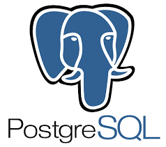


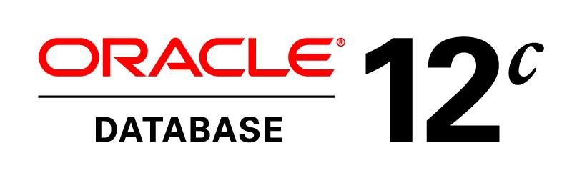
What is Hibernate?
Databases
MySQL
Oracle
Microsoft SQL Server
PostgreSQL

Slide 9



What is Hibernate?
Hibernate Query Language (HQL)
Object-oriented
Similar to SQL
Use this instead of SQL in your code
Makes your code more portable
Real life example – FamilySearch
Convert Oracle to PostgreSQL

Slide 10
Hibernate
http://hibernate.org/orm/
http://hibernate.org/orm/downloads/

Slide 11

Hibernate – Part 1

