Slide 1

Hibernate - Part 2 Examples, HQL & More
CIT 360
Dan Hively

Slide 2
Hibernate
http://hibernate.org/orm/
http://hibernate.org/orm/downloads/
https://en.wikipedia.org/wiki/Hibernate_%28framework%29

Slide 3
Hibernate Setup
After following these steps, you should be ready to begin on the project
Hibernate - Part 2 will provide step by step instructions

Slide 4
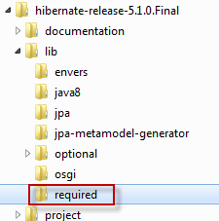
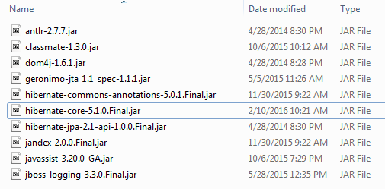
Hibernate Setup
Expanded directory looks like this
You will need all files in the required subdirectory

Slide 5
Hibernate Setup
Expanded directory looks like this
You will need all files in the required subdirectory

Slide 6
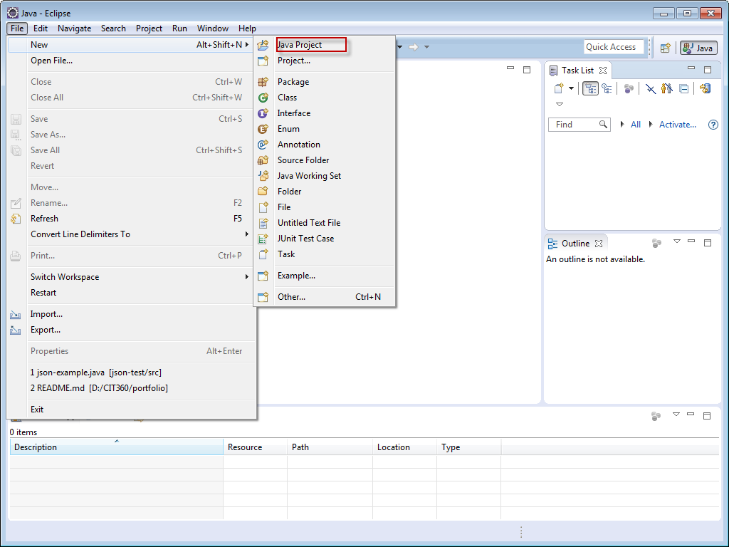
Hibernate Setup
Start Eclipse and create a new Java Project

Slide 7
Hibernate Setup

Slide 8
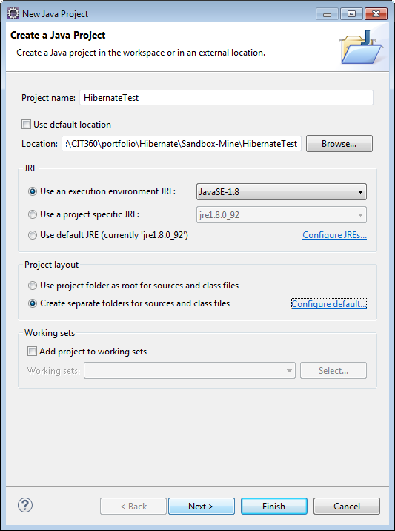
Hibernate Setup

Slide 9
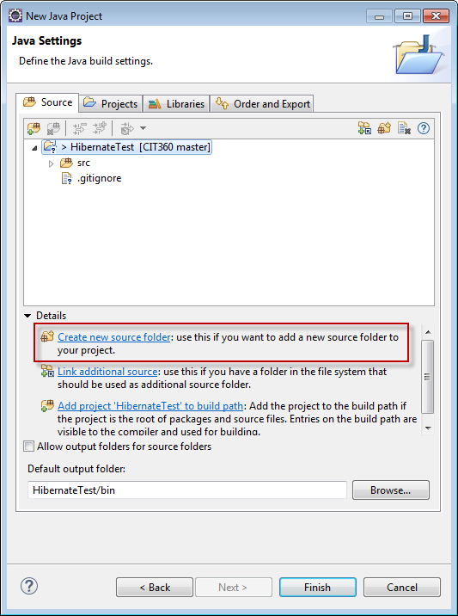
Hibernate Setup
Create a lib subdirectory in your project

Slide 10
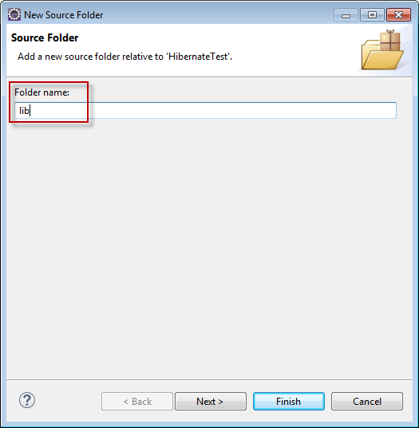
Hibernate Setup
Create a lib subdirectory in your project

Slide 11
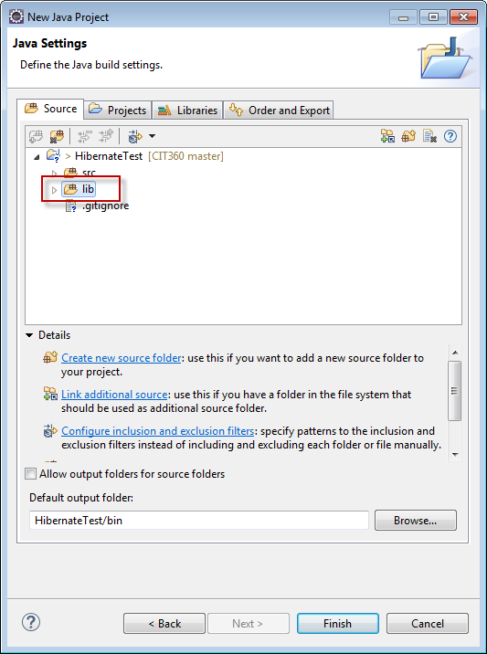
Hibernate Setup
Like this

Slide 12
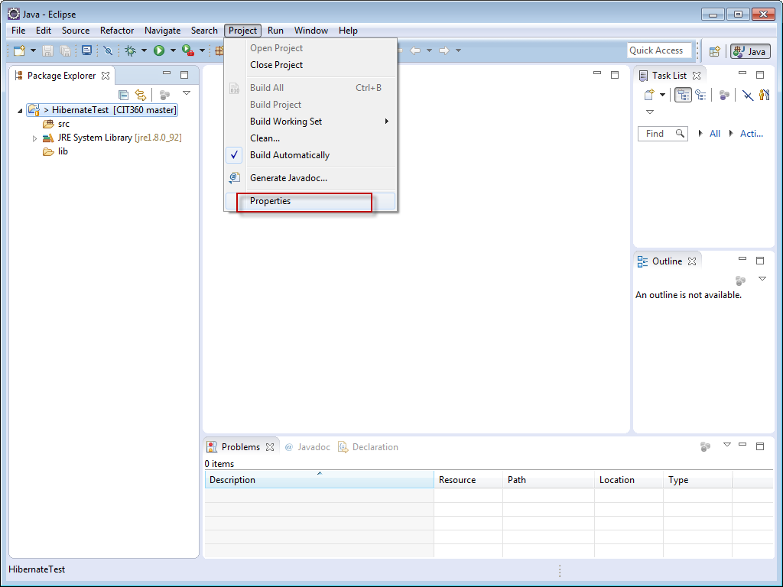
Hibernate Setup
Now you need to create a User library on the Eclipse IDE.

Slide 13
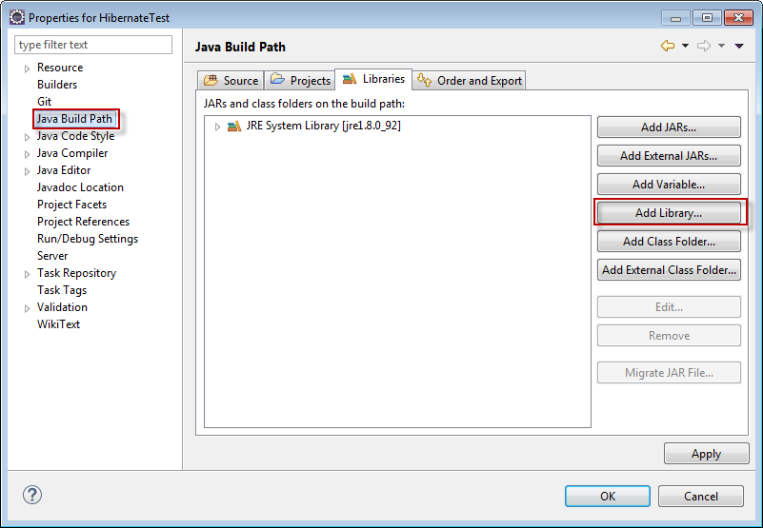
Hibernate Setup

Slide 14
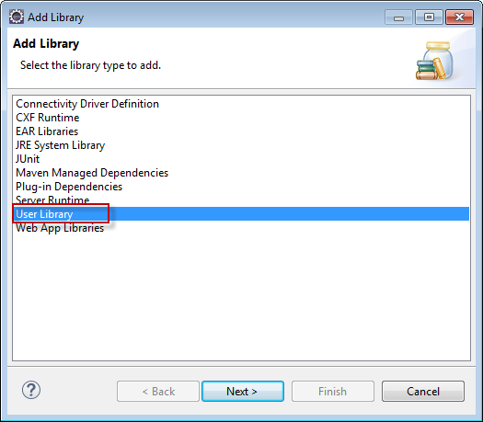
Hibernate Setup

Slide 15
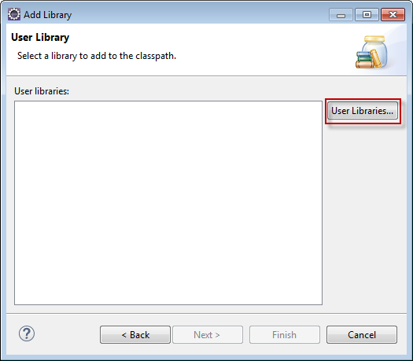
Hibernate Setup

Slide 16
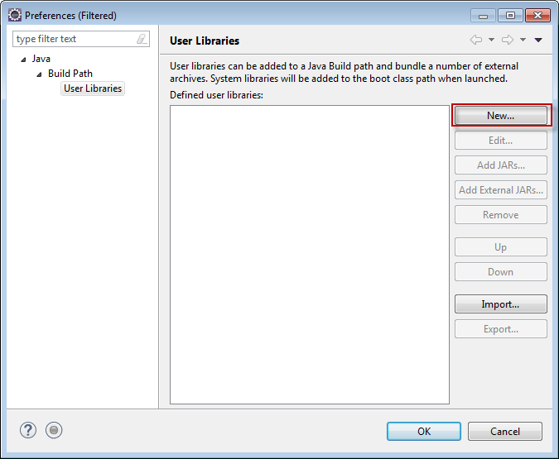
Hibernate Setup

Slide 17
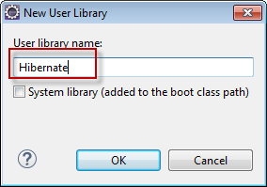
Hibernate Setup
Call the library Hibernate

Slide 18
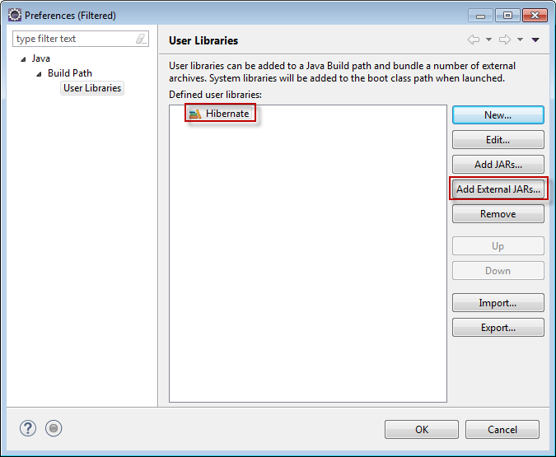
Hibernate Setup

Slide 19
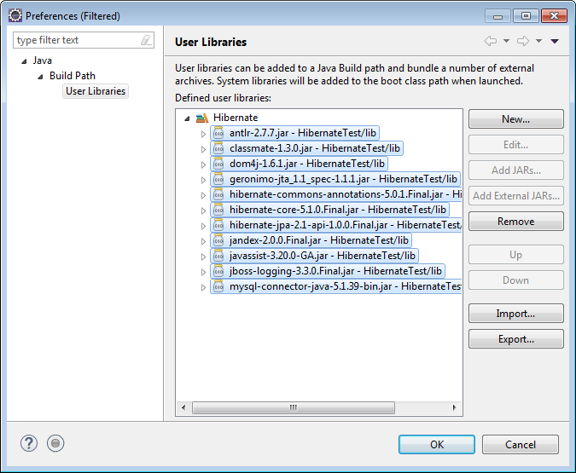
Hibernate Setup
Select all of the JAR files in your lib directory and click OK

Slide 20
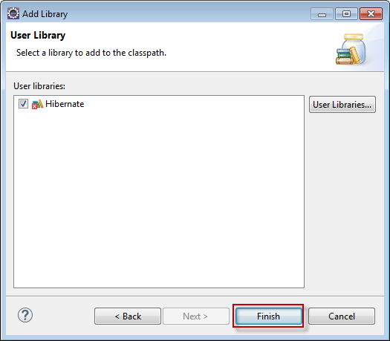
Hibernate Setup
Make sure your newly created User Library is selected and click Finish.

Slide 21
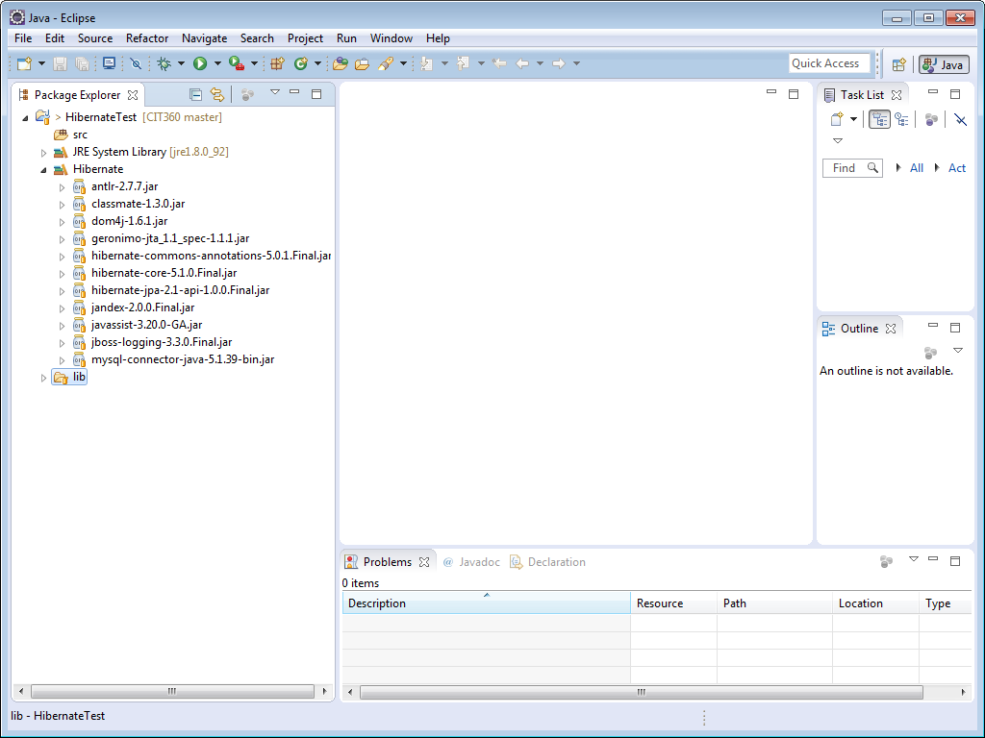
Hibernate Setup
Your project should look something like this.

Slide 22
Hibernate Setup
After following these steps, you should be ready to begin on the project
Hibernate - Part 2 will provide step by step instructions

Slide 23

Hibernate Setup

