Slide 1

Hibernate - Part 3 Setting Up a Generic Project Eclipse
CIT 360
Dan Hively

Slide 2
Hibernate
http://hibernate.org/orm/
http://hibernate.org/orm/downloads/
https://en.wikipedia.org/wiki/Hibernate_%28framework%29
Download the hibernate software from the link above.
Unzip it to a local directory

Slide 3
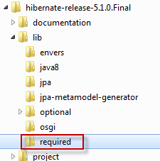
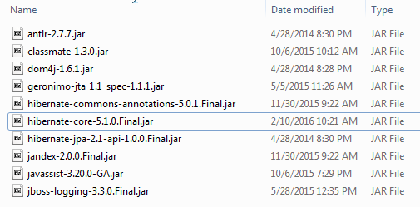
Hibernate Setup
Expanded directory looks like this
You will need all files in the required subdirectory

Slide 4
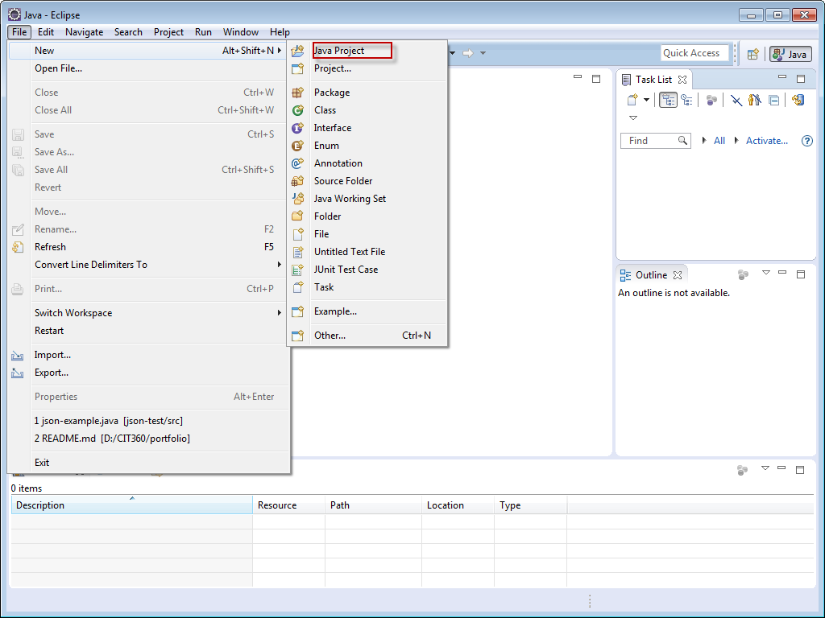
Hibernate Setup
Start Eclipse and create a new Java Project

Slide 5
Hibernate Setup

Slide 6
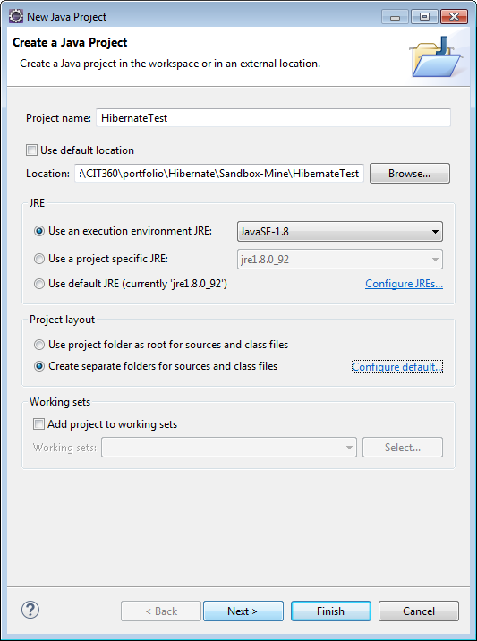
Hibernate Setup

Slide 7
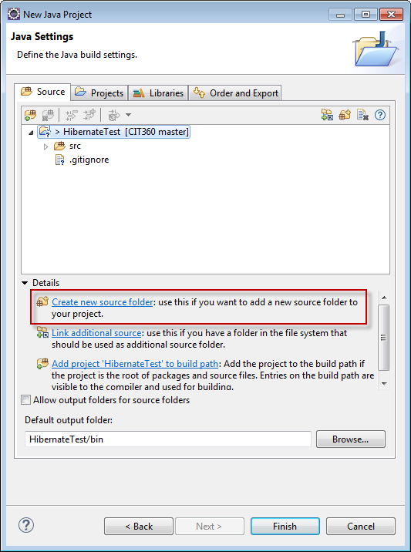
Hibernate Setup
Create a lib subdirectory in your project

Slide 8
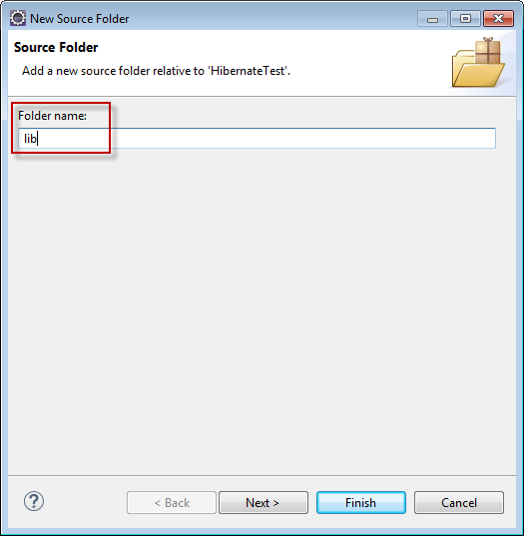
Hibernate Setup
Create a lib subdirectory in your project

Slide 9
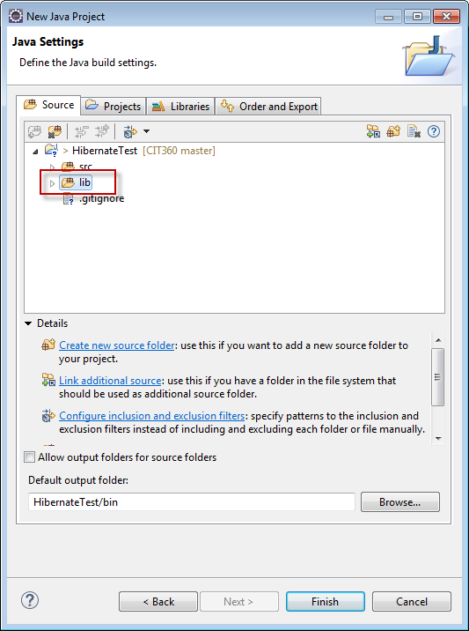
Hibernate Setup
Like this

Slide 10
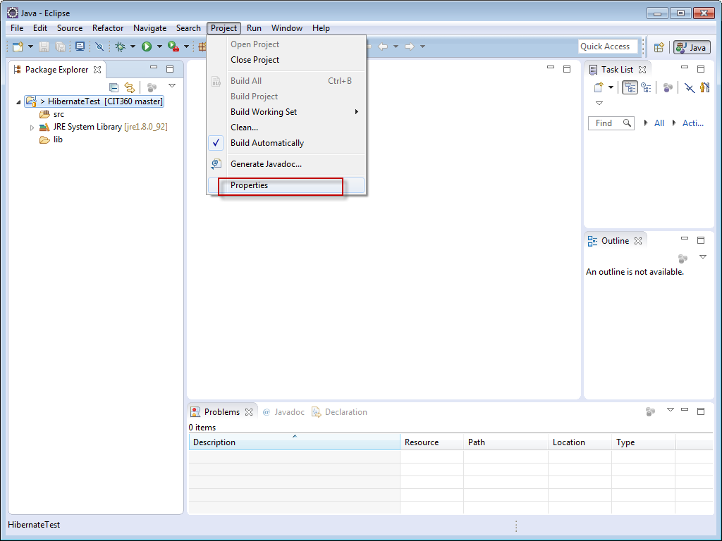
Hibernate Setup
Now you need to create a User library on the Eclipse IDE.

Slide 11
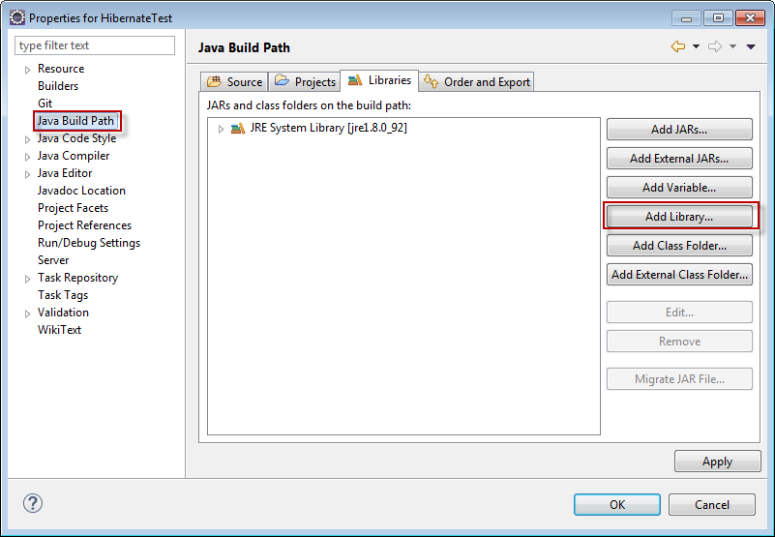
Hibernate Setup

Slide 12
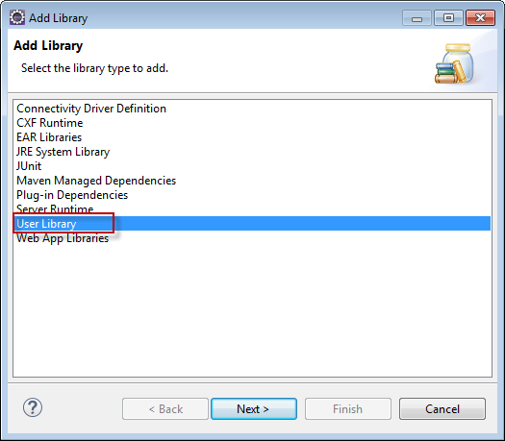
Hibernate Setup

Slide 13
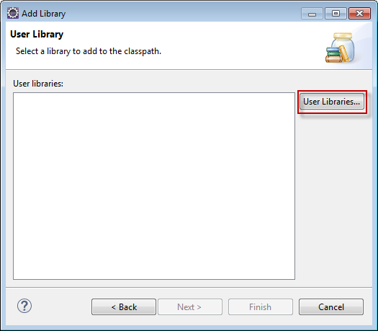
Hibernate Setup

Slide 14
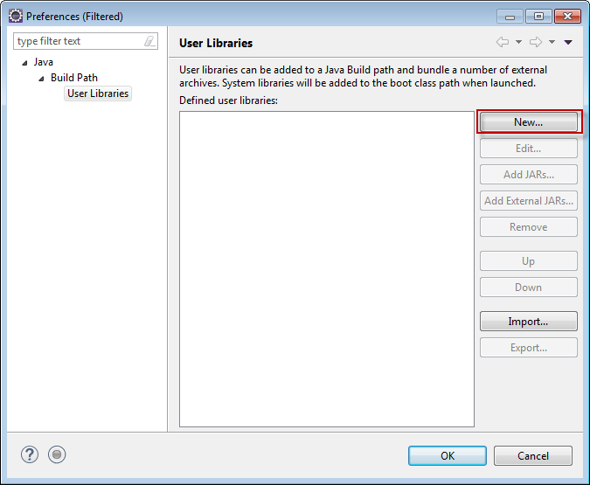
Hibernate Setup

Slide 15
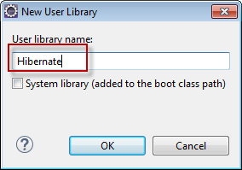
Hibernate Setup
Call the library Hibernate

Slide 16
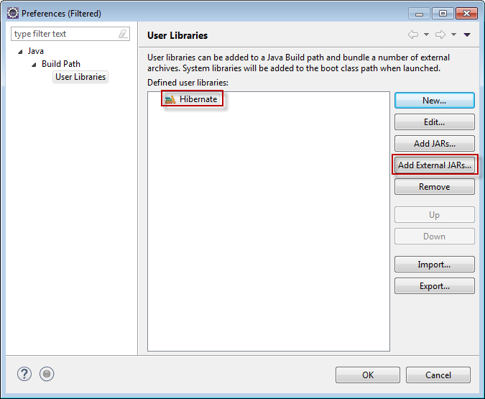
Hibernate Setup

Slide 17
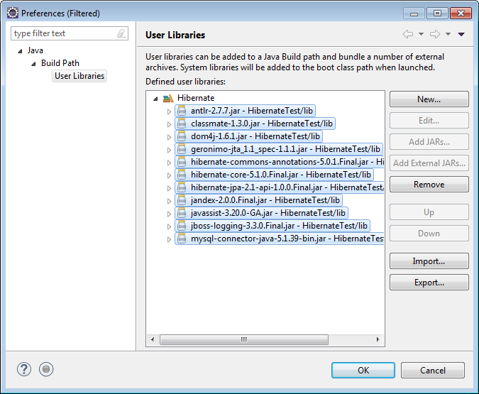
Hibernate Setup
Select all of the JAR files in your lib directory and click OK

Slide 18
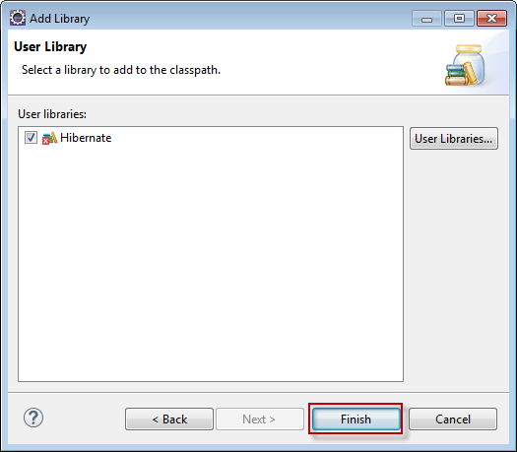
Hibernate Setup
Make sure your newly created User Library is selected and click Finish.

Slide 19
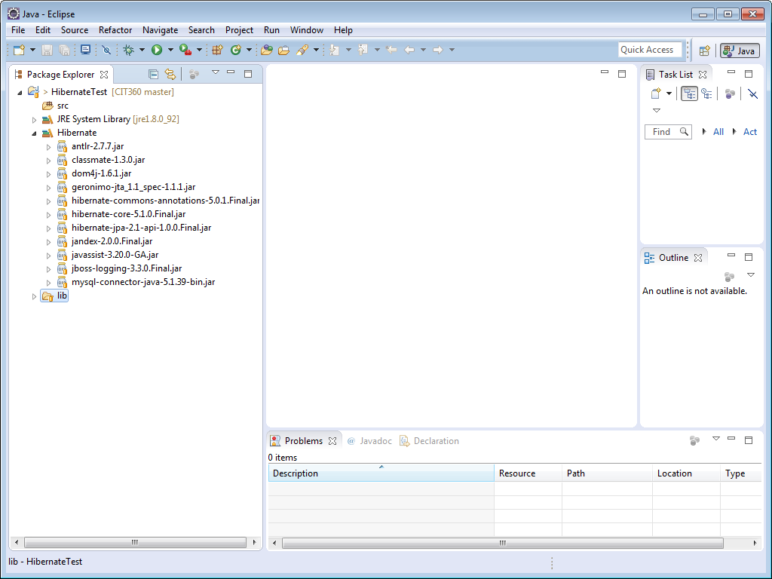
Hibernate Setup
Your project should look something like this.

Slide 20
Hibernate Setup
After following these steps, you should be ready to begin on the project
Hibernate - Part 2 will provide step by step instructions

Slide 21
What is persistence?
The storage of an object on a disk or other permanent storage device or data that exists from session to session
as opposed to transient data
Persistent data typically implies that it is durable (i.e. will survive a crash or shutdown of the process) usually with some guarantee of integrity
Persistence generally implies use of a database
One could use the file system (with suitably careful procedures)

Slide 22
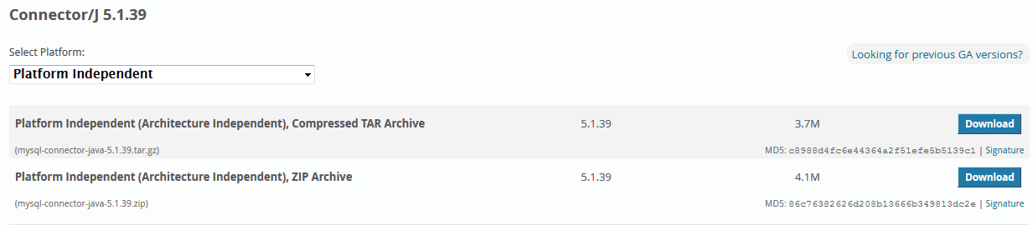
Hibernate Setup
You need a database driver JAR that Hibernate uses to connect to your database.
The official JDBC driver for MySQL is at
http://dev.mysql.com/downloads/connector/j/

Slide 23
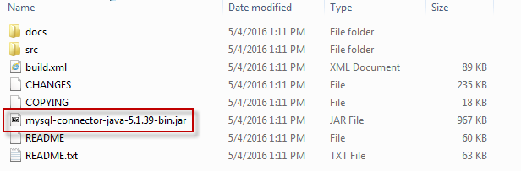
Hibernate Setup
Unzip/extract the file you downloaded
You need this JAR file

Slide 24
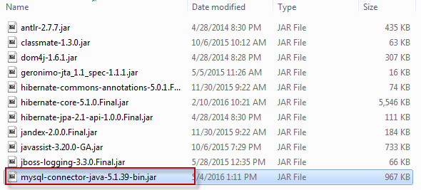
Hibernate Setup
For simplicity place the mysql-connector-java-5.1.39-bin.jar in the project lib subdirectory with the JAR files from Hibernate.

Slide 25
What is persistence?

Slide 26
What is persistence?

Slide 27
3 ways to persist data to the DB
JDBC
http://java.sun.com/products/jdbc/
Spring JDBC
http://www.springframework.org/docs/reference/jdbc.html
Hibernate
http://www.hibernate.org/

Slide 28
JDBC Info
Java Database Connectivity
Industry standard but has some issues:
The developer needs to deal with lot of plumbing and infrastructure, such as endless try-catch-finally-try-catch blocks.
Applications need complex error handling to ensure that connections are properly closed after they're used, which makes the code verbose, bloated, and repetitive.
JDBC uses the rather uninformative SQLException.
JDBC has no exception hierarchy
Bottom Line: Don’t use this!
From: http://java.sun.com/products/jdbc/

Slide 29
Spring JDBC Info
Abstraction framework for JDBC
i.e. It does lots of stuff for you!
Some features of Spring JDBC
JdbcDaoSupport – superclass, provides JdbcTemplate access
Spring provides an abstract exception layer, moving verbose and error-prone exception handling out of application code into the framework. The framework takes care of all exception handling; application code can concentrate on using appropriate SQL.
Spring provides a significant exception hierarchy for your application code to work with in place of SQLException.
For creating instances of oracle.sql.BLOB (binary large object) and oracle.sql.CLOB(character large object), Spring provides the class org.springframework.jdbc.support.lob.OracleLobHandler.
Bottom Line: If you love writing SQL, use this!
From: http://www.springframework.org/docs/reference/jdbc.html

Slide 30
Hibernate Info
Object / Relational mapping (ORM) and persistence / query framework
i.e. It does even more stuff for you!
Some features of Hibernate
HibernateDaoSupport – superclass, easy HibernateTemplate access
Database independence - sits between the database and your java code, easy database switch without changing any code
Object / Relational Mapping (ORM) - Allows a developer to treat a database like a collection of Java objects
Object oriented query language (HQL) - *Portable* query language, supports polymorphic queries etc.
You can also still issue native SQL, and also queries by “Criteria” (specified using “parse tree” of Java objects)
Hibernate Mapping - Uses HBM XML files to map value objects (POJOs) to database tables
Transparent persistence - Allows easy saves/delete/retrieve for simple value objects
Very high performance “in general” due to intelligent (2-level) caching, although in a few cases hand-written SQL might beat it
From: http://www.hibernate.org/

Slide 31
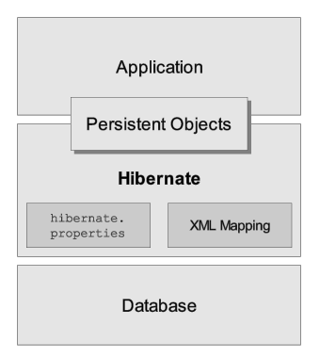
More Hibernate Info
Hibernate basically sits between the DB and your code
Can map persistent objects to tables
In Sakai, the Hibernate configuration is set for you already
From: http://www.hibernate.org/hib_docs/v3/reference/en/html/architecture.html

Slide 32
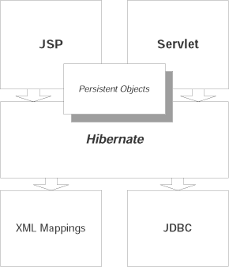
Even more Hibernate Info
Hibernate 2-tier web architecture
Can send data to JDBC or XML files
Best to just use it the way Sakai does (JDBC)
Bottom Line: Use this!
From: http://www.hibernate.org/354.html

Slide 33
Hibernate Commentary
Beyond the hype:
Hibernate *is* the best ORM persistence framework
probably in any language
Not to say it is without numerous issues
ORM is a tricky problem and general solutions are very difficult
Many aspects of the Hibernate framework are “over-eager”
lazy Collections, cascade options, long transactions
Many aspects of Hibernate are overly rigid
proxy behaviour, initial configuration sets cannot be changed, poor cross-ClassLoader behaviour
Advice
Use it cautiously! (pay attention to tips)
Avoid lazy Collections, be conservative with cascade options
In general just use it on one entity at a time, with explicit save/load on for each database operation
In some cases you may still actually want to fall back to SQL
recommended by the Hibernate team for certain situations

Slide 34
Some database tips
Always turn on hbm2ddl.auto
<prop key="hibernate.hbm2ddl.auto">update</prop>
You may want to turn this off for production environments
HSQLDB works well for development and for demos
Caveat: You cannot look at the HSQLDB database without some serious trickery
If all else fails, switch to HSQLDB file storage

Slide 35
More database tips
MySQL despite being a “production” option is actually really easy to set up for development
Allows you to look at the database through its console to see if things are working
Works well on most platforms and tends to get into a lock state somewhat easily which helps you find transaction problems

Slide 36
One last database tip
You can turn on verbose Hibernate logging to see every SQL statement that it runs
Change the following from false to true <prop key="hibernate.show_sql">false</prop>
Note: You do NOT want to leave this on in a production environment

Slide 37
Hibernate Development
4 methods of development using Hibernate
Top down (good for existing code)
implement a Java (JavaBeans) object model
write a mapping document by hand, or generate it from XDoclet tags
export the database tables using the Hibernate Tools
Bottom up (good for existing database or code conversion)
start with an existing data model
use the Hibernate Tools to generate the mapping documents
use the Hibernate Tools to generate skeletal Java code
fill in the business logic by hand
Middle out (good for new development)
express your conceptual object model directly as a mapping document
use the Hibernate Tools to generate skeletal Java code
fill in the business logic by hand
export the database tables using the Hibernate Tools
Meet in the middle (good for existing JDBC to Hibernate switch)
start with an existing data model and existing Java classes
write a mapping document to adapt between the two models
From: http://www.hibernate.org/355.html

Slide 38
Hibernate Tips - Avoid primitives
Don’t use primitives for properties on persistent objects
This works fine in general but it does not work if you are doing a findByExample
If you do decide to use primitives, you cannot leave them null/unset when doing a findByExample or they will be set to the default value for that primitive
Things seem to work better when not using primitives sometimes (e.g. Boolean)

Slide 39
Hibernate Tips - don’t preset values
Don’t set the values of persistent objects in the POJO
This can cause problems with frameworks that expect to be able to instantiate the POJO with all properties unset
It may be more work to set the properties for all non-null attributes but it is worth it

Slide 40
Hibernate Tips - save dependent objects first
If you have any dependent entities as properties of a persistent object you *must* save them before saving the parent class
Hibernate has numerous “cascade” options that claim to do this automatically, but it is best to start simple
The same thing goes for deleting

Slide 41
Hibernate Tips - non-primitive generated ids
Use non-primitive generated ids for the primary key of persistent objects
It is more efficient and is a good idea in most databases anyway
Use java.lang.Long or java.lang.String for best results
More best practices here: http://www.hibernate.org/hib_docs/reference/en/html/best-practices.html

Slide 42
Hibernate Tools
Hibernate provides a set of Eclipse tools
http://www.hibernate.org/255.html
Mapping Editor: An editor for Hibernate XML mapping files, supporting auto-completion and syntax highlighting
Console: a view in Eclipse. Provides a tree overview of console configurations and interactive view of persistent classes and relationships. Also allows the execution of HQL queries against your database and browsing of results in Eclipse.
Development Wizards: Includes the Hibernate configuration (cfg.xml) files wizard and reverse engineering wizard for turning an existing database schema into POJO source files and HBM files.
From: http://www.hibernate.org/255.html

Slide 43
Using hibernate in your app
Create a Hibernate SessionFactory using config settings in your app
You should only create one Session Factory per database
You can create another one when connecting to an external database
More info on session configuration:
http://www.hibernate.org/hib_docs/reference/en/html/session-configuration.html

Slide 44
Use the Generic Dao package
The GenericDao is an abstraction layer that will allow you to use Hibernate with your persistent objects without needing to write a DAO at all
It has usage information in the Javadocs
Highly configurable and extendable
Has no Hibernate dependencies in the interfaces (*any* DAO should be like this)
URL: http://bugs.sakaiproject.org/confluence/display/BOOT/Generic+DAO+package

Slide 45
More on GenericDao
Get the code and javadocs from the VT Maven repository:
http://source.edtech.vt.edu/maven/generic-dao/
Usage (Sakai related) is demonstrated in the tasklist code here:
https://source.sakaiproject.org/contrib/programmerscafe/trunk/tasklist/

Slide 46
Let’s look at some code!
Let’s see what it takes to use Hibernate
Hibernate and Spring packages
Hibernate mapping file(s)
Hibernate properties file
Hibernate related Spring beans
DAO beans

Slide 47
Hibernate and Spring packages
Download the Hibernate Core from: http://www.hibernate.org/6.html
Get at least version 3.1.3
Download the Spring framework here: http://www.springframework.org/download
Get version 1.2.8 for now
Version 2.0 is risky, wait for patches

Slide 48
Hibernate Mapping Files
Hibernate uses an XML file to map Java objects onto database columns
We will create our mapping file from a simple template attached to the persistence page
For applications with many tables, use a tool to help generate the HBM files

Slide 49
Basic HBM template
<?xml version="1.0"?> <!DOCTYPE hibernate-mapping PUBLIC "-//Hibernate/Hibernate Mapping DTD 3.0//EN" "http://hibernate.sourceforge.net/hibernate-mapping-3.0.dtd"> <hibernate-mapping> <class name="org.sakaiproject.toolname.model.MyObject" table="TOOLNAME_MYOBJECT"> <id name="id" type="long">
<generator class="native"> <param name="sequence">MYOBJECT_ID_SEQ</param> </generator> </id> <property name="myProperty" type="string" length="255" not-null="true”/> </class> </hibernate-mapping>

Slide 50
Template customization
Change the class name and table name
edu.vt.group.toolname.model.MyObject
Change the id sequence name
Copy and paste the property block to add the properties from your persistent object
owner
title
creationDate
Etc…

Slide 51
Creating a DAO for Hibernate
Create a new class which implements your DAO interface
Write a DAO interface if you do not have one
Extend HibernateDaoSupport
part of Spring-Hibernate
Add import for HibernateDaoSupport
Make sure you use the one for hibernate 3
Or use Generic DAO package!

Slide 52
DAO sample code
Make an interface for your DAO
public interface MyAppDAO {
}
Make an implementation of the DAO interface
public class MyAppDAOImpl
extends HibernateDaoSupport
implements MyAppDAO {
}
Note that it Extends HibernateDaoSupport

Slide 53
Spring configuration
Now we need to tie everything together with Spring
First we will tell hibernate about our MyObject.hbm.xml mapping file
Next we will give the hibernate stuff to our DAO implementation
Finally we will tie the new DAO to the rest of the webapp

Slide 54
Create a Data Source
<bean id=“myLocalDataSource"
class="org.springframework.jdbc.datasource.DriverManagerDataSource">
<property name="driverClassName">
<value>oracle.jdbc.driver.OracleDriver</value>
</property>
<property name="url">
<value>jdbc:oracle:thin:@myDB.host.com:1521:SCHEMA</value>
</property>
<property name="username">
<value>USERNAME</value>
</property>
<property name="password">
<value>PASSWORD</value>
</property>
</bean>
Setup the connection settings for the database

Slide 55
Create a SessionFactory (part 1)
<bean id=“myAppSessionFactory"
class="org.springframework.orm.hibernate3.LocalSessionFactoryBean">
<property name="dataSource">
<ref local=“myLocalDataSource" />
</property>
<property name="mappingResources">
<list>
<value>
com/group/myapp/impl/hbm/MyObject.hbm.xml
</value>
</list>
</property>
...
This ties our persistent objects with the newly created SessionFactory bean

Slide 56
Create a SessionFactory (part 2)
<property name="hibernateProperties">
<props>
<prop key="hibernate.dialect">
org.hibernate.dialect.Oracle9Dialect</prop>
<prop key="hibernate.show_sql">false</prop>
<prop key="hibernate.cache.provider_class">
org.hibernate.cache.EhCacheProvider</prop>
<prop key="hibernate.query.substitutions">true 1, false 0</prop>
<prop key="hibernate.hbm2ddl.auto">update</prop>
<!-- create, update, create-drop (wipe and create), or blank -->
</props>
</property>
</bean>
This sets up the various properties (could also come from a props file)

Slide 57
Create a transaction manager
<bean id=“myAppTransactionManager"
class="org.springframework.orm.hibernate3.HibernateTransactionManager">
<property name="sessionFactory">
<ref local=“myAppSessionFactory" />
</property>
</bean>
Creates a spring transaction manager
We need this in order to manage transactions in a reasonable way later
You can manage them manually, but why?

Slide 58
Create a DAO bean
<bean id=“com.group.myapp.dao.target.MyAppDAO"
class=“com.group.myapp.dao.impl.MyAppDAOImpl"
init-method="init">
<property name="sessionFactory">
<ref local=“myAppSessionFactory" />
</property>
</bean>
Create a DAO bean using the data access object class that we have created
This injects the SessionFactory into that class bean

Slide 59
Define a declarative transaction interceptor
<bean id=“com.group.myapp.dao.MyAppDAO"
class="org.springframework.transaction.interceptor.TransactionProxyFactoryBean">
<property name="target">
<ref local=“com.group.myapp.dao.target.MyAppDAO"/>
</property>
<property name="transactionManager">
<ref bean=“myAppTransactionManager" />
</property>
<property name="transactionAttributes">
<props>
<prop key="*">PROPAGATION_REQUIRED</prop>
</props>
</property>
</bean>
This involves much less work than opening and closing transactions in code, and is more reliable
Note that this is what we will access, not the actual DAO bean (the use of the name of the interface is a convention, not a requirement)

Slide 60
Use Hibernate in code
Access the persistent objects just like you would any normal java POJO
Use the dao operations (save, delete, etc.) to control the lifetimes of objects
Take advantage of the Hibernate tools

Slide 61
Example App revisit
Same basic structure
Alpha is the main class
Bravo handles user interaction
Charlie handles application logic
Delta handles data access
New implementation of the Delta interface
UserString model class and hbm
Alpha
Bravo
Charlie
UserString
(hbm and class)
DeltaHibernate
Delta
A B = A depends on B

Slide 62
Changes to Example App
Implemented Delta interface using Spring HibernateDaoSupport
Adjusted bean definitions to point to the new implementation
Created hbm file and model class
Added bean definitions for Hibernate
Programmers Cafe - Example App Spring Hibernate

Slide 63
Any questions?
Hibernate: http://www.hibernate.org/
Spring ORM
http://www.springframework.org/docs/reference/orm.html

