Slide 1


Event Management for Catering Websites
Event management plays a critical role in the success of catering websites. From planning and coordination to logistics and execution, event management ensures a seamless experience for clients.
by Anagha Prabhu
S3 MCA
ROLL NO:06
1

Slide 2

INDEX
INTRODUCTION
MODULES
DFD
DATABASE TABLES
FRONTEND AND BACKEND
CONCLUSION
2

Slide 3

1.INTRODUCTION
Welcome to our Event management website,
designed specifically for catering services.
Our platform aims to streamline the process of
organizing and managing catering for various events
Ensuring a seamless and enjoyable experience for both
clients and service providers
3

Slide 4

2.MODULES
USER MODULE
Login/Register: User accounts.
User Dashboard: Personal details, event history.
Browse Services: Explore catering options.
Design Menu: Customize menus.
Make Payment: Secure transactions.
Order Confirmation: Confirm orders.
Receive Promo: Promotions and rewards.
Gallery: Upload photos and reviews.
4

Slide 5

ADMIN MODULE
Login: Admin access.
Admin Dashboard: System overview.
Manage Services: Update catering options.
View Orders: Order details.
Update Menu: Modify menu items.
Assign Catering: Allocate tasks.
Monitor Inventory: Track stock.
Update Status: Order statuses.
5

Slide 6
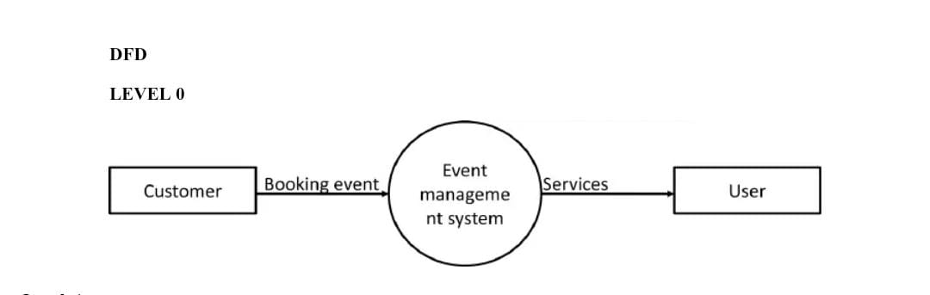
3.DATA FLOW DIAGRAM
LEVEL 0
6

Slide 7
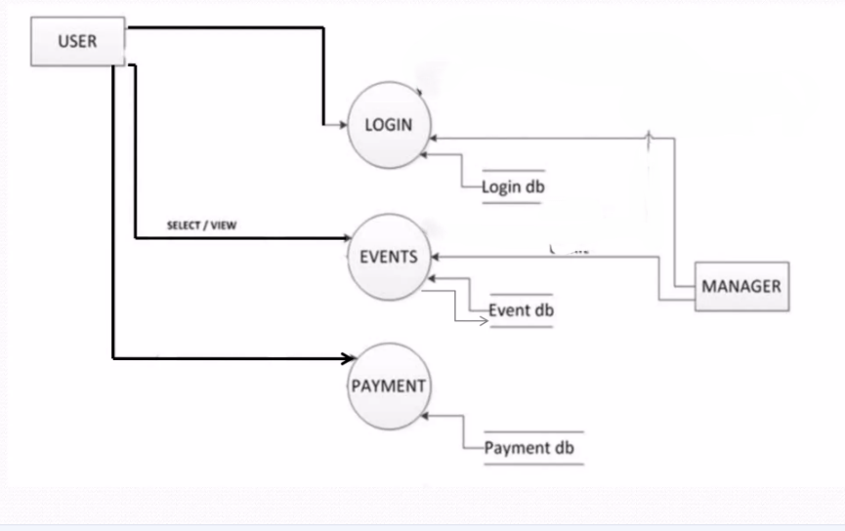
LEVEL 1 – For User
7

Slide 8
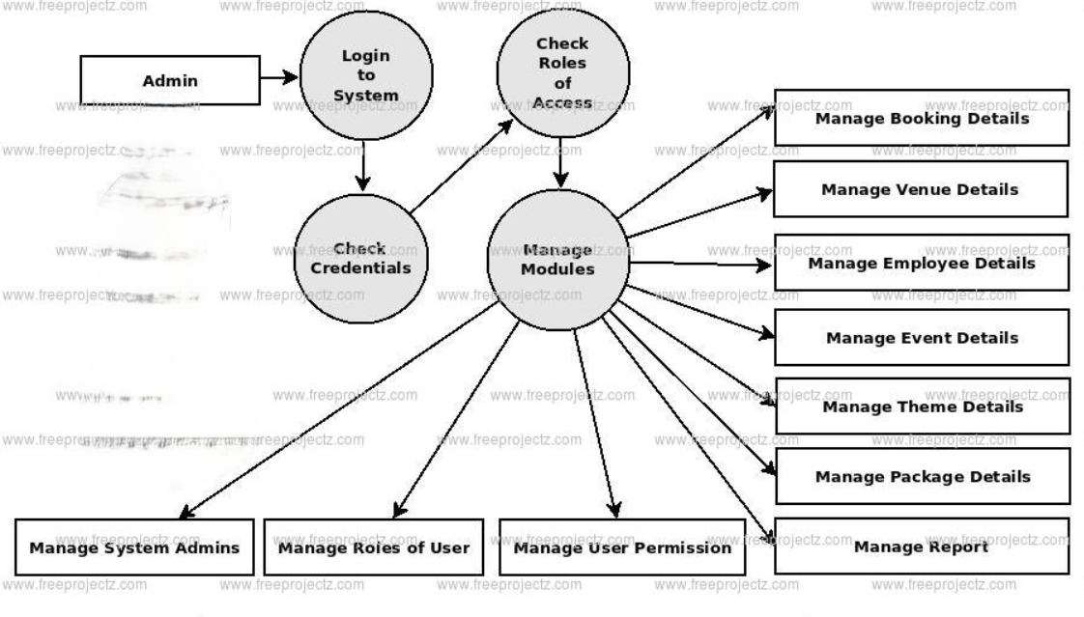
User Table
Level 1- For Admin
8

Slide 9
4.DATABASE TABLE
USER TABLE
Column Name | Data Type | Constraints | Description
user_id | INT | Primary Key | Unique identifier for users
username | VARCHAR |  | User's login name
password | VARCHAR |  | User's password
email | VARCHAR |  | User's email address
phone_number | VARCHAR |  | User's phone number
9

Slide 10
ADMIN TABLE
Column Name | Data Type | Constraints | Description
admin_id | INT | Primary Key | Unique identifier for admins
admin_username | VARCHAR |  | Admin's login name
admin_password | VARCHAR |  | Admin's password
admin_email | VARCHAR |  | Admin's email address
10

Slide 11
EVENT TABLE
Column Name | Data Type | Constraints | Description
event_id | INT | Primary Key | Unique identifier for events
event_name | VARCHAR |  | Name of the event
event_date | DATE |  | Date of the event
event_location | VARCHAR |  | Location of the event
user_id | INT | Foreign Key | ID of the user hosting the event
11

Slide 12
ORDER TABLE
Column Name | Data Type | Constraints | Description
order_id | INT | Primary Key | Unique identifier for orders
user_id | INT | Foreign Key | ID of the user placing the order
event_id | INT | Foreign Key | ID of the event for which the order is placed
order_total | DECIMAL |  | Total amount of the order
12

Slide 13
MENU TABLE
Column Name | Data Type | Constraints | Description
menu_id | INT | Primary Key | Unique identifier for menus
menu_name | VARCHAR |  | Name of the menu item
menu_description | TEXT |  | Description of the menu item
menu_price | DECIMAL |  | Price of the menu item
13

Slide 14
ORDERS_DETAILS TABLE
Column Name | Data Type | Constraints | Description
order_detail_id | INT | Primary Key | Unique identifier for order details
order_id | INT | Foreign Key | ID of the associated order
menu_id | INT | Foreign Key | ID of the ordered menu item
quantity | INT |  | Quantity of the menu item
14

Slide 15
REVIEW TABLE
Column Name | Data Type | Constraints | Description
review_id | INT | Primary Key | Unique identifier for reviews
user_id | INT | Foreign Key | ID of the user writing the review
event_id | INT | Foreign Key | ID of the event being reviewed
review_text | TEXT |  | Text of the review
review_rating | INT |  | Rating given in the review
15

Slide 16
GALLERY TABLE
Column Name | Data Type | Constraints | Description
photo_id | INT | Primary Key | Unique identifier for photos
user_id | INT | Foreign Key | ID of the user uploading the photo
event_id | INT | Foreign Key | ID of the event in the photo
photo_url | VARCHAR |  | URL of the uploaded photo
16

Slide 17

5.FRONTEND AND BACKEND
Frontend:
User interface elements: buttons, text, images, layout.
Uses languages like HTML, CSS, JavaScript.
Focuses on user experience and design.
Backend:
Deals with databases, servers, application logic.
Uses languages like Python, Java.
Ensures smooth and secure operation.
17

Slide 18

6.CONCLUSION
Successfully combined frontend and backend for a cohesive application.
Frontend ensures an engaging user experience with intuitive design.
Backend supports robust performance, security, and database management.
Together, they create a seamless, responsive, and efficient user experience.
Provides a solid foundation for future enhancements and scalability.
18

Slide 19
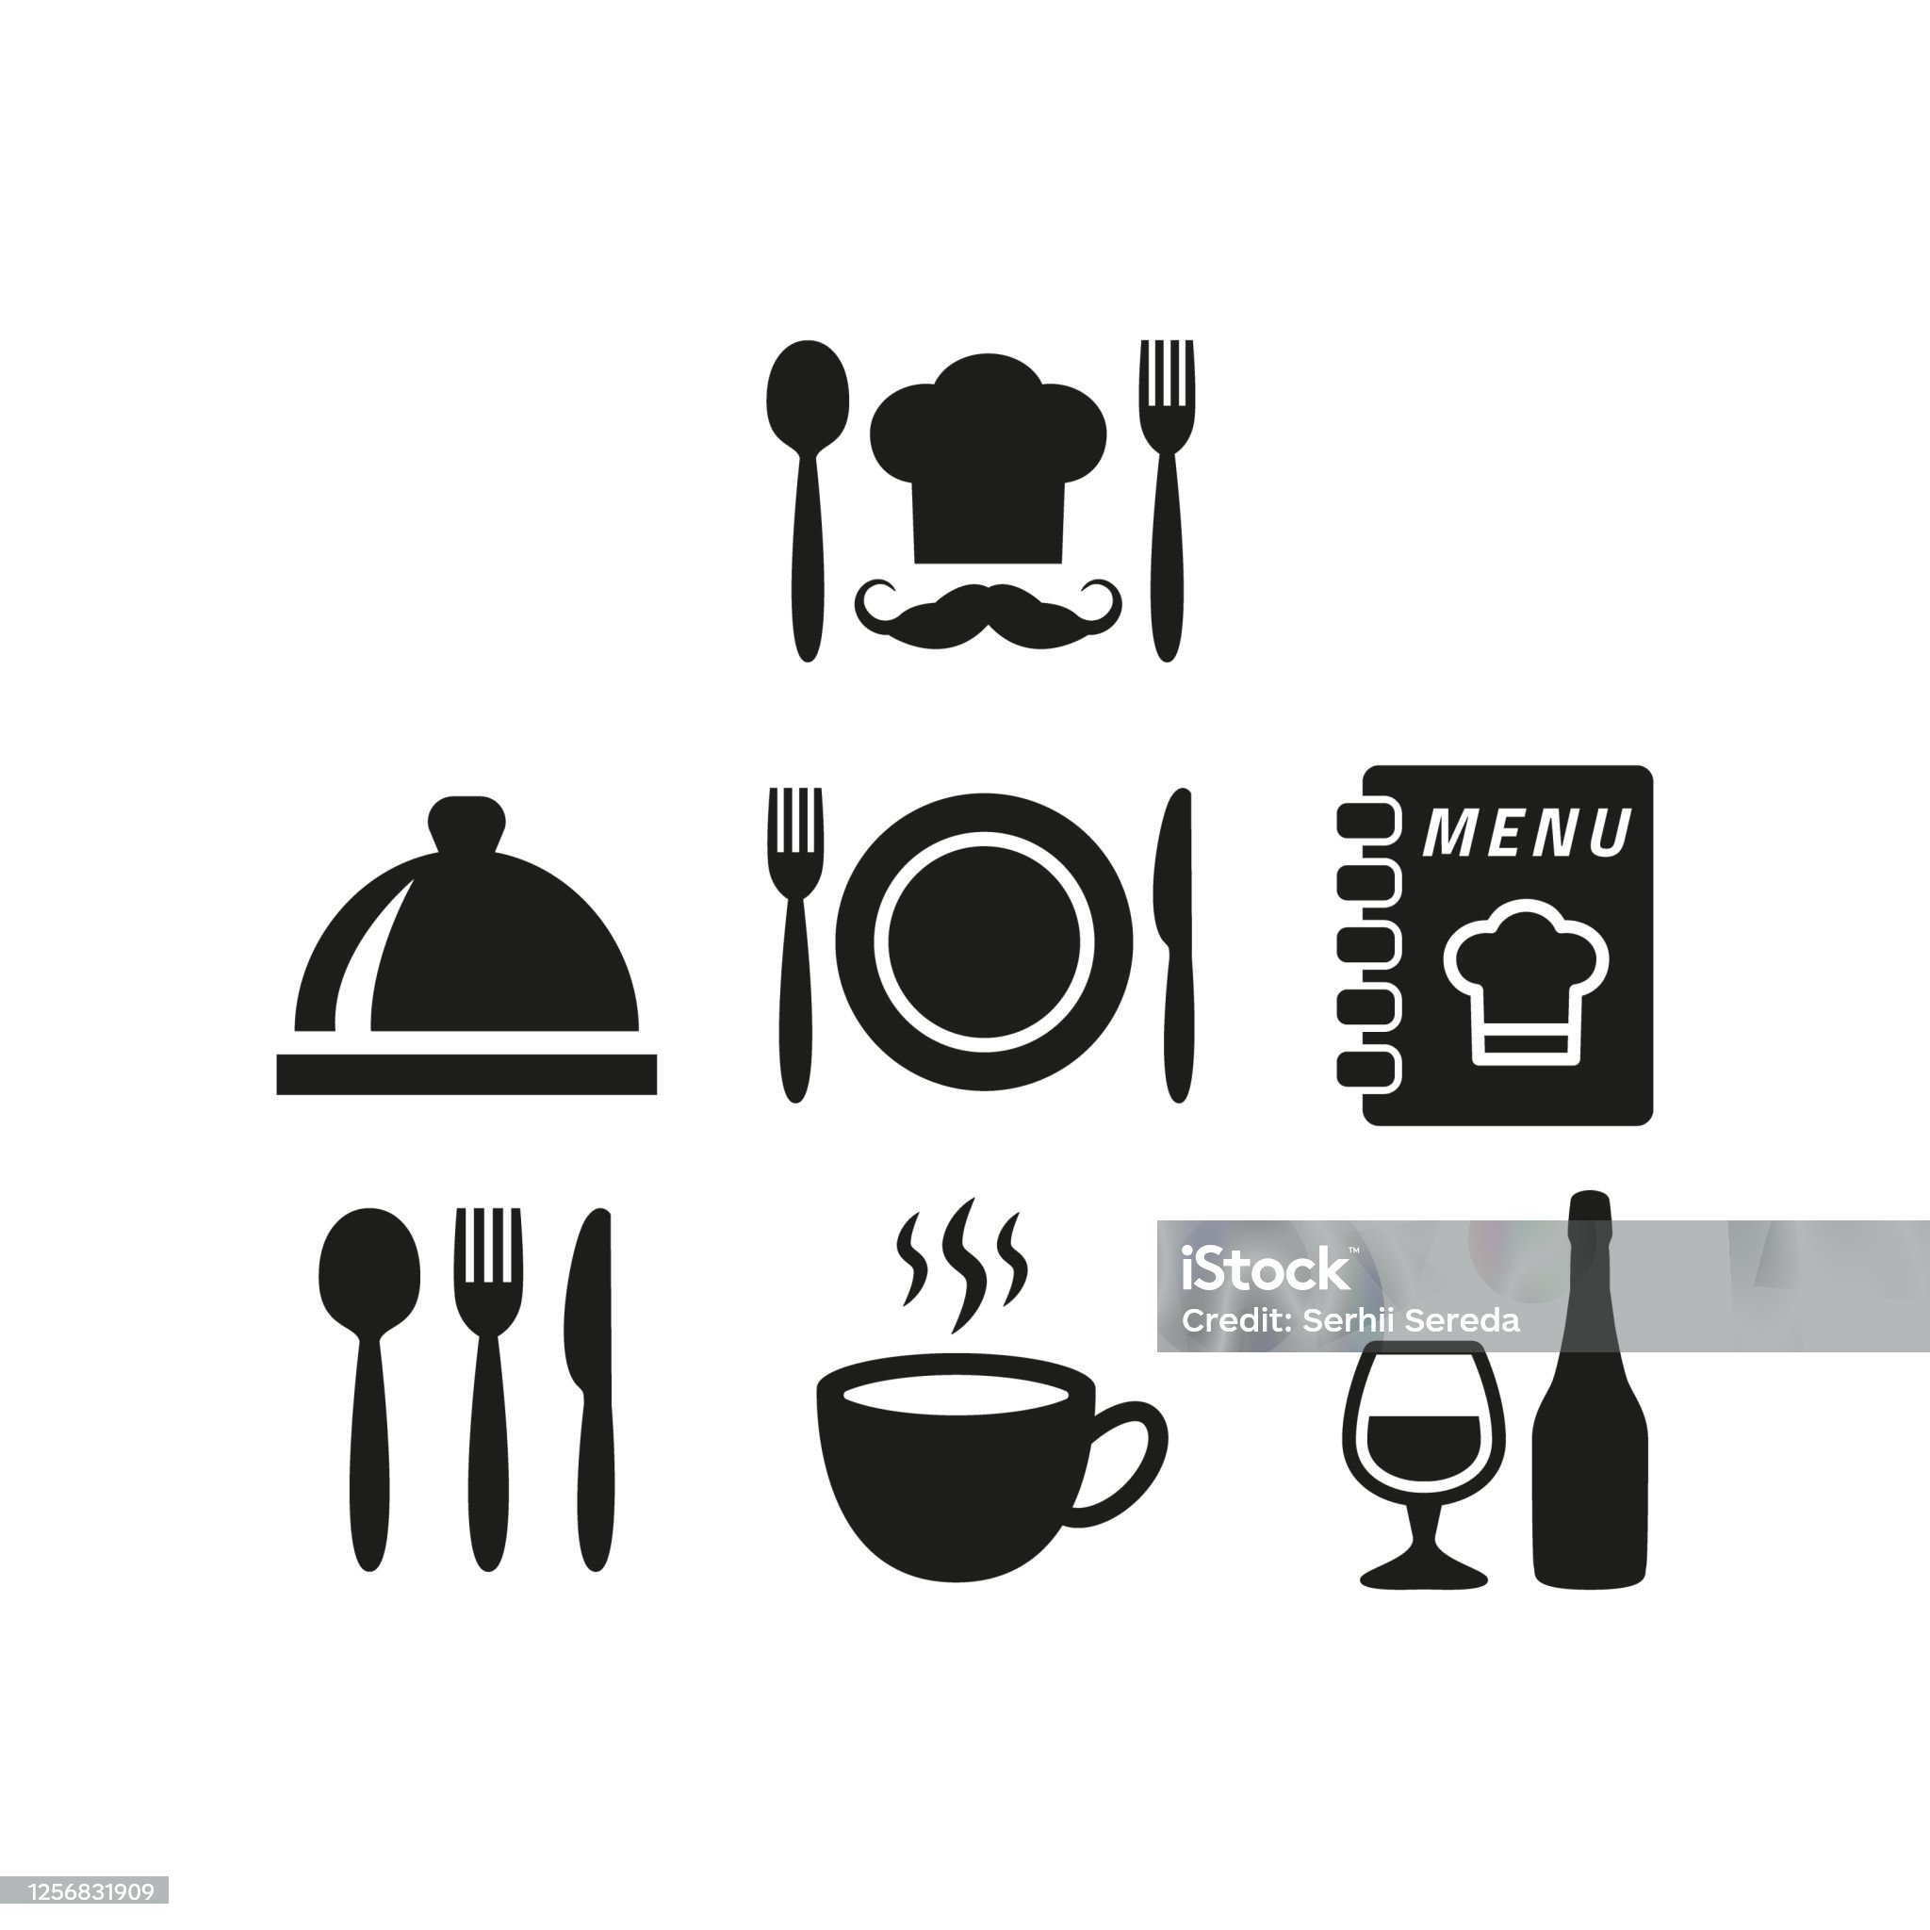
THANKYOU
19

