Slide 1








Microsoft Copilot Studio – Multi-Agent Orchestration Architecture
Intelligent Intent-Based Routing, Knowledge Retrieval & Response Generation
1 USER INTERFACE
Microsoft Teams
Microsoft 365 Copilot
Users submit questions via either channel
2 MAIN ORCHESTRATOR
Copilot Studio
Understands intent via generative orchestration
Identifies & invokes the right agent(s)
Collects & consolidates agent responses
Returns the final response to the user
3 SPECIALIZED AGENTS
AGENT 1 · SPECIALIZED AGENT
Knowledge Agent 1
Manages domain · retrieves · summarizes
AGENT 2 · SPECIALIZED AGENT
Knowledge Agent 2
Manages domain · retrieves · summarizes
AGENT 3 · SPECIALIZED AGENT
Knowledge Agent N
Manages domain · retrieves · summarizes
4 KNOWLEDGE SOURCES & TOOLS
SharePoint Knowledge Base
Different folders by domain
MCP Server
Model Context Protocol tools
Request flow (question → orchestrator → agents → knowledge)
Response flow (retrieved info → agents → orchestrator → Teams / M365 Copilot)
Notes:
Agents never respond to Teams / M365 Copilot directly; all final answers pass through the Main Orchestrator.

Slide 2
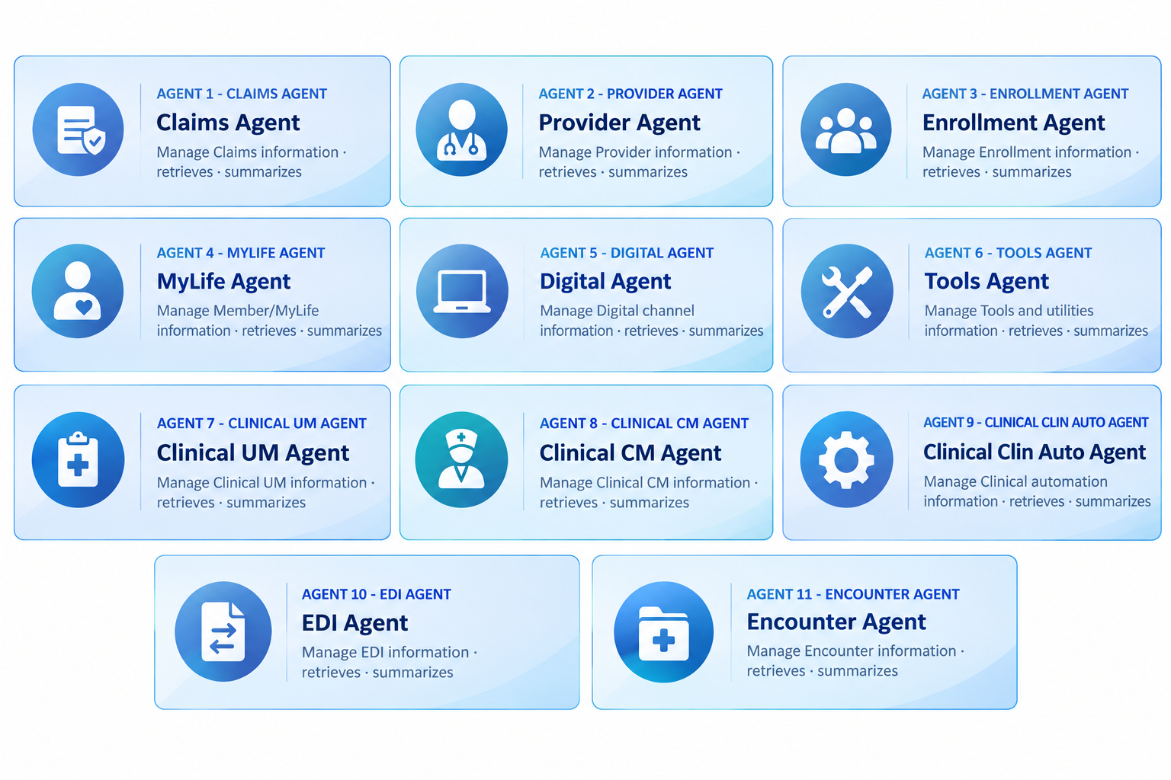
Microsoft Copilot Studio – Search Agent Developed

