Slide 1
Structured Query Language
introduction & basic querying

Slide 2
What is SQL?
SQL (Structured Query Language) is a language used to
store, retrieve,and manage data in relational databases
using commands like SELECT, INSERT, UPDATE, and DELETE.

Slide 3
How are data stored?
Data is stored as table in rows and columns
Rows: represent objects
Columns: represent attributes about objects

Slide 4
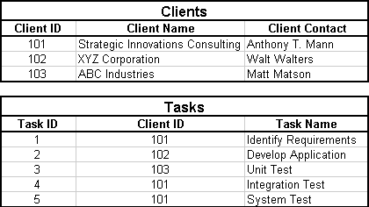
How are tables related?
PRIMARY KEY: unique identifier per row
FOREIGN KEY: enforces relationships between tables

Slide 5
ACID Properties
Atomicity: all or nothing
Consistency: valid state transitions
Isolation: transactions don't interfere
Durability: once committed, remains persistent

Slide 6
SELECT
SELECT column1, column2, … FROM table_name;
SELECT DISTINCT column FROM table_name;

Slide 7
WHERE Clause
SELECT * FROM table_name WHERE condition; Conditional operators:
AND OR NOT < <= > >= = <> LIKE: _ and % IN list BETWEEN x AND y

Slide 8
NULL Handling
IS NULL, IS NOT NULL in WHERE clauses
IFNULL(expr1, expr2) to replace NULLs

Slide 9
Aggregate Functions
SELECT COUNT(column), SUM(column), AVG(column), MIN(column), MAX(column)
FROM table_name;

Slide 10
LIMIT and OFFSET
SELECT * FROM table_name LIMIT N OFFSET M;

Slide 11
ORDER BY Clause
SELECT * FROM table_name
ORDER BY column ASC|DESC;

Slide 12
GROUP BY and HAVING
SELECT column, AGG(column)
FROM table_name
GROUP BY column
HAVING condition;

Slide 13
Advanced Queries
Set operations, Builtin functions and Joins!

Slide 14
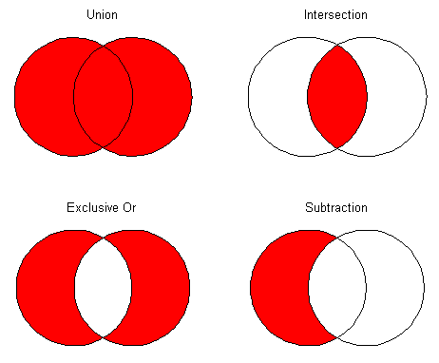
Set operations
UNION, INTERSECT & EXCEPT

Slide 15
UNION
SELECT column FROM table1
UNION
SELECT column FROM table2;

Slide 16
UNION ALL
SELECT column FROM table1
UNION ALL
SELECT column FROM table2;

Slide 17
INTERSECT
SELECT column FROM table1
INTERSECT
SELECT column FROM table2;

Slide 18
EXCEPT
SELECT column FROM table1
EXCEPT
SELECT column FROM table2;

Slide 19
Built-in Functions
For Strings and Numbers

Slide 20
String Functions
SELECT UPPER(column), LOWER(column), LENGTH(column), SUBSTRING(column, start, length)
FROM table;

Slide 21
Numeric Functions
SELECT ABS(column), CEIL(column), FLOOR(column), ROUND(column, decimals)
FROM table;

Slide 22
Subquery in WHERE
SELECT column FROM table
WHERE column IN
(SELECT column FROM table2 WHERE condition);

Slide 23
Subquery in FROM
SELECT alias.column
FROM (SELECT column FROM table WHERE condition) AS alias;

Slide 24
Subquery in SELECT
SELECT
column1,
(SELECT column FROM table2 WHERE condition) AS alias
FROM table1;

Slide 25
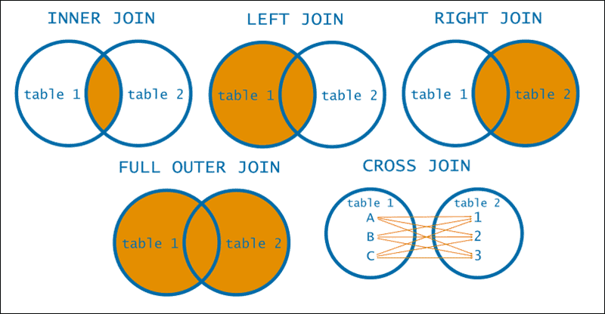
Joins

Slide 26
INNER JOIN
SELECT columns
FROM table1 INNER JOIN table2 ON table1.column = table2.column;

Slide 27
LEFT JOIN
SELECT columns
FROM table1 LEFT JOIN table2
ON table1.column = table2.column;

Slide 28
RIGHT JOIN
SELECT columns
FROM table1 RIGHT JOIN table2
ON table1.column = table2.column;

Slide 29
CROSS JOIN
SELECT columns
FROM table1 CROSS JOIN table2;

Slide 30
SELF JOIN
SELECT a.columns, b.columns
FROM table AS a, table AS b
WHERE a.common_column = b.common_column;

Slide 31
Data Manipulation
INSERT, UPDATE & DELETE

Slide 32
INSERT
INSERT INTO table (column1, column2)
VALUES (value1, value2);

Slide 33
UPDATE
UPDATE table
SET column1 = value1, column2 = value2
WHERE condition;

Slide 34
DELETE
DELETE FROM table
WHERE condition;

Slide 35
Data Definition
CREATE, ALTER & DROP

Slide 36
Data Types
INT or INTEGER FLOAT or REAL BIGINT CHAR(n) VARCHAR(n) TEXT
DATE TIME DATETIME TIMESTAMP BOOLEAN BLOB

Slide 37
Constraints
PRIMARY KEY
AUTO_INCREMENT
UNIQUE
DEFAULT value CHECK condition
NOT NULL
FOREIGN KEY (column) REFERENCES table(column)

Slide 38
CREATE DATABASE
CREATE DATABASE [IF NOT EXISTS] database_name;

Slide 39
CREATE TABLE
CREATE TABLE [IF NOT EXISTS] table_name (
column1 datatype constraints…,
column2 datatype constraints…,
…, constraint(column), …
)

Slide 40
ALTER TABLE - ADD COLUMN
ALTER TABLE table_name
ADD COLUMN column_name datatype constraint;

Slide 41
ALTER TABLE - MODIFY COLUMN
ALTER TABLE table_name
MODIFY COLUMN column_name datatype;

Slide 42
ALTER TABLE - DROP COLUMN
ALTER TABLE table_name
DROP COLUMN column_name;

Slide 43
ALTER TABLE - ADD CONSTRAINT
ALTER TABLE table_name
ADD CONSTRAINT constraint_name constraint;

Slide 44
ALTER TABLE - DROP CONSTRAINT
ALTER TABLE table_name
DROP CONSTRAINT constraint_name;

Slide 45
ALTER TABLE - RENAME COLUMN
ALTER TABLE table_name RENAME COLUMN old_col_name TO new_col_name;

Slide 46
RENAME TABLE
RENAME TABLE old_table_name TO new_table_name;

Slide 47
DROP DATABASE
DROP DATABASE [IF EXISTS] database_name;

Slide 48
DROP TABLE
DROP TABLE [IF EXISTS] table_name;

Slide 49
TRUNCATE TABLE
TRUNCATE TABLE Students;

Slide 50
INDEXES - for fast lookups
CREATE & DROP

Slide 51
CREATE INDEX
CREATE INDEX index_name ON table(column);

Slide 52
DROP INDEX
DROP INDEX index_name ON table_name;

Slide 53
VIEWS
CREATE & DROP

Slide 54
CREATE VIEW
CREATE VIEW view_name AS query;

Slide 55
DROP VIEW
DROP VIEW [IF EXISTS] view_name;

Slide 56
Data Control
GRANT & REVOKE

Slide 57
GRANT
GRANT privileges ON database.table TO 'username'@'host';

Slide 58
REVOKE
REVOKE privileges ON database.table FROM 'username'@'host';

Slide 59
Transaction Control
COMMIT & ROLLBACK

Slide 60
START TRANSACTION;
COMMIT;
To write changes to DB
ROLLBACK;
To undo changes

Slide 61
SAVEPOINT name;
ROLLBACK TO name;
To undo changes

Slide 62
Triggers

Slide 63
CREATE TRIGGER
CREATE TRIGGER trigger_name
{BEFORE | AFTER} {INSERT | UPDATE | DELETE}
ON table_name
FOR EACH ROW
statement;

Slide 64
DROP TRIGGER
DROP TRIGGER name;

Slide 65
