Slide 1
Structured Query Language
introduction & basic querying

Slide 2
What is SQL?
SQL (Structured Query Language) is a language used to
store, retrieve,and manage data in relational databases
using commands like SELECT, INSERT, UPDATE, and DELETE.

Slide 3
How are data stored?
Data is stored as table in rows and columns
Rows: represent objects
Columns: represent attributes about objects

Slide 4
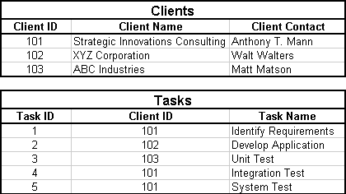
How are tables related?
PRIMARY KEY: unique identifier per row
FOREIGN KEY: enforces relationships between tables

Slide 5
ACID Properties
Atomicity: all or nothing
Consistency: valid state transitions
Isolation: transactions don't interfere
Durability: once committed, remains persistent

Slide 6
SELECT
SELECT column1, column2, … FROM table_name;
SELECT DISTINCT column FROM table_name;

Slide 7
WHERE Clause
SELECT * FROM table_name WHERE condition; Conditional operators:
AND OR NOT < <= > >= = <> LIKE: _ and % IN BETWEEN

Slide 8
NULL Handling
IS NULL, IS NOT NULL in WHERE clauses
IFNULL(expr1, expr2) to replace NULLs

Slide 9
Aggregate Functions
SELECT COUNT(column), SUM(column), AVG(column), MIN(column), MAX(column)
FROM table_name;

Slide 10
LIMIT and OFFSET
SELECT * FROM table_name LIMIT N OFFSET M;

Slide 11
ORDER BY Clause
SELECT * FROM table_name
ORDER BY column ASC|DESC;

Slide 12
GROUP BY and HAVING
SELECT column, AGG(column)
FROM table_name
GROUP BY column
HAVING condition;

