Slide 1
Credit Score Status Prediction
A Machine Learning Based Intelligent Classification System

Slide 2
About the Project
This project aims to build a predictive model that classifies individuals into credit score categories (Good, Standard, Bad) based on their financial data.
This model helps financial institutions automate creditworthiness evaluation, reducing manual intervention and risk assessment time.

Slide 3
Dataset Overview
The dataset contains the following financial and behavioral features:
'Month', 'Age', 'Occupation', 'Annual_Income', 'Monthly_Inhand_Salary’,
'Num_Bank_Accounts', 'Num_Credit_Card', 'Interest_Rate', 'Num_of_Loan',
'Delay_from_due_date', 'Num_of_Delayed_Payment', 'Changed_Credit_Limit',
'Num_Credit_Inquiries', 'Credit_Mix', 'Outstanding_Debt', 'Credit_Utilization_Ratio', 'Credit_History_Age', 'Payment_of_Min_Amount', 'Total_EMI_per_month', 'Amount_invested_monthly', 'Payment_Behaviour', 'Monthly_Balance'

Slide 4
Models Used for Prediction
The following classifiers were evaluated for credit score prediction after feature selection using Recursive Feature Elimination:
KNeighborsClassifier: 93.20%
SVC: 93.31%
MultinomialNB: 70.37%
DecisionTreeClassifier: 93.70%
RandomForestClassifier: 96.43%
GradientBoostingClassifier: 94.58%
AdaBoostClassifier: 84.57%
XGBClassifier: 96.27%

Slide 5
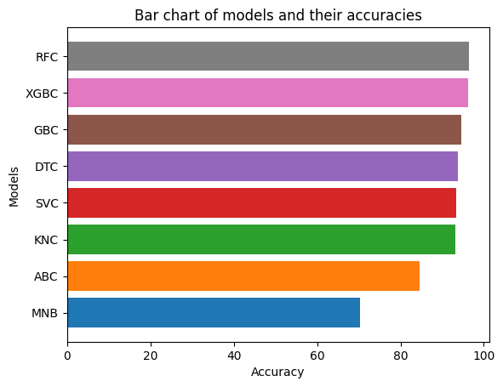
Selection of Best Model
→ Selected Model: RandomForestClassifier with an accuracy of 96.43%

Slide 6
Model Training Workflow
1. Data Cleaning: Removed nulls, corrected data types, and dropped irrelevant data.
2. Outlier Handling: IQR method used to eliminate invalid/negative values.
3. EDA: Conducted using Matplotlib and Seaborn for insights.
4. Encoding: Label and Ordinal Encoding applied.
5. Feature Selection: Used Recursive Feature Elimination (RFE) to pick the top 10 features.
6. Modeling: Trained multiple classifiers, selected RandomForestClassifier.
7. Deployment: Streamlit interface with Pickle for real-time prediction.

Slide 7
Modules Used in Model Building
Core Libraries:
pandas, numpy, re
Visualization:
matplotlib.pyplot, seaborn
Preprocessing & Modeling:
sklearn.preprocessing (MinMaxScaler, LabelEncoder, OrdinalEncoder)
sklearn.model_selection (train_test_split, GridSearchCV)
sklearn.feature_selection (RFE)
sklearn.ensemble (RandomForestClassifier, GradientBoostingClassifier, AdaBoostClassifier)
sklearn.metrics (accuracy_score, classification_report)
xgboost (XGBClassifier)
pickle

Slide 8
Highly Correlated Features with Credit Mix
Top 10 correlated features with Credit Mix using correlation matrix:
- Num_of_Delayed_Payment 0.751
- Payment_of_Min_Amount 0.741
- Interest_Rate 0.729
- Num_Bank_Accounts 0.699
- Outstanding_Debt 0.697
- Delay_from_due_date 0.669
- Credit_History_Age 0.647
- Num_Credit_Inquiries 0.638
- Num_of_Loan 0.634
- Num_Credit_Card 0.537
These features significantly influence the classification performance.

Slide 9
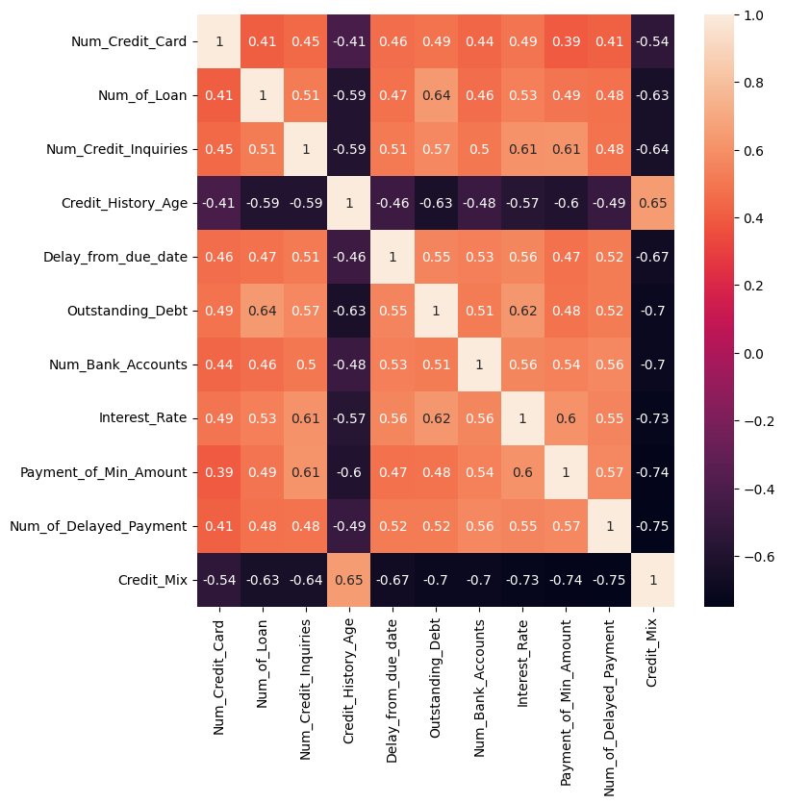
Insights from Heatmap

Slide 10
Conclusion
✔ RandomForestClassifier outperformed all other models with ~96.43% test accuracy.
✔ The system effectively classifies credit status and helps reduce human evaluation time using an intelligent automated workflow.

