Slide 1
CSCI 4430 - Spring 22
Tutorial 10

Slide 2
WTP: basics
aim: a reliable transport protocol for file transfering
4 pkt types: START; END; DATA; ACK
size
IP header 20B; UDP header 8B; WTP header 32B
Ethernet frame upto 1500B
type
seqNum
length
checksum
data
4B
4B
4B
4B
up to 1456B
 |  | WTP hdr | WTP data
 | UDP hdr | UDP data
IP hdr | IP data
Ethernet frame

Slide 3
WTP: stages
initiate:
Sender: “I have something for you!” <START, R, 0, 0>
Receiver: “I am ready, please proceed.” <ACK, R, 0, 0>
data transmission:
Sender: “Here is the i-th part.” <DATA, i, LEN, SUM>
Receiver: “Got you, please send me the j-th one.” <ACK, j, 0, 0>
finish:
Sender: “That’s all there is for file R” <END, R, 0, 0>
Receiver: “I have saved it.” <ACK, R, 0, 0>
special note:
initiate and finish stages use the same random seqNum R
unrelated to data packets
to mark the begin and end of the same file
seqNum in data ACK is the next packet to be expected just like TCP
begin at 0 and increment by 1 for each packet

Slide 4
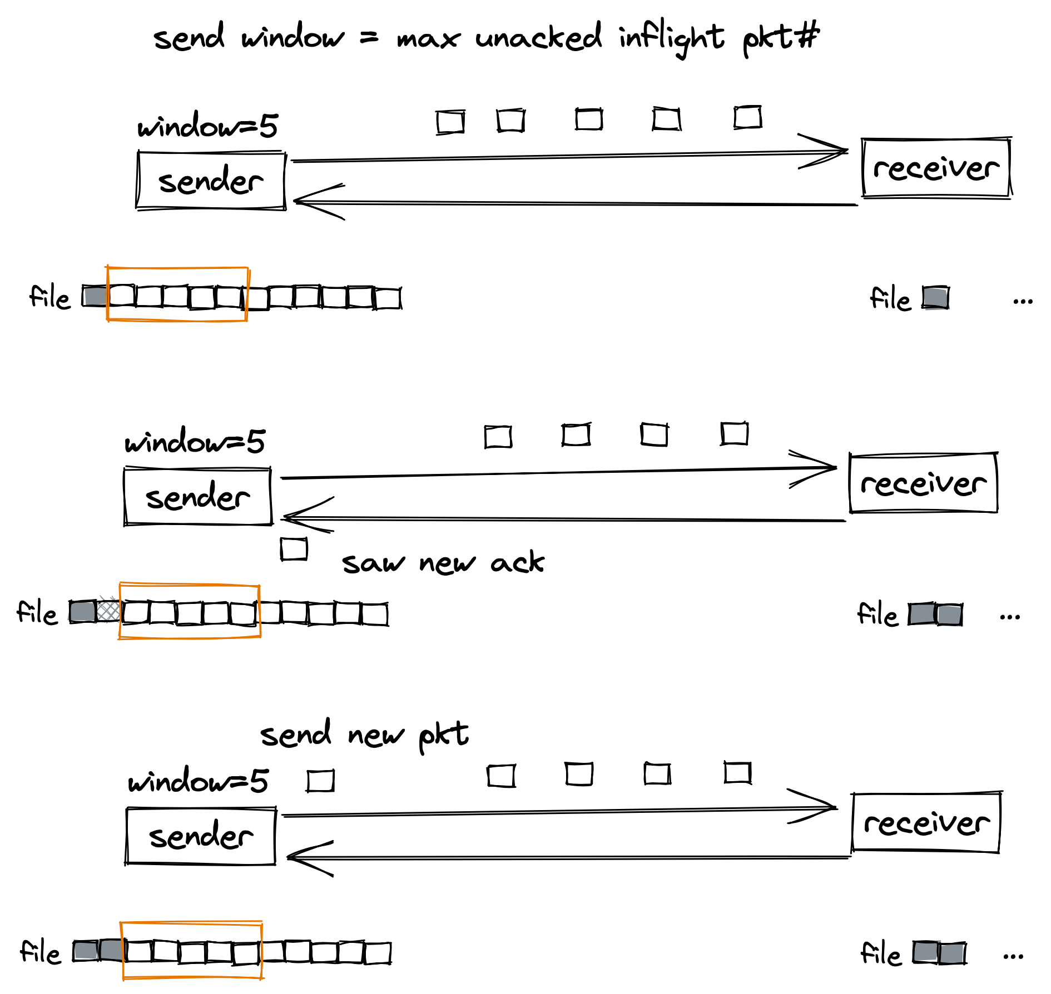
WTP: sliding window
initially
send a window of pkts
when saw a new ack
advance the window by how many pkt acked (could > 1: cumulative ack)
send new pkts covered by the window

Slide 5
WTP: sender
special cases stragegy
pkt loss: retransmission timer
reordered/delayed/duplicated ACK:
ignore if the ACKed packet is not in the sending window
otherwise retransmit the desired packet
implementation of retransmission timer
we implement the timer as a simple timestamp
implement the data sending and ack receiving in a single loop
update timestamp when sending data pkts
check for timeout and retransmit at the end of each iteration
problem: recvfrom might block forever if noting has arrived

Slide 6
Hint: non-blocking recv
recvfrom with flag MSG_DONTWAIT
if the operation would block, the call fails with the error EAGAIN or EWOULDBLOCK
i.e. “there is no packet to recv, I can check later”
Is possible that I miss some pkt?
no, if you did not receive anything in this iteration, you will eventually in the next few tries.

Slide 7

The last quiz
URL: http://ureply.mobi
Session number: L28779

