Slide 1
ESTR4120 Computer Networks Lecture 2: HTTP/2, HTTPS, P2P
Hong Xu

Slide 2
More on HTTP

Slide 3
HTTP/2
Key goal: decreased delay in multi-object HTTP requests
HTTP1.1: introduced multiple, pipelined GETs over single TCP connection
server responds in-order (FCFS: first-come-first-served scheduling) to GET requests
with FCFS, small object may have to wait for transmission (head-of-line (HOL) blocking) behind large object(s)
loss recovery (retransmitting lost TCP segments) stalls object transmission
Notes:
t’

Slide 4
HTTP/2
Key goal: decreased delay in multi-object HTTP requests
HTTP/2: [RFC 7540, 2015] increased flexibility at server in sending objects to client:
methods, status codes, most header fields unchanged from HTTP 1.1
transmission order of requested objects based on client-specified object priority (not necessarily FCFS)
push unrequested objects to client
divide objects into frames, schedule frames to mitigate HOL blocking
Notes:
t’

Slide 5

HTTP/2: mitigating HOL blocking
HTTP 1.1: client requests 1 large object (e.g., video file) and 3 smaller objects
server
GET O₄
GET O₃
GET O₂
GET O₁
object data requested
client
O₁
O₂
O₁
O₃
O₂
O₃
O₄
O₄
objects delivered in order requested: O₂, O₃, O₄ wait behind O₁
Notes:
t’

Slide 6
HTTP/2: mitigating HOL blocking
HTTP/2: objects divided into frames, frame transmission interleaved
server
GET O₄
GET O₃
GET O₂
GET O₁
object data requested
client
O₂
O₄
O₃
O₁
O₂
O₃
O₄
O₁
O₂, O₃, O₄ delivered quickly, O₁ slightly delayed
Notes:
shortest job first: decreased average delay!

Slide 7
HTTP/2 to HTTP/3
HTTP/2 over single TCP connection means:
recovery from packet loss still stalls all object transmissions
as in HTTP 1.1, browsers have incentive to open multiple parallel TCP connections to reduce stalling, increase overall throughput
no security over vanilla TCP connection
HTTP/3: adds security, per object error- and congestion-control (more pipelining) over UDP
more on HTTP/3 in transport layer
Notes:
t’

Slide 8
HTTPS in a nutshell
HTTPS: HTTP Secure; encrypts communication
HTTP is plain-text –> open to many attacks
Data can be easily “sniffed” – packet sniffing, intercepted, monitored
ISPs can easily inject content (e.g. ads!)
HTTPS = Encryption + HTTP
Encryption protocol: TLS – Transport layer security protocol
Formerly known as SSL – Secure sockets layer protocol (e.g. OpenSSL)
Most websites default to HTTPS now
Most web browsers flag non-HTTPS sites

Slide 9
TLS
Latest version: TLS 1.3, [RFC 8446, 2018] https://datatracker.ietf.org/doc/html/rfc8446
Three main components
Authentication: ensures the parties are actually who they claim to be
Encryption: hides the data from third-parties
Integrity: ensures the data has not been tampered with or forged
Relies on public key infrastructure
Technical underpinnings in cryptography
Symmetric/asymmetric key, hashing, etc.

Slide 10
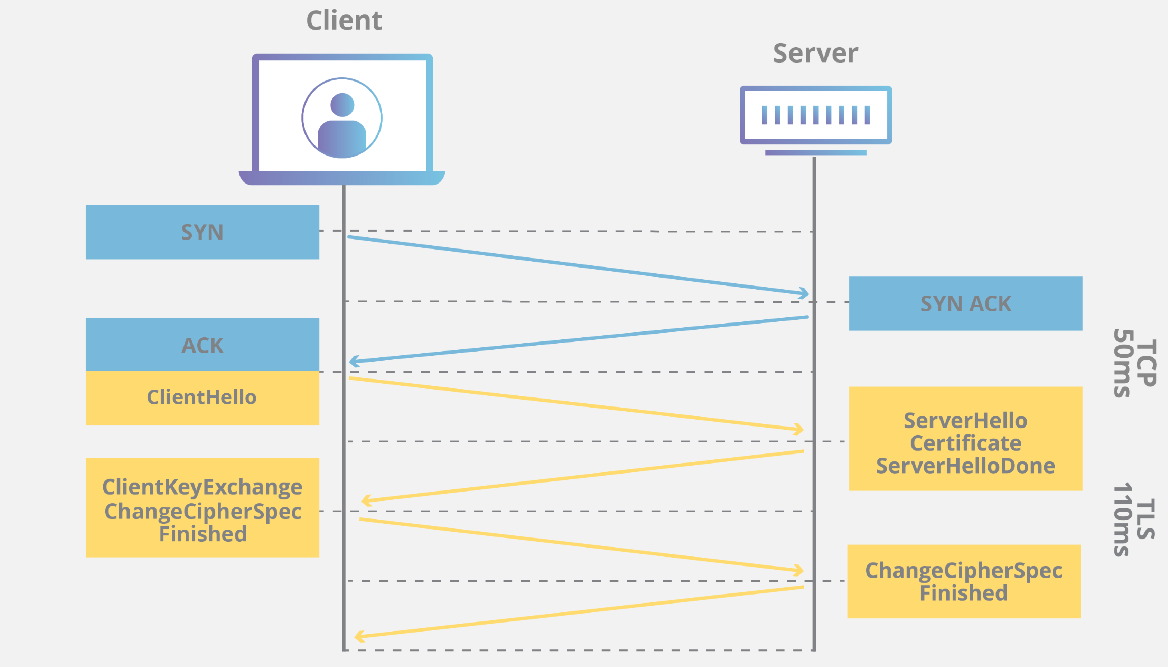
TLS: How does it work (for a web app)
A valid certificate must be installed on the origin server [demo]
Issued by a certificate authority (CA) to the domain owner
Client connects to server with TLS handshake
Agree on TLS version, cipher suites
Authenticate server identity
Generate session keys
Data is encrypted, and also signed with a message authentication code for integrity
Copyright: Cloudflare

Slide 11
References
RFCs on IETF
RFC7230: HTTP/1.1
RFC7540: HTTP/2
RFC8740: HTTP/2 with TLS 1.3
RFC8446: TLS 1.3
https://httpwg.org/specs/
Cloudflare provides a nice and easy-to-read set of articles about HTTPS, TLS, and related technologies
https://www.cloudflare.com/learning/ssl/what-is-https/
https://www.cloudflare.com/learning/ssl/transport-layer-security-tls/
and links within…
Cryptography/Security course

Slide 12
Peer-to-peer

Slide 13








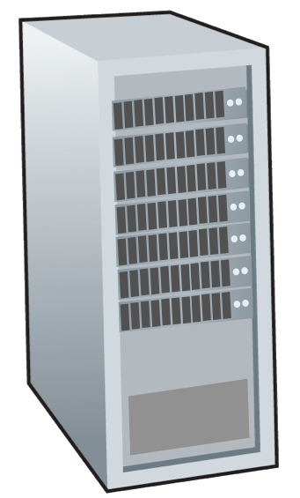







Client-server paradigm
server:
always-on host
permanent IP address
often in data centers, for scaling
clients:
contact, communicate with server
may be intermittently connected
may have dynamic IP addresses
do not communicate directly with each other
examples: HTTP, IMAP, FTP
mobile network
national or global ISP
local or regional ISP
home network
content
provider
network
datacenter
network
enterprise
network

Slide 14
Peer-to-peer (P2P) architecture
no always-on server
arbitrary end systems directly communicate
peers request service from other peers, provide service in return to other peers
self scalability – new peers bring new service capacity, and new service demands
peers are intermittently connected and change IP addresses
complex management
examples: P2P file sharing (BitTorrent), streaming (KanKan), VoIP (Skype)
mobile network
national or global ISP
local or regional ISP
home network
content
provider
network
datacenter
network
enterprise
network

Slide 15
File distribution: client-server vs P2P
Q: how much time to distribute a file from a server to N peers?
peer upload/download capacity is limited resource
u_{s}: server upload capacity
d_{i}: peer i download capacity
file, size F
u₁
d₁
u₂
u_{s}
d₂
server
d_{i}
u_{N}
network (with abundant
bandwidth)
u_{i}
d_{N}
u_{i}: peer i upload capacity

Slide 16
File distribution time: client-server
server transmission: must sequentially send (upload) N file copies:
time to send one copy: F/u_{s}
time to send N copies: NF/u_{s}
F
u_{s}
d_{i}
network
client: each client must download file copy
d_{min} = min client download rate
min single-client download time: F/d_{min}
u_{i}
time to distribute F
to N clients using
client-server approach
D_{c-s} > max{NF/u_{s}, F/d_{min}}
increases linearly in N

Slide 17
File distribution time: P2P
server transmission: must upload at least one copy:
time to send one copy: F/u_{s}
F
u_{s}
client: each client must download file copy
min client download time: F/d_{min}
d_{i}
network
u_{i}
clients: as aggregate must download NF bits
max upload rate (limiting max download rate) is u_{s} + Σu_{i}
time to distribute F
to N clients using
P2P approach
D_{P2P} > max{F/u_{s} , F/d_{min} , NF/(u_{s} + Σu_{i})}
increases linearly in N …
… but so does this, as each peer brings service capacity

Slide 18
Client-server vs. P2P: example
client upload rate = u, F/u = 1 hour, u_{s} = 10u, d_{min} ≥ u_{s}

Slide 19


P2P file distribution: BitTorrent
file divided into 256Kb chunks
peers in torrent send/receive file chunks
tracker: tracks peers
participating in torrent
torrent: group of peers exchanging chunks of a file
Alice arrives …
… obtains list
of peers from tracker
… and begins exchanging
file chunks with peers in torrent

Slide 20


P2P file distribution: BitTorrent
peer joining torrent:
has no chunks, but will accumulate them over time from other peers
registers with tracker to get list of peers, connects to subset of peers (“neighbors”)
while downloading, peer uploads chunks to other peers
peer may change peers with whom it exchanges chunks
churn: peers may come and go
once peer has entire file, it may (selfishly) leave or (altruistically) remain in torrent

Slide 21
BitTorrent: requesting, sending file chunks
Requesting chunks:
at any given time, different peers have different subsets of file chunks
periodically, Alice asks each peer for list of chunks that they have
Alice requests missing chunks from peers, rarest first
Sending chunks: tit-for-tat
Alice sends chunks to those four peers currently sending her chunks at highest rate
other peers are choked by Alice (do not receive chunks from her)
re-evaluate top 4 every 10 secs
every 30 secs: randomly select another peer, starts sending chunks
“optimistically unchoke” this peer
newly chosen peer may join top 4

Slide 22

BitTorrent: tit-for-tat
(1) Alice “optimistically unchokes” Bob
(2) Alice becomes one of Bob’s top-four providers; Bob reciprocates
(3) Bob becomes one of Alice’s top-four providers
higher upload rate: find better trading partners, get file faster !

