Slide 1
CSCI 4430 - Spring 22
Tutorial 4
YANG Yitao
ytyang@cse.cuhk.edu.hk
Credits to Umich EECS 489 Discussion 4

Slide 2
Outline
Introduction to programming with “select”
A simple demo.

Slide 3
A2 Preparation: select()
select(): I/O Multiplexing
Allow a program to monitor multiple file descriptors, waiting until one or more of the file descriptors becomes "ready" for some class of I/O operation.

Slide 4
A2 Preparation: select()
Why “select” instead of multi-threading
Non-blocking for only one-threaded program. Less system resource required. (although more complex for coding)
Notes:
Less CPU/DRAM/context switching/ not need to using lock for sync

Slide 5
A2 Preparation: select()
// set of socket descriptors
fd_set readfds;
Explanation:
fd_set is a data type usually used to store a set of file descriptors. This is very common in Unix and Unix-like systems, especially when using the select() system call for I/O multiplexing.

Slide 6
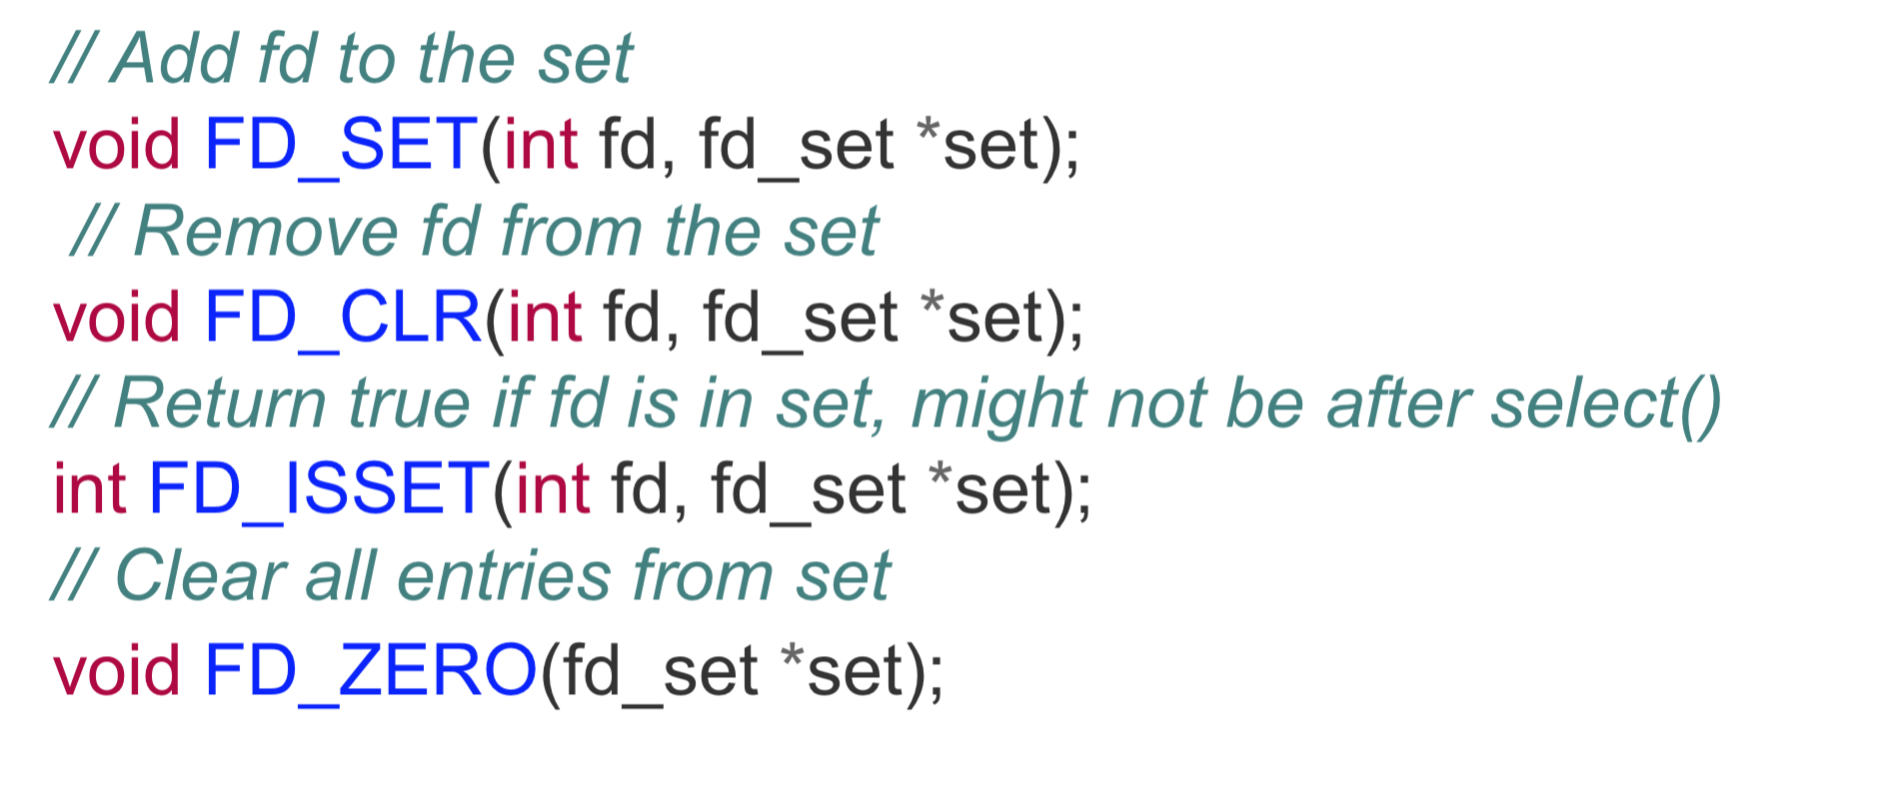
A2 Preparation: select()
Some useful macros:

Slide 7
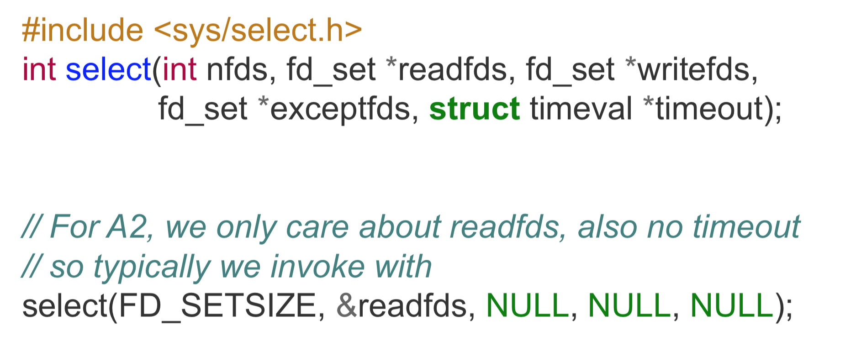
A2 Preparation: select()
The property of the select() function:
Select() is a blocking operation; it will block the program until any activity happens on some sockets.
Select() function will return a number.
If the return value > 0, it means there happened activities on some sockets.
If the return value = 0, it means timeout expires but no activity occurs on any socket.
If the return value < 0, it means that there is an error in the select function call.

Slide 8
A2 Preparation: select()
Notes:
Three NULL represent: do not watch writing activity & do not watch error socket & do not have timeout limit

Slide 9
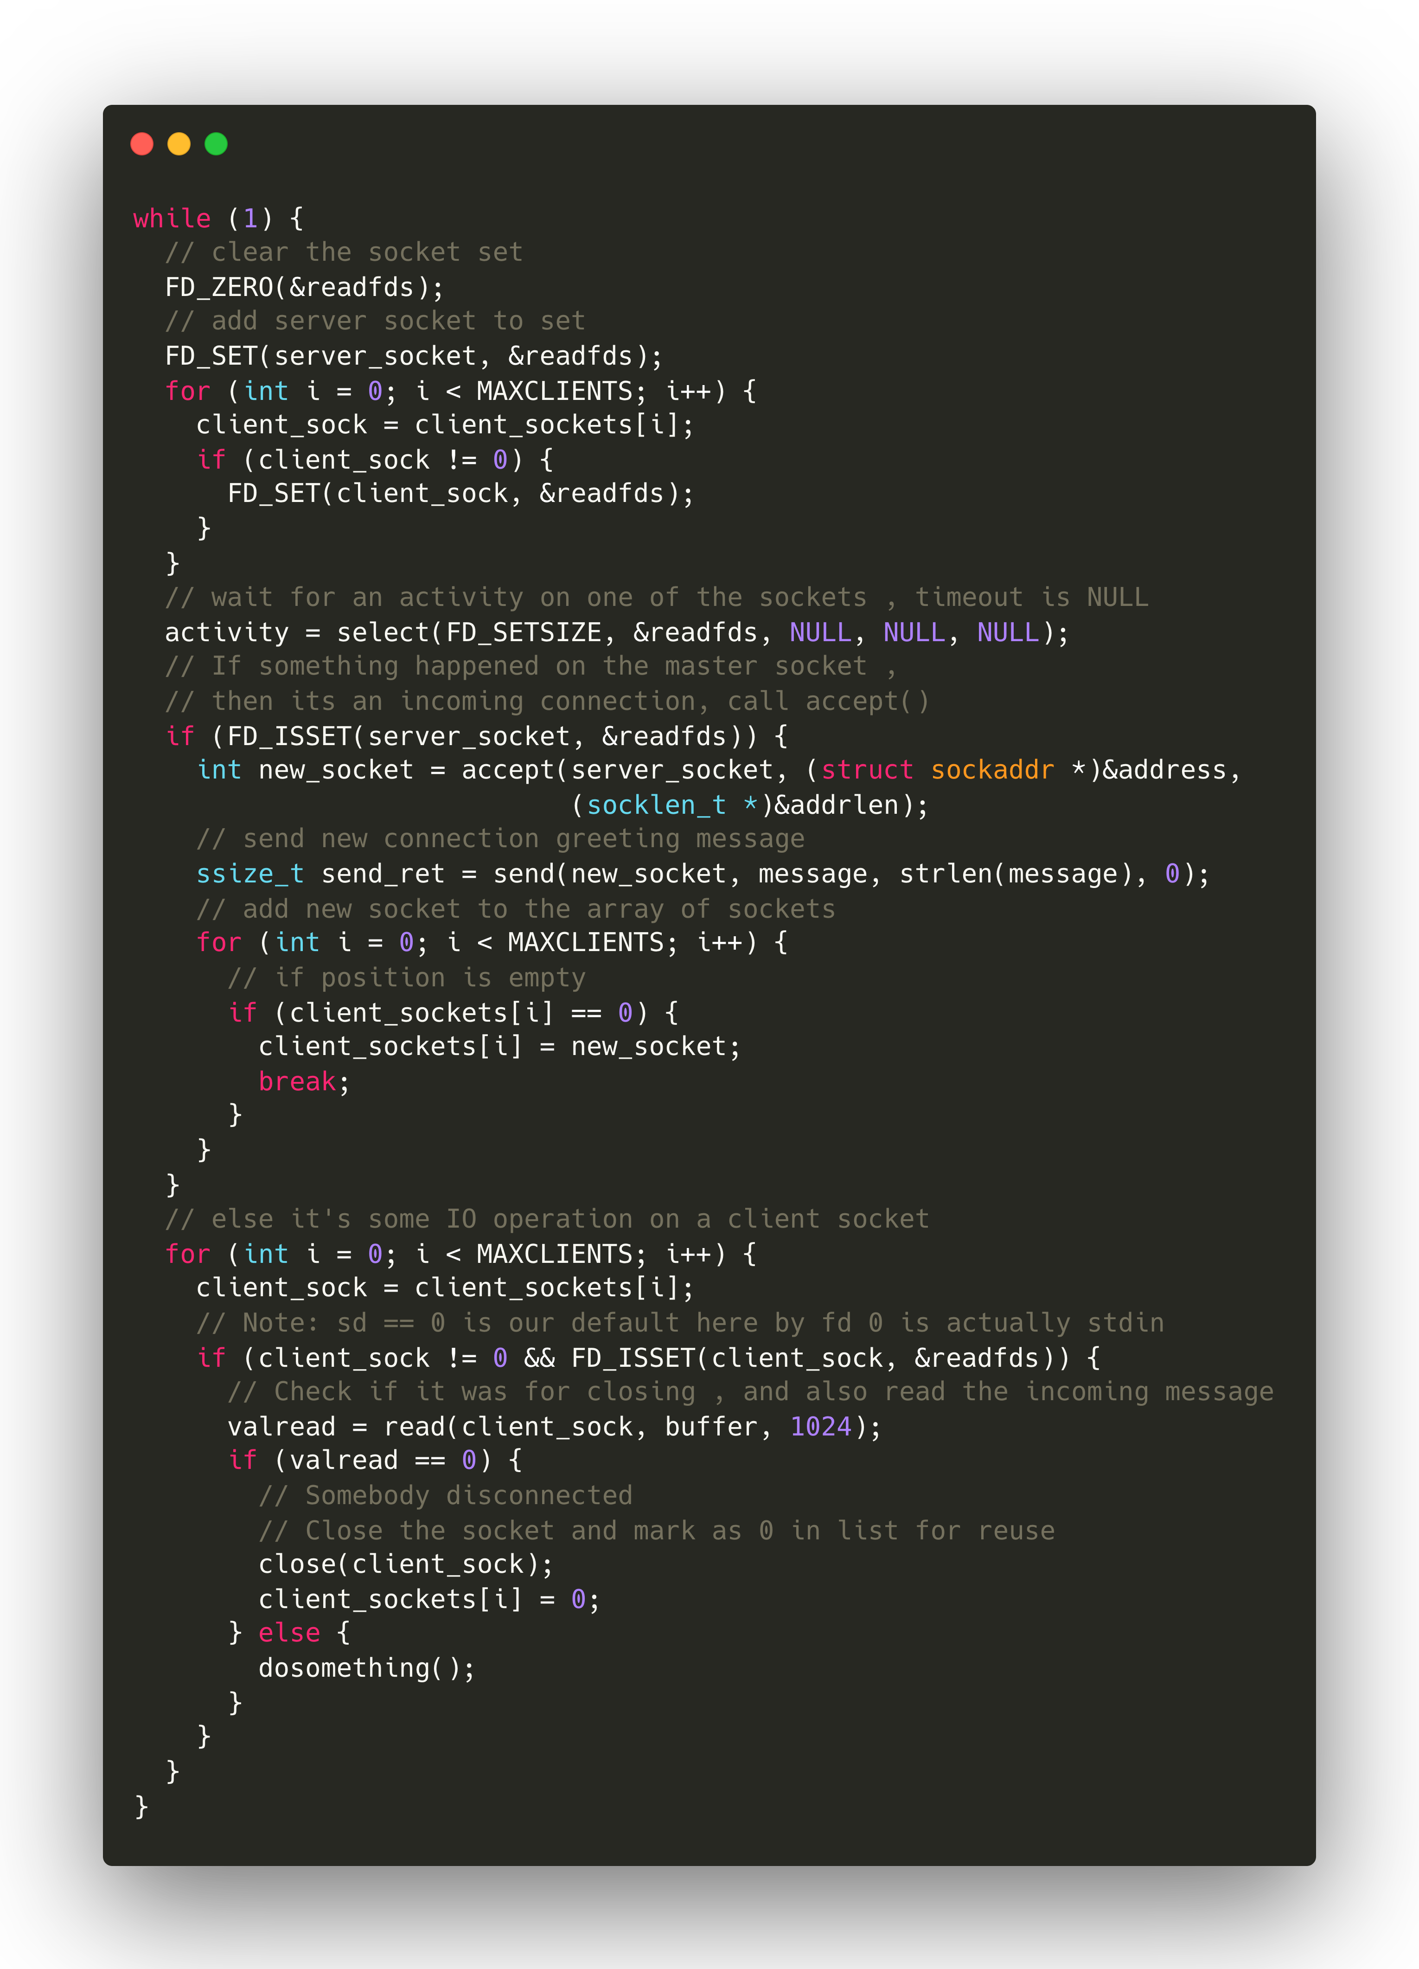
A2 Preparation: select()

Slide 10
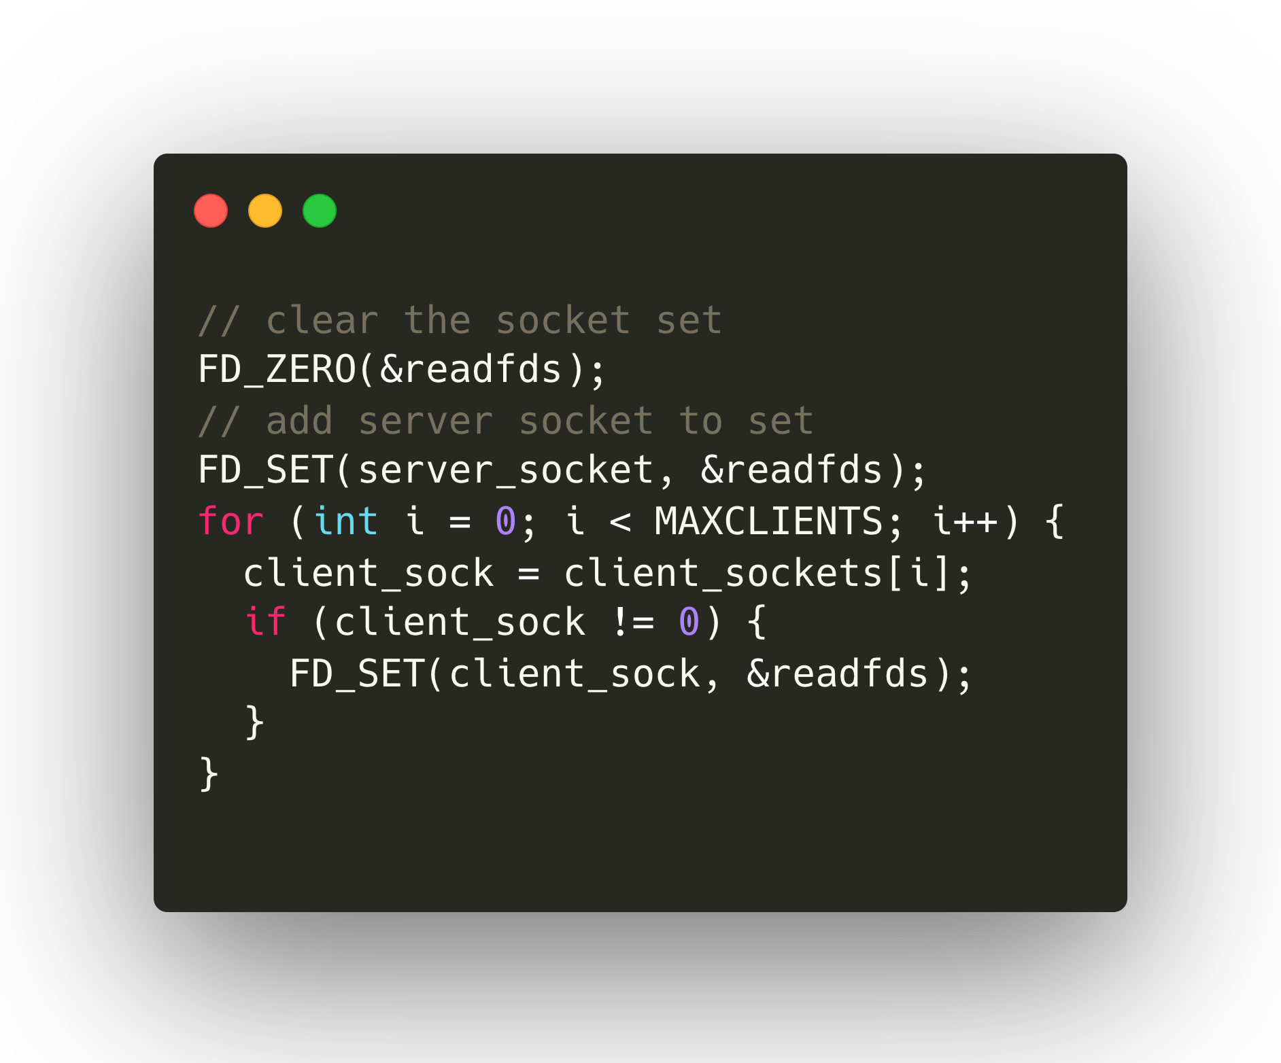
A2 Preparation: select()
Step 1: initialize(FD_ZERO) fd_set and set(FD_SET) fd_set for sockets

Slide 11
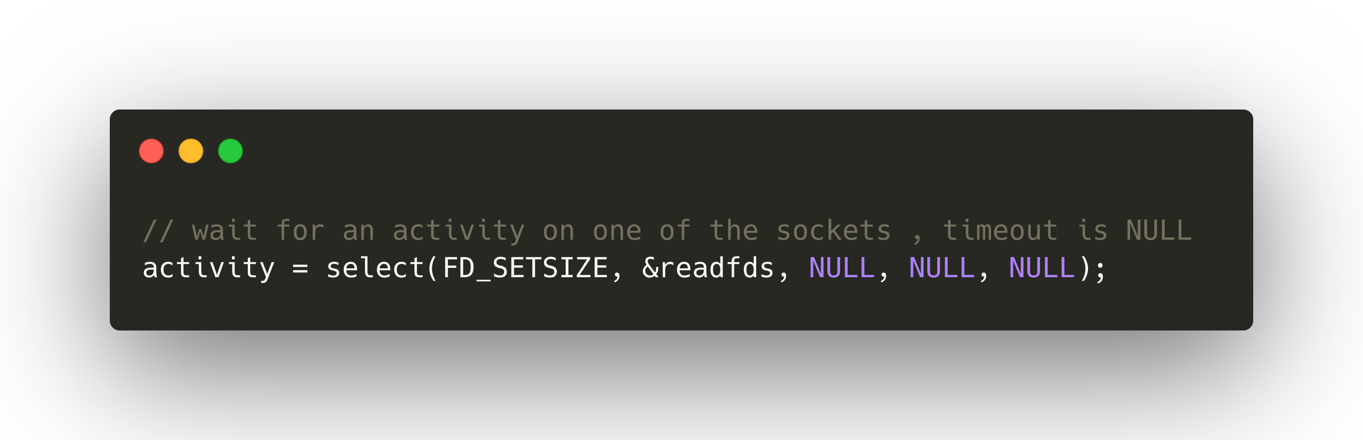
A2 Preparation: select()
Step 2: call select

Slide 12
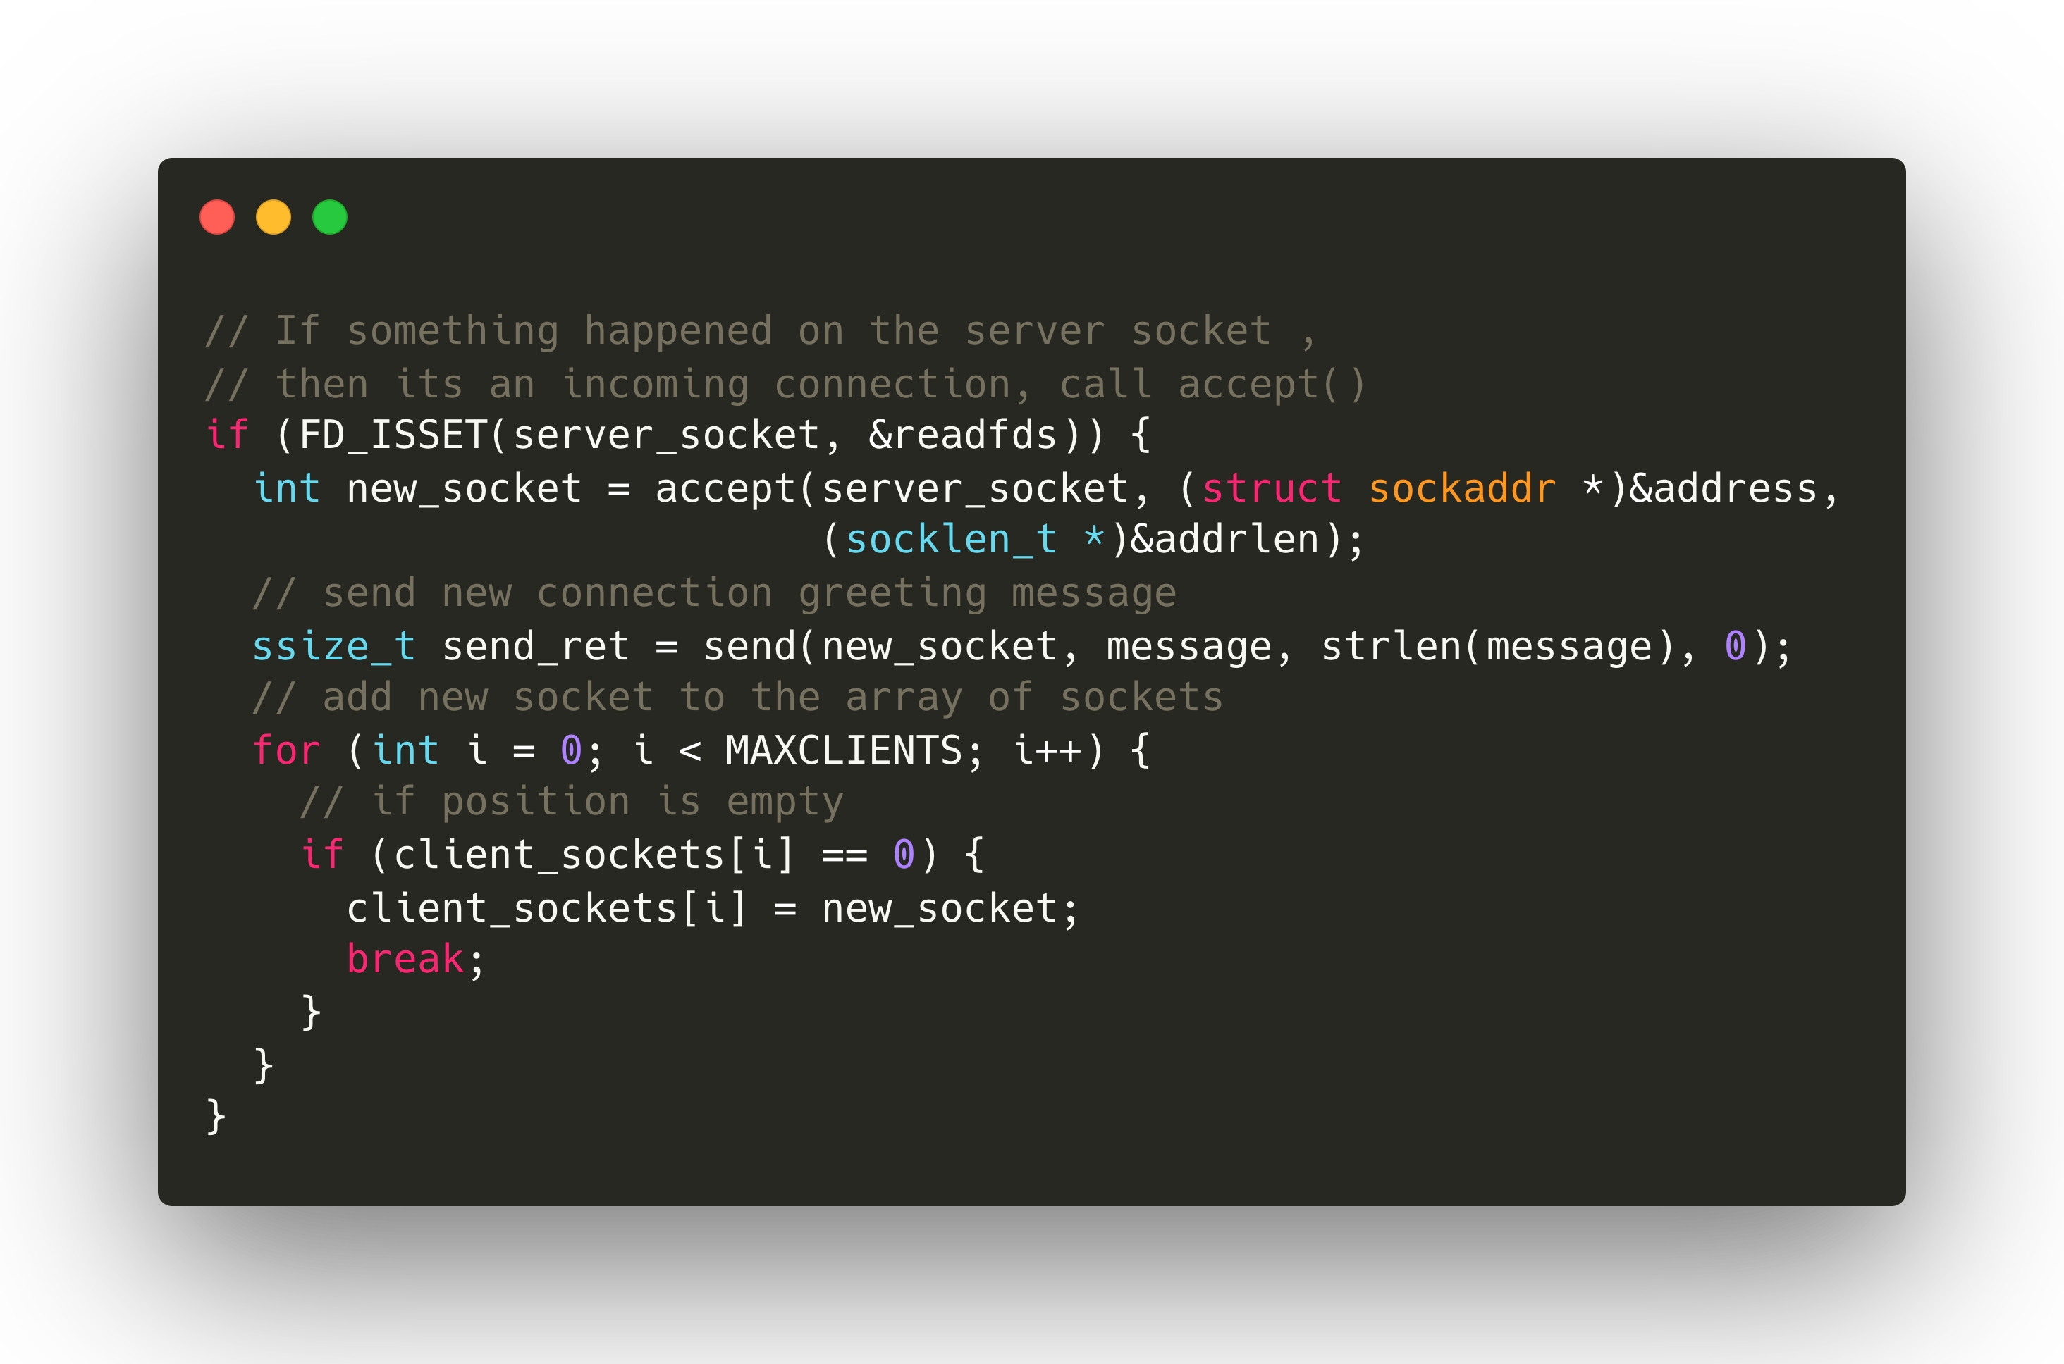
A2 Preparation: select()
Step 3: check socket status (for server socket) and accept connection

Slide 13
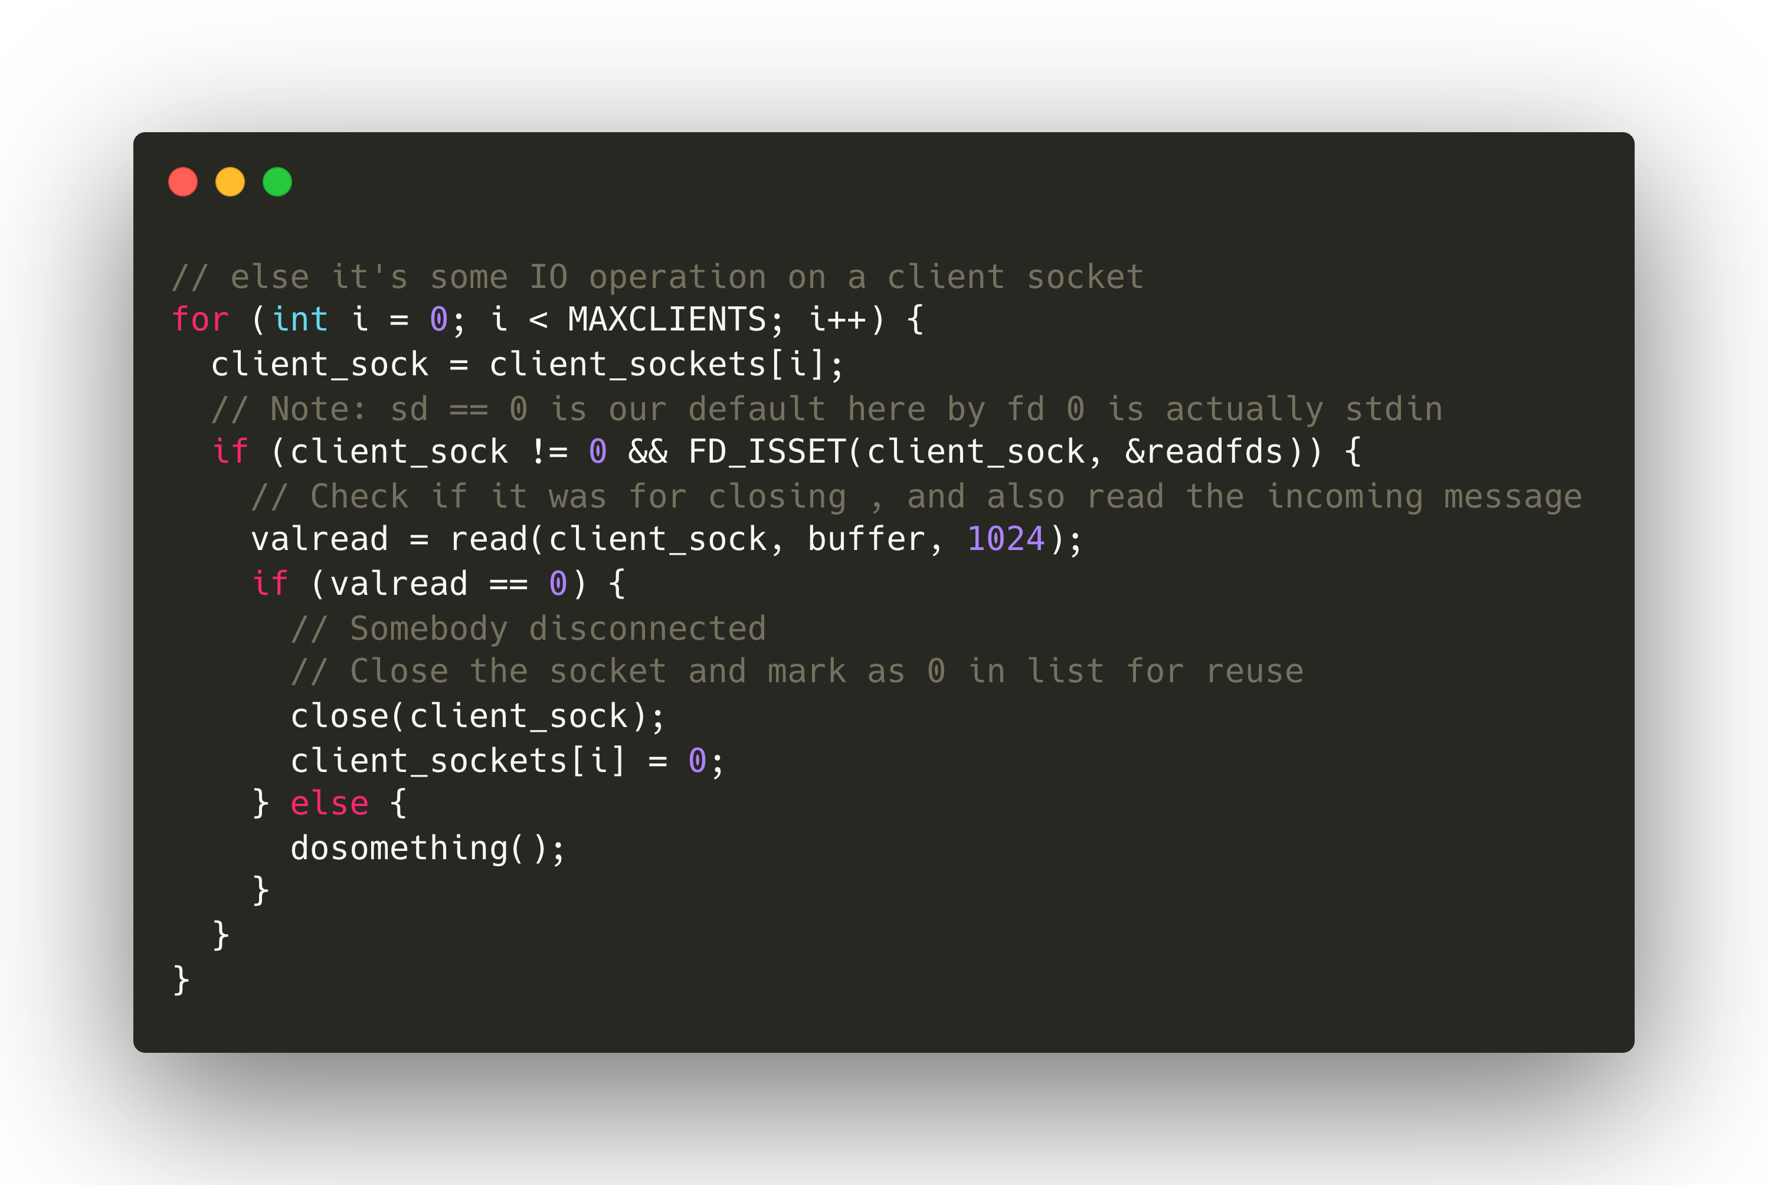
A2 Preparation: select()
Step 3: check socket status (for client socket) and do something

Slide 14
Select Programming: A Demo
Select example code: echo server
Linux or Mac OS.
You can use netcat (“nc” in command line) to communicate with the “echo server”.

Slide 15
Select Programming Links
“select” document:
https://man7.org/linux/man-pages/man2/select.2.html
“select” code example:
https://github.com/henryhxu/CSCI4430-ESTR4120/tree/2023_fall/tutorial/T04/select_example
man is always your good friend
“man select” for checking more details about select

Slide 16
Next Week
Assignment 2 will be released next week!
Happy National Day and Mid-Autumn Festival!

Slide 17
Thanks!

