Slide 1
CSCI4430 Computer Networks Lecture 7: Transport Layer – TCP
Hong Xu, Henry
CSE@CUHK, 2022
Material with thanks to Patrick Lee, Mosharaf Chowdhury, Aditya Akella, Sugih Jamin, Philip Levis, Sylvia Ratnasamy, Peter Steenkiste, and many other colleagues.

Slide 2
Agenda
From reliable data transfer to TCP
TCP connection setup and teardown

Slide 3
Recap: Designing a reliable transport protocol
Stop and Wait vs Sliding Window
Sliding Window
Acknowledgements: Cumulative vs Selective
Resending packets: Go-Back-N vs Selective Repeat

Slide 4
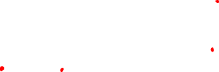
Sliding window at receiver
Receiving process
User space
Last byte read
Buffer size (B)
Kernel space
Received and ACKed and
read by application
Received and ACKed
Next byte needed (1st byte not received)

Slide 5
TCP: Transmission Control Protocol

Slide 6
The TCP Abstraction
TCP delivers a reliable, in-order, byte stream
Reliable: TCP resends lost packets (recursively)
Until it gives up and shuts down connection
In-order: TCP only hands consecutive chunks of data to application
Byte stream: TCP assumes there is an incoming stream of data, and attempts to deliver it to app

Slide 7
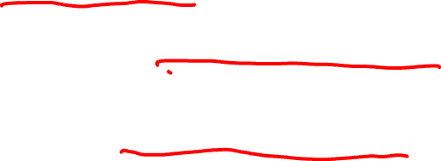
What does TCP use from what we’ve seen so far?
Most of what we’ve seen
Checksums
Sequence numbers are byte offsets
Sender and receiver maintain a sliding window
Receiver sends cumulative acknowledgements (like GBN)
Sender maintains a single retransmission timer
Receivers buffer out-of-sequence packets (like SR)
Few more: fast retransmit, timeout estimation algorithms etc.

Slide 8
Build the TCP header
Source port
Destination port
Used to Mux
and Demux
Data

Slide 9
Build the TCP header
Source port
Destination port
Computed over pseudo-header
and data
Checksum
Data

Slide 10
What does TCP do?
Most of what we’ve seen
Checksum
Sequence numbers are byte offsets

Slide 11

Build the TCP header
Source port
Destination port
Sequence number
Byte offsets
(NOT packet id),
because TCP is a
byte stream
Checksum
Data

Slide 12
TCP “stream of bytes” service…
Application @ Host A
Byte 0
Byte 1
Byte 2
Byte 3
Byte 80
Byte 0
Byte 1
Byte 2
Byte 3
Byte 80
Application @ Host B

Slide 13
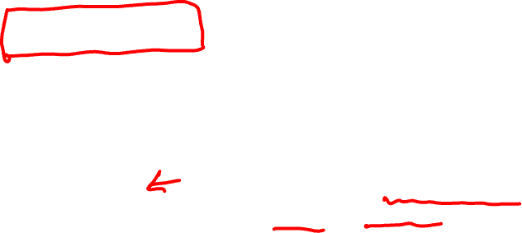
… provided using TCP “segments”
Host A
Byte 0
Byte 1
Byte 2
Byte 3
Byte 80
Segment sent when:
Segment full (Max Segment Size),
Not full, but times out
TCP Data
TCP Data
Host B
Byte 0
Byte 1
Byte 2
Byte 3
Byte 80

Slide 14
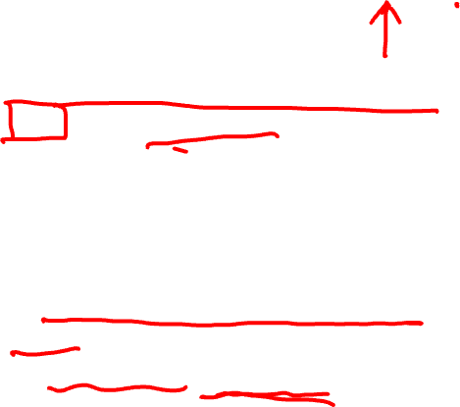
TCP segment
IP Data
TCP Data (segment)
TCP Hdr
IP Hdr
IP packet
No bigger than Maximum Transmission Unit (MTU)
E.g., up to 1500 bytes with Ethernet
TCP packet
IP packet with a TCP header and data inside
TCP header ≥ 20 bytes long
TCP segment
No more than Maximum Segment Size (MSS) bytes
E.g., up to 1460 consecutive bytes from the stream
MSS = MTU – (IP header) – (TCP header)

Slide 15
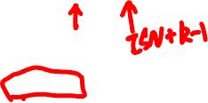
Sequence numbers
ISN (Initial Sequence Number)
k bytes
Host A
Sequence number = 1st byte in segment = ISN + k

Slide 16
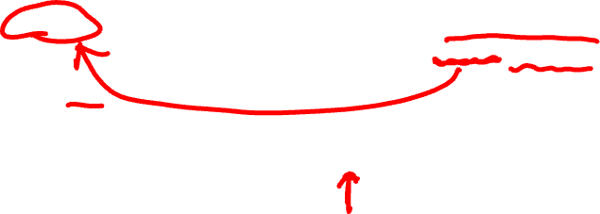
Sequence numbers
ISN (Initial Sequence Number)
k
Host A
Sequence number = 1st byte in segment = ISN + k
TCP Data
TCP
HDR
ACK sequence number
= next expected byte
= seqno + length(data)
TCP Data
TCP
HDR
Host B

Slide 17
Build the TCP header
Source port
Destination port
Sequence number
Starting byte offset of data carried in this segment
Checksum
Data

Slide 18
What does TCP do?
Most of what we’ve seen
Checksum
Sequence numbers are byte offsets
Receiver sends cumulative acknowledgements (like GBN)

Slide 19

ACKs and sequence numbers
Sender sends packet
Data starts with sequence number X
Packet contains B bytes [X, X+1, X+2, ….X+B-1]
Upon receipt of packet, receiver sends an ACK
If all data prior to X already received:
ACK acknowledges X+B (because that is next expected byte)
If highest in-order byte received is Y s.t. (Y+1) < X
ACK acknowledges Y+1
Even if this has been ACKed before

Slide 20

Typical operation
Sender: seqno=X, length=B
Receiver: ACK=X+B
Sender: seqno=X+B, length=B
Receiver: ACK=X+2B
Sender: seqno=X+2B, length=B
Seqno of next packet is same as last ACK field

Slide 21

Build the TCP header
Source port
Destination port
Sequence number
Acknowledgment gives seqno just beyond highest seqno received in order
Acknowledgment
Checksum
Data

Slide 22
What does TCP do?
Most of what we’ve seen
Checksum
Sequence numbers are byte offsets
Receiver sends cumulative acknowledgements (like GBN)
Receivers can buffer out-of-sequence packets (like SR)

Slide 23
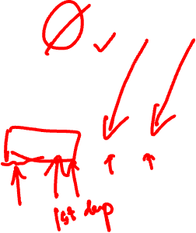
Loss with cumulative ACKs
Sender sends packets with 100B and seqnos.:
100, 200, 300, 400, 500, 600, 700, 800, …
Assume the fifth packet (seqno 500) is lost, but no others
Stream of ACKs will be:
200, 300, 400, 500, 500, 500, 500,…

Slide 24
What does TCP introduce?
Most of what we’ve seen
Checksum
Sequence numbers are byte offsets
Receiver sends cumulative acknowledgements (like GBN)
Receiver can buffer out-of-sequence packets (like SR)
Introduces fast retransmit: duplicate ACKs trigger early retransmission

Slide 25
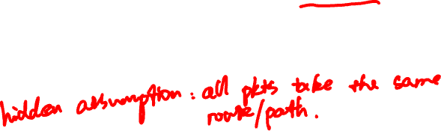
Loss with cumulative ACKs
Duplicate ACKs are a sign of an isolated loss
The lack of ACK progress means 500 hasn’t been delivered
Stream of ACKs means some packets are being delivered
Trigger retransmission upon receiving k duplicate ACKs
TCP uses k=3
Faster than waiting for timeout

Slide 26
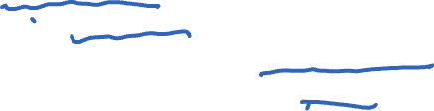
Loss with cumulative ACKs
Two choices after resending
Send missing packet and move sliding window by the number of dup ACKs
Speeds up transmission, but might be wrong
Send missing packet, and wait for ACK to move sliding window
Is slowed down by single dropped packets
Which should TCP do?
Choose correctness

Slide 27
What does TCP introduce?
Most of what we’ve seen
Checksum
Sequence numbers are byte offsets
Receiver sends cumulative acknowledgements (like GBN)
Receivers buffer out-of-sequence packets (like SR)
Introduces fast retransmit: duplicate ACKs trigger early retransmission
Sender maintains a single retransmission timer (like GBN) and retransmits on timeout

Slide 28
Retransmission timeout
If the sender hasn’t received an ACK by timeout, retransmit the first packet in the window
How do we pick a timeout value?
Notes:
If the window moves, the timer is restarted

Slide 29
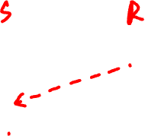
Timing illustration
1
1
Timeout
RTT
RTT
1
Timeout
1
Timeout too long → inefficient
Timeout too short →
duplicate packets

Slide 30
Retransmission timeout
If the sender hasn’t received an ACK by timeout, retransmit the first packet in the window
How to set timeout?
Too long: connection has low throughput
Too short: retransmit packet that was just delayed
Solution: make timeout proportional to RTT
But how do we measure RTT?

Slide 31

RTT estimation
Exponential weighted average of RTT samples
EstimatedRTT = (1- α)*EstimatedRTT + α*SampleRTT

Slide 32
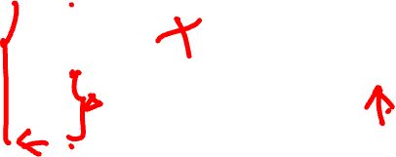
Problem: Ambiguous measurements
How do we differentiate between the real ACK, and ACK of the retransmitted packet?
Sender
Receiver
Sender
Receiver
Original Transmission
Original Transmission
SampleRTT
ACK
SampleRTT
Retransmission
Retransmission
ACK

Slide 33
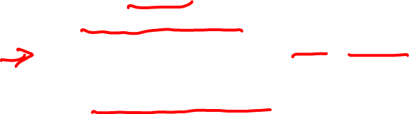
Karn/Partridge algorithm
Don’t use SampleRTT from retransmissions
Once retransmitted, ignore that segment in the future
Computes EstimatedRTT using α = 0.125
Timeout value (RTO) = 2 × EstimatedRTT
Employs exponential backoff
Every time RTO timer expires, set RTO ← 2·RTO
(Up to maximum ≥ 60 sec)
Every time new measurement comes in (= successful original transmission), collapse RTO back to 2 × EstimatedRTT
Sensitive to RTT variations
Notes:
0.125 is 1/8, which is easier to compute by simple right shifting bits.

Slide 34

Jacobson/Karels algorithm
Problem: need to better capture variability in RTT
Directly measure deviation
Deviation = | SampleRTT – EstimatedRTT |
DevRTT: exponential average of Deviation
RTO = EstimatedRTT + 4 x DevRTT

Slide 35
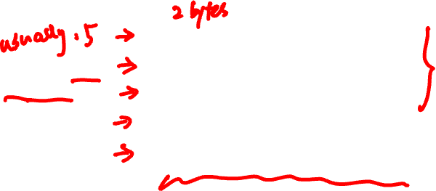
Build the TCP header
Source port
Destination port
Sequence number
Number of 4-byte words in the header
Acknowledgment
HdrLen
Checksum
Urgent pointer
Data

Slide 36
TCP Connection Establishment

Slide 37
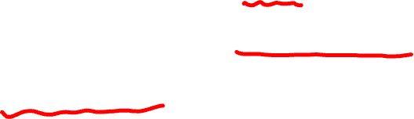
Initial Sequence Number (ISN)
Sequence number for the very first byte
Why not just use ISN = 0?
Practical issue
IP addresses and port #s uniquely identify a connection
Eventually, though, these port #s do get used again; small chance an old packet is still in flight
Also, others might try to spoof your connection
Why does using ISN help?
Hosts exchange ISNs when establishing connection

Slide 38
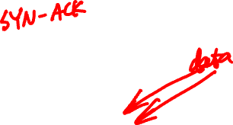
Establishing a TCP connection
Three-way handshake to establish a connection
Host A sends a SYN (open; “synchronize sequence numbers”) to host B
Host B returns a SYN acknowledgment (SYN ACK)
Host A sends an ACK to acknowledge the SYN ACK
A
B
SYN
SYN ACK
ACK
Data
Data

Slide 39

Build the TCP header
Source port
Destination port
Sequence number
Flags:
SYN
ACK
FIN
RST
PSH
URG
Acknowledgment
HdrLen
0
Flags
Checksum
Urgent pointer
Data

Slide 40
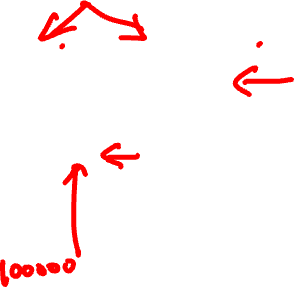
Step 1: A’s initial SYN packet
A’s port
B’s port
A’s Initial Sequence Number
A tells B to open a connection
N/A
5
0
SYN
Checksum
Urgent pointer

Slide 41
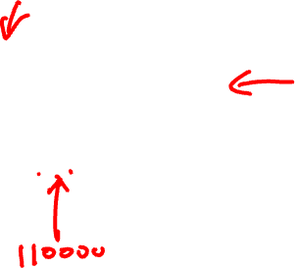
Step 1: B’s SYN-ACK packet
B’s port
A’s port
B’s Initial Sequence Number
B tells it accepts and is ready to accept next packet
ACK=A’s ISN+1
5
0
SYN|ACK
Checksum
Urgent pointer

Slide 42
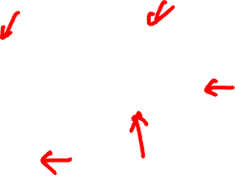
Step 1: A’s ACK to SYN-ACK
A’s port
B’s port
A’s Initial Sequence Number + 1
A tells B to open a connection
ACK=B’s ISN+1
5
0
ACK
Checksum
Urgent pointer

Slide 43
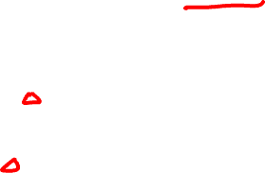
TCP’s 3-Way handshaking
Active Open
Passive Open
Client (initiator)
Server
connect()
listen()
SYN, SeqNum = x
SYN + ACK, SeqNum = y, Ack = x + 1
ACK, Ack = y + 1

Slide 44
What if the SYN Packet Gets Lost?
Suppose the SYN packet gets lost
Packet dropped by the network or server is busy
Eventually, no SYN-ACK arrives
Sender retransmits the SYN on timeout
How should the TCP sender set the timer?
Sender has no idea how far away the receiver is
Hard to guess a reasonable length of time to wait
SHOULD (RFCs 1122 & 2988) use default of 3 seconds
Some implementations instead use 6 seconds

Slide 45
SYN loss and web downloads
User clicks on a hypertext link
Browser creates a socket and does a “connect”
The “connect” triggers the OS to transmit a SYN
If the SYN is lost…
3-6 seconds of delay: can be very long
User may become impatient and can retry
User triggers an “abort” of the “connect”
Browser creates a new socket and another “connect”
Can be effective in some cases

Slide 46
TCP connection teardown

Slide 47
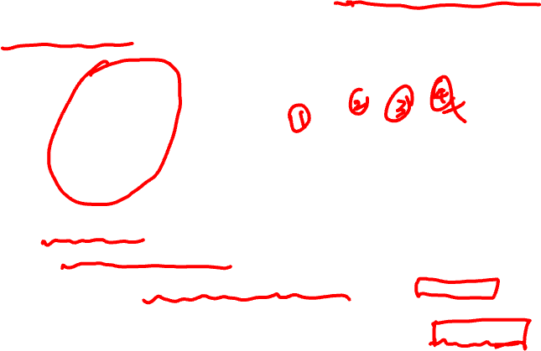
Normal termination, one side at a time
B
ACK
SYN
SYN ACK
Data
ACK
FIN
ACK
FIN
ACK
A
time
Finish (FIN) to close and receive remaining bytes
FIN occupies one byte in the sequence space
Other host acks the byte to confirm
Closes A’s side of the connection, but not B’s
Until B likewise sends a FIN
Which A then acks
Connection now closed
Connection now half-closed
TIME_WAIT:
Avoid reincarnation
B will retransmit FIN if ACK is lost
Notes:
Why timer? Will get packet with no state!!

Slide 48
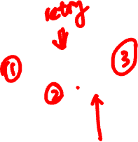
Normal termination, both together
B
ACK
ACK
SYN
SYN ACK
Data
ACK
FIN
FIN + ACK
A
time
TIME_WAIT:
Avoid reincarnation
Can retransmit FIN ACK if ACK lost
Connection now closed
Same as before, but B sets FIN with their ack of A’s FIN

Slide 49
Abrupt termination
B
ACK
SYN
SYN ACK
ACK
RST
RST
Data
Data
A
time
A sends a RESET (RST) to B
E.g., because application process on A crashed
That’s it
B does not ack the RST
Thus, RST is not delivered reliably, and any data in flight is lost
But: if B sends anything more, will elicit another RST

Slide 50
Summary
Reliability is not easy!
Next
Flow control
LOTs of congestion control

Slide 51
Additional material on TCP reset

Slide 52
TCP reset
The following is from RFC3360, “Inappropriate TCP Resets Considered Harmful”, by Sally Floyd
TCP reset was devised to prevent old duplicate connection initiations from causing confusion in TCP's three-way handshake. The reset is also used when a host receives data for a TCP connection that no longer exists.
In practice, a number of firewalls and load-balancers send a reset in response to a TCP SYN packet that use flags from the Reserved field in the TCP header.

Slide 53
TCP reset
RFC 793 and RFC 1122 both include Jon Postel's famous robustness principle, also from RFC 791: "Be liberal in what you accept, and conservative in what you send."
https://datatracker.ietf.org/doc/rfc3360/
Sally Floyd, https://en.wikipedia.org/wiki/Sally_Floyd

