Slide 1
CSCI 4430 - Spring 22
Tutorial 8
Credits to CUHK CSCI 4420 Spring 2020 Tutorial 03

Slide 2
Outline
UDP Introduction
Socket Programming for UDP

Slide 3
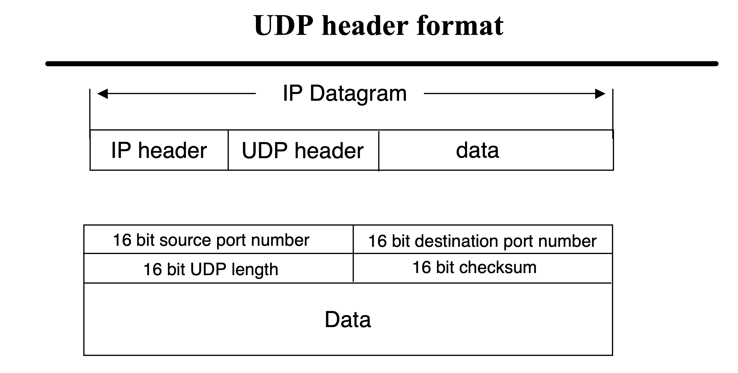
UDP (User Datagram Protocol)

Slide 4
UDP (User Datagram Protocol)
Another transport layer protocol (recall TCP).
Difference from TCP:
TCP guarantees reliable data transmission by establishing connection between client and server.
UDP does not establish connection between server and client. It is a connection-less protocol.
no handshaking between UDP sender, receiver • each UDP segment handled independently of
UDP, thus, does not guarantee the arrival, arrival time and content of the message.

Slide 5
TCP Socket Programming Workflow:
Server
Client

Slide 6
UDP Socket Programming Workflow:
socket()
bind()
socket()
Server
Client
recvfrom()
sendto()
recvfrom()
sendto()
close()
close()

Slide 7
UDP Socket Programming: socket()
Create a socket
socket_fd = socket(AF_INET, SOCK_DGRAM, IPPROTO_UDP);

Slide 8
UDP Socket Programming-Server: bind()
Bind an address to a socket
struct sockaddr_in addr;
memset(&addr, 0, sizeof(addr));
addr.sin_family = AF_INET;
addr.sin_addr.s_addr = INADDR_ANY;
addr.sin_port = htons(port);
bind(sockfd, (struct sockaddr *) &addr, sizeof(addr));

Slide 9
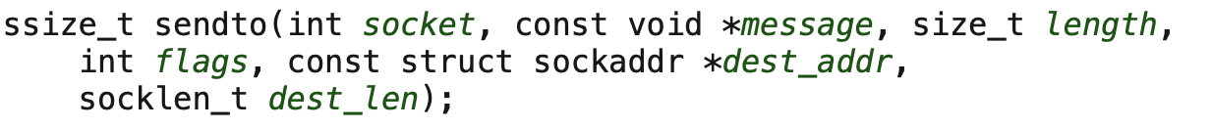
UDP Socket Programming: sendto()
Send a message on a socket
sendto(s, buffer, MSG_SIZE, MSG_NOSIGNAL, (struct sockaddr *) &si_other, &slen);

Slide 10
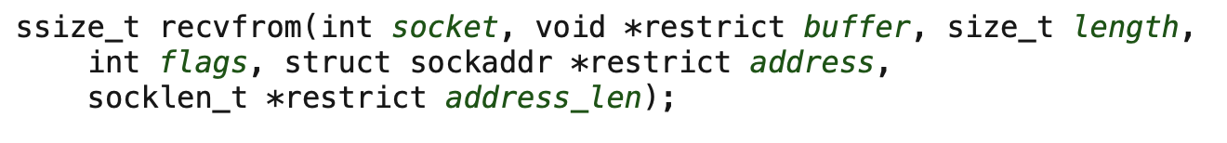
UDP Socket Programming: recvfrom()
Receive a message on a socket
byte_recved = recvfrom(s, buffer, len, MSG_NOSIGNAL, (struct sockaddr *) &si_other, &slen);

Slide 11
Thanks!

