Slide 1
CSCI 4430 - Spring 22
Tutorial 6
Credits to Umich EECS 489 Discussion 6

Slide 2
Assignment 2
Due: Sun, 27th Feb. 11:59:59 p.m. Sun, 6th March. 11:59:59 p.m.
Start early!

Slide 3
Assignment 2 Overview
Web
Server
miProxy
Browser
Request
Request
Response
Response
The proxy only forwards messages between the browser and the web server
Doesn’t care what are forwarded
Don’t make any assumption on what are forwarded

Slide 4
Assignment 2 Overview
Tasks for the miProxy:
Received f4m file request:
Modify the HTTP GET request as “_nolist.f4m” file request
Send BOTH the original f4m file request and the modified “_nolist.f4m” request to server
Keep the received original f4m response (for parsing bitrates) and not forward it to browser
Forward the received “_nolist.f4m” response to the browser
Received video chunk request:
Modify the HTTP GET request based on your current throughput and the available bitrates
Forward the modified request to server
Forward the received response to browser
Other requests:
Not modify the HTTP GET request
Forward the received response to browser directly

Slide 5
Assignment 2 Overview: First GET Request
GET / HTTP/1.1
Host: 10.0.0.2:8888
User-Agent: Mozilla/5.0 (X11; Ubuntu; Linux x86_64; rv:59.0) Gecko/20100101 Firefox/59.0
Accept: text/html,application/xhtml+xml,application/xml;q=0.9,*/*;q=0.8
Accept-Language: en-US,en;q=0.5
Accept-Encoding: gzip, deflate
Connection: keep-alive
Upgrade-Insecure-Requests: 1

Slide 6
Assignment 2 Overview
GET /swfobject.js HTTP/1.1
Host: 10.0.0.2:8888
User-Agent: Mozilla/5.0 (X11; Ubuntu; Linux x86_64; rv:59.0) Gecko/20100101 Firefox/59.0
Accept: */*
Accept-Language: en-US,en;q=0.5
Accept-Encoding: gzip, deflate
Referer: http://10.0.0.2:8888/
Connection: keep-alive

Slide 7
Assignment 2 Overview
GET /StrobeMediaPlayback.swf HTTP/1.1
Host: 10.0.0.2:8888
User-Agent: Mozilla/5.0 (X11; Ubuntu; Linux x86_64; rv:59.0) Gecko/20100101 Firefox/59.0
Accept: text/html,application/xhtml+xml,application/xml;q=0.9,*/*;q=0.8
Accept-Language: en-US,en;q=0.5
Accept-Encoding: gzip, deflate
Referer: http://10.0.0.2:8888/
Connection: keep-alive

Slide 8
Assignment 2 Overview: F4m Request
GET /vod/big_buck_bunny.f4m HTTP/1.1
Host: 10.0.0.2:8888
User-Agent: Mozilla/5.0 (X11; Ubuntu; Linux x86_64; rv:59.0) Gecko/20100101 Firefox/59.0
Accept: text/html,application/xhtml+xml,application/xml;q=0.9,*/*;q=0.8
Accept-Language: en-US,en;q=0.5
Accept-Encoding: gzip, deflate
Referer: http://10.0.0.2:8888/StrobeMediaPlayback.swf
Connection: keep-alive
big_buck_bunny_nolist.f4m

Slide 9
Assignment 2 Overview: Chunk Request
GET /vod/1000Seg1-Frag1 HTTP/1.1
Host: 10.0.0.2:8888
User-Agent: Mozilla/5.0 (X11; Ubuntu; Linux x86_64; rv:59.0) Gecko/20100101 Firefox/59.0
Accept: text/html,application/xhtml+xml,application/xml;q=0.9,*/*;q=0.8
Accept-Language: en-US,en;q=0.5
Accept-Encoding: gzip, deflate
Referer: http://10.0.0.2:8888/StrobeMediaPlayback.swf
Connection: keep-alive

Slide 10
Assignment 2 Overview: Response Example
HTTP/1.1 200 OK
Date: Mon, 01 Jan 2018 02:10:50 GMT
Server: Apache/2.2.32 (Unix)
Content-Length: 83594
Last-Modified: Mon, 01 Jan 2018 02:10:50 GMT
Keep-Alive: timeout=30000, max=499906
Connection: Keep-Alive
Content-Type: video/f4f

Slide 11
Assignment 2 Overview
A Quick Demo

Slide 12
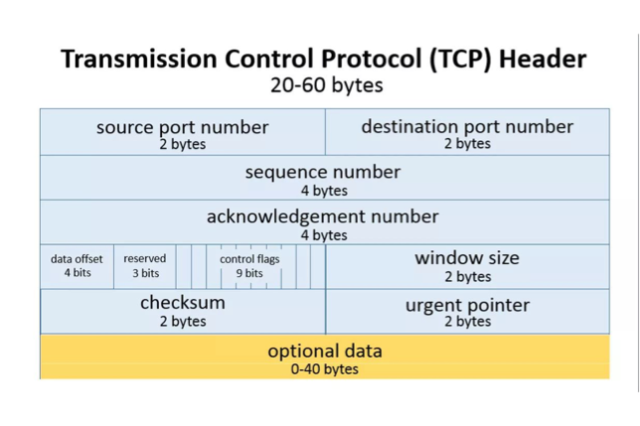
TCP: Transmission Control Protocol

Slide 13
Q1 TCP File Transfer
Consider transferring an enormous file of L bytes from host A to host B. What is the maximum value of L such that we don’t run out of TCP sequence numbers?
- Note:TCP sequence number is 4 bytes in the header
2^32 Bytes
Given L = 2^32 bytes, find how long it takes to transmit the file. Assume:
- MSS (max segment size) = 1460 Bytes
- MTU (max transmission unit) = 1500 Bytes
- 128 Mbps link from A to B
- Ignore flow and congestion control, assume A sends as fast as possible contiguously.
(2^32 / 1460 * 1500) / (128 *10^6 / 8) = 276 s
amount of data / bandwidth

Slide 14
Q2 TCP Segment Metadata
Host A (sender) and B (receiver) are communicating over a TCP connection. Assume the following events happen in order:
B has received the first 127 bytes of the flow from A, this consumes seq num 0-126
A then sends two segments, S1 (80 bytes of data), S2 (40 bytes of data)
S1 has sequence num 127, source port 30302, destination port 80
B sends ACK1 and ACK2 to A when it receives the first / second segment respectively
Assume S1 and S2 arrive in order
Q: For S2, what are the sequence num, source port and destination port?
Seq num: 207, Source port: 30302, Destination port: 80
Q: For ACK1, what are the ack num, source port and destination port?
Ack num: 207, Source port: 80, Destination port: 30302
Now assume S1 and S2 come out of order
Q: For ACK1, what are the ack num, source port and destination port?
Ack num: 127, Source port: 80, Destination port: 30302

Slide 15
Q3 TCP Segment CWND
Consider sending a large file over a lossless TCP connection Assume:
TCP uses AIMD for congestion control with slow start
ssthres = 16 MSS
Approximately constant RTT
CWND starts at 1 MSS
Q: How long does it take for CWND to increase from 1 MSS to 20 MSS?
CWND: 1 2 4 8 16 17 18 19 20; 8 RTT
Q: What is the average throughput (in terms of MSS and RTT) of the above
process?
(1+2+4+8+16+17+18+19) / 8 = 85 MSS / 8 RTT

Slide 16
Thanks!

