Slide 1
CSCI 4430 - Spring 22
Tutorial 9
Credits to Umich EECS 489 Discussion 7

Slide 2
Q1 IP True or False
IPv6 packet headers have fixed size and thus are more efficient to process. However, because an IPv6 header uses 128-bit source and destination addresses instead of 32-bit ones, it is larger than any IPv4 header.
False. IPv6 headers are always 40 B and IPv4 headers can be 20 - 60 B.

Slide 3
Q2 IP MCQ
Which is NOT the four basic processes used in the IP to accomplish end-to-end transport?
1. Addressing packets with an IP address
2. Encapsulation
3. Guaranteed delivery
4. Routing
5. Decapsulation
IP only provides best-effort delivery.
Guaranteed delivery is provided by Transport Layer (e.g.TCP)

Slide 4
Q3 IP Fragmentation
Suppose a TCP message containing 2048 bytes of data and 20 bytes of TCP header is passed to IP for delivery across two networks of the Internet. The first network has an MTU of 1024 bytes; the second has an MTU of 512 bytes.
Give the sizes and offsets of the fragments delivered to the network layer at the destination host. Assume all IP headers are 20 bytes. Assume we send out the largest fragments whenever we can.

Slide 5


Q3 IP Fragmentation
20B
2068B
IP Datagram : (2048 + 20 + 20) Bytes
IP Payload : (2048 + 20) Bytes
IP Header
IP Payload
Fragmented Payload:
Network 1 MTU: 1024B
$$8n<1024−20, n∈N$$
20B
1000B
Payload: $8n=1000$
Fragment 1
Offset: 0
Fragment 2
20B
1000B
Offset: 1000/8 = 125
Fragment 3
20B
68B
Offset: 1000/8 = 250

Slide 6
Q3 IP Fragmentation
Network 1 MTU: 1024B
Network 2 MTU: 512B
Fragment 1
20B
1000B
Offset: 0
20B
488B
Offset: 0
20B
488B
Offset: 488/8= 61
20B
24B
Offset: 976/8=122
20B
1000B
Offset: 125
20B
68B
Offset: 250

Slide 7
Q3 IP Fragmentation
Network 1 MTU: 1024B
Network 2 MTU: 512B
Fragment 1
20B
1000B
Offset: 125
20B
488B
Offset: 125
20B
488B
Offset: 125+61=186
20B
24B
Offset: 125+122=247
20B
68B
Offset: 250

Slide 8
Q3 IP Fragmentation
Network 1 MTU: 1024B
Network 2 MTU: 512B
Fragment 1
20B
1000B
Offset: 250
20B
68B
Offset: 250

Slide 9
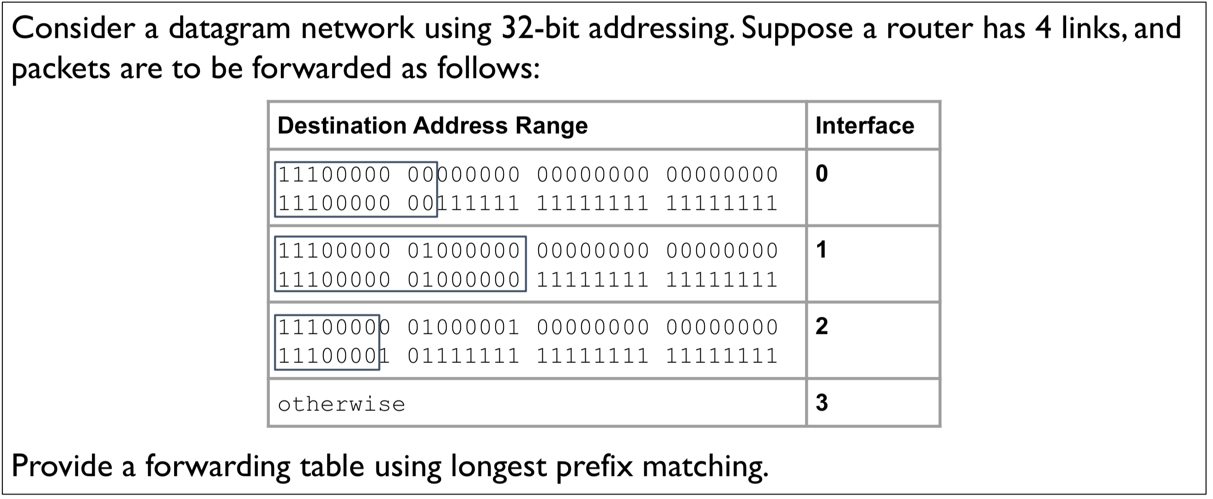
Q4 Forwarding Table

Slide 10
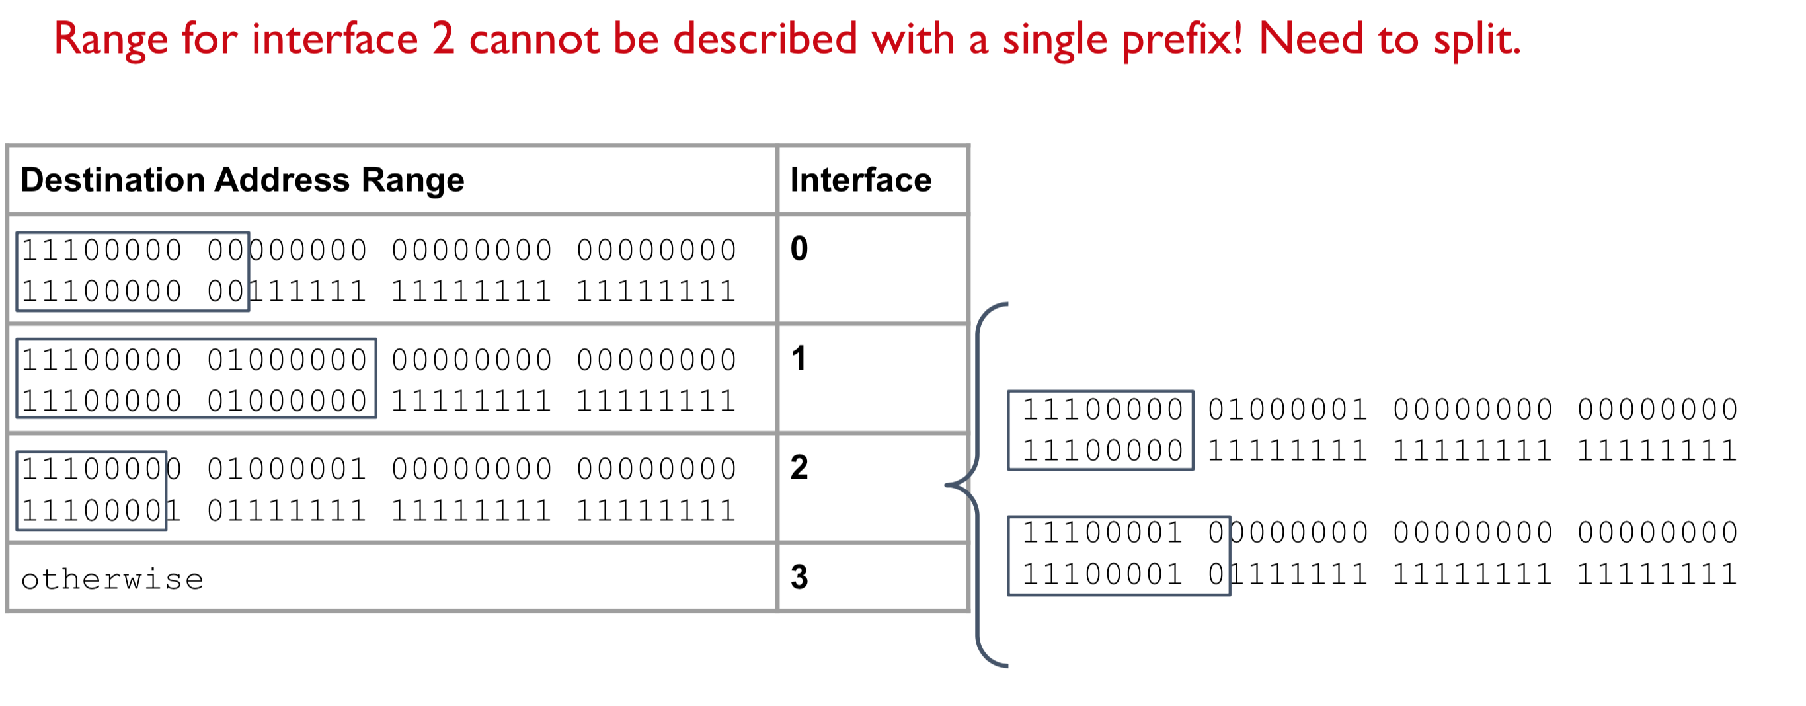
Q4 Forwarding Table

Slide 11
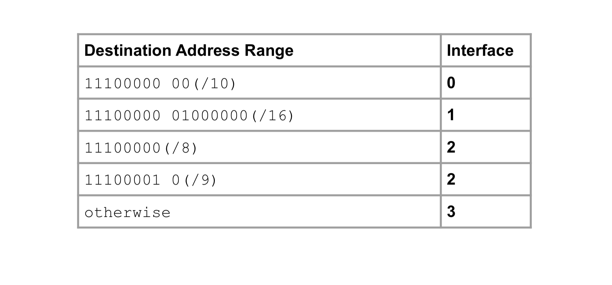
Q4 Forwarding Table

Slide 12
Quiz

Slide 13
Thanks!

