Slide 1
CSCI4430 Computer Networks Lecture 3: Application Layer – Socket programming, HTTP
Hong Xu
Material with thanks to Patrick Lee, Mosharaf Chowdhury, Aditya Akella, Sugih Jamin, Philip Levis, Sylvia Ratnasamy, Peter Steenkiste, and many other colleagues.

Slide 2
Agenda
Socket programming
HTTP and the Web
Improving HTTP performance

Slide 3
How to implement a network application?
Implementation of each protocol layer is located in either the user-space, kernel-space, or the device (hardware)
Client/Server
Program
Application
User
Transport
Network
Kernel
Data Link
Physical
Device

Slide 4
How to implement a network application?
We need a “door” so that a network application can send/receive messages to/from the network
The door should appear between the user space and kernel space so that details of the kernel space can be hidden
Socket is the door!
Client/Server
Program
Application
User
What is the interface?
Transport
Kernel

Slide 5
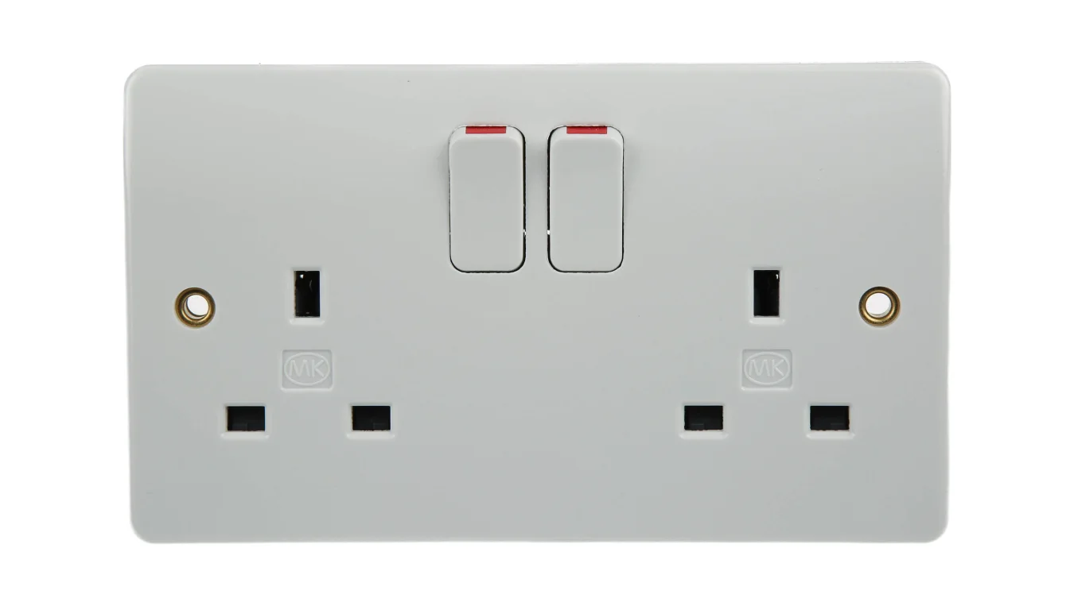
How to implement a network application?
A socket is a host-local, application-created, OS-controlled interface (a “door”) into which application process can both send and receive messages to/from another application process
Similar to a file descriptor, which interfaces between an application and a file
One socket is tied to one application process (or thread)
An application can create many processes (and hence sockets)
Client/Server
Program
Socket
Socket
Socket
TCP Control
UDP Control

Slide 6
Socket programming
Socket programming is to build client/server application that communicate using sockets
Socket API
introduced in BSD 4.1 UNIX, 1981
explicitly created, used, released by apps
client/server paradigm
two types of transport service via socket API:
unreliable datagram
reliable, byte stream-oriented

Slide 7
Socket programming using TCP
TCP service: reliable transfer of bytes from one process to another.
An application may view TCP a reliable, in-order pipe (or stream).
controlled by
application
developer
controlled by
application
developer
process
process
socket
socket
controlled by
operating
system
TCP with
buffers,
variables
TCP with
buffers,
variables
controlled by
operating
system
internet
host or
server
host or
server

Slide 8
Socket programming using TCP
Before client contacts server:
server process must first be running
server must have created a socket (door) to receive client’s contact
Client contacts server by:
creating a local TCP socket
specifying IP address, port number of server process
After client creates a socket: client establishes a TCP connection to server
When contacted by client, server creates a new TCP socket for server process to communicate with client
allows server to talk to many clients simultaneously
IP addr and source port number used to distinguish clients

Slide 9
Socket programming using TCP
TCP server
When a server creates a socket, it needs to specify:
Identifier of the socket
Connection mode (TCP/UDP)
Analogous to when you open a file in C, you need to specify:
location of the file
access mode (e.g., read-only, write-only)
socket
Operations of socket programming in C/C++
bind
(TA will go through details)
listen
TCP client
socket
accept
3-way handshake
connect
send/recv
share data
send/recv
close
close

Slide 10
Programming stuff...client
read()
socket()
bind()
connect()
write()
Client flow chart
Step (1). socket()
- Create a socket.
read() – to receive data.
write() – to send data.
close() – to close the socket
Step (2). bind() [optional]
- Assign the socket a port number.
- Skip this step and will have a random port number assigned.
Important System calls
Client side | Server side
socket()
bind()* | bind()
connect() | listen() and accept()
Step (3). connect()
- Connect to the remote server.
- It is a blocking system call.
* means optional.

Slide 11

Programming stuff...server
socket()
bind()
listen()
read()
Server flow chart
accept()
write()
Step (1) & Step(2) [ you know them now. ]
read() – to receive data.
write() – to send data.
close() – to close the socket
Step (3). listen()
- It sets the port to be listening to incoming connections, for TCP only.
Important System calls
Client side | Server side
socket()
bind()* | bind()
connect() | listen() and accept()
Step (4). accept()
- Accept incoming connections.
- A blocking system call.
* means optional.

Slide 12
Programming stuff...accept()
Socket FD
socket()
bind()
listen()
Accept FD
Socket FD
Socket FD
connection #1
read() & write()
accept()
Socket FD
Accept FD
connection #n
read() & write()
Server flow chart
An interesting thing about accept() is the creation of a new file descriptor!
Application layer’s point of view.
Good! It provides each connection a new handler and we can distinguish every connection!
Transport layer’s point of view.
Well, for TCP, every FD points to an unique TCP control structure. It is a necessary for reliable data transfer!

Slide 13
Programming stuff...complete flow
socket()
bind()
listen()
accept()
New connection arrives
connection is closed.
Server flow chart
Application-layer code
Limitation:
Only supports a single client!
read()
&
write()
Application-layer code
DONE!
socket()
bind()
connect()
close()
exit()
Client flow chart

Slide 14
Programming stuff...server parallelization
socket()
bind()
listen()
accept()
New connection arrives
parent
Server main
flow chart
fork() or pthread_create()
child
Server client-handler flow chart
exit() or
pthread_exit()
Application-layer code
connection is closed.

Slide 15
Addressing processes
A server can run many processes (or threads), each serving a client
If I’m a client, how to identify a server process?
IP address of host may work, but many processes can be running on same host
Use (IP address, port number)
Analogous to mailing a letter to a professor in a department:
IP address is the address of the department
Port number is the mail box of the professor

Slide 16
Addressing processes
Identifier of a server process includes both IP address of the server host and port number.
Port number: 16 bits, 0–65535
Example port numbers:
HTTP server: 80; HTTPS: 443
Mail server: 25
See /etc/services on a Linux machine for more
To send HTTP messages to www.cse.cuhk.edu.hk:
IP address: 137.189.91.182
Port number: 443

Slide 17
Addressing processes
A service on the server usually has a fixed port number so that clients know where to connect.
When a socket is created, a fixed port number is associated.
However, client’s port number is allocated on demand when a socket is created.
In summary, the IP address and port number are together used to address a server process.

Slide 18
Illustrations on Socket Use with TCP
HTTP server
socket
IP: 137.189.91.182
Port: 80
accept()
Step 1: Server waits for clients’ connections (i.e., calling accept())

Slide 19
Illustrations on Socket Use with TCP
HTTP server
socket
IP: 137.189.91.182
Port: 80
accept()
connect()
IP: 137.189.x.y
Port: 12345
HTTP client
Step 2: Client makes a connection via connect().

Slide 20
Illustrations on Socket Use with TCP
HTTP server
socket
IP: 137.189.91.182
Port: 80
accept()
IP: 137.189.91.182, port 80
IP: 137.189.x.y, port 12345
Connection is identified by
(server’s IP, server’s port,
client’s IP, client’s port)
IP: 137.189.91.182, port 80
IP: 137.189.x.y, port 12345
HTTP client
Step 3: Server creates a new TCP socket to serve the connection

Slide 21
Illustrations on Socket Use with TCP
HTTP server
socket
IP: 137.189.91.182
Port: 80
accept()
IP: 137.189.91.182, port 80
IP: 137.189.x.y, port 12345
IP: 137.189.91.182, port 80
IP: 137.189.u.v, port 16876
IP: 137.189.91.182, port 80
IP: 137.189.x.y, port 12345
IP: 137.189.91.182, port 80
IP: 137.189.u.v, port 16876
HTTP client
HTTP client
Step 4: Server can accept more connections…

Slide 22
HTTP and the web

Slide 23
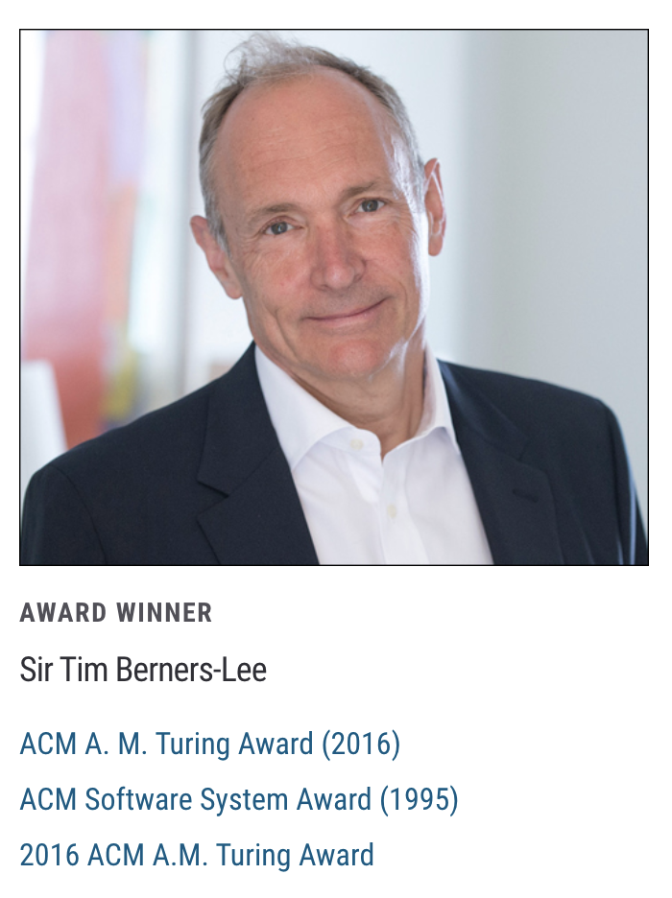
The Web: History
World Wide Web (WWW): a distributed database of “pages” linked through Hypertext Transport Protocol (HTTP)
First HTTP implementation – 1990
Tim Berners-Lee at CERN
HTTP/0.9 – 1991
Simple GET command for the Web
HTTP/1.0 – 1992
Client/server information, simple caching

Slide 24
The Web: History (cont’d)
World Wide Web (WWW): a distributed database of “pages” linked through Hypertext Transport Protocol (HTTP)
HTTP/1.1 – 1996
Performance and security optimizations
HTTP/2 – 2015
Latency optimizations via request multiplexing over single TCP connection
Binary protocol instead of text
Server push

Slide 25
The Web: History (cont’d)
World Wide Web (WWW): a distributed database of “pages” linked through Hypertext Transport Protocol (HTTP)
HTTP/3 – TBA
Built on top of QUIC, which is a user-space congestion control protocol on UDP
Solves head-of-line (HOL) blocking problem in multiplexing over single TCP connection

Slide 26
What does it consist of?
Who uses it?
Who provides the content?
How do they communicate?
How do we find the content?
How is the content organized?
How is it displayed?

Slide 27
Web components
Infrastructure:
Clients
Servers (DNS, CDN, Datacenters)
Content:
URL: naming content
HTML: formatting content
Protocol for exchanging information: HTTP

Slide 28
Why is there nothing about the network?
Application
Application
Transport
Transport
Network
Network
Network
Datalink
Datalink
Datalink
Physical
Physical
Physical
Clients
Switch
Servers

Slide 29




What we want
http://123.xyz
123.xyz server
HTTP Request

Slide 30
What we get
http://123.xyz
123.xyz server
Hello
HTTP Response

Slide 31
URL: Uniform Record Locator
protocol://host-name[:port]/directory-path/resource
Extend the idea of hierarchical hostnames to include anything in a file system
https://github.com/henryhxu/CSCI4430-ESTR4120/tree/2023_spring/lecture/lec1.pptx
Extend to program executions as well…
https://www.google.com/search?q=csci4430
Server-side processing can be included in the name

Slide 32
URL: Uniform Record Locator
protocol://host-name[:port]/directory-path/resource
protocol: http, ftp, https, smtp, rtsp, etc.
host-name: DNS name, IP address
port: defaults to protocol’s standard port
E.g., http: 80, https: 443
directory path: hierarchical, reflecting file system
resource: Identifies the desired resource

Slide 33
Hyper Text Transfer Protocol (HTTP)
Client-server architecture
Server is “always on” and “well known”
Clients initiate contact to server
Synchronous request/reply protocol
Runs over TCP, Port 80
Stateless
ASCII format
Before HTTP/2

Slide 34
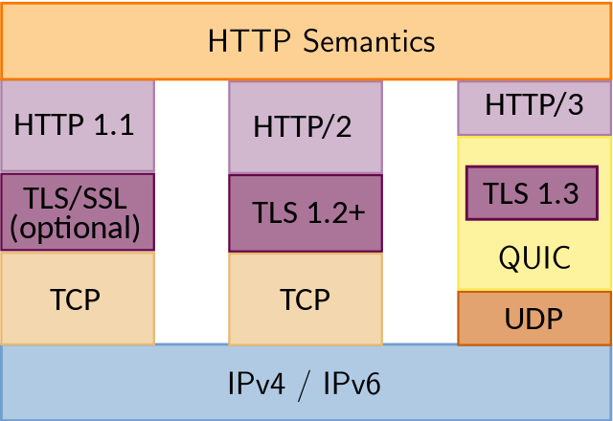
HTTP variants

Slide 35
Steps in HTTP request/response
Client
Server
TCP syn
Establish
TCP connection
TCP syn + ack
Client
request
TCP ack + HTTP GET
.
.
Request
response
.
Close connection

Slide 36
Method types (HTTP 1.1)
GET, HEAD
POST
Send information (e.g., web forms)
PUT
Uploads file in entity body to path specified in URL field
DELETE
Deletes file specified in the URL field

Slide 37
Client-to-server communication
HTTP Request Message
Request line: method, resource, and protocol version
request line
GET /somedir/page.html HTTP/1.1
Host: www.someschool.edu
User-agent: Mozilla/4.0
Connection: close
Accept-language: en
(blank line)
header
lines
carriage return line feed
indicates end of message

Slide 38
Client-to-server communication
HTTP Request Message
Request line: method, resource, and protocol version
Request headers: provide info or modify request
Body: optional data (e.g., to “POST” data to server)
request line
GET /somedir/page.html HTTP/1.1
Host: www.someschool.edu
User-agent: Mozilla/4.0
Connection: close
Accept-language: en
(blank line)
header
lines
carriage return line feed
indicates end of message

Slide 39
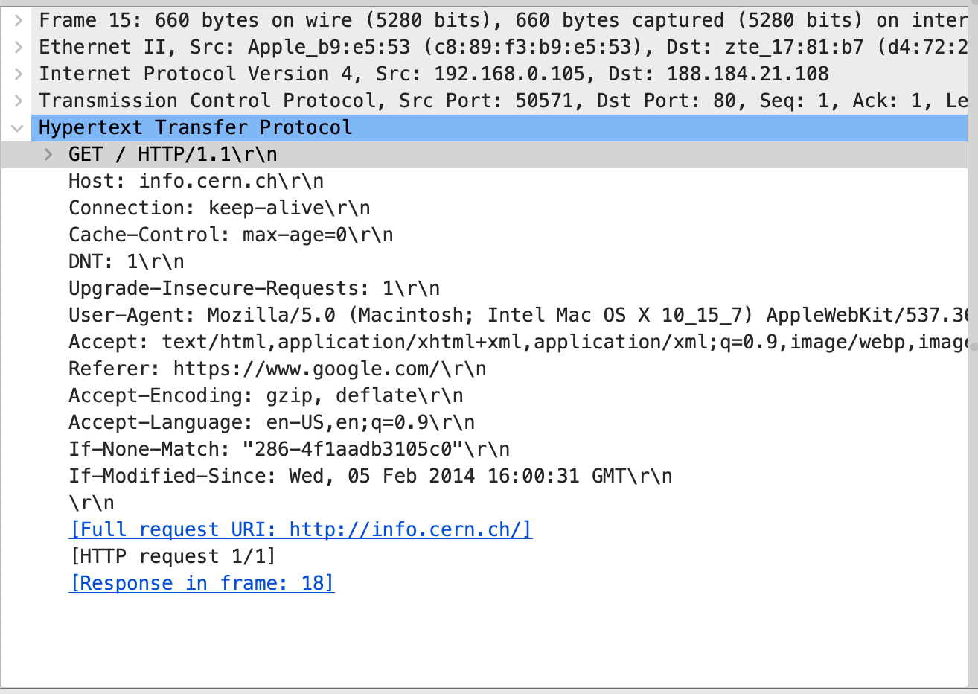
A real example

Slide 40
Server-to-client communication
HTTP Response Message
Status line: protocol version, status code, status phrase
Response headers: provide information
Body: optional data
status line
(protocol, status code, status phrase)
HTTP/1.1 200 OK
Connection close
Date: Thu, 06 Jan 2017 12:00:15 GMT
Server: Apache/1.3.0 (Unix)
Last-Modified: Mon, 22 Jun 2006 ...
Content-Length: 6821
Content-Type: text/html
(blank line)
data data data data data ...
header lines
data
e.g., requested HTML file

Slide 41
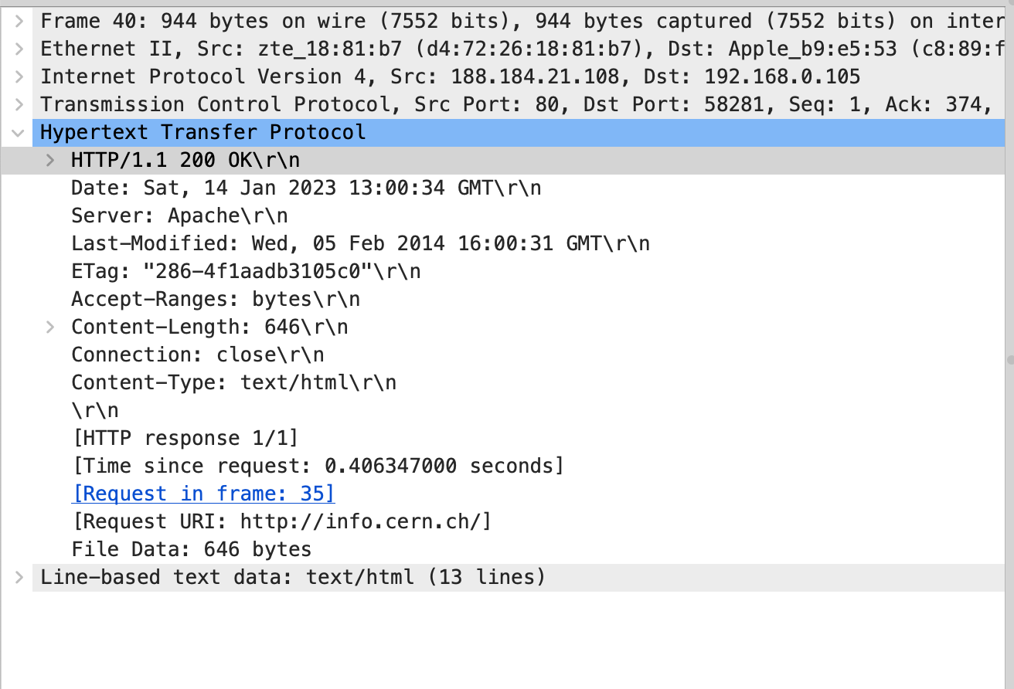
A real example

Slide 42
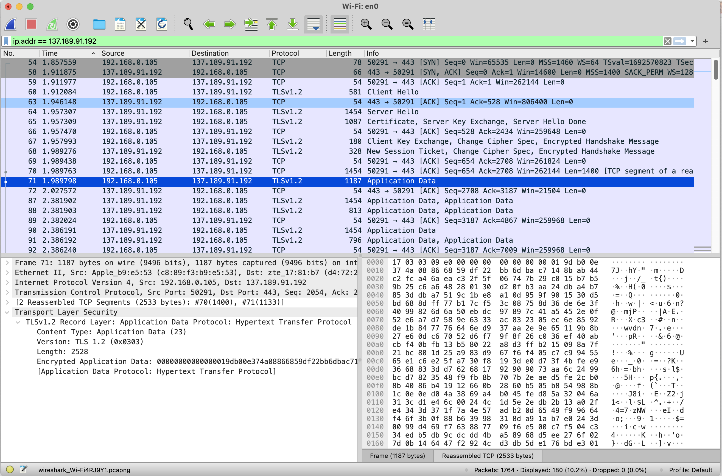
What about HTTPS?

Slide 43
HTTP is stateless
Each request-response treated independently
Servers not required to retain state
Good: Improves scalability on the server-side
Failure handling is easier
Can handle higher rate of requests
Order of requests doesn’t matter
Bad: Some applications need persistent state
Need to uniquely identify user or store temporary info
e.g., Shopping cart, user profiles, usage tracking, …
Notes:
Fate sharing

Slide 44
How does a stateless protocol keep state?

Slide 45
State in a stateless protocol: Cookies
Client-side state maintenance
Client stores small state on behalf of server
Client sends state in future requests to the server
Can provide authentication
Request
Store Cookie
Response
Set-Cookie: XYZ
DB
DB
Request
Cookie: XYZ
Client
Server
Notes:
Creates a notion of a “SESSION” for the user
Customize the user experience
Statefulness comes from the client side

Slide 46
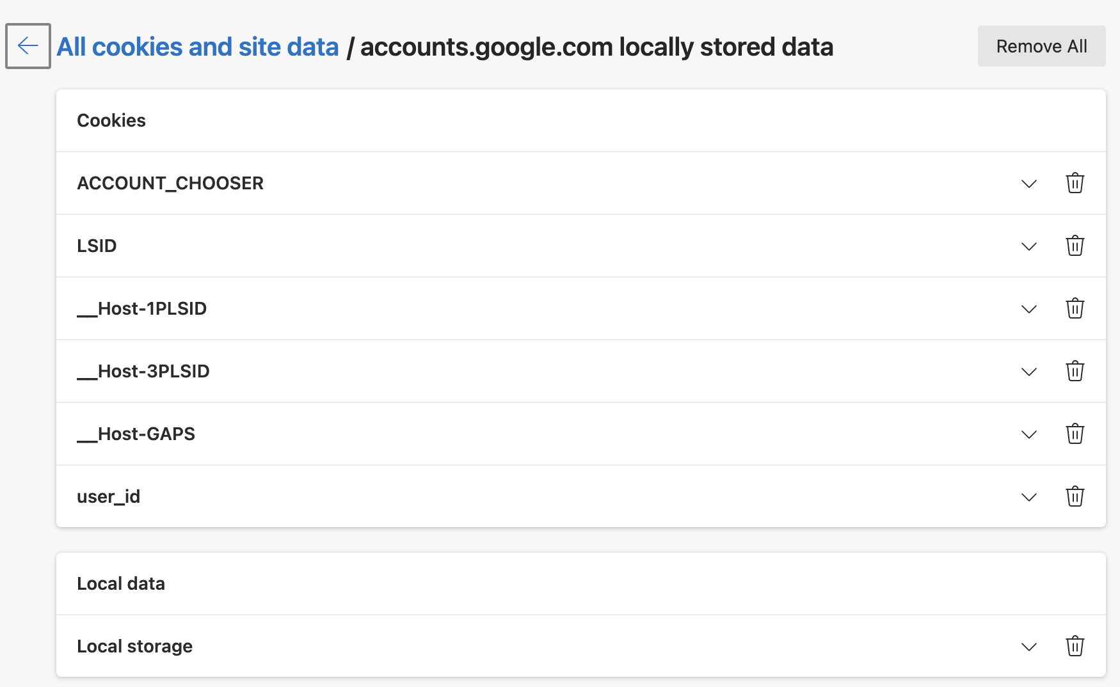
A real example

Slide 47
Beyond cookies
Cookies provide excellent marketing opportunities and create concerns for privacy
Advertising companies tracks your preferences and viewing history across sites
Many are trying to replace personalized cookies with group-based identifiers
Example: FLoC in Google Chrome that uses federated learning

Slide 48
Improving HTTP performance

Slide 49
Performance goals
User
Fast downloads (not identical to low-latency communication!)
High availability
Content provider
Happy users (hence, above)
Cost-effective infrastructure
Network (secondary)
Avoid overload

Slide 50
Solutions?
Improve networking protocols including HTTP, TCP, etc.
User
Fast downloads (not identical to low-latency communication!)
High availability
Content provider
Happy users (hence, above)
Cost-effective infrastructure
Network (secondary)
Avoid overload

Slide 51
Solutions?
Improve networking protocols including HTTP, TCP, etc.
User
Fast downloads (not identical to low-latency communication!)
High availability
Content provider
Happy users (hence, above)
Cost-effective infrastructure
Network (secondary)
Avoid overload
Caching and replication

Slide 52
Solutions?
Improve networking protocols including HTTP, TCP, etc.
User
Fast downloads (not identical to low-latency communication!)
High availability
Content provider
Happy users (hence, above)
Cost-effective infrastructure
Network (secondary)
Avoid overload
Caching and replication
Exploit economies of scale; e.g., webhosting, CDNs, datacenters

Slide 53
HTTP performance
Most webpages have multiple objects
e.g., HTML file and a bunch of embedded images
How do you retrieve those objects (naively)?
One item at a time
New TCP connection per (small) object!

Slide 54
Object request response time
RTT (round-trip time)
Time for a small packet to travel from client to server and back
Response time
1 RTT for TCP setup
1 RTT for HTTP request and first few bytes
Transmission time
Total = 2RTT + Transmission Time
Client
Server
TCP syn
RTT
TCP syn + ack
TCP ack + HTTP GET
RTT
Tx

Slide 55
Non-persistent connections
Default in HTTP/1.0
2RTT+△ for each object in the HTML file!
One more 2RTT+△ for the HTML file itself
Doing the same thing over and over again
Inefficient

Slide 56
Concurrent requests and responses
Use multiple connections in parallel
Does not necessarily maintain order of responses
Client
R2
R3
R1
T2
T3
T1
Client = ☺
Content provider = ☺
Network = ☹ Why?
Server

Slide 57
Persistent connections
Maintain TCP connection across multiple requests
Including transfers subsequent to current page
Client or server can tear down connection
Advantages
Avoid overhead of connection set-up and tear-down
Allow underlying layers (e.g., TCP) to learn about RTT and bandwidth characteristics
Default in HTTP/1.1

Slide 58
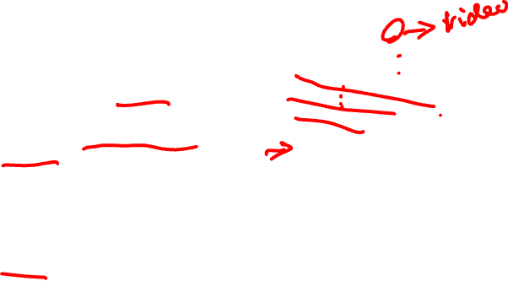
Pipelined requests & responses
Batch requests and responses to reduce the number of packets
Multiple requests can be contained in one TCP segment
Data are sent in a FIFO manner
Can lead to head-of-line (HOL) blocking if many small responses follow a large one
Not supported by default by major browsers circa 2015
Solution
Priority and preemption
Client
Server
Request 1
Request 2
Request 3
Transfer 1
Transfer 2
Transfer 3
Notes:
HTTP/1.1 allows multiple HTTP requests to be written out to a socket together without waiting for the corresponding responses. The requestor then waits for the responses to arrive in the order in which they were requested. The act of pipelining the requests can result in a dramatic improvement in page loading times, especially over high latency connections.

Slide 59

Scorecard: Getting n small objects
Time dominated by latency
One-at-a-time: ~2n RTT
m concurrent: ~2[n/m] RTT
Persistent: ~ (n+1) RTT
Pipelined: ~2 RTT
Pipelined and Persistent: ~2 RTT first time; RTT later for another n from the same site

Slide 60

Scorecard: Getting n large objects each of size F
Time dominated by TCP throughput B_{C} (<= B_{L}), where link bandwidth is referred by B_{L}
One-at-a-time: ~ nF/B_{C}
m concurrent: ~ nF/(mB_{C})
Assuming each TCP connection gets the same throughput and mB_{C} <= B_{L}
Pipelined and/or persistent: ~ nF/B_{C}
The only thing that helps is higher throughput

Slide 61
Summary
Socket programming
HTTP/1.1
Text-based protocol
Replaced by binary HTTP/2 protocol, which is being replaced by HTTP/3
Many ways to improve performance
Pipelining and batching
Caching in proxies and CDNs （next lecture）
Datacenters

