Slide 1
CSCI4430 Computer Networks Lecture 4: Application Layer – Caching and CDN, DNS
Hong Xu, Henry
CSE@CUHK, 2023
Material with thanks to Mosharaf Chowdhury, Aditya Akella, Sugih Jamin, Philip Levis, Sylvia Ratnasamy, Peter Steenkiste, and many other colleagues.

Slide 2
Agenda
Caching
CDN: Content Distribution Network
DNS: Domain Name System

Slide 3
Recap: Improving HTTP
Optimizing connections using three “P”s
Persistent (latency)
Parallel/concurrent (bandwidth and latency)
Pipelined over the same connection (latency)
Caching
Forward proxy: close to clients
Reverse proxy: close to servers
Replication

Slide 4
Caching
Why does caching work?
Exploits locality of reference
How well does caching work?
Very well, up to a limit
Large overlap in content
But many unique requests
A universal story!
Effectiveness grows logarithmically in size

Slide 5
Caching: How
Modifier to GET requests:
If-modified-since – returns “not modified” if resource not modified since specified time
GET /somedir/page.html HTTP/1.1
Host: www.someschool.edu
User-agent: Mozilla/4.0
If-modified-since: Wed, 18 Jan 2017 10:25:50 GMT
(blank line)

Slide 6
Caching: How
Modifier to GET requests:
If-modified-since – returns “not modified” if resource not modified since specified time
Client specifies “if-modified-since” time in request
Server compares this against “last modified” time of resource
Server returns “Not Modified” if resource has not changed
…. or a “OK” with the latest version otherwise

Slide 7
Caching: How
Modifier to GET requests:
If-modified-since – returns “not modified” if resource not modified since specified time
Response header:
Expires – how long it’s safe to cache the resource
No-cache – ignore all caches; always get resource directly from server

Slide 8
Caching: Where?
Options
Client (browser)
Forward proxies
Reverse proxies
Content Distribution Network

Slide 9
Caching: Where?
Many clients request the same content
E.g., cuhk; youtube videos; software updates
Generate unnecessary server and network load
Clients experience unnecessary latency
Server
Tier-1 ISP
ISP-1
ISP-2
Clients

Slide 10
Caching with Reverse Proxies
Cache documents close to server
Decrease server load
By content provider
Reverse proxies
Tier-1 ISP
ISP-1
ISP-2
Clients
10

Slide 11
Caching with Forward Proxies
Cache documents close to clients
Reduce network traffic and decrease latency
By ISPs or enterprises
Reverse proxies
Tier-1 ISP
Forward proxies
ISP-1
ISP-2
Clients
11

Slide 12
Replication
Replicate popular websites across many machines
Spreads load across servers
Places content closer to clients
Helps when content isn’t cacheable

Slide 13
Content Distribution Networks (CDN)
Caching and replication as a service
Large-scale distributed storage infrastructure (usually) administered by one entity
e.g., Akamai is in 135 countries and 1300+ networks
[demo]
Combination of caching and replication
Pull: Direct result of clients’requests (caching)
Push: Expectation of high access rate (replication)
Notes:
Transcoding = change compression rate per user’s bandwidth

Slide 14
Cost-effective content delivery
General theme: multiple sites hosted on shared physical infrastructure
Efficiency of statistical multiplexing
Economies of scale (volume pricing, etc.)
Amortization of human operator costs
Examples:
CDNs
Web hosting companies
Cloud infrastructure

Slide 15
CDN example – Akamai
Akamai creates new domain names for each client
e.g., a128.g.akamai.net for cnn.com
The client content provider modifies content so that embedded URLs reference new domains
“Akamaize” content
e.g., http://www.cnn.com/image-of-the-day.gif becomes http://a128.g.akamai.net/image-of-the-day.gif
Requests now sent to CDN’s infrastructure

Slide 16
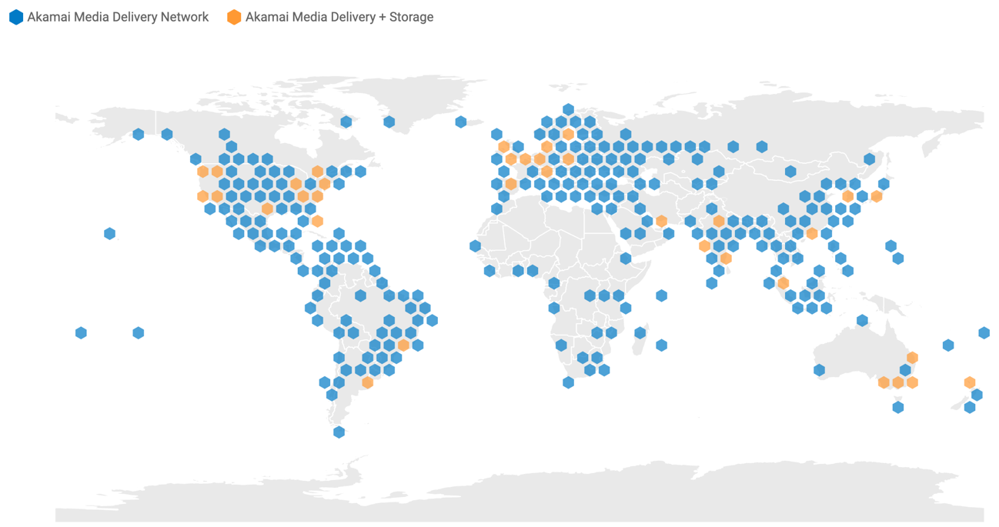
CDN example – Akamai
Retrieved on Sep 10, 2021 from https://www.akamai.com/visualizations/media-delivery-network-map

Slide 17
Why direct clients to particular replicas?
Balancing load across server replicas
Pairing clients with nearby servers to decrease latency and overall bandwidth usage

Slide 18
DNS: Domain name system

Slide 19
Internet names & addresses
Machine addresses: e.g., 141.212.113.143
Router-usable labels for machines
Conforms to network structure (the “where”)
Machine names: e.g., cse.cuhk.edu.hk
Human-usable labels for machines
Conforms to organizational structure (the “who”)
The Domain Name System (DNS) is how we map from one to the other
A directory service

Slide 20
Why?
Convenience
Easier to remember
Provides a level of indirection!
Decoupled names from addresses
Many uses beyond just naming a specific host

Slide 21
DNS: History
Initially all host-address mappings were in a hosts.txt file (in /etc/hosts):
Maintained by the Stanford Research Institute (SRI)
Changes were submitted by email and updates downloaded periodically from SRI
As the Internet grew SRI could not handle load
Names were not unique anymore
Hosts had inaccurate copies of hosts.txt

Slide 22
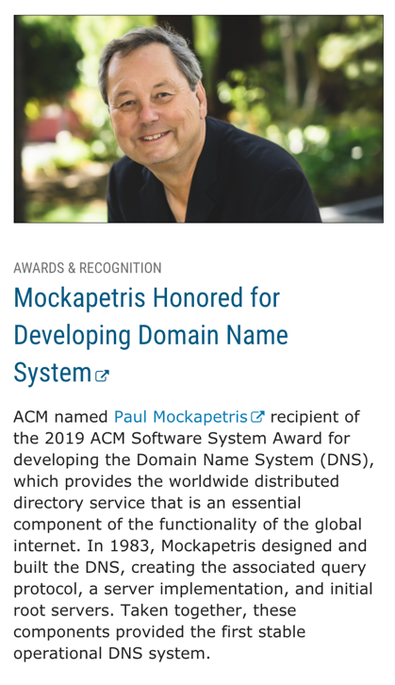
DNS: History
In 1983, the first stable operational DNS implementation included
The associated query protocol;
A server implementation; and
Initial root servers.
Since inception, DNS scaled from 1000s of queries/day to 10s of billions queries/day

Slide 23
Goals
Uniqueness: no naming conflicts
Scalable
Many names and frequent updates (secondary)
Distributed, autonomous administration
Ability to update my own (machines’) names
Don’t have to track everybody’s updates
Highly available
Lookups are fast
Perfect consistency is a non-goal

Slide 24
How?
Partition the namespace
Distribute administration of each partition
Autonomy to update my own (machines’) names
Don’t have to track everybody’s updates
Distribute name resolution for each partition
How should we partition things?

Slide 25
Key idea: Hierarchy
Three intertwined hierarchies
Hierarchical namespace
As opposed to original flat namespace
Hierarchically administered
As opposed to centralized
(Distributed) hierarchy of servers
As opposed to centralized storage

Slide 26
Hierarchical namespace
root
edu
com
gov
mil
org
net
cn
fr
…
“Top Level Domains” are at the top
Domains are subtrees
e.g., .edu, umich.edu, eecs.umich.edu
Name is leaf-to-root path
cse.eecs.umich.edu
Depth of tree is arbitrary (limit 128)
Name collisions trivially avoided
Each domain is responsible
umich
berkeley
eecs
law
cse

Slide 27
Hierarchical administration
ICANN/IANA
root
edu
com
gov
mil
org
net
cn
fr
…
umich
berkeley
eecs
law
A zone corresponds to an administrative authority that is responsible for that portion of the hierarchy
e.g., UMich controls names: *.umich.edu
e.g., EECS controls names: *.eecs.umich.edu
cse
Notes:
ICANN: Internet Corporation for Assigned Names and Numbers
IANA: Internet Assigned Numbers Authority

Slide 28
Server hierarchy
Top of hierarchy: Root servers
Location hardwired into other servers
Next Level: Top-level domain (TLD) servers
.com, .edu, etc.
Managed professionally
Bottom Level: Authoritative DNS servers
Actually store the name-to-address mapping
Maintained by the corresponding administrative authority

Slide 29
Server hierarchy
Each server stores a (small!) subset of the total DNS database
An authoritative DNS server stores “resource records” for all DNS names in the domain that it has authority for
Each server needs to know other servers responsible for other portions of the hierarchy
Every server knows the root
Root server knows about all top-level domains

Slide 30
DNS root
Located in Virginia, USA
How do we make the root scale?

Slide 31
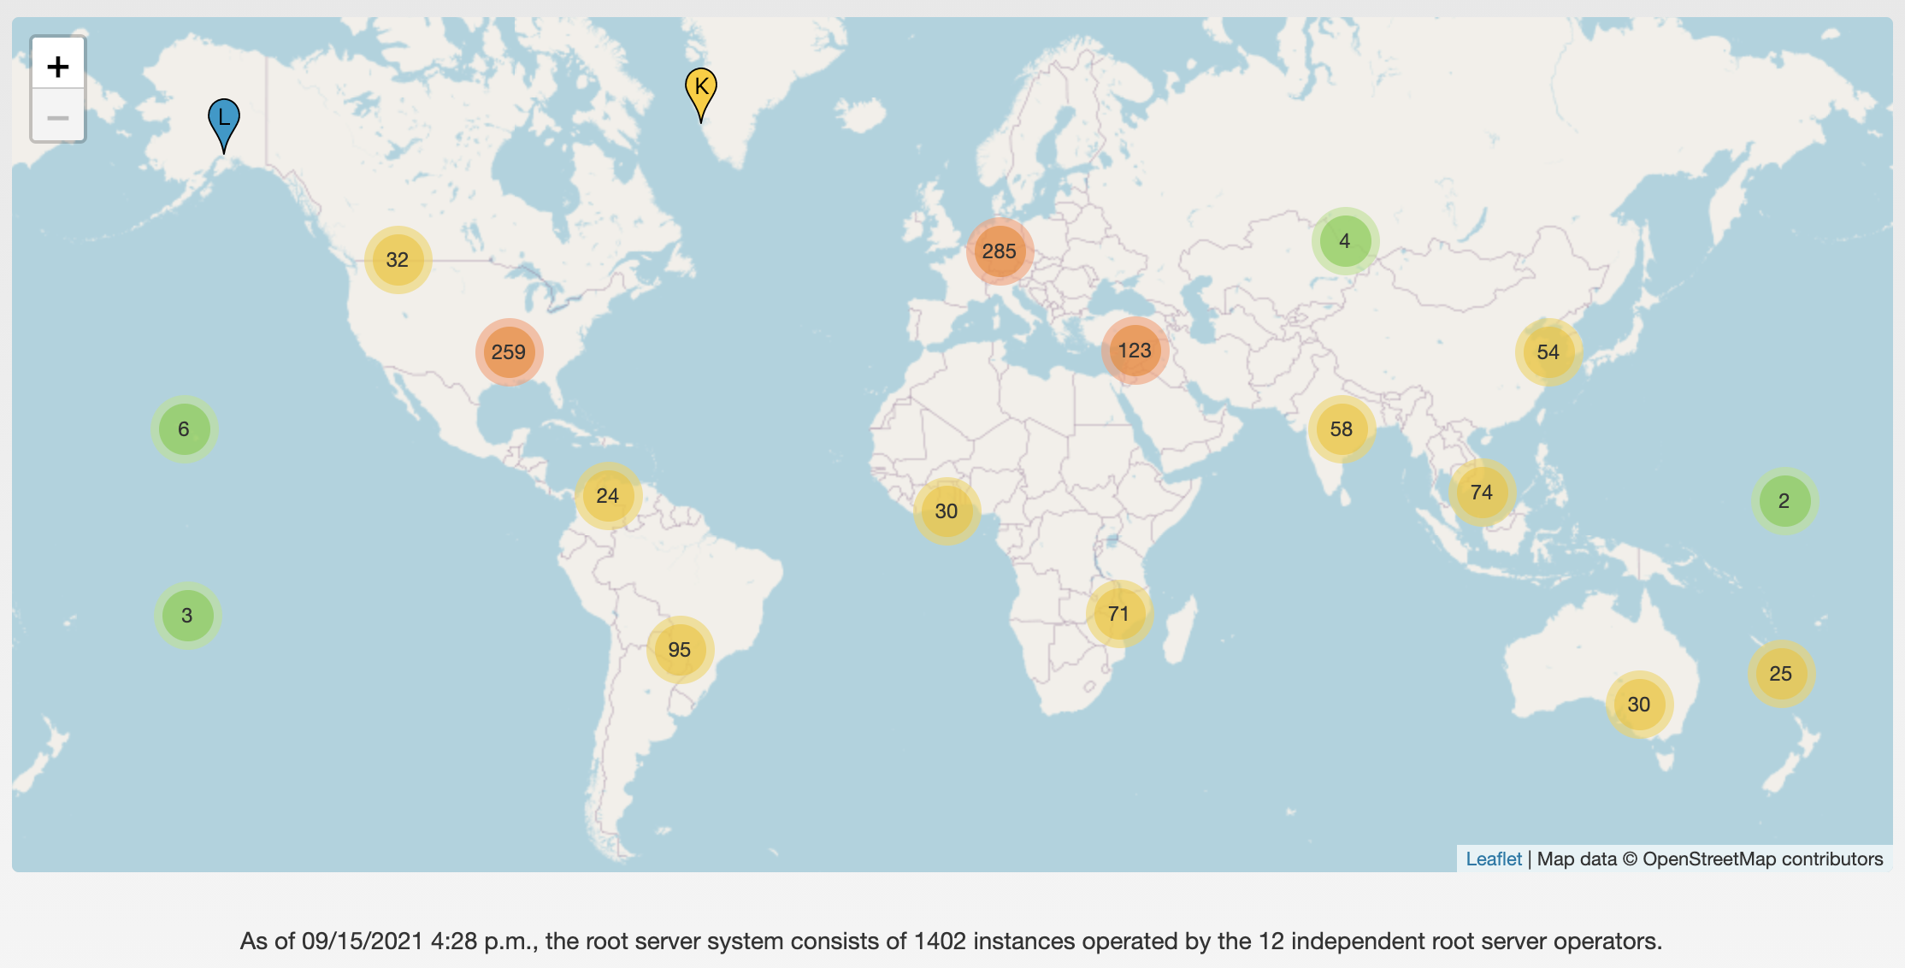
13 DNS root servers
https://root-servers.org/

Slide 32
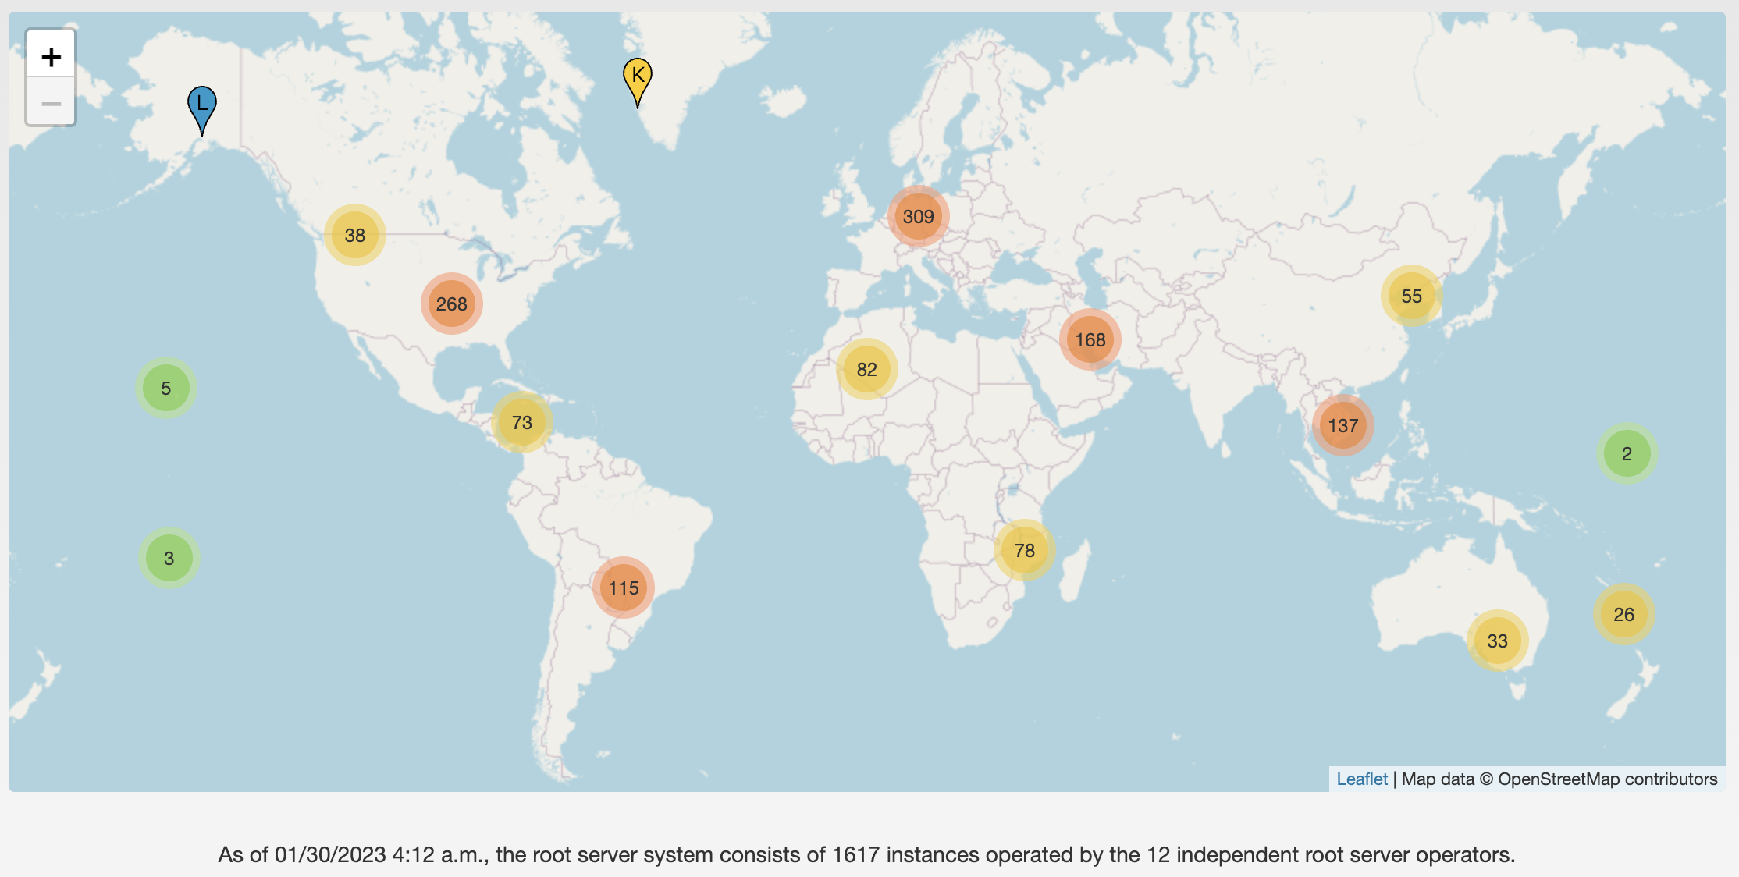
DNS root servers in 2023
https://root-servers.org/

Slide 33
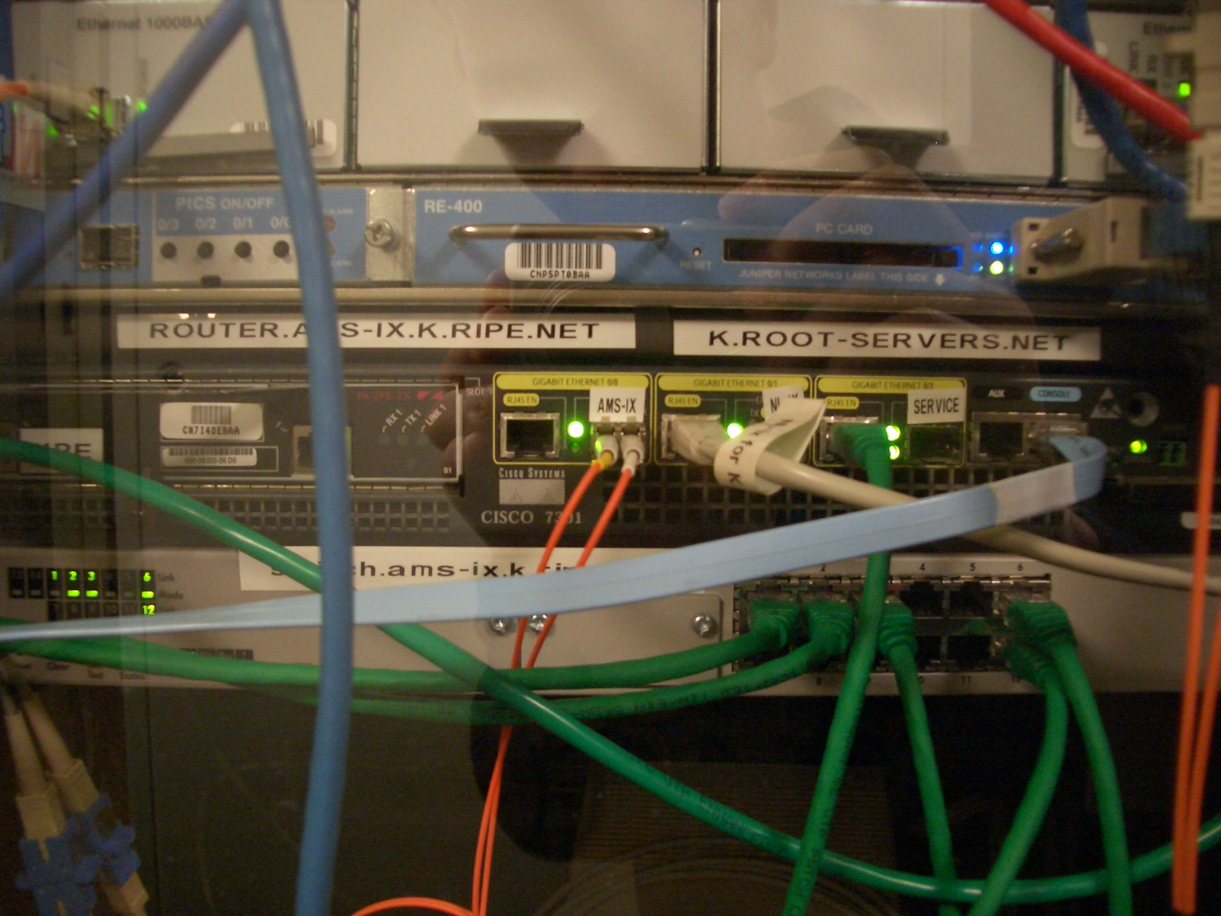
Root servers
https://www.iana.org/domains/root/servers
13 root servers, many instances for each
A Cisco 7301 router and a Juniper M7i, part of the K root-server instance at AMS-IX
Credit: https://commons.wikimedia.org/wiki/File:Ams-ix.k.root-servers.net.jpg

Slide 34
Start assignment 1 asap!

Slide 35
DNS records
DNS servers store resource records (RRs)
RR is (name, value, type, TTL)
Type = A: (→ Address)
name = hostname
value = IP address
Type = NS: (→ Name Server)
name = domain
value = name of DNS server for domain

Slide 36
DNS records (cont’d)
Type = CNAME: (→ Canonical Name)
name = alias name for some “canonical” (real) name
e.g., cse.umich.edu is really cse.eecs.umich.edu
value = canonical name
Type = MX: (→ Mail eXchanger)
name = domain in email address
value = name(s) of mail server(s)

Slide 37
Inserting Resource Records
Register foobar.com at registrar
Provide registrar with names and IP addresses of your authoritative name server(s)
Registrar inserts RR pairs into the .com TLD server:
(foobar.com, dns1.foobar.com, NS)
(dns1.foobar.com, 212.44.9.129, A)
Store resource records in your server dns1.foobar.com
e.g., type A record for www.foobar.com
e.g., type MX record for foobar.com

Slide 38
Using DNS (Client/App View)
Two components
Local DNS servers
Resolver software on hosts
Local DNS server (“default name server”)
Clients configured with default server’s address OR learn it via a host configuration protocol (e.g., DHCP)
Client application
Obtain DNS name (e.g., from URL)
Do getnameinfo() to trigger DNS request to its local DNS server
Notes:
DHCP: Dynamic Host Configuration Protocol

Slide 39
dig
dig nyu.edu
; <<>> DiG 9.10.6 <<>> nyu.edu
;; global options: +cmd
;; Got answer:
;; ->>HEADER<<- opcode: QUERY, status: NOERROR, id: 47443
;; flags: qr rd ra; QUERY: 1, ANSWER: 1, AUTHORITY: 0, ADDITIONAL: 1
;; OPT PSEUDOSECTION:
; EDNS: version: 0, flags:; udp: 512
;; QUESTION SECTION:
;nyu.edu. IN A
;; ANSWER SECTION:
nyu.edu. 60 IN A 216.165.47.10
;; Query time: 39 msec
;; SERVER: 192.168.1.1#53(192.168.1.1)
;; WHEN: Fri Sep 10 08:21:43 EDT 2021
;; MSG SIZE rcvd: 52

Slide 40
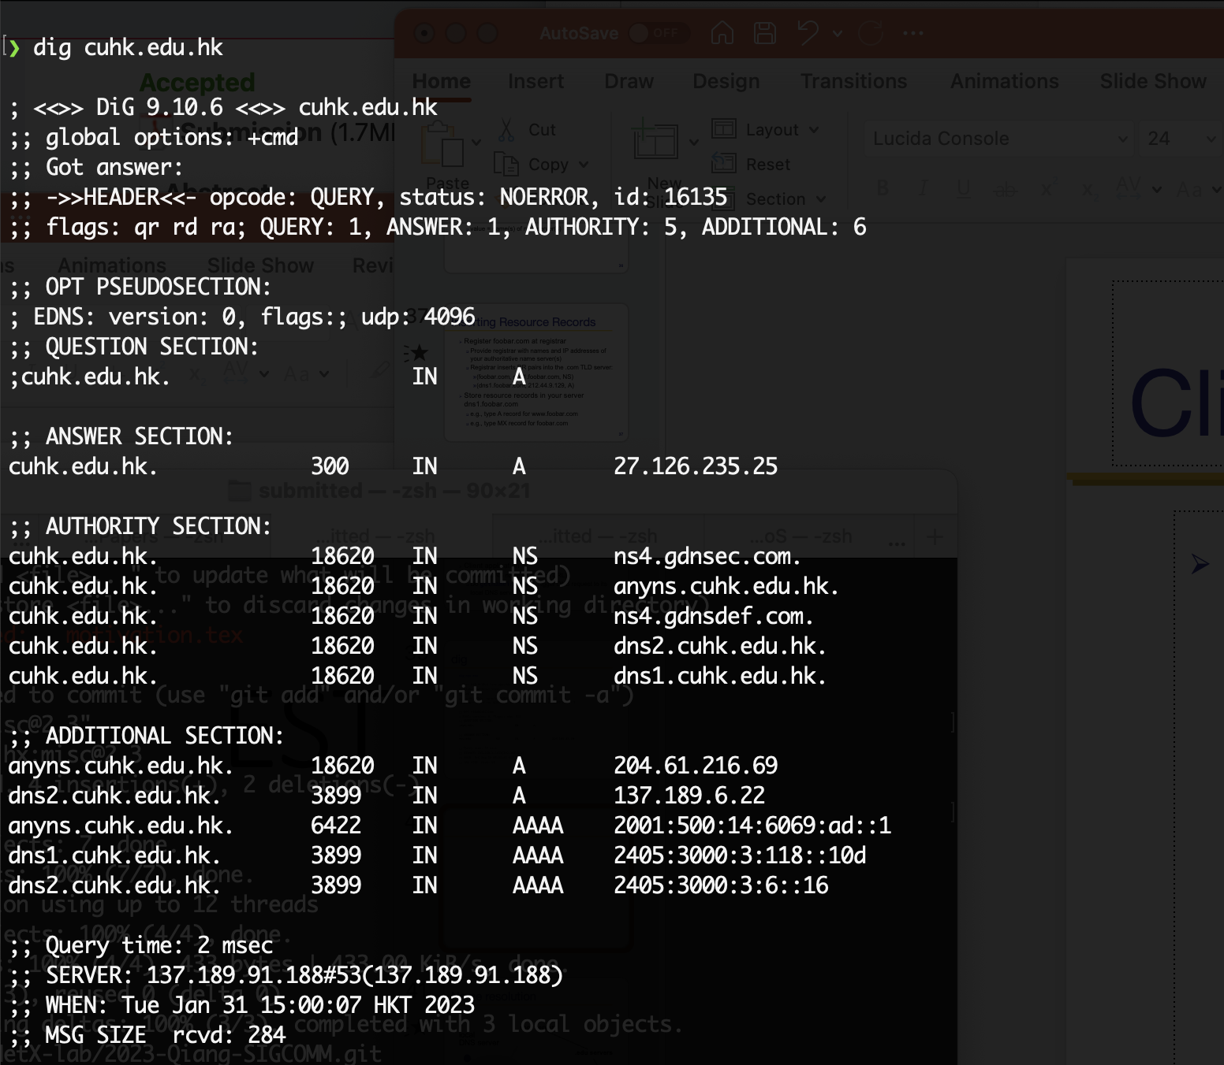
dig CUHK

Slide 41
Name resolution
root servers
local
DNS server
.edu servers
nyu.edu servers
DNS client (me.cse.umich.edu)

Slide 42
Name resolution
root servers
local
DNS server
(mydns.umich.edu)
.edu servers
nyu.edu servers
www.nyu.edu?
DNS client (me.cse.umich.edu)

Slide 43
Name resolution
root servers
local
DNS server
(mydns.umich.edu)
.edu servers
nyu.edu servers
www.nyu.edu?
DNS client (me.cse.umich.edu)

Slide 44
Name resolution
root servers
local
DNS server
(mydns.umich.edu)
.edu servers
nyu.edu servers
www.nyu.edu?
DNS client (me.cse.umich.edu)

Slide 45
Name resolution: Recursive
root servers
local
DNS server
(mydns.umich.edu)
.edu servers
nyu.edu servers
www.nyu.edu?
DNS client (me.cse.umich.edu)

Slide 46
Name resolution: Iterative
root servers
local
DNS server
.edu servers
nyu.edu servers
www.nyu.edu?
DNS client (me.cse.umich.edu)

Slide 47
Two ways to resolve a name
Recursive name resolution
Ask server to do it for you
Iterative name resolution
Ask server who to ask next
The iterative example we saw is a mix of both!

Slide 48
DNS protocol
Query and Reply messages; both with the same message format
Header: identifier, flags, etc.
Plus resource records
Client-server interaction on UDP Port 53
Spec supports TCP too, but not always implemented

Slide 49
Goals: Are we there yet?
Uniqueness: No naming conflicts
Scalable
Distributed, autonomous administration
Highly available?

Slide 50
Reliability
Replicated DNS servers (primary/secondary)
Name service available if at least one replica is up
Queries can be load-balanced between replicas
Usually, UDP used for queries
Reliability, if needed, must be implemented on UDP
Try alternate servers on timeout
Exponential backoff when retrying same server
Same identifier for all queries
Don’t care which server responds

Slide 51
Goals: Are we there yet?
Uniqueness: No naming conflicts
Scalable
Distributed, autonomous administration
Highly available
Fast lookups?

Slide 52
DNS caching
Performing all these queries takes time
Up to 1-second latency before starting download
Caching can greatly reduce overhead
The top-level servers very rarely change
Popular sites (e.g., www.google.com) visited often
Local DNS server often has the information cached
How DNS caching works
DNS servers cache responses to queries
Responses include a “time to live” (TTL) field
Server deletes cached entry after TTL expires

Slide 53
TTL in dig output
dig nyu.edu
; <<>> DiG 9.10.6 <<>> nyu.edu
;; global options: +cmd
;; Got answer:
;; ->>HEADER<<- opcode: QUERY, status: NOERROR, id: 47443
;; flags: qr rd ra; QUERY: 1, ANSWER: 1, AUTHORITY: 0, ADDITIONAL: 1
;; OPT PSEUDOSECTION:
; EDNS: version: 0, flags:; udp: 512
;; QUESTION SECTION:
;nyu.edu. IN A
;; ANSWER SECTION:
nyu.edu. 60 IN A 216.165.47.10
;; Query time: 39 msec
;; SERVER: 192.168.1.1#53(192.168.1.1)
;; WHEN: Fri Sep 10 08:21:43 EDT 2021
;; MSG SIZE rcvd: 52
TTL
Notes:
60 Seconds

Slide 54
Negative caching
Remember things that do not work
Misspellings like www.google.comm
These can take a long time to fail the first time
Good to remember that they do not work so the failure takes less time the next time around
Negative caching is optional
Not widely implemented

Slide 55
Important properties of DNS
Administrative delegation and hierarchy enables:
Easy unique naming
Reasonable trust model
Caching increases scalability and performance

Slide 56
DNS provides indirection
Addresses can change underneath
Move www.cnn.com to 4.125.91.21
Name could map to multiple IP addresses
Load-balancing (CDN)
Reducing latency by picking nearby servers (CDN)
Try out: dig google.com a few times
Multiple names for the same address
E.g., many services (mail, www) on same machine
E.g., aliases like www.cnn.com and cnn.com

Slide 57
Summary
CDNs improve web performance
Via replication and caching
Good server selection
DNS allows us to go to webpages without having to memorize IP addresses
Allows a level of indirection that enables many functionalities including CDN server selection

