Slide 1
CSCI 4430 - Fall 23
Tutorial 2
Credits to Umich EECS 489 Discussion 2

Slide 2
Assignment 1
Due: 11:59:59 p.m., Fri, Oct. 6th

Slide 3
Outline
Performance Metrics - Delay
Performance Metrics - Throughput
Exercise 1
Exercise 2

Slide 4
Performance Metrics - Delay
Link properties
Transmission delay
Propagation delay
Sender
Receiver
Propagation delay
Transmission delay

Slide 5
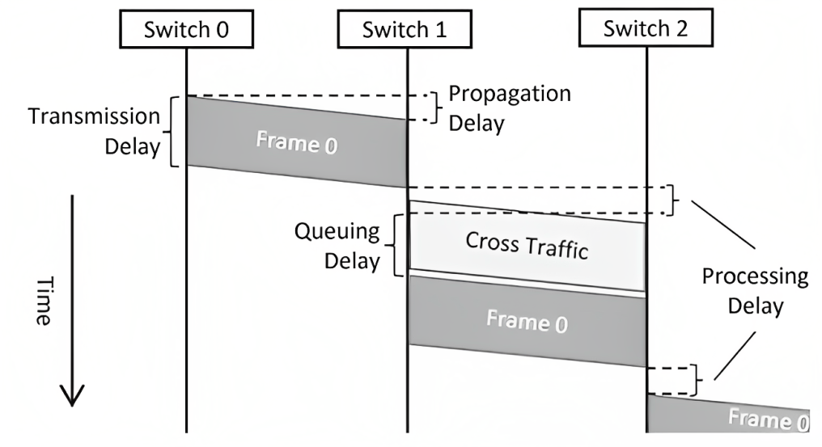
Performance Metrics - Delay
Traffic mix and switch internals
Queuing delay
Processing delay (negligible?)
[1] Graphical_Description_of_Network_Delay.png (428×233) (wikimedia.org)

Slide 6
Performance Metrics - Throughput
Throughput = Data transferred / Transfer time
Transfer time = transmission delay + propagation delay

Slide 7
Exercise - Q1
Suppose a 100-Mbps point-to-point link is being set up between Earth and a new lunar colony.
The distance from the moon to Earth is approximately 385,000 km, and data travels over the link at the speed of light = 3∗10^8 m/s.
(a) Calculate the minimum RTT(round-trip time) for the link.
propagation delay = 385000 km / (3 * 10^5 km/s) = 1.28333s
RTT = 2 * propagation delay = 2 * 1.28333 = 2.56666s

Slide 8
Exercise - Q1
Suppose a 100-Mbps point-to-point link is being set up between Earth and a new lunar colony.
The distance from the moon to Earth is approximately 385,000 km, and data travels over the link at the speed of light = 3∗10^8 m/s.
(b) Suppose Mission Control on Earth wishes to download a 25MB (1MB = 10^6B) image from a camera on the lunar base. What is the minimum amount of time that will elapse between when the request for the data goes out and the transfer is finished? Throughput?
transmission delay = 25MB / 100Mbps = 25 * 8 / 100 = 2s
delay = RTT + transmission delay = 2.5666 + 2 = 4.5666s
throughput = 25MB * 8 / (2s + 1.28333s) = 60.9 Mbps

Slide 9
Exercise - Q1
Suppose a 100-Mbps point-to-point link is being set up between Earth and a new lunar colony.
The distance from the moon to Earth is approximately 385,000 km, and data travels over the link at the speed of light = 3∗10^8 m/s.
(c) The maximum number of flying bits on the link?
# bits = propagation delay * bandwidth
= 1.28333s * 100Mbps = 1.28333 * 10^8

Slide 10
Exercise - Q2
Calculate the latency (from first bit sent to last bit received) for the following:
(a) A 10-Mbps link with a single store-and-forward switch in the path, and a packet size of 5,000 bits. Assume that each section of the link introduces a propagation delay of 10 microseconds, and that the switch begins retransmitting immediately after it has finished receiving the packet.
(5000 b / 10Mbps + 10us) * 2 = 1.02ms

Slide 11
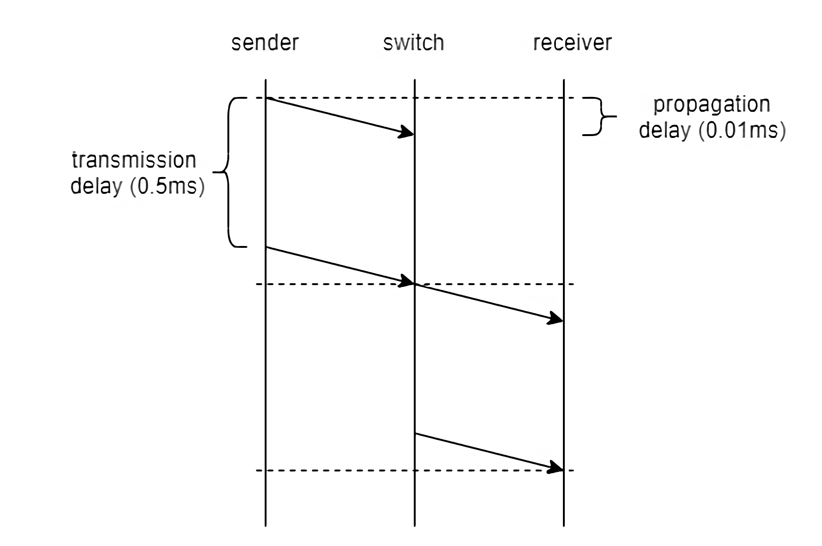
Exercise - Q2
(5000 b / 10Mbps + 10us) * 2 = 1.02ms

Slide 12
Exercise - Q2
Calculate the latency (from first bit sent to last bit received) for the following:
(b) A 10-Mbps link with a single cut-off switch in the path, and a packet size of 5,000 bits. Assume that each section of the link introduces a propagation delay of 10 microseconds, and that the switch begins retransmitting immediately after the first 200 bits have been received.
0.51ms + 200b / 10Mbps + 10us = 0.54ms

Slide 13
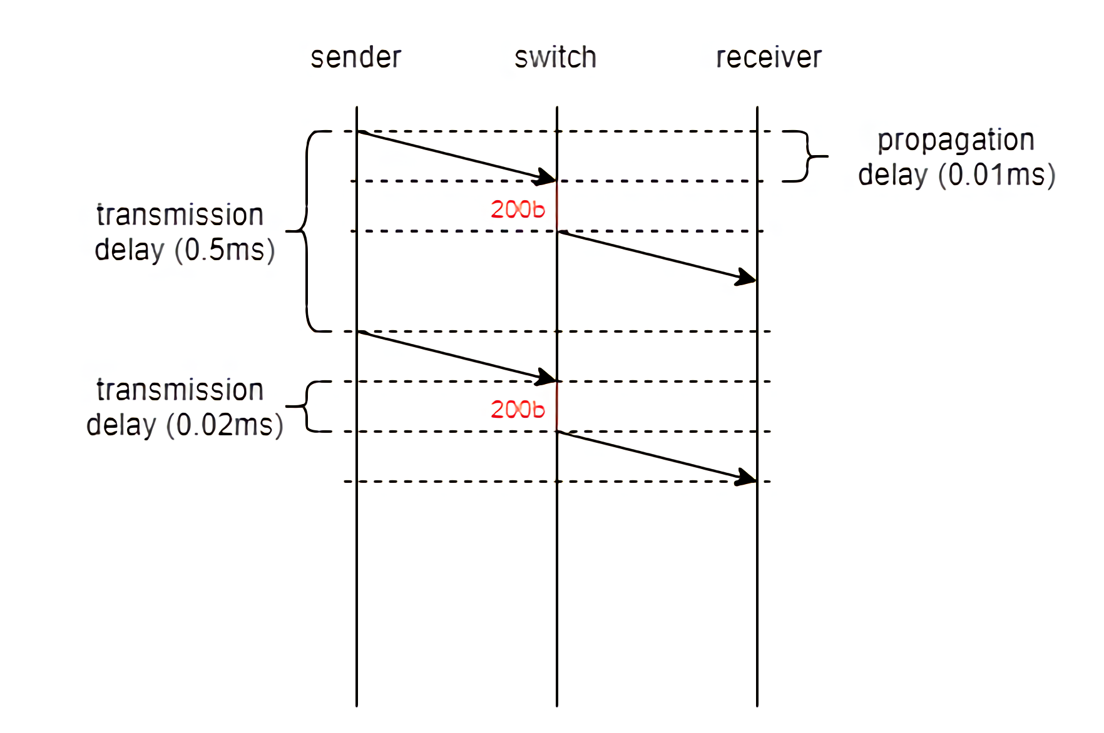
Exercise - Q2
0.51ms + 200b / 10Mbps + 10us = 0.54ms

Slide 14
Thanks!

