Slide 1
CSCI 4430 - Fall 23
Tutorial 3
Credits to Umich EECS 489 Discussion 3

Slide 2
Assignment 1
Due: 11:59:59 p.m., Fri, Oct. 6th

Slide 3
Outline
HTTP Request
HTTP Response
Exercises
Open-source project

Slide 4
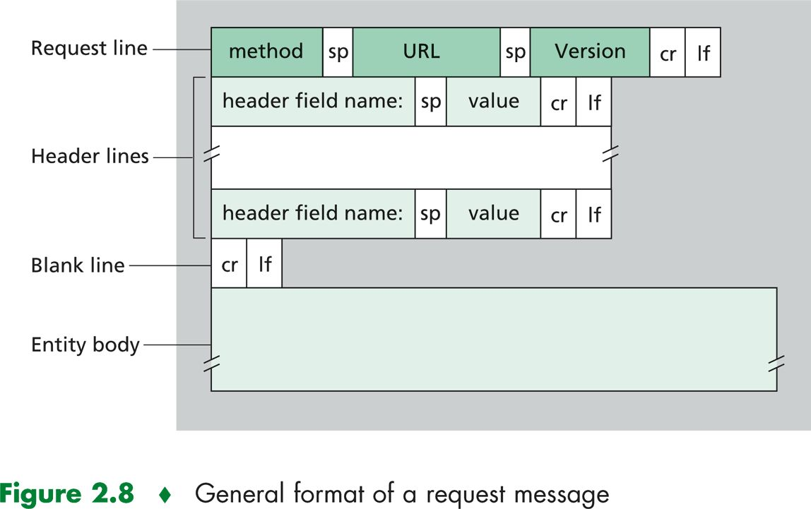
HTTP Request

Slide 5
HTTP Request
Curl get:
"GET /test HTTP/1.1\r\n"
"User-Agent: curl/7.18.0 (i486-pc-linux-gnu) libcurl/7.18.0 OpenSSL/0.9.8g zlib/1.2.3.3 libidn/1.1\r\n"
"Host: 0.0.0.0=5000\r\n"
"Accept: */*\r\n"
"\r\n"

Slide 6
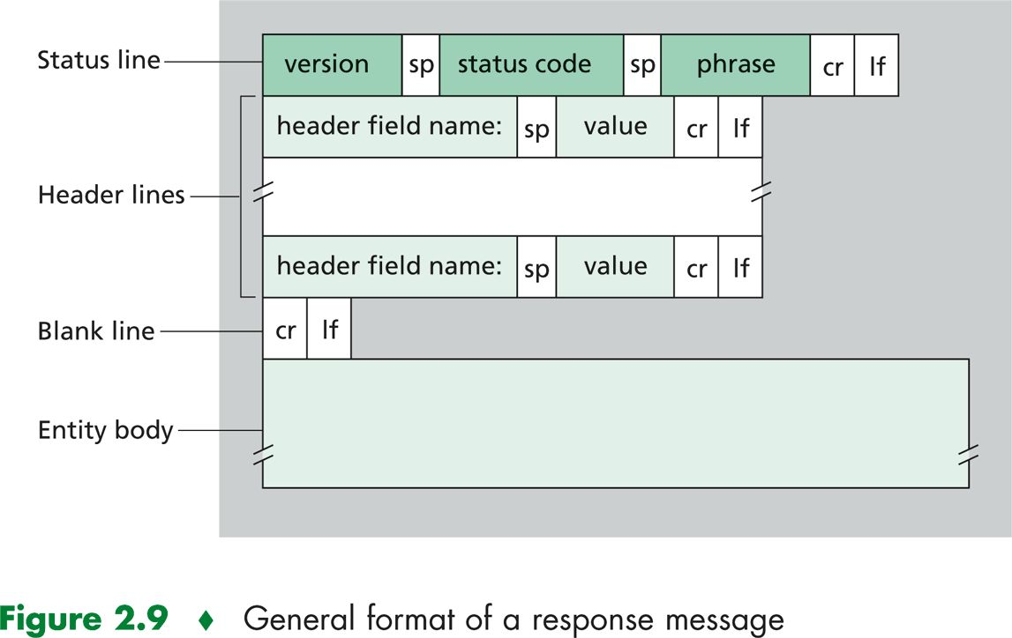
HTTP Response

Slide 7
HTTP Response
Google 301 response:
"HTTP/1.1 301 Moved Permanently\r\n"
"Location: http://www.google.com/\r\n"
"Content-Type: text/html; charset=UTF-8\r\n"
"Date: Sun, 26 Apr 2009 11:11:49 GMT\r\n"
"Expires: Tue, 26 May 2009 11:11:49 GMT\r\n"
"X-$PrototypeBI-Version: 1.6.0.3\r\n" /* $ char in header field */
"Cache-Control: public, max-age=2592000\r\n"
"Server: gws\r\n"
"Content-Length: 219 \r\n"
"\r\n"
"<HTML><HEAD><meta http-equiv=\"content-type\" content=\"text/html;charset=utf-8\">\n"
"<TITLE>301 Moved</TITLE></HEAD><BODY>\n"
"<H1>301 Moved</H1>\n"
"The document has moved\n"
"<A HREF=\"http://www.google.com/\">here</A>.\r\n"
"</BODY></HTML>\r\n"

Slide 8
Q1 True or False
HTTP response messages never have an empty message body
False.
• Some HTTP response messages have an empty message body.
HTTP Status-Code of 200 for HEAD request can be sent without message-body
HTTP Status-Code of 204 and 304 MUST NOT include a message body. (RFC 2616)

Slide 9
Q2 True or False
Two distinct Web pages (for example, www.mit.edu/research.html and www.mit.edu/students.html) can be sent over the same persistent connection.
True.
• It is because both of these web pages are on the same physical server (www.mit.edu).

Slide 10
Q3 True or False
With non-persistent connections between browser and origin server, it is possible for a single TCP segment to carry two distinct HTTP request messages.
False.
• In a non-persistent connection, the connection closes after each request-response. In this case, the connection will close once the first message is received, and there will be a new connection opened to send the second message.

Slide 11
Q4.1 Consider the Following Request
GET /cs453/index.html HTTP/1.1
Host: gaia.cs.umass.edu
Connection: keep-alive
Cache-Control: max-age=0
Upgrade-Insecure-Requests: 1
User-Agent: Mozilla/5.0 (Windows NT 10.0; Win64; x64) AppleWebKit/537.36 (KHTML, like Gecko) Chrome/97.0.4692.71 Safari/537.36 Edg/97.0.1072.62
Accept: text/html,application/xhtml+xml,application/xml;q=0.9,image/webp,image/apng,*/*;q=0.8,application/signed-exchange;v=b3;q=0.9
Accept-Encoding: gzip, deflate
Accept-Language: en-US,en;q=0.9
If-None-Match: "db1-4161d5aad1d80"
If-Modified-Since: Tue, 13 Jun 2006 16:13:58 GMT
1. What is the URL
(w/o scheme) of the
document requested
by the browser?
gaia.cs.umass.edu/
cs453/index.html
2. Does the browser
request a persistent
or non-persistent
connection?
Persistent

Slide 12
Q4.2 Consider the Following Request
GET /cs453/index.html HTTP/1.1
Host: gaia.cs.umass.edu
Connection: keep-alive
Cache-Control: max-age=0
Upgrade-Insecure-Requests: 1
User-Agent: Mozilla/5.0 (Windows NT 10.0; Win64; x64) AppleWebKit/537.36 (KHTML, like Gecko) Chrome/97.0.4692.71 Safari/537.36 Edg/97.0.1072.62
Accept: text/html,application/xhtml+xml,application/xml;q=0.9,image/webp,image/apng,*/*;q=0.8,application/signed-exchange;v=b3;q=0.9
Accept-Encoding: gzip, deflate
Accept-Language: en-US,en;q=0.9
If-None-Match: "db1-4161d5aad1d80"
If-Modified-Since: Tue, 13 Jun 2006 16:13:58 GMT
1. What type of browser
initiates this message?
Why is browser type
needed in an HTTP
request message?
Mozilla/5.0
Different browsers may handle the same webpage differently, due to having different capabilities.

Slide 13
Q5.1 Consider the Following Response
HTTP/1.1 200 OK\r\nDate: Fri, 21 Jan 2022 06:38:29 GMT\r\nServer: Apache/2.4.6 (CentOS)\r\nOpenSSL/1.0.2k\r\nfips\r\nPHP/7.4.25\r\nmod_perl/2.0.11\r\nPerl/v5.16.3\r\nLast-Modified: Tue, 13 Jun 2006 16:13:58 GMT\r\nETag: "db1-4161d5aad1d80"\r\nAccept-Ranges: bytes\r\nContent-Length: 3505\r\nKeep-Alive: timeout=5, max=100\r\nConnection: Keep-Alive\nContent-Type: text/html; charset=UTF-8\r\n\r\n<!doctype html public "-//w3c//dtd html 4.0 transitional//en">\n<html>\n<head>\n <meta http-equiv="Content-Type" content="text/html; charset=iso-8859-1">\n <meta name="GENERATOR" content="Mozilla/4.79 [en] \n(Windows NT 5.0; U) [Netscape]">\n <title>CMPSCI 453 / 591 / NTU-ST550A \nSpring 2005 homepage</title>\n</head> <much more document text following here (not shown)>
1. Did the server
successfully find
the document?
Yes
2. How many bytes
are being returned in the
document?
3505

Slide 14
Q5.2 Consider the Following Response
HTTP/1.1 200 OK\r\nDate: Fri, 21 Jan 2022 06:38:29 GMT\r\nServer: Apache/2.4.6 (CentOS)\r\nOpenSSL/1.0.2k\r\nfips\r\nPHP/7.4.25\r\nmod_perl/2.0.11\r\nPerl/v5.16.3\r\nLast-Modified: Tue, 13 Jun 2006 16:13:58 GMT\r\nETag: "db1-4161d5aad1d80"\r\nAccept-Ranges: bytes\r\nContent-Length: 3505\r\nKeep-Alive: timeout=5, max=100\r\nConnection: Keep-Alive\nContent-Type: text/html; charset=UTF-8\r\n\r\n<!doctype html public "-//w3c//dtd html 4.0 transitional//en">\n<html>\n<head>\n <meta http-equiv="Content-Type" content="text/html; charset=iso-8859-1">\n <meta name="GENERATOR" content="Mozilla/4.79 [en] \n(Windows NT 5.0; U) [Netscape]">\n <title>CMPSCI 453 / 591 / NTU-ST550A \nSpring 2005 homepage</title>\n</head> <much more document text following here (not shown)>
1. What are the first
5 bytes of the document being returned?
<!doc
2. Did the server agree to a persistent connection?
Yes

Slide 15
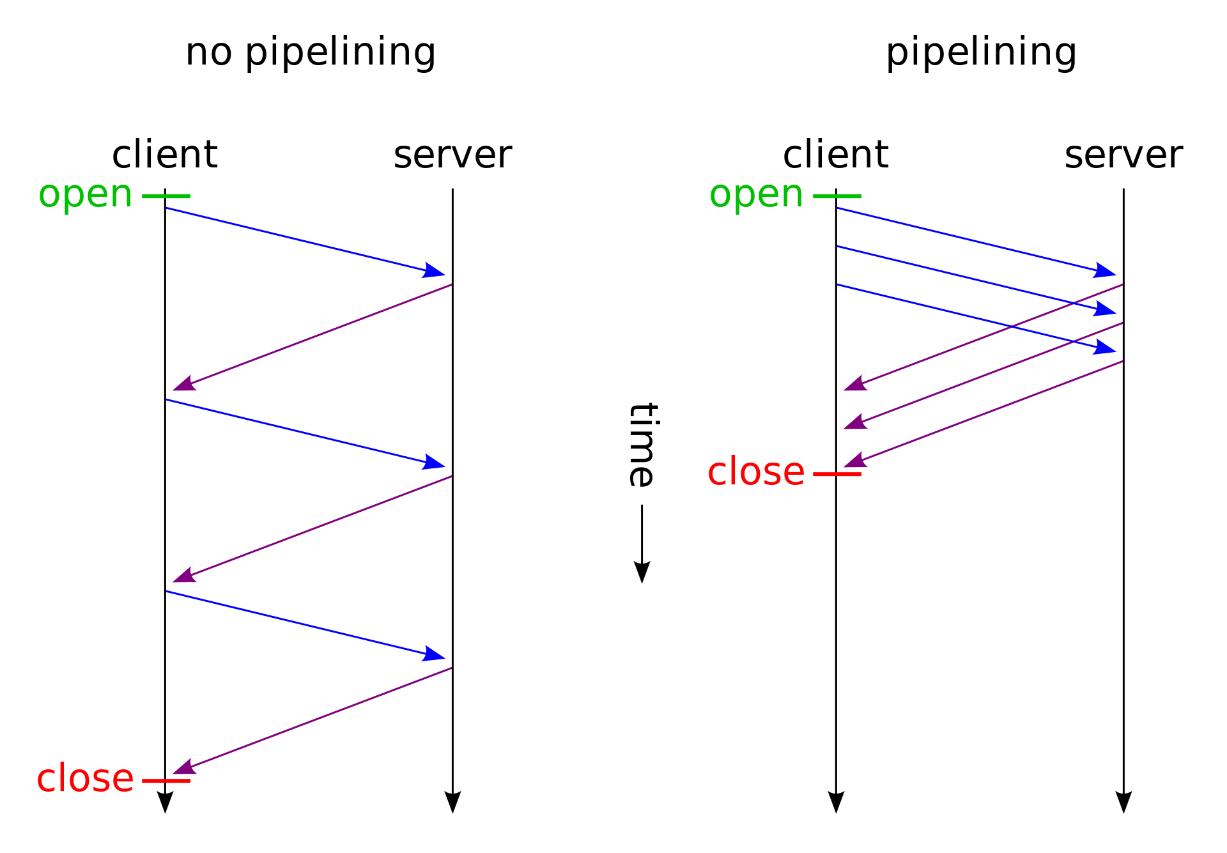
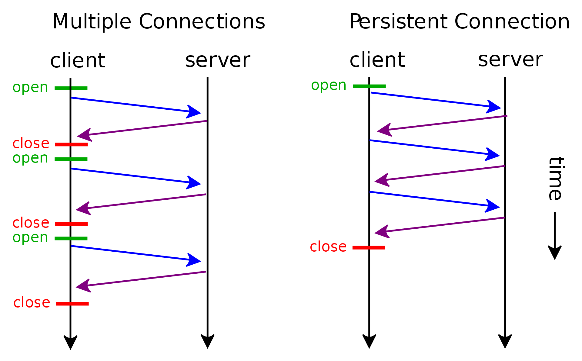
HTTP Connections
HTTP persistent connection – Wikipedia
HTTP pipelining - Wikipedia

Slide 16



Q6
You request a very small HTML file from a server. This HTML
references eight other very small images. Let X denote the RTT
between the localhost and the server. How much time elapses
with:
1. Non-persistent HTTP with no parallel TCP connections
$$9∗2X=18X$$
2. Non-persistent HTTP with the browser configured for 5 parallel
connections
$$2X+2X+2X=6X$$
3. Persistent HTTP with pipelining
$$2X+X=3X$$

Slide 17
Open-source Project
http-parser: nodejs/http-parser: http request/response parser for c (github.com)

Slide 18
Summary
Non-persistent: redundant first handshake
Parallel: redundant request
Pipelining: response “in parallel”

Slide 19
Q&A
Thanks!

