Slide 1
CSCI4430 Computer Networks Lecture 9: Transport Layer – More on congestion control
Hong Xu, Henry
CSE@CUHK, 2023
Material with thanks to Patrick Lee, Mosharaf Chowdhury, Aditya Akella, Sugih Jamin, Philip Levis, Sylvia Ratnasamy, Peter Steenkiste, and many other colleagues.

Slide 2
Agenda
TCP congestion control wrap-up
TCP throughput equation
Problems with congestion control

Slide 3
Recap
Flow Control
Restrict window to RWND to make sure that the receiver isn’t overwhelmed
Congestion Control
Restrict window to CWND to make sure that the network isn’t overwhelmed
Together
Restrict window to min{RWND, CWND} to make sure that neither the receiver nor the network are overwhelmed

Slide 4
CC Implementation
States at sender
CWND (initialized to a small constant)
ssthresh (initialized to a large constant)
dupACKcount and timer
Events
ACK (new data)
dupACK (duplicate ACK for old data)
Timeout

Slide 5
Event: ACK (new data)
If CWND < ssthresh
CWND += 1
CWND packets per RTT
Hence, after one RTT with no drops: CWND = 2xCWND

Slide 6
Event: ACK (new data)
If CWND < ssthresh
CWND += 1
Else
CWND = CWND + 1/CWND
Slow start phase
Congestion avoidance phase
CWND packets per RTT
Hence, after one RTT with no drops: CWND = CWND + 1

Slide 7
Event: TimeOut
On Timeout
ssthresh ← CWND/2
CWND ← 1

Slide 8
Event: dupACK
dupACKcount ++
If dupACKcount == 3 /* fast retransmit */
ssthresh = CWND/2
CWND = CWND/2

Slide 9
Example
Window
Timeout
SSThresh
Set to Here
Fast Retransmission
Slow start in operation until it reaches half of previous CWND, i.e., SSTHRESH
t
Slow-start restart: Go back to CWND = 1 MSS, but take advantage of knowing the previous value of CWND

Slide 10
Not done yet!
Problem: congestion avoidance too slow in recovering from an isolated loss

Slide 11
Example
Consider a TCP connection with:
CWND=10 packets
Last ACK was for packet #101
i.e., receiver expecting next packet to have seq. no. 101
10 packets [101, 102, 103,…, 110] are in flight
Packet 101 is dropped

Slide 12
Timeline: [101, 102, …, 110]
✗
ACK 101 (due to 102) cwnd=10 dupACK#1 (no xmit)
ACK 101 (due to 103) cwnd=10 dupACK#2 (no xmit)
ACK 101 (due to 104) cwnd=10 dupACK#3 (no xmit)
RETRANSMIT 101 ssthresh=5 cwnd= 5
ACK 101 (due to 105) cwnd=5 + 1/5 (no xmit)
ACK 101 (due to 106) cwnd=5 + 2/5 (no xmit)
ACK 101 (due to 107) cwnd=5 + 3/5 (no xmit)
ACK 101 (due to 108) cwnd=5 + 4/5 (no xmit)
ACK 101 (due to 109) cwnd=5 + 5/5 (no xmit)
ACK 101 (due to 110) cwnd=6 + 1/6 (no xmit)
ACK 111 (due to 101) ⬅ only now can we transmit new packets
Plus no packets in flight so ACK “clocking” (to increase CWND) stalls for another RTT

Slide 13

Solution: Fast recovery
Idea: Grant the sender temporary “credit” for each dupACK so as to keep packets in flight
If dupACKcount == 3
ssthresh = CWND/2
CWND = ssthresh + 3
While in fast recovery
CWND = CWND + 1 for each additional dupACK
Exit fast recovery after receiving new ACK
set CWND = ssthresh

Slide 14
Example
Consider a TCP connection with:
CWND=10 packets
Last ACK was for packet #101
i.e., receiver expecting next packet to have seq. no. 101
10 packets [101, 102, 103,…, 110] are in flight
Packet 101 is dropped

Slide 15
Timeline: [101, 102, …, 110]
✗
ACK 101 (due to 102) cwnd=10 dup#1
ACK 101 (due to 103) cwnd=10 dup#2
ACK 101 (due to 104) cwnd=10 dup#3
RETRANSMIT 101 ssthresh=5 cwnd= 8 (5+3)
ACK 101 (due to 105) cwnd= 9 (no xmit)
ACK 101 (due to 106) cwnd=10 (no xmit)
ACK 101 (due to 107) cwnd=11 (xmit 111)
ACK 101 (due to 108) cwnd=12 (xmit 112)
ACK 101 (due to 109) cwnd=13 (xmit 113)
ACK 101 (due to 110) cwnd=14 (xmit 114)
ACK 111 (due to 101) cwnd = 5 (xmit 115) ⬅ exiting fast recovery
Packets 111-114 already in flight
ACK 112 (due to 111) cwnd = 5 + 1/5 ← back in cong. avoidance

Slide 16
TCP state machine
timeout
Slow Start
Cong. Avoid.
new ACK
dupACK
CWND > ssthresh
timeout
dupACK
new ACK
timeout
new ACK
dupACK=3
dupACK=3
Fast Recovery
dupACK

Slide 17
Timeouts ➔ Slow Start
timeout
Slow Start
Cong. Avoid.
new ACK
dupACK
CWND > ssthresh
timeout
dupACK
new ACK
timeout
new ACK
dupACK=3
dupACK=3
Fast Recovery
dupACK

Slide 18
dupACKs ➔ Fast Recovery
timeout
Slow Start
Cong. Avoid.
new ACK
dupACK
CWND > ssthresh
timeout
dupACK
new ACK
timeout
new ACK
dupACK=3
dupACK=3
Fast Recovery
dupACK

Slide 19
New ACK changes state ONLY from Fast Recovery
timeout
Slow Start
Cong. Avoid.
new ACK
dupACK
CWND > ssthresh
timeout
dupACK
new ACK
timeout
new ACK
dupACK=3
dupACK=3
Fast Recovery
dupACK

Slide 20
TCP state machine
timeout
Slow Start
Cong. Avoid.
new ACK
dupACK
CWND > ssthresh
timeout
dupACK
new ACK
timeout
new ACK
dupACK=3
dupACK=3
Fast Recovery
dupACK

Slide 21

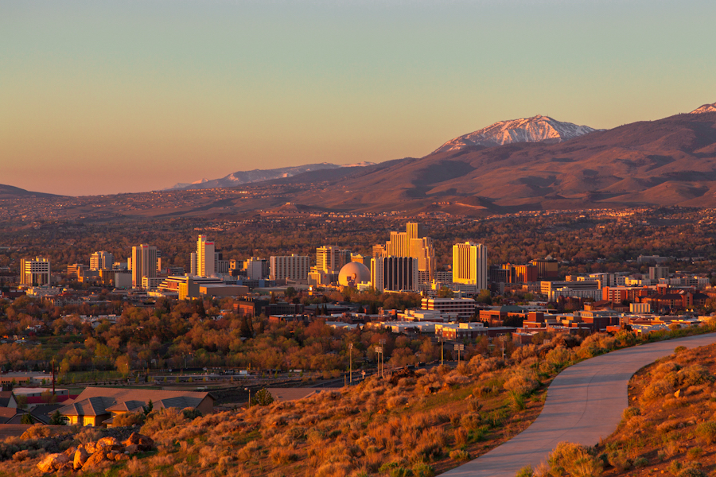

TCP flavors
TCP-Tahoe
CWND =1 on 3 dupACKs
TCP-Reno
CWND =1 on timeout
CWND = CWND/2 on 3 dupACKs
TCP-newReno
TCP-Reno + improved fast recovery
TCP-SACK
Incorporates selective ACK
TCP-Vages

Slide 22
How can they coexist?
All follow the same principle
Increase CWND on good news
Decrease CWND on bad news

Slide 23
TCP Throughput Equation

Slide 24

A simple model for TCP throughput
cwnd
Loss
½ W_{max} RTTs between drops
A
Avg. ¾ W_{max} packets per RTTs
1
time
RTT

Slide 25
A simple model for TCP throughput
cwnd
Loss
½ W_{max} RTTs between drops
A
Avg. ¾ W_{max} packets per RTTs
time
in MSS

Slide 26
Implications (1): Different RTTs
Flows get throughput inversely proportional to RTT
TCP unfair in the face of heterogeneous RTTs!
A1
B1
100ms
200ms
A2
bottleneck
link
B2

Slide 27
Implications (2): High-speed TCP
Assume RTT = 100ms, MSS=1500bytes, BW=100Gbps
What value of p is required to reach 100Gbps throughput?
~ 2 x 10⁻¹²
How long between drops?
~ 16.6 hours
How much data has been sent in this time?
~ 6 petabits

Slide 28
Adapting TCP to high speed
Once past a threshold speed, increase CWND faster
A proposed standard [Floyd’03]: once speed is past some threshold, change equation to p^{-.8} rather than p^{-.5}
Let the additive constant in AIMD depend on CWND
Other approaches?
Multiple simultaneous connections (hack but works today)
Router-assisted approaches

Slide 29
Implications (3): Rate-based CC
TCP throughput is swings between W/2 to W
Apps may prefer steady rates (e.g., streaming)
“Equation-Based Congestion Control”
Ignore TCP’s increase/decrease rules and just follow the equation
Measure drop percentage p, and set rate accordingly
Following the TCP equation ensures “TCP friendliness”
i.e., use no more than TCP does in similar setting

Slide 30
Implications (4): Loss not due to congestion?
TCP will confuse corruption with congestion
Flow will cut its rate
Throughput ~ 1/sqrt(p) where p is loss prob.
Applies even for non-congestion losses!

Slide 31
Implications (5): Short flows cannot ramp up
50% of flows have < 1500B to send; 80% < 100KB
Implications
Short flows never leave slow start!
They never attain their fair share
Too few packets to trigger dupACKs
Isolated loss may lead to timeouts
At typical timeout values of ~500ms, might severely impact flow completion time

Slide 32
Implications (6): Short flows share long delays
A flow deliberately overshoots capacity, until it experiences a drop
Means that delays are large, and are large for everyone
Consider a flow transferring a 10GB file sharing a bottleneck link with 10 flows transferring 100B
Larger flows dominate smaller ones

Slide 33
Implications (7): Cheating
Three easy ways to cheat
Increasing CWND faster than +1 MSS per RTT

Slide 34
Implications (7): Cheating
Three easy ways to cheat
Increasing CWND faster than +1 MSS per RTT
Using large initial CWND
Common practice by many companies

Slide 35
Implications (7): Cheating
Three easy ways to cheat
Increasing CWND faster than +1 MSS per RTT
Using large initial CWND
Common practice by many companies
Opening many connections

Slide 36
Open many connections
x
Assume
A starts 10 connections to B
D starts 1 connection to E
Each connection gets about the same throughput
Then A gets 10 times more throughput than D
A
B
y
D
E

Slide 37
Implications (8): CC intertwined with reliability
CWND adjusted based on ACKs and timeouts
Cumulative ACKs and fast retransmit/recovery rules
Complicates evolution
Changing from cumulative to selective ACKs is hard
Sometimes we want CC but not reliability
e.g., real-time applications
We may also want reliability without CC

Slide 38
Recap: TCP problems
Routers tell endpoints if they’re congested
Misled by non-congestion losses
Fills up queues leading to high delays
Short flows complete before discovering available capacity
AIMD impractical for high speed links
Saw tooth discovery too choppy for some apps
Unfair under heterogeneous RTTs
Tight coupling with reliability mechanisms
End hosts can cheat
Routers tell endpoints what rate to send at
Routers enforce fair sharing
Could fix many of these with some help from routers!

Slide 39
Summary
TCP works even though it has many flaws
Many of them can be fixed via assistance from the network
Next: The Network Layer

