Slide 1
CSCI 4430 - Spring 22
Tutorial 7
Credits to Computer Networking by Jim Kurose

Slide 2
Assignment 2
Due: Sun, 27th Feb. 11:59:59 p.m. Sun, 6th March. 11:59:59 p.m.
Start early!

Slide 3
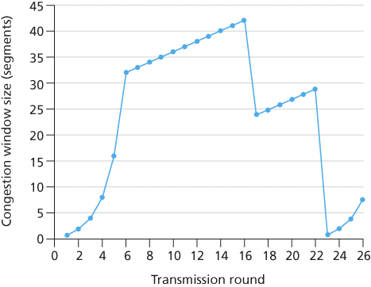
Q1 TCP Congestion Control
Assuming TCP Reno is the protocol experiencing the behavior shown above, answer the following questions. In all cases, you should provide a short discussion justifying your answer.
1. Identify the intervals of time when TCP slow start is operating.
2. Identify the intervals of time when TCP congestion avoidance is operating.
1. TCP slowstart is operating in the intervals [1,6] and [23,26]
2. TCP congestion avoidance is operating in the intervals [6,16] and [17,22]

Slide 4
Q1 TCP Congestion Control
Assuming TCP Reno is the protocol experiencing the behavior shown above, answer the following questions. In all cases, you should provide a short discussion justifying your answer.
3. After the 16th transmission round, is segment loss detected by a triple duplicate ACK or by a timeout?
4. After the 22nd transmission round, is segment loss detected by a triple duplicate ACK or by a timeout?
3. After the 16th transmission round, packet loss is recognized by a triple duplicate ACK.
If there was a timeout, the congestion window size would have dropped to 1.
4. After the 22nd transmission round, segment loss is detected due to timeout, and hence
the congestion window size is set to 1.

Slide 5
Q1 TCP Congestion Control
Assuming TCP Reno is the protocol experiencing the behavior shown above, answer the following questions. In all cases, you should provide a short discussion justifying your answer.
5. What is the initial value of ssthresh at the first transmission round?
6. What is the value of ssthresh at the 18th transmission round?
7. What is the value of ssthresh at the 24th transmission round?
5. The threshold is initially 32, since it is at this window size that slowstart stops and congestion avoidance begins.
6. The threshold is set to half the value of the congestion window when packet loss is detected. When loss is detected during transmission round 16, the congestion windows size is 42. Hence the threshold is 21 during the 18th transmission round.
7. The threshold is set to half the value of the congestion window when packet loss is detected. When loss is detected during transmission round 22, the congestion windows size is 29. Hence the threshold is 14 (taking lower floor of 14.5) during the 24th transmission round.

Slide 6
Q2 TCP Throughput
Consider that only a single TCP (Reno) connection uses one 10Mbps link which does not buffer any data. Suppose that this link is the only congested link between the sending and receiving hosts. Assume that the TCP sender has a huge file to send to the receiver, and the receiver’s receive buffer is much larger than the congestion window. We also make the following assumptions: each TCP segment size is 1,500 bytes; the two-way propagation delay of this connection is 150 msec; and this TCP connection is always in congestion avoidance phase, that is, ignore slow start.
What is the maximum window size (in segments) that this TCP connection can achieve?
Let W denote the max window size measured in segments. Then, W*MSS/RTT = 10Mbps, as packets will be dropped if the maximum sending rate exceeds link capacity. Thus, we have W*1500*8/0.15=10*10^6, then W is about 125 segments.

Slide 7
Q2 TCP Throughput
Consider that only a single TCP (Reno) connection uses one 10Mbps link which does not buffer any data. Suppose that this link is the only congested link between the sending and receiving hosts. Assume that the TCP sender has a huge file to send to the receiver, and the receiver’s receive buffer is much larger than the congestion window. We also make the following assumptions: each TCP segment size is 1,500 bytes; the two-way propagation delay of this connection is 150 msec; and this TCP connection is always in congestion avoidance phase, that is, ignore slow start.
What is the average window size (in segments) and average throughput (in bps) of this TCP connection?
As congestion window size varies from W/2 to W, then the average window size is 0.75W=94 (ceiling of 93.75) segments. Average throughput is 94*1500*8/0.15 =7.52Mbps.

Slide 8
Q2 TCP Throughput
Consider that only a single TCP (Reno) connection uses one 10Mbps link which does not buffer any data. Suppose that this link is the only congested link between the sending and receiving hosts. Assume that the TCP sender has a huge file to send to the receiver, and the receiver’s receive buffer is much larger than the congestion window. We also make the following assumptions: each TCP segment size is 1,500 bytes; the two-way propagation delay of this connection is 150 msec; and this TCP connection is always in congestion avoidance phase, that is, ignore slow start.
How long would it take for this TCP connection to reach its maximum window again after recovering from a packet loss?
When there is a packet loss, W becomes W/2, i.e., 125/2=62.
(125 - 62) *0.15 = 9.45 seconds, as the number of RTTs (that this TCP connections
needs in order to increase its window size from 62 to 125) is 63. Recall the window
size increases by one in each RTT

Slide 9
Assignment 2 Q & A

Slide 10
Thanks!

