Slide 1
ESTR4120 Computer Networks Lecture 7: Data Center TCP
Hong Xu
Materials from Mohammad Alizadeh’s slides on 6.888 at MIT

Slide 2

6.888: Lecture 3 Data Center Congestion Control
Mohammad Alizadeh
Spring 2016

Slide 3


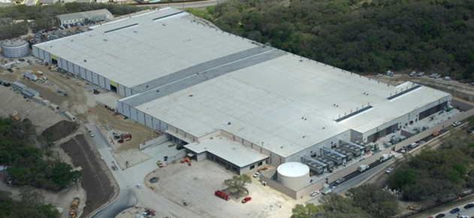



Transport inside the DC
100Kbps–100Mbps links
~100ms latency
INTERNET
Fabric
10–40Gbps links
~10–100μs latency
Servers

Slide 4
Transport inside the DC
INTERNET
Fabric
Interconnect for distributed compute workloads
Servers
web
app
cache
data-base
map-reduce
HPC
monitoring
Notes:
Specifically, while some of the traffic in data center networks is sent across the Internet, the majority of data center traffic is between the servers within the data center and never leaves the data center.
This is because

Slide 5
What’s Different About DC Transport?
Network characteristics
Very high link speeds (Gb/s); very low latency (microseconds)
Application characteristics
Large-scale distributed computation
Challenging traffic patterns
Diverse mix of mice & elephants
Incast
Cheap switches
Single-chip shared-memory devices; shallow buffers

Slide 6


Data Center Workloads
Mice & Elephants
Short messages
(e.g., query, coordination)
Large flows
(e.g., data update, backup)
Low Latency
High Throughput
Notes:
So the ultimate goal of data center transport is to complete these internal transactions or “flows” as quickly as possible.
What makes this challenging is that the flows are actually quite diverse. In particular, there are…
And these different flows require different things to complete quickly. For the short flows, we need to provide low latency…

Slide 7

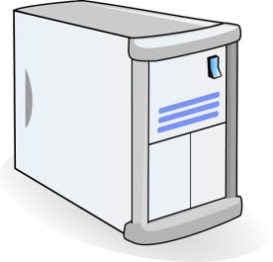
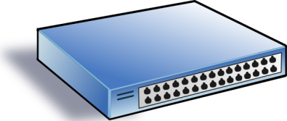
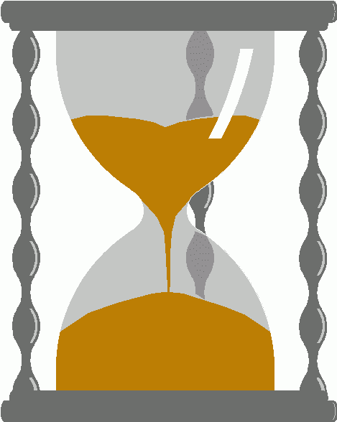
Incast
Synchronized fan-in congestion
Worker 1
Aggregator
Worker 2
Worker 3
RTO_{min} = 300 ms
Worker 4
TCP timeout
Vasudevan et al. (SIGCOMM’09)
Notes:
Not only does DCTCP’s low queue occupancy keep latency down, it also increases tolerance to traffic bursts because most of the buffer is sitting there empty to absorb bursts.
This is important in data centers to handle certain traffic patterns that are particularly bursty…

Slide 8
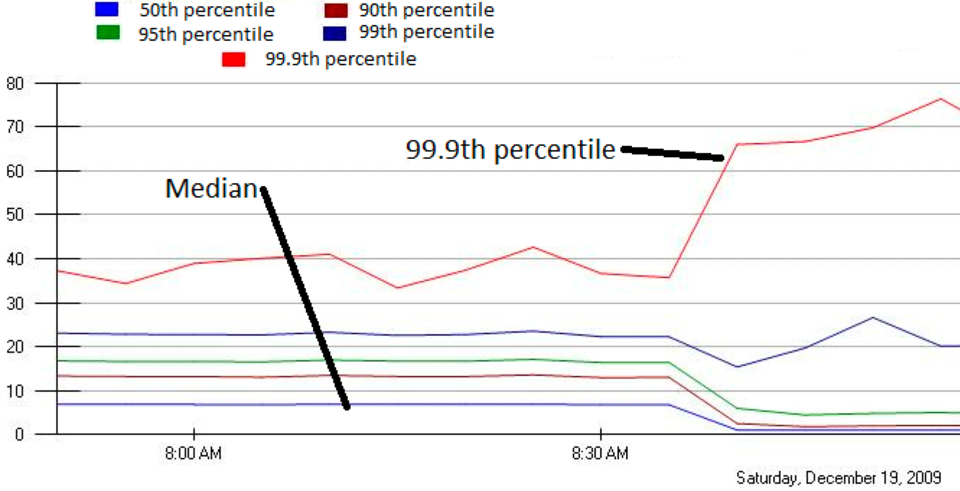
Incast in Bing
MLA Query Completion Time (ms)
Jittering trades of median for high percentiles
Requests are jittered over 10ms window.
Jittering switched off around 8:30 am.
Notes:
1. Incast really happens – see this actual screenshot from production tool
2. People care, they’ve solved it at application by jittering.
3. They care about the 99.9th percentile, 1-1000 customers

Slide 9
DC Transport Requirements
Low Latency
Short messages, queries
High Throughput
Continuous data updates, backups
High Burst Tolerance
Incast
The challenge is to achieve these together

Slide 10
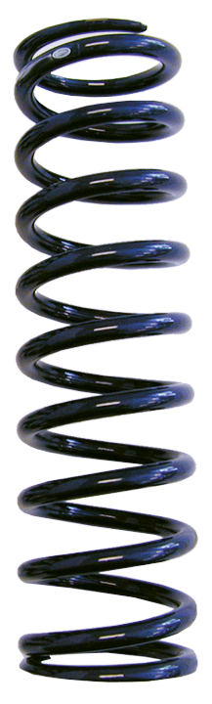
High Throughput
Low Latency
Baseline fabric latency (propagation + switching): 10 microseconds
Notes:
And the reason I say this is a challenge is that there’s an inherent tension between high throughput and low latency in packet-switched networks.
Recall that I said the baseline fabric latency… but this is when there is no traffic. When we have a lot of traffic at high throughput, we also get traffic-dependent queue buildup in the switches that adds latency in the form of queuing delay. This essentially occurs because packet transmissions are not tightly coordinated in packet-switched networks: every flow is independently making decisions which leads to rate mismatches.

Slide 11
High Throughput
Low Latency
Baseline fabric latency (propagation + switching): 10 microseconds
High throughput requires buffering for rate mismatches
… but this adds significant queuing latency
Notes:
Dealing with these rate mismatches requires buffering which adds latency.
Now this is a general problem in networks. But it’s particularly detrimental in data center networks because the baseline latency is so small that queuing delays dominate the overall latency.

Slide 12
Data Center TCP

Slide 13
TCP in the Data Center
TCP [Jacobsen et al.’88] is widely used in the data center
More than 99% of the traffic
Operators work around TCP problems
Ad-hoc, inefficient, often expensive solutions
TCP is deeply ingrained in applications
Practical deployment is hard
→ keep it simple!
Notes:
TCP has been the dominant transport protocol in the Internet for 25 years and is widely used in the data center as well.
However, it was not really designed for this environment and does not meet the demands of data center applications.

Slide 14
Review: The TCP Algorithm
Sender 1
Additive Increase:
W → W+1 per round-trip time
Multiplicative Decrease:
W → W/2 per drop or ECN mark
ECN Mark (1 bit)
Receiver
Window Size (Rate)
Time
Sender 2
ECN = Explicit Congestion Notification
Notes:
DCTCP is based on the existing Explicit Congestion Notification framework in TCP.
----- Meeting Notes (3/7/12 12:24) -----
Remember to mention "SAWTOOTH"

Slide 15
TCP Buffer Requirement
Bandwidth-delay product rule of thumb:
A single flow needs C×RTT buffers for 100% Throughput.
B < C×RTT
B ≥ C×RTT
B
Buffer Size
B
100%
100%
Throughput
Notes:
Now in the case of TCP, the question of how much buffering is needed for high throughput has been studied and is known in the literature as the buffer sizing problem.
So if we can find a way to lower the variance of the sending rates, then we can reduce the buffering requirements and that’s exactly what DCTCP is designed to do”

Slide 16

Reducing Buffer Requirements
Appenzeller et al. (SIGCOMM ‘04):
Large # of flows: is enough.
Window Size
(Rate)
Buffer Size
Throughput
100%
Notes:
Now, there are previous results that show in some circumstances, we don't need big buffers.

Slide 17
Reducing Buffer Requirements
Appenzeller et al. (SIGCOMM ‘04):
Large # of flows: is enough
Can’t rely on stat-mux benefit in the DC.
Measurements show typically only 1-2 large flows at each server
Key Observation:
Low variance in sending rate → Small buffers suffice

Slide 18
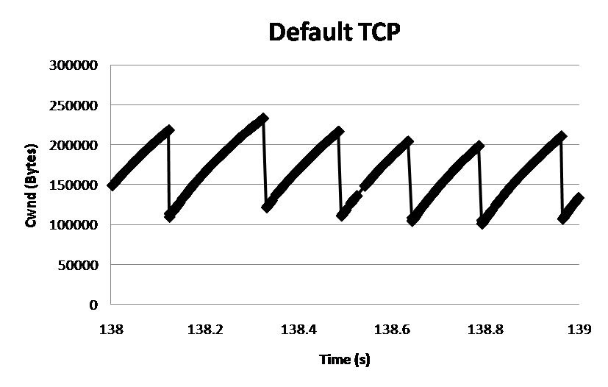
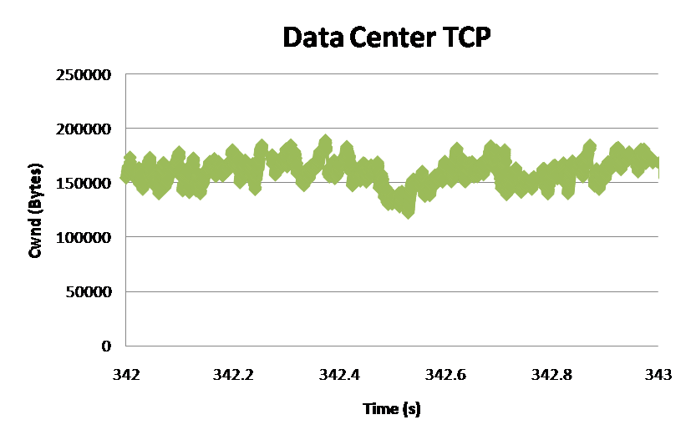
DCTCP: Main Idea
Extract multi-bit feedback from single-bit stream of ECN marks
Reduce window size based on fraction of marked packets.
ECN Marks | TCP | DCTCP
1 0 1 1 1 1 0 1 1 1 | Cut window by 50% | Cut window by 40%
0 0 0 0 0 0 0 0 0 1 | Cut window by 50% | Cut window by 5%
TCP
DCTCP
Window Size (Bytes)
Window Size (Bytes)
Time (sec)
Time (sec)
Notes:
Start with: “How can we extract multi-bit information from single-bit stream of ECN marks?”
- Standard deviation: TCP (33.6KB), DCTCP (11.5KB)

Slide 19
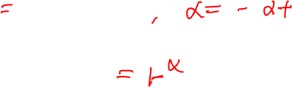
DCTCP: Algorithm
B
K
Don’t
Mark
Switch side:
Mark packets when Queue Length > K.
Mark
Sender side:
Maintain running average of fraction of packets marked (α).
Adaptive window decreases:
Note: decrease factor between 1 and 2.
Notes:
very simple marking mechanism
not all the tunings other aqms have
on the source side, the source is tryign to estimate the fraction of packets getting marked
using the obs that there is a stream of ecn marks coming back – more info in the stream than in any single bit
trying to maintain smooth rate variations to operate well even when using shallow buffers, and only a few flows (no stat mux)
F over the last RTT. In TCP there is always a way to get the next RTT from the window size. Comes from the self-clocking of TCP.
Only changing the decrease. Simplest version – makes a lot of sense. So generic could apply it to any algorithm – CTCP, CUBIC – how to cut its window leaving increase part to what it already does. Have to be careful here.

Slide 20
DCTCP vs TCP
Experiment: 2 flows (Win 7 stack), Broadcom 1Gbps Switch
Buffer is mostly empty
(KBytes)
DCTCP mitigates Incast by creating a
large buffer headroom
ECN Marking Thresh = 30KB

Slide 21
Why it Works
Low Latency
Small buffer occupancies → low queuing delay
2. High Throughput
ECN averaging → smooth rate adjustments, low variance
3. High Burst Tolerance
Large buffer headroom → bursts fit
Aggressive marking → sources react before packets are dropped

Slide 22
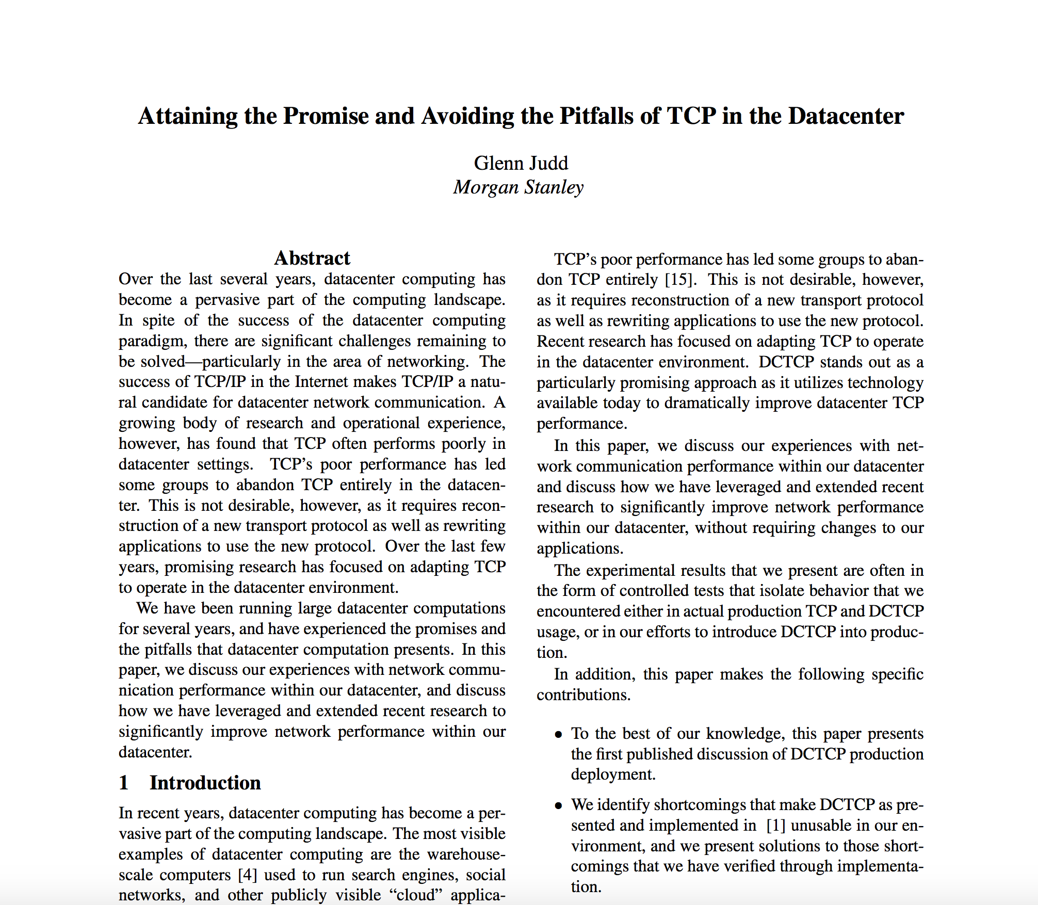
DCTCP Deployments

Slide 23
Evaluation
Implemented in Windows stack.
Real hardware, 1Gbps and 10Gbps experiments
90 server testbed
Broadcom Triumph 48 1G ports – 4MB shared memory
Cisco Cat4948 48 1G ports – 16MB shared memory
Broadcom Scorpion 24 10G ports – 4MB shared memory
Numerous micro-benchmarks
– Throughput and Queue Length
– Multi-hop
– Queue Buildup
– Buffer Pressure
Bing cluster benchmark
– Fairness and Convergence
– Incast
– Static vs Dynamic Buffer Mgmt

Slide 24
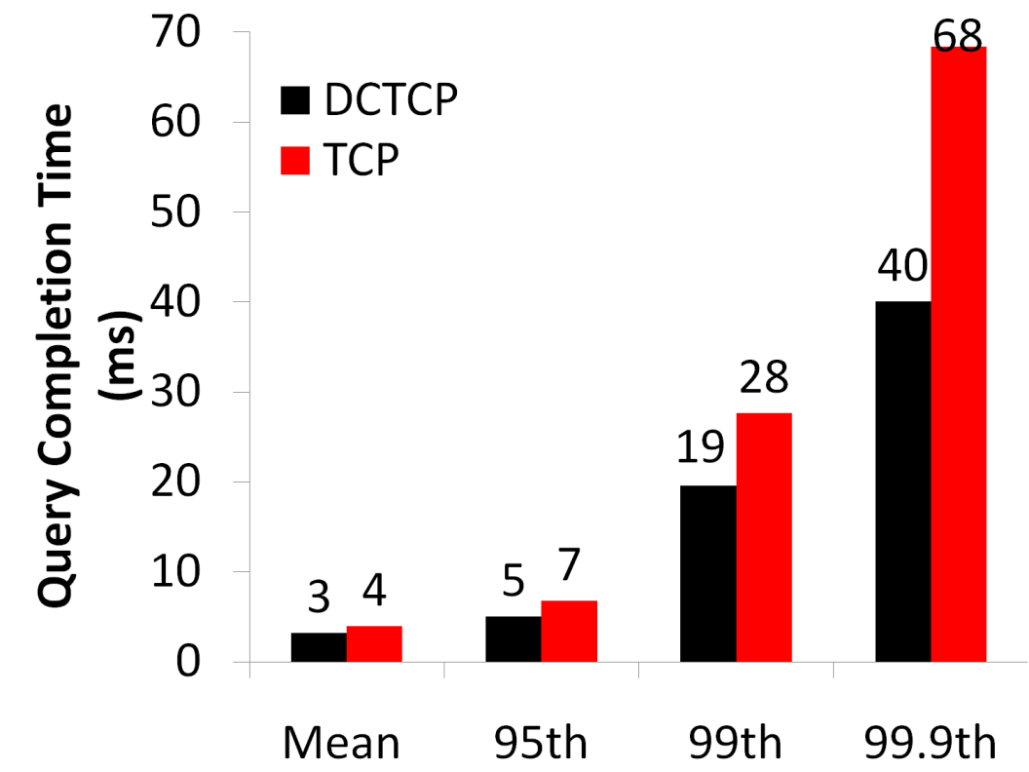
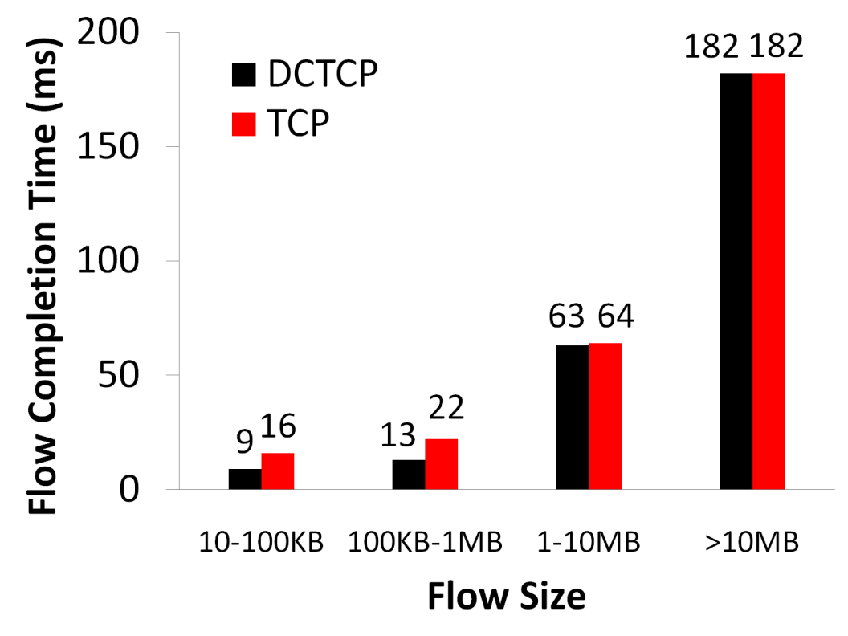
Bing Benchmark (baseline)
Background Flows
Query Flows
Notes:
To transition to scaled traffic: people always want to get more out of their network.

Slide 25
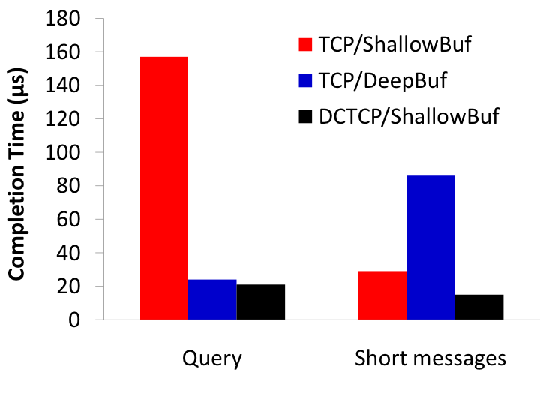
Bing Benchmark (scaled 10x)
Incast
Deep buffers fix incast, but increase latency
DCTCP good for both incast & latency
Completion Time (ms)
Query Traffic
(Incast bursts)
Short messages
(Delay-sensitive)
Notes:
Emphasize that these are two traffic classes within same experiment

