Slide 1
CSCI 4430 - Spring 23
Tutorial 4
Credits to Umich EECS 489 Discussion 4

Slide 2
Assignment 2 grouping
Try to form a group of exactly 2 students as soon as possible.
Use this link to enter the group info for your group
The deadline for grouping is: 23:59:59, Feb 21, 2023, the next Tuesday.

Slide 3
Outline
Introduction to programming with “select”
A simple demo.

Slide 4
A2 Preparation: select()
select(): I/O Multiplexing
Allow a program to monitor multiple file descriptors, waiting until one or more of the file descriptors becomes "ready" for some class of I/O operation.

Slide 5
A2 Preparation: select()
Why “select” instead of multi-threading
Non-blocking for only one-threaded program. Less system resource required. (although more complex for coding)

Slide 6
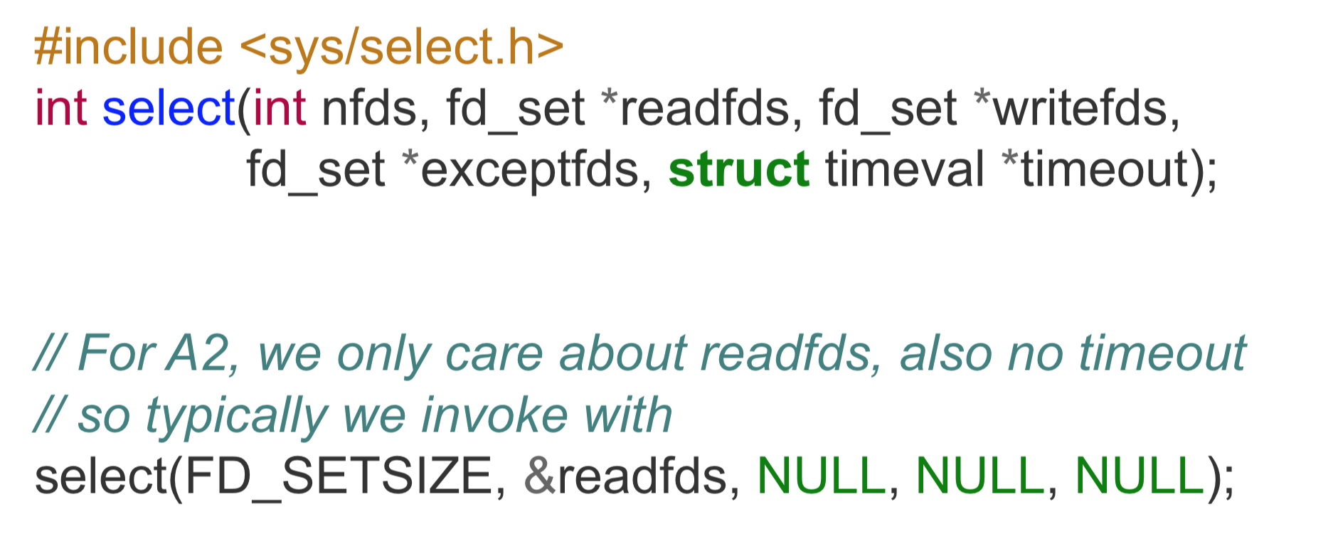
A2 Preparation: select()

Slide 7
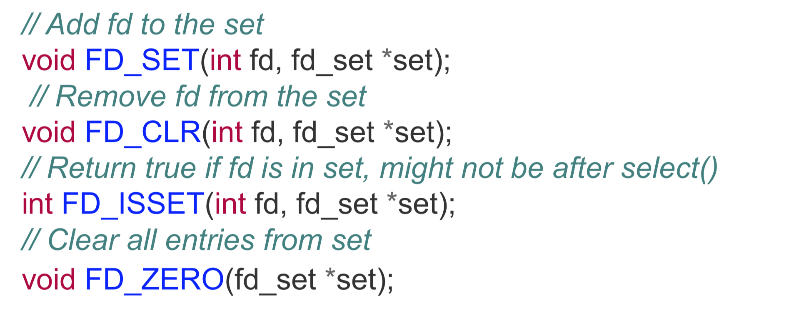
A2 Preparation: select()
Some useful macros:

Slide 8
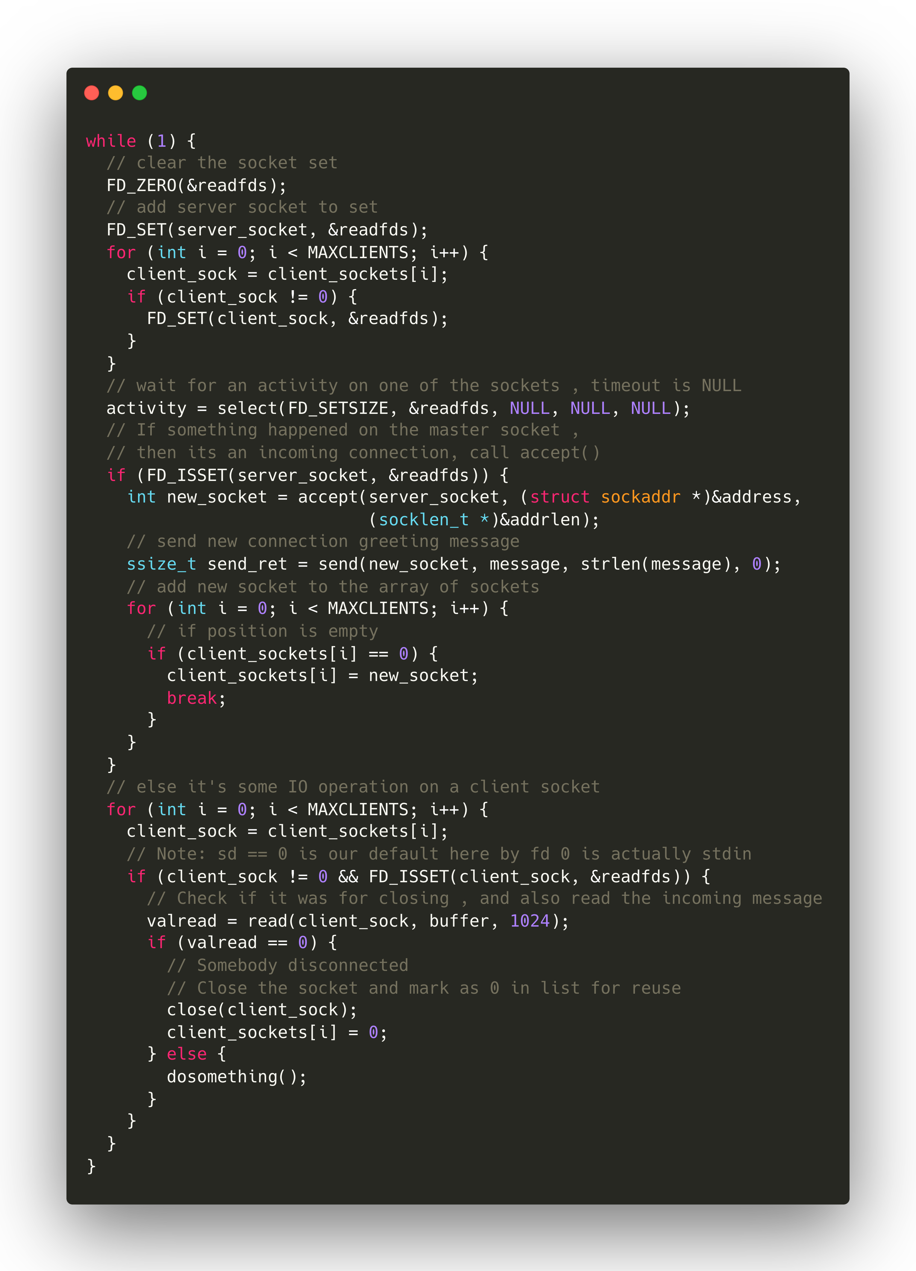
A2 Preparation: select()

Slide 9
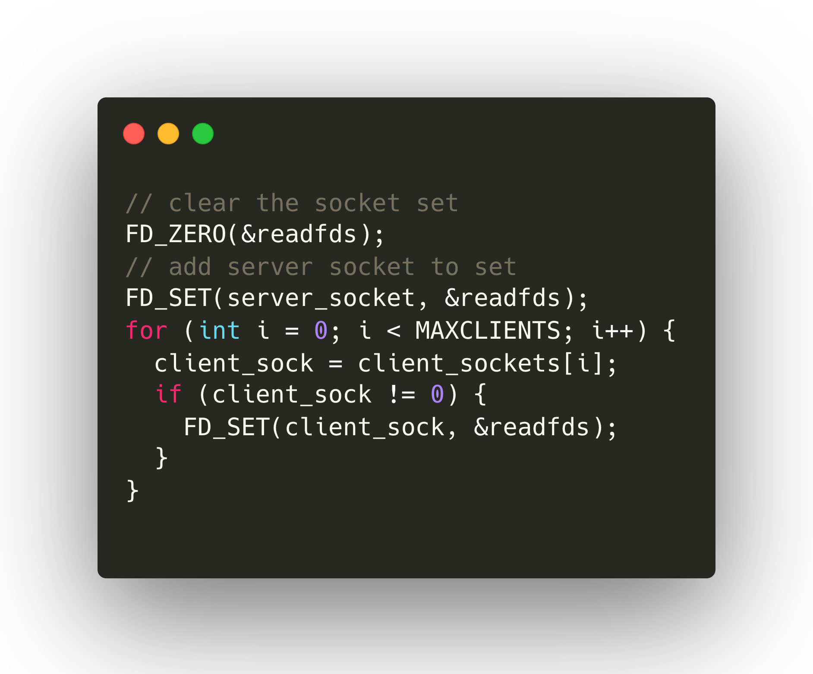
A2 Preparation: select()
Step 1: initialize(FD_ZERO) fd_set and set(FD_SET) fd_set for sockets

Slide 10
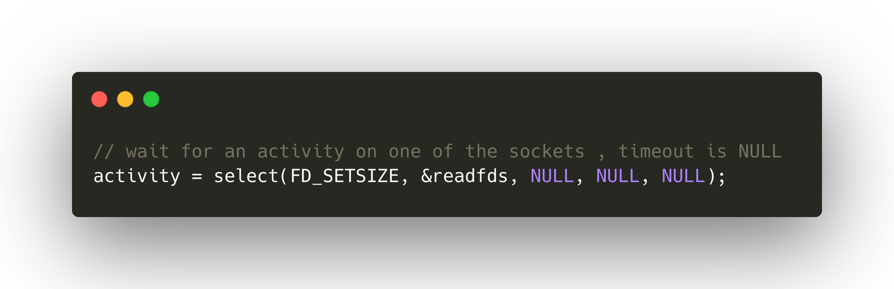
A2 Preparation: select()
Step 2: call select

Slide 11
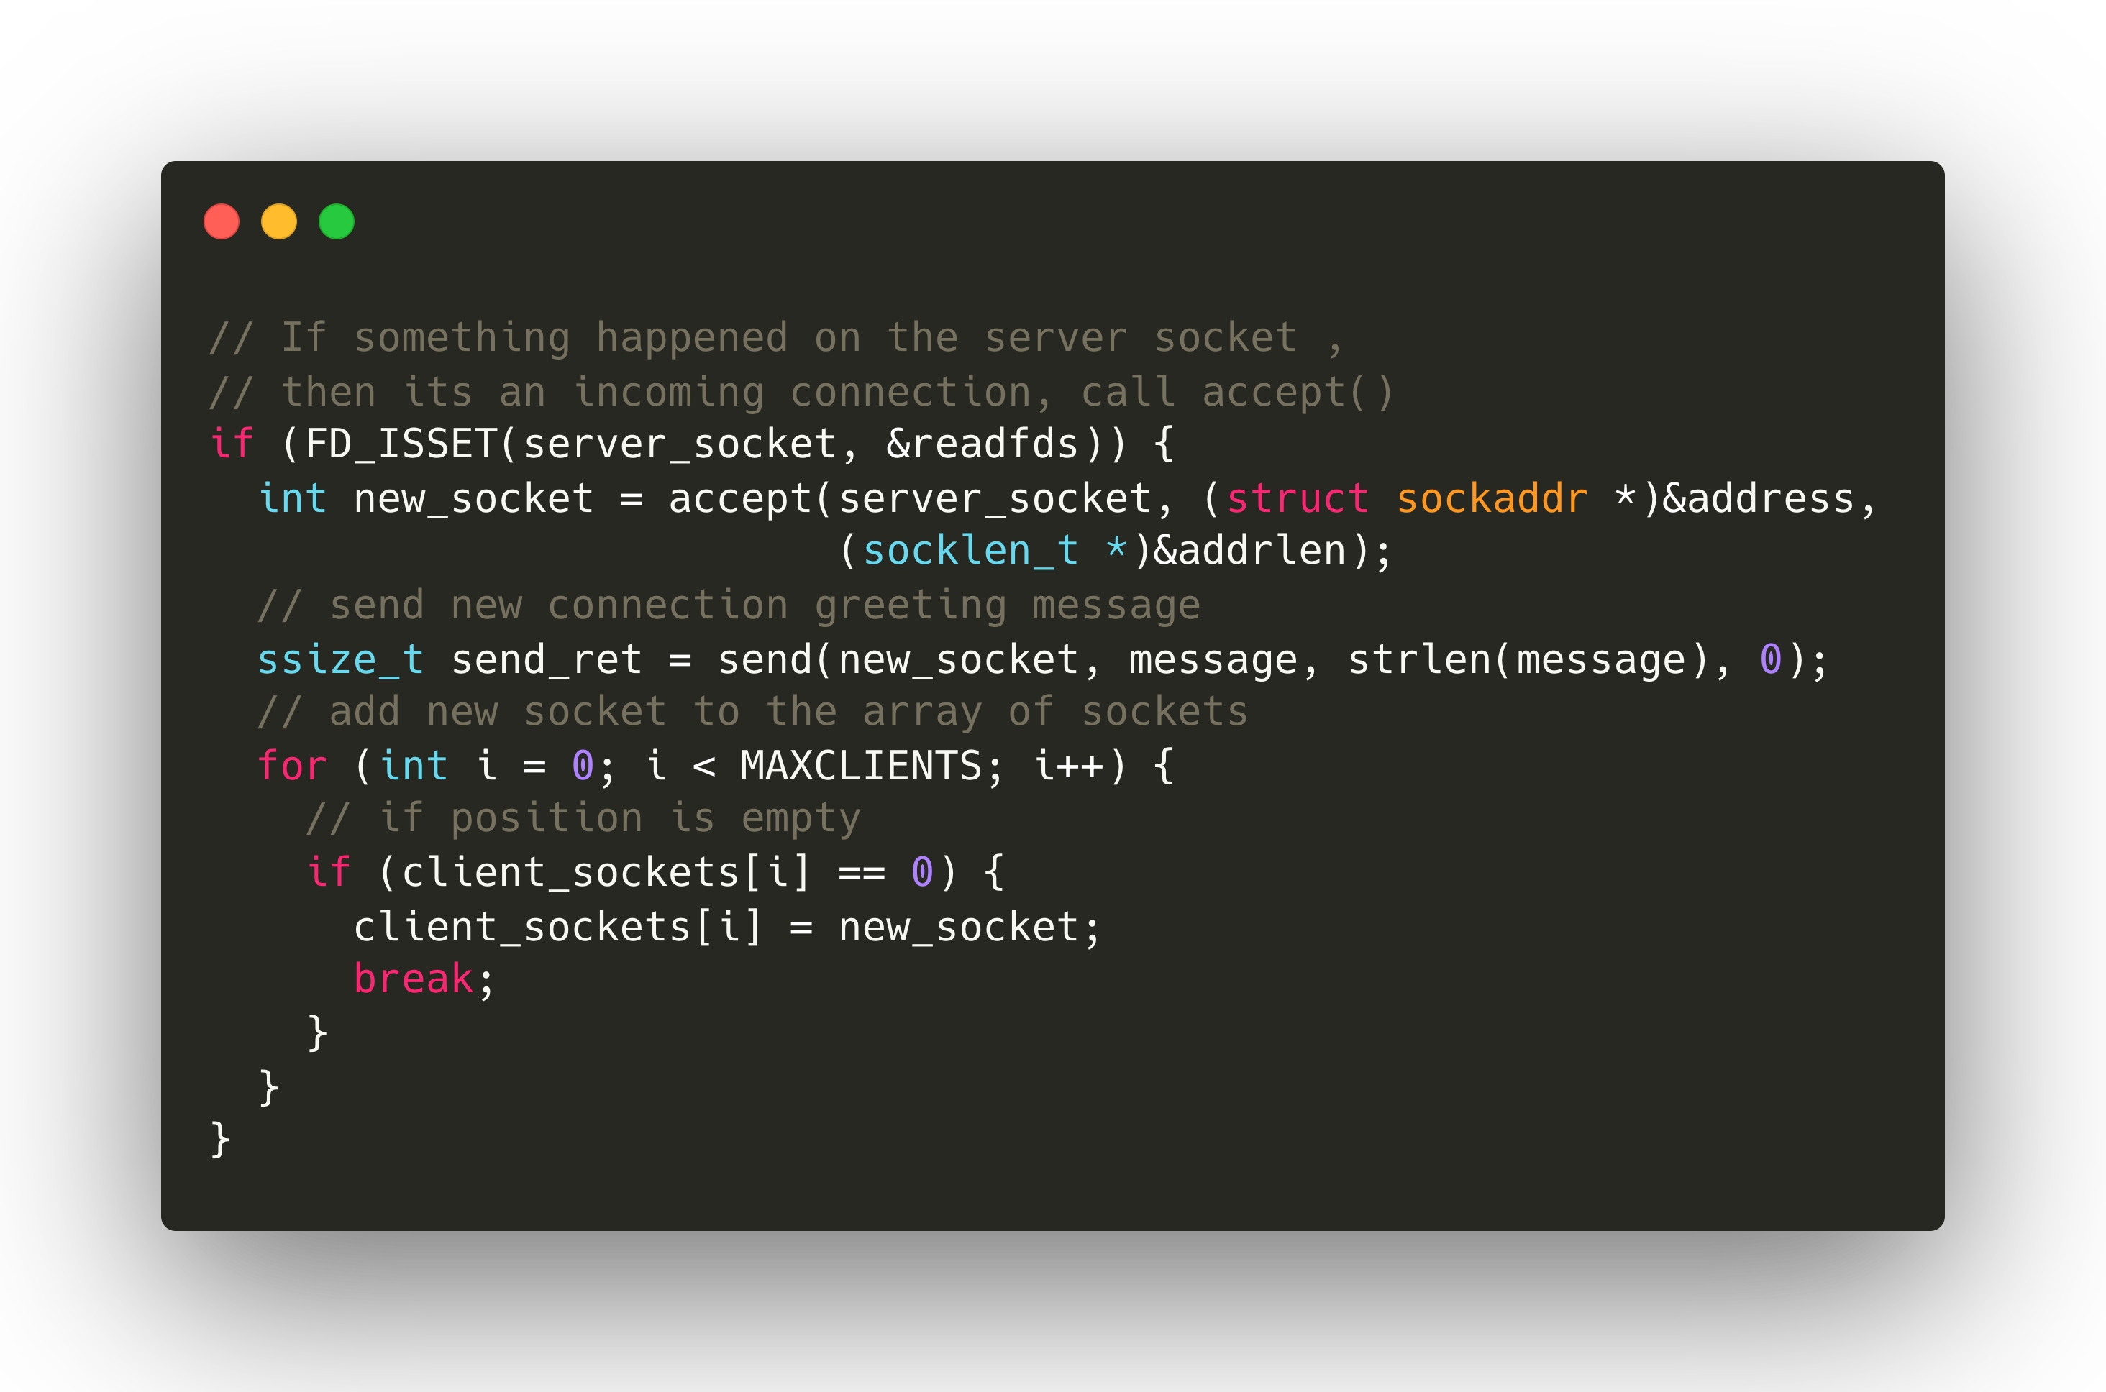
A2 Preparation: select()
Step 3: check socket status (for server socket) and accept connection

Slide 12
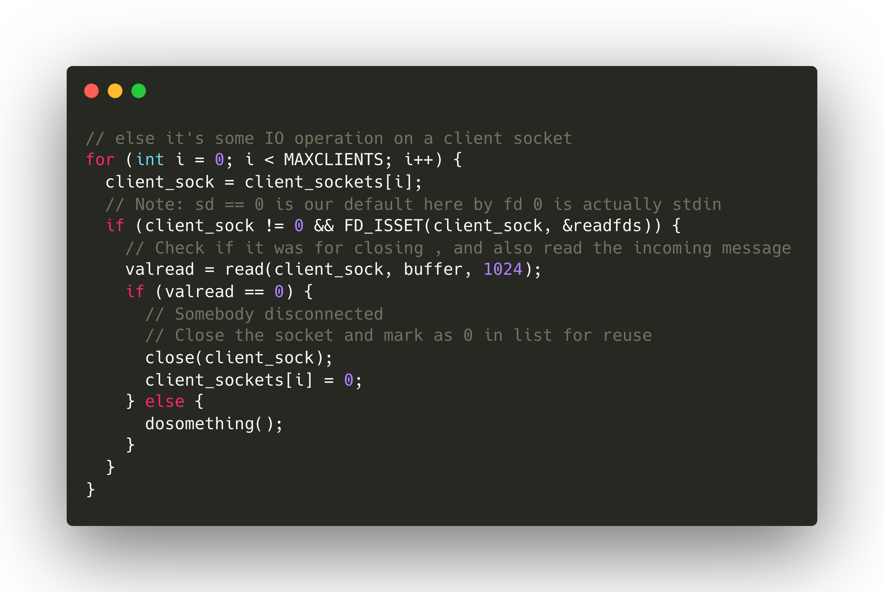
A2 Preparation: select()
Step 3: check socket status (for client socket) and do something

Slide 13
Select Programming: A Demo
Select example code: echo server
Linux or Mac OS.
You can use netcat (“nc” in command line) to communicate with the “echo server”.

Slide 14
Select Programming Links
“select” document:
https://man7.org/linux/man-pages/man2/select.2.html
“select” code example:
https://github.com/henryhxu/CSCI4430-ESTR4120/tree/2023_spring/tutorial/T04/select_example
man is always your good friend
“man select” for checking more details about select

Slide 15
Thanks!

