Slide 1
CSCI 4430 - Spring 23
Tutorial 10
Credits to Umich EECS 489 Discussion 7

Slide 2
Q1 IP True or False
IPv6 packet headers have fixed size; hence, unlike IPv4, IPv6 cannot have Options-like functionalities.
False. Although IPv6 headers have a fixed size of 40 B, their packets can include extension headers out of 40 B headers that provide additional functionalities, similar to IPv4 options.
Notes:
False. IPv6 packet headers have a fixed size of 40 bytes, but they can include extension headers that provide additional functionalities, similar to IPv4 options. IPv6 extension headers are designed to be more efficient and flexible than IPv4 options, and can be used for various purposes, such as specifying routing information, fragmenting packets, and providing security through encryption and authentication. Therefore, IPv6 can have Options-like functionalities through the use of extension headers.
Origin header:
| 3-bit Version | 4-bit Traffic Class | 20-bit Flow Label |
| 16-bit Payload Length | 8-bit Next Header |
| 8-bit Hop Limit | 128-bit Source Address |
| 128-bit Destination Address |
Extension headers are as follows and are not in IPv6 header.

Slide 3
Q2 IP MCQ
Which is NOT the four basic processes used in IP end-to-end transport?
1. Addressing packets with an IP address
2. Encapsulation
3. Guaranteed delivery
4. Routing
5. Decapsulation
IP only provides best-effort delivery.
Guaranteed delivery is provided by Transport Layer (e.g. TCP)
Notes:
While end-to-end transport using IP involves addressing packets with an IP address (1), encapsulating data into IP packets (2), routing packets through the network (4), and decapsulating the data at the destination (5), IP does not provide guaranteed delivery (3). IP is a best-effort protocol, which means that packets may be lost, delayed, or delivered out of order. Higher-level transport protocols, such as TCP (Transmission Control Protocol), provide reliable, guaranteed delivery by adding error detection, retransmission, and flow control mechanisms on top of IP.

Slide 4
Q3 IP Fragmentation
Suppose a TCP message containing 2048 bytes of data and 20 bytes of TCP header is passed to IP for delivery across two networks on the Internet. The first network has an MTU of 1024 bytes; the second has an MTU of 512 bytes.
Give the sizes and offsets of the fragments delivered to the network layer at the destination host. Assume all IP headers are 20 bytes. Assume we send out the largest fragments whenever we can.

Slide 5


Q3 IP Fragmentation
1 offset = 8B!!!
20B
2068B
IP Datagram : (2048 + 20 + 20) Bytes
IP Payload : (2048 + 20) Bytes
IP Header
IP Payload
Fragmented Payload:
Network 1 MTU: 1024B
$$8n<1024−20, n∈N$$
20B
1000B
Payload: $8n=1000$
Fragment 1
Offset: 0
At most transfer 1000B in one packet
Fragment 2
20B
1000B
Offset: 1000/8 = 125
Fragment 3
20B
68B
Offset: 125+1000/8 = 250
Notes:
Data should transfer in terms of

Slide 6
Q3 IP Fragmentation
Network 1 MTU: 1024B
Network 2 MTU: 512B
Fragment 1
20B
1000B
Offset: 0
20B
488B
Offset: 0
20B
488B
Offset: 488/8= 61
20B
24B
Offset: 61+488/8=122
20B
1000B
Offset: 125
20B
68B
Offset: 250

Slide 7
Q3 IP Fragmentation
Network 1 MTU: 1024B
Network 2 MTU: 512B
Fragment 2
20B
1000B
Offset: 125
20B
488B
Offset: 122+24/8=125
20B
488B
Offset: 125+488/8=186
20B
24B
Offset: 186+488/8=247
20B
68B
Offset: 250

Slide 8
Q3 IP Fragmentation
Network 1 MTU: 1024B
Network 2 MTU: 512B
Fragment 3
20B
68B
Offset: 250
20B
68B
Offset: 247+24/8=250

Slide 9
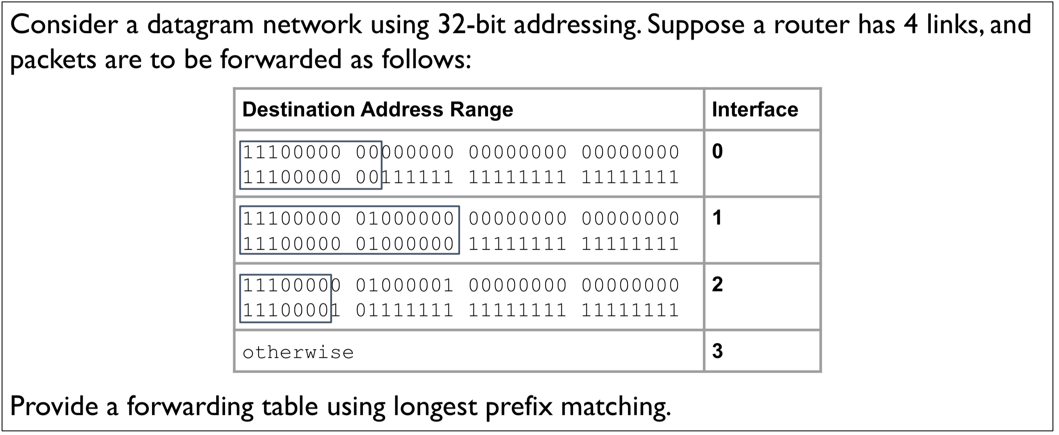
Q4 Forwarding Table

Slide 10
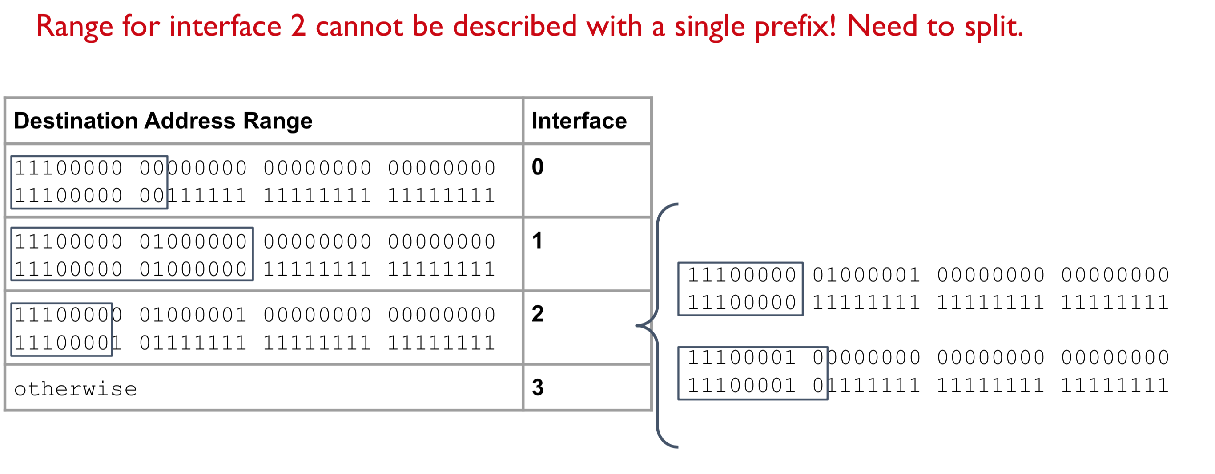
Q4 Forwarding Table
Notes:
If not split, for example, 11100001 11111111 11111111 11111111 will be with interface 3, it is not allowed. The prefix covers too much.

Slide 11
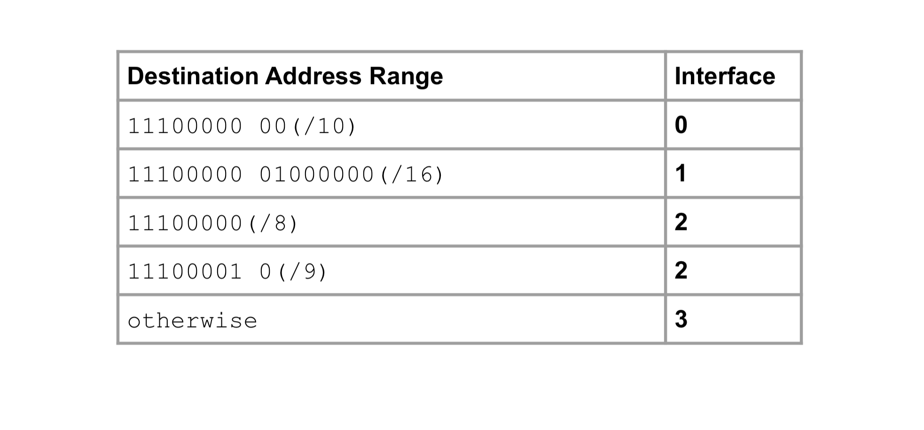
Q4 Forwarding Table

Slide 12
Thanks!

