Slide 1
CSCI4430 Computer Networks Lecture 5: Application Layer – Video; cloud & datacenters
Hong Xu, Henry
CSE@CUHK, 2023
Material with thanks to Mosharaf Chowdhury, Aditya Akella, Sugih Jamin, Philip Levis, Sylvia Ratnasamy, Peter Steenkiste, and many other colleagues.

Slide 2
Agenda
Video streaming
Datacenter applications

Slide 3
How is video different?
Often too large to send in one GET
Doesn’t even make sense even if it’s possible
Users may skip forward! ⇒ save bandwidth wastage
User connection quality may change (e.g., switching from WiFi to LTE) ⇒ lower resolution to save bandwidth
Our focus is on stored video (i.e., not live)

Slide 4
Why video is important?
Dominates the global Internet traffic landscape
About 60%, i.e., every 3 of 5 bytes in 2020!
Major sources
Netflix
YouTube
…

Slide 5
The video medium
Video is a sequence of images/frames displayed at a constant rate (moving pictures)
Digital image is an array of pixels, each pixel represented by bits
Examples:
Single frame image encoding: 1024x1024 pixels, 24 bits/pixel ⇒ 3 MB/image
Movies: 24 frames/sec ⇒ 72 MB/sec
TV: 30 frames/sec ⇒ 90 MB/sec

Slide 6

The video medium (cont’d)
spatial coding example: instead of sending N values of same color (all purple), send only two values: color value (purple) and number of repeated values (N)
Compression is key
Lots of algorithms to compress
The same video can be (and typically is) compressed to multiple quality levels
E.g., 480p, 720p, 1080p, 4K
Why multiple resolutions?
Adapt to conditions
……………………..
……………….…….
frame i
temporal coding example: instead of sending complete frame at i+1, send only differences from frame i
frame i+1

Slide 7
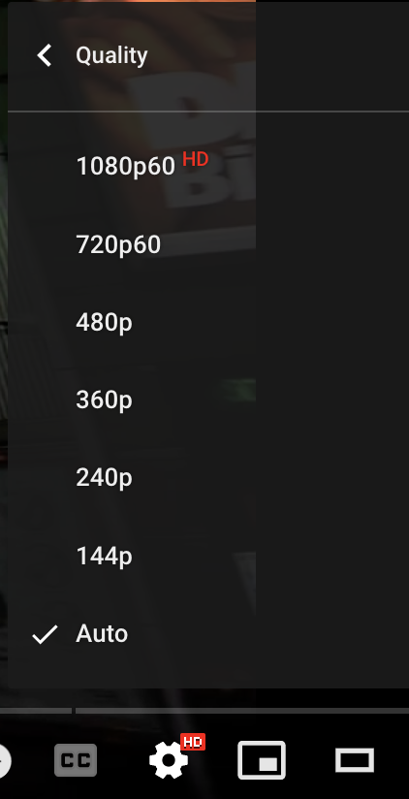
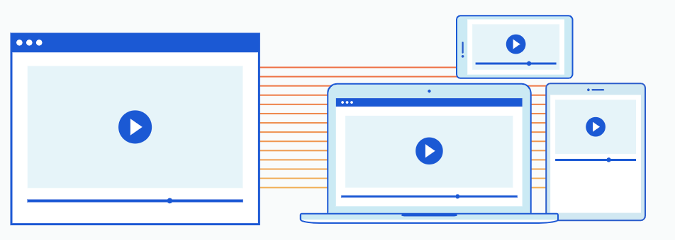
How do we serve video?
It’s in the name!
Video streaming

Slide 8
HTTP streaming
Video is stored at an HTTP server with a URL
Clients send a GET request for the URL
Server sends the video file as a stream
Client first buffers for a while. Why?
To minimize interruptions later
Once the buffer reaches a threshold
The video plays in the foreground
More frames are downloaded in the background

Slide 9


HTTP streaming
Cumulative data
2. video
sent
video
recorded (e.g., 30 frames/sec)
3. video received,
played out at client
(30 frames/sec)
network delay
(fixed in this example)
time
streaming: at this time, client
playing out early part of video,
while server still sending later
part of video

Slide 10
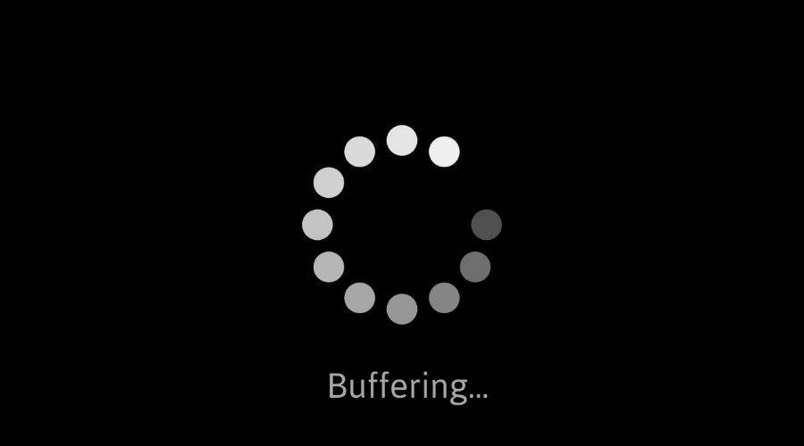
Challenges
Absorb network delay variations
Handle user interactions
Jump forward, fast-forward, rewind, pause
Handle packet loss, retransmission etc.

Slide 11

HTTP streaming: Revisited
constant bit
rate video
transmission
client video
reception
constant bit
rate video
playout at client
Cumulative data
variable
network
delay
buffered
video
client playout
delay
time
Client-side buffering and playout delay: compensate for network-added delay, delay jitter

Slide 12
Issues with HTTP streaming
Same bitrate for all clients
Clients can have very different network conditions
Clients network conditions can change over time
Cannot dynamically adapt to conditions

Slide 13
DASH : Dynamic Adaptive Streaming over HTTP
Keep multiple resolutions of the same video
Stored in a manifest file in the HTTP server
Client asks for the manifest file first to learn about the options
Asks for chunks at a time and measures available bandwidth while they are downloaded
Low bandwidth ⇒ switch to lower bitrate
High bandwidth ⇒ switch to higher bitrate

Slide 14
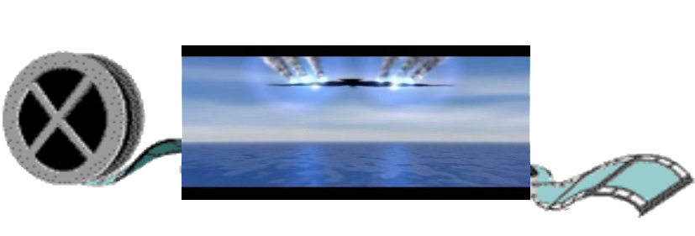
DASH
...
server:
divides video file into many chunks
each chunk encoded at multiple different rates
different rate encodings stored in different files
files replicated in various CDN nodes
manifest file: provides URLs for different chunks
?
...
client
client:
periodically estimates server-to-client bandwidth
consulting manifest, requests one chunk at a time
chooses maximum coding rate sustainable given current bandwidth
can choose different coding rates at different points in time (depending on available bandwidth at time), and from different servers

Slide 15

DASH
“intelligence” at client: client determines
when to request a chunk (so that buffer starvation, or overflow does not occur)
what bit rate to request (higher quality when more bandwidth available) -> adaptive bit-rate (ABR)
where to request chunk (can request from URL server that is “close” to client or has high available bandwidth)
...
?
...
client
Streaming video = encoding + DASH + playout buffering

Slide 16

Short videos
Differences?
Short duration, typically <30s
No fast-forward; swipe to next
Serving technologies
No ABR
Prefetching: download chunks of next video in advance

Slide 17
Cloud, datacenters

Slide 18
Who’s serving Web services?
Server
User
HTTP GET

Slide 19
Who’s serving Web services?
<html>
<body>
... …
</body>
</html>
Server
User
HTTP Response

Slide 20
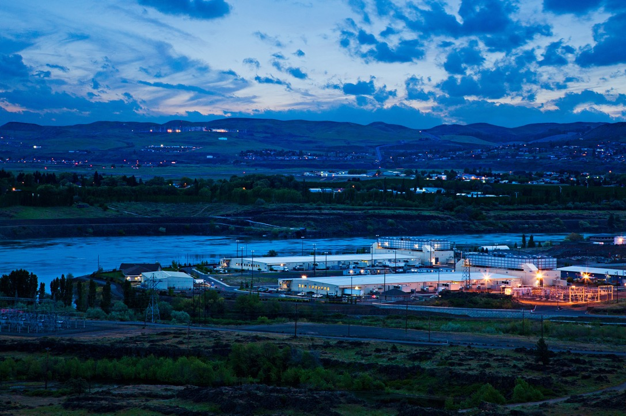
Cloud datacenters run the world
Source: Google
https://www.google.com/about/datacenters/

Slide 21
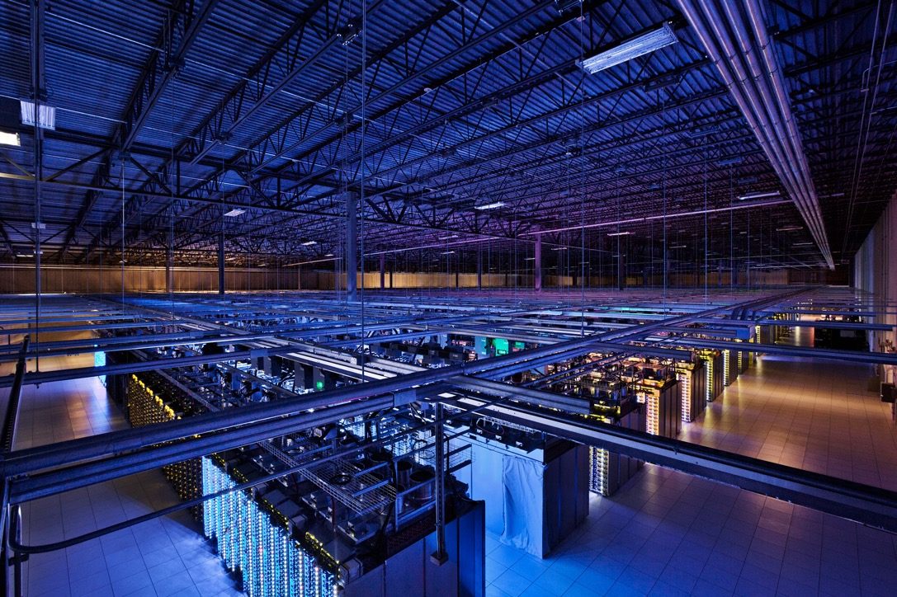
Cloud datacenters run the world
Source: Google

Slide 22

Cloud datacenters run the world
Source: Google

Slide 23
How big is a datacenter (DC)?
1M servers/site [Microsoft/Amazon/Google]
> $1B to build one site [Facebook]
>$20M/month/site operational costs [MS’09]
Data center hardware spending grew to $177 billion in 2017. [Gartner report]
But only O(10-100) sites

Slide 24
Implications (1)
Scale
Need scalable designs
Low-cost designs: e.g., use commodity technology
High utilization (efficiency): e.g., >60% avg. utilization
Contrast: avg. utilization on Internet links often ~30%
Tolerate frequent failure
Large number of (low cost) components
Automate

Slide 25
Implications (2)
Service model: clouds / multi-tenancy
Performance guarantees
Isolation guarantees
Portability

Slide 26
Applications
Common theme: parallelism
Applications decomposed into tasks
Running in parallel on different machines
Two common paradigms
Partition-Aggregate
Map-Reduce

Slide 27




Partition-Aggregate
csci 4430
Top-level Aggregator
Mid-level Aggregators
Workers

Slide 28
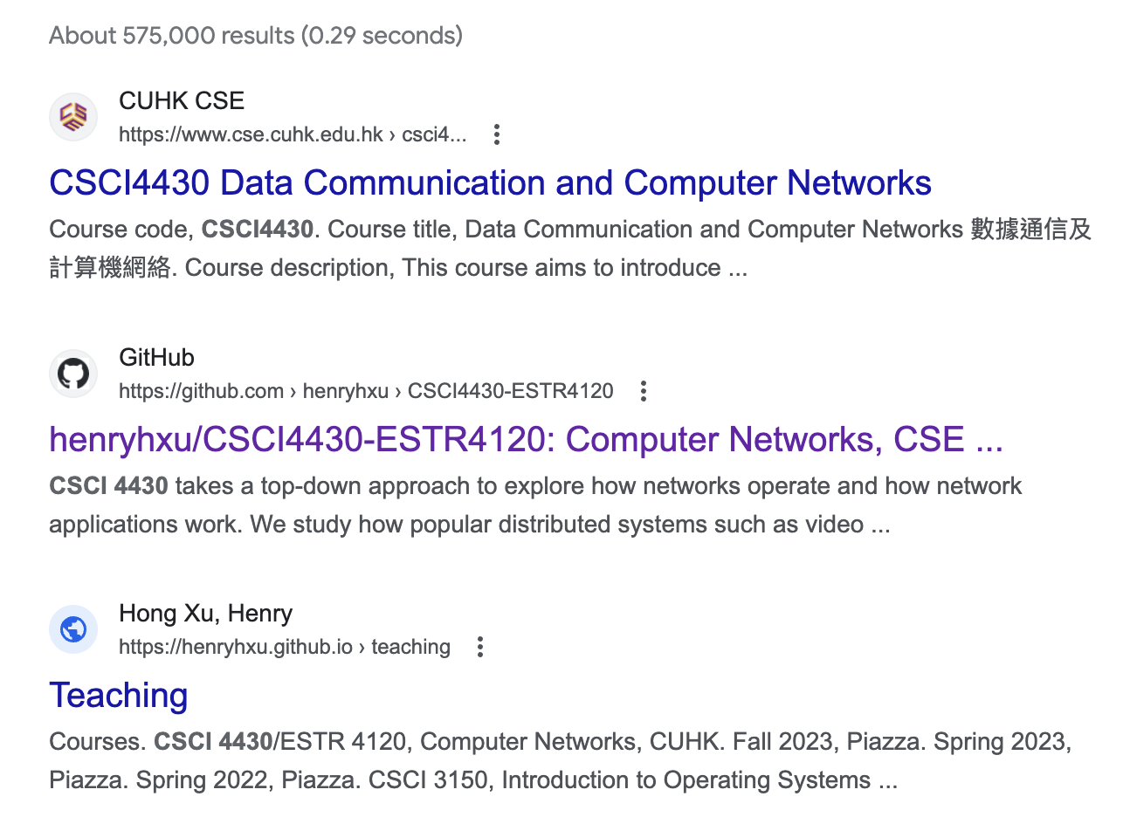
Partition-Aggregate
csci 4430
Top-level Aggregator
Mid-level Aggregators
Workers

Slide 29
End-to-end response time
Less than 200 milliseconds between receiving user query in the browser and displaying the results
RTT = O(10) to 100 milliseconds
What remains?
Next time, when the page is not loading fast enough, think about the poor servers working for you ☺

Slide 30
Applications
Common theme: parallelism
Applications decomposed into tasks
Running in parallel on different machines
Two common paradigms
Partition-Aggregate
Map-Reduce

Slide 31
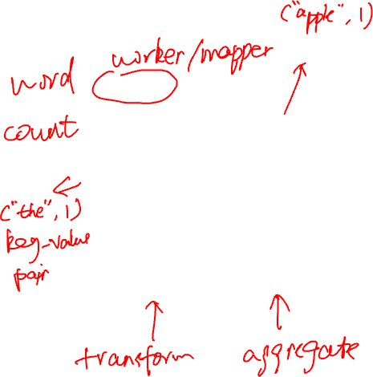
Map-Reduce
Map Stage
Reduce Stage
The most popular software that follows this paradigm is Apache Spark

Slide 32
East-West traffic
Traffic between servers in the datacenter
Communication within “big data” computations
Traffic may shift on small timescales (< minutes)

Slide 33
Datacenter traffic characteristics
Two key characteristics
Most flows are small
Most bytes come from large flows
Applications want
High bandwidth (large flows)
Low latency (small flows)

Slide 34
High bandwidth
Ideal: Each server can talk to any other server at its full access link rate
Conceptually: Datacenter network as one giant switch

Slide 35
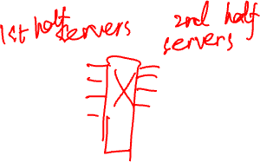
High bandwidth
Ideal: Each server can talk to any other server at its full access link rate
Conceptually: Datacenter network as one giant switch
Would require a 10 Pbits/sec switch!
1M ports (one port/server)
10Gbps per port
Practical approach: build a network of switches (“fabric”) with high “bisection bandwidth”
Each switch has practical #ports and link speeds

Slide 36
Bisection bandwidth
Partition a network into two equal parts
Minimum bandwidth between the partitions is the bisection bandwidth
Full bisection bandwidth: bisection bandwidth in an N-node network is N/2 times the bandwidth of a single link
Nodes of any two halves can communicate at full speed with each other

Slide 37
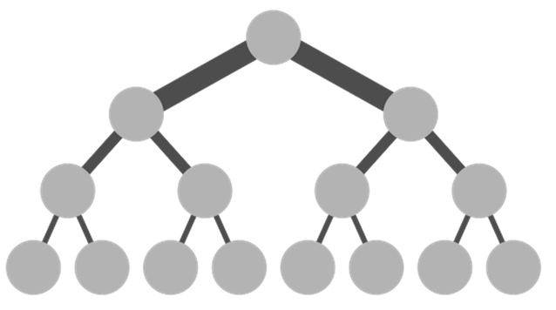
Achieving full bisection bandwidth
Scale up
Make links fatter toward the core of the network
Problem: Scaling up a traditional tree topology is expensive!
Requires non-commodity / impractical / link and switch components
Solutions?
Over-subscribe (i.e., provision less than full BBW)
Better topologies

Slide 38


Oversubscription
40G
20G
20G
10G
10G
10G
Need techniques to avoid congesting oversubscribed links!

Slide 39
Oversubscription
Not enough bandwidth
Oversubscription: Less bandwidth in the ToR-Agg links than all the server bandwidth in the rack
Oversubscription ratio: Ratio between bandwidth underneath and bandwidth above
Not enough paths between server pairs
Load balancing issues
Failure recovery issues

Slide 40
Better topologies
Core
Aggregation
Rack

Slide 41
Better topologies
Core
Aggregation
Rack

Slide 42
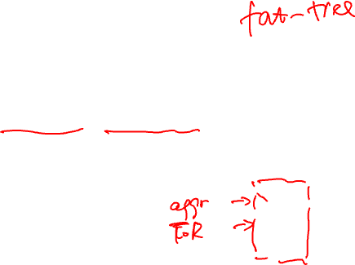
Clos topology
Multi-stage network
k pods, where each pod has two layers of k/2 switches
k/2 ports up and k/2 down
All links have the same b/w
At most k³/4 machines
Example
k = 4
16 machines
For k=48, 27648 machines
Pod 1
Pod 2
Pod 3
Pod 4

Slide 43
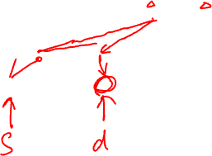
Challenges of scale-out design
Topology offers high bisection bandwidth
All other system components must be able to exploit this available capacity
Routing must use all paths
Transport protocol must fill all pipes (fast)

Slide 44
Summary
Video streaming
Too large to send, so stream it
Dynamically adapt to the network and users
Cloud systems
Forms the backend of modern web services
Runs in datacenters where all the processing happens
https://github.com/henryhxu/CSCI4430-ESTR4120

Slide 45
For reference

Slide 46
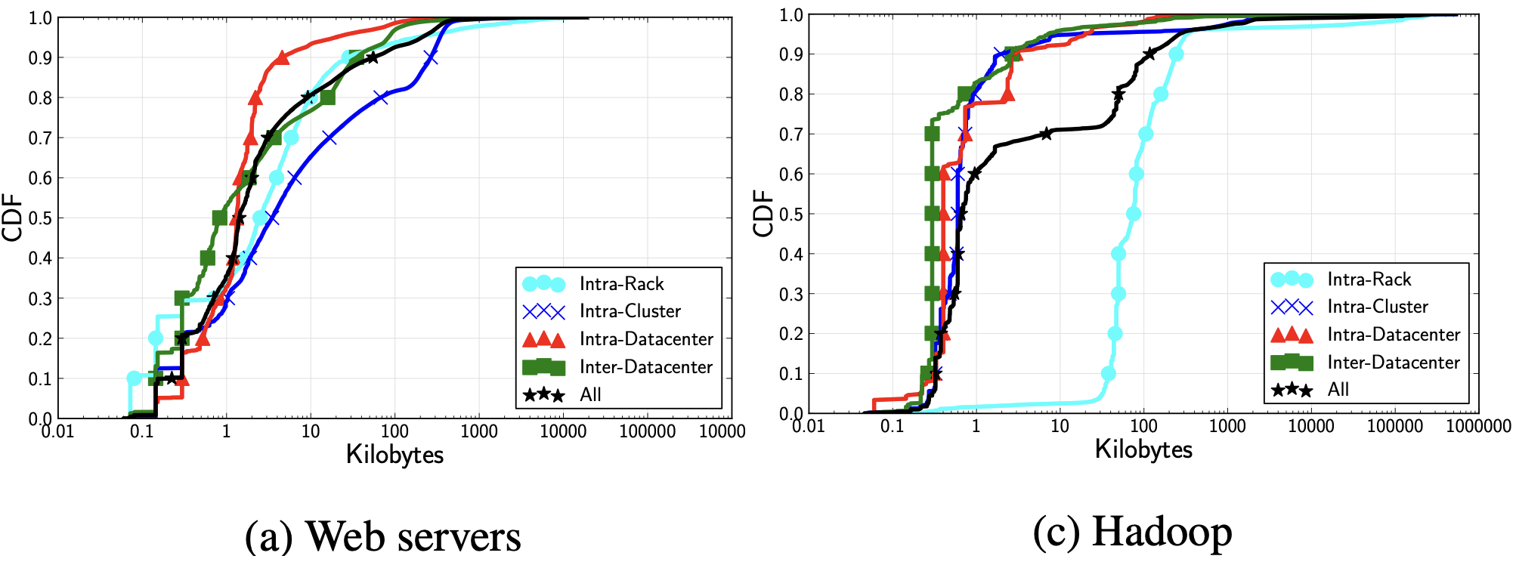

Datacenter traffic characteristics
A. Roy et al. Inside the social network’s (datacenter) network. In Proc. of ACM SIGCOMM, 2015.

Slide 47
Datacenter networks
Aggregation
ToR Switch
Server

Slide 48
Datacenter networks (Cont.)
Core
Aggregation
Rack

Slide 49
Datacenter traffic
Core
North-South Traffic
Aggregation
Rack
East-West Traffic

