Slide 1
CSCI 4430 – Fall 23
Tutorial 5
Credits to Umich EECS 489 Discussion 5

Slide 2
Assignment 2
Release: Mon, 9th Oct.
Asg2 and Asg3 are both group projects for 2 people.
Please be sure to submit your team information on the AutoGrader website. Autograder (cuhk.edu.hk)

Slide 3
Exercise - Q1 HTTP Streaming
Consider a simple HTTP streaming model.
𝑄 is the number of bits that must be buffered before the client application begins playout.
𝑟 is the video consumption rate.
𝑥 is the bits sending rate whenever the client buffer is not full.
Also assume that 𝑥 < 𝑟.
Describe the behavior of the video output:
Alternate between playout and freeze.
Suppose the buffer starts out empty. How long will it be before the video can begin playout?
Q / x
Assume the number of bits in buffer currently is Z (> 𝑄).
How long will the playout last?
Z / (r - x)

Slide 4
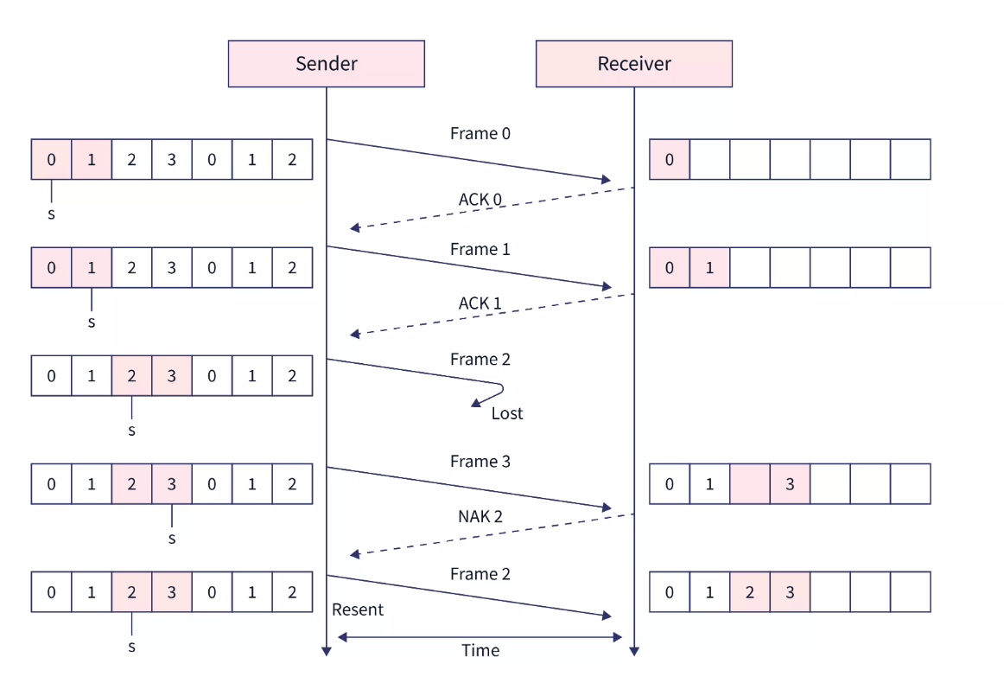
Exercise – Q2 Selective Repeat
With the Selective Repeat (SR) protocol, Is it possible for the sender to receive an ACK for a packet that falls outside of its current window? Why?
True
Selective Repeat ARQ Protocol | Scaler Topics
Notes:
Frame2 network contention

Slide 5
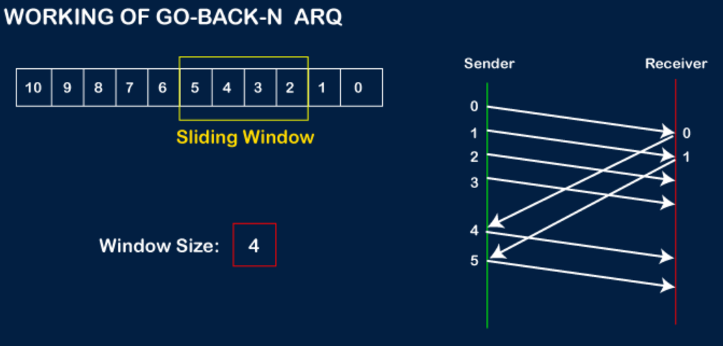
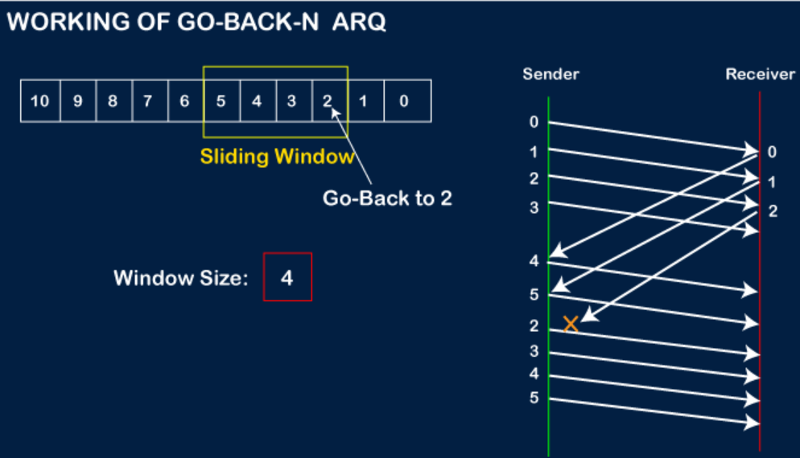
Exercise – Q3 Go-Back-N
With the Go-Back-N (GBN) protocol, Is it possible for the sender to receive an ACK for a packet that falls outside of its current window? Why?
True
Go-Back-N ARQ - javatpoint

Slide 6
Exercise – Q4 (N)ACK
Consider a reliable data transfer protocol that uses only negative acknowledgments (NACK). Suppose the sender sends data only infrequently. Would a NACK-only protocol be preferable to a protocol that uses ACKs? Why?
ACK: send ACK upon packet arrival
NACK: send NACK upon packet loss
No. In a NAK only protocol, the loss of packet x is only detected by the receiver when packet x+1 is received. If there is a long delay between the transmission of x and the transmission of x+1, then it will be a long time until x can be recovered, under a NAK only protocol

Slide 7
Exercise – Q5 (N)ACK
Now suppose the sender has a lot of data to send and the end-to-end connection experiences few losses. In this second case, would a NACK-only protocol be preferable to a protocol that uses ACKs? Why? (Assuming ACK/NACK is never lost)
ACK: send ACK upon packet arrival
NACK: send NACK upon packet loss
Yes. If data is being sent often, then recovery under a NAK-only scheme could happen quickly. Moreover, if errors are infrequent, then NAKs are only occasionally sent (when needed).

Slide 8
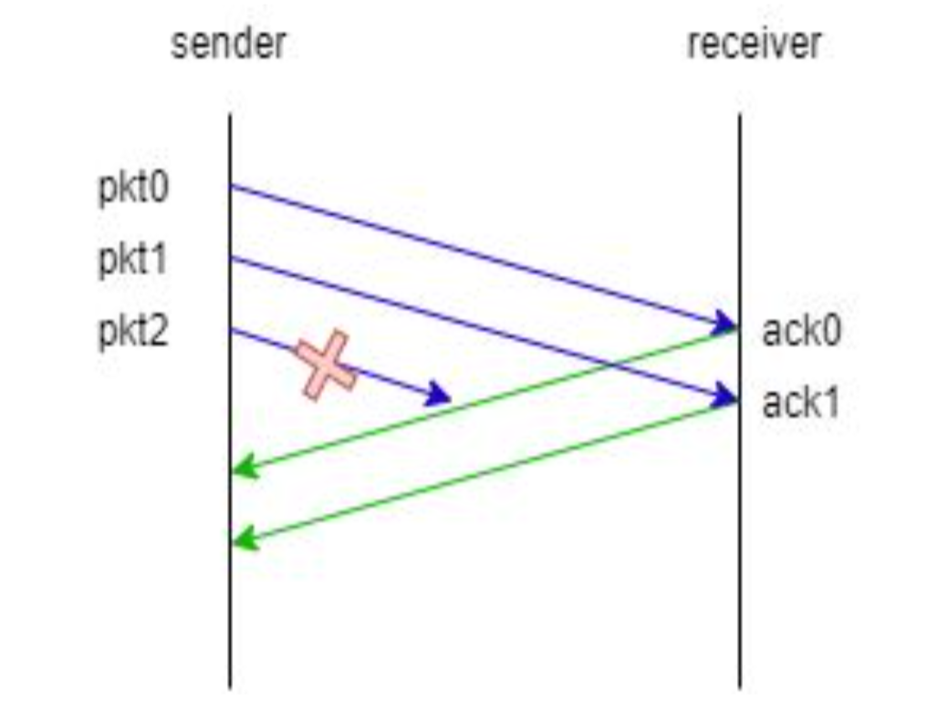
Exercise – Q6 Sliding Window Protocols (1)
Consider the sliding window protocol in the following figure. Does this figure indicate that GBN is being used, SR is being used, or there is not enough information to tell?
There is not enough information to tell, since both GBN and SR will individually ACK each of the first two messages as they are received correctly.

Slide 9
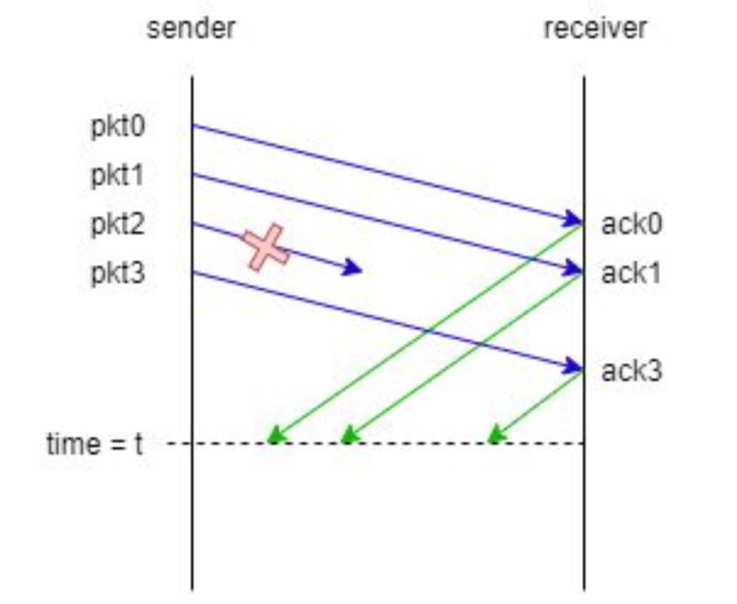
Exercise – Q7 Sliding Window Protocols (2)
Consider the sliding window protocol in the following figure. Does this figure indicate that GBN is being used, SR is being used, or there is not enough information to tell?
This must be the SR protocol since pkt3 is acked even though pkt2 was lost. GBN will discard pkt3 if pkt2 was dropped.

Slide 10
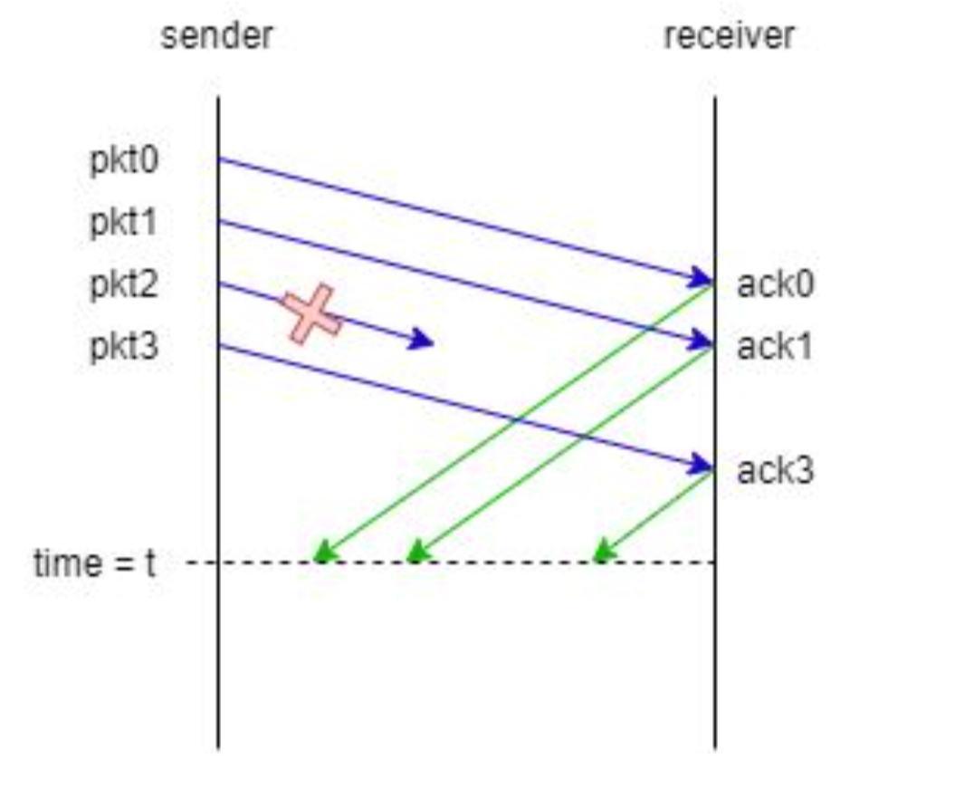
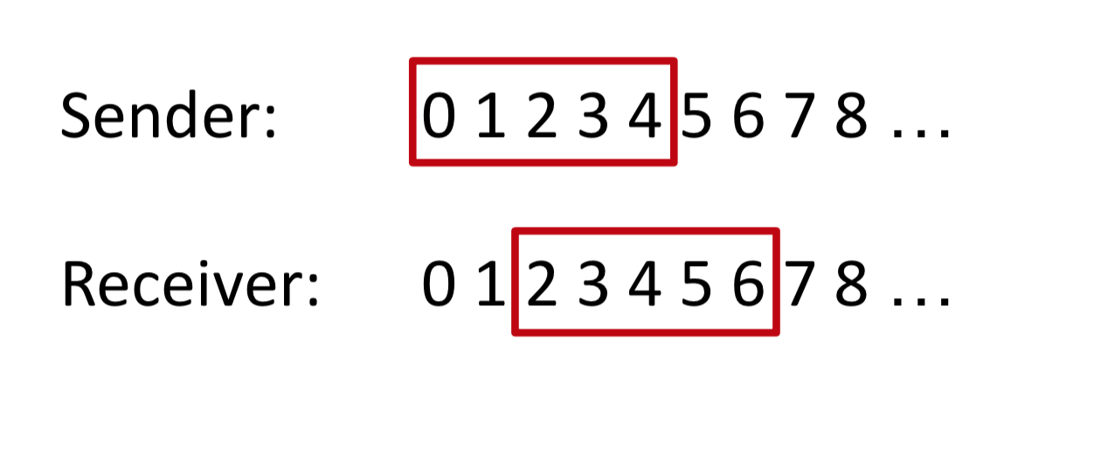
Exercise – Q8 Sliding Window Protocols (3)
Consider the sliding window protocol in the following figure. Suppose the window size = 5 for both sides. Show the positions of windows for the sender and receiver at time = t (no ack has been received).

Slide 11
Thanks!

