Slide 1
CSCI 4430 - Fall 23
Tutorial 6
Credits to Umich EECS 489 Discussion 6

Slide 2
Assignment 2
Due: Fri, 5th November. 11:59:59 p.m.
Form a group of exactly 2 students
First enter group info on the google sheet GroupingSheet-CSCI4430-Fall2023 - Google Sheet. Then on the autograder.
Assignment2: CSCI4430-ESTR4120/assignment/assignment-2 at 2023_fall · henryhxu/CSCI4430-ESTR4120 (github.com)
Start early!

Slide 3
Assignment 2 Overview
Web
Server
miProxy
Browser
Request
Request
Response
Response
The proxy only forwards messages between the browser and the web server
Doesn’t care what are forwarded
Don’t make any assumption on what are forwarded

Slide 4
Assignment 2 Overview
Tasks for the miProxy:
Received f4m file request:
Modify the HTTP GET request as “_nolist.f4m” file request
Send BOTH the original f4m file request and the modified “_nolist.f4m” request to server
Keep the received original f4m response (for parsing bitrates) and not forward it to browser
Forward the received “_nolist.f4m” response to the browser
Received video chunk request:
Modify the HTTP GET request based on your current throughput and the available bitrates
Forward the modified request to server
Forward the received response to browser
Other requests:
Not modify the HTTP GET request
Forward the received response to browser directly

Slide 5
Assignment 2 Overview: First GET Request (index.html)
GET / HTTP/1.1
Host: 10.0.0.2:8888
User-Agent: Mozilla/5.0 (X11; Ubuntu; Linux x86_64; rv:59.0) Gecko/20100101 Firefox/59.0
Accept: text/html,application/xhtml+xml,application/xml;q=0.9,*/*;q=0.8
Accept-Language: en-US,en;q=0.5
Accept-Encoding: gzip, deflate
Connection: keep-alive
Upgrade-Insecure-Requests: 1
Note: / means index.html
Notes:
Get index.html

Slide 6
Assignment 2 Overview
GET /swfobject.js HTTP/1.1
Host: 10.0.0.2:8888
User-Agent: Mozilla/5.0 (X11; Ubuntu; Linux x86_64; rv:59.0) Gecko/20100101 Firefox/59.0
Accept: */*
Accept-Language: en-US,en;q=0.5
Accept-Encoding: gzip, deflate
Referer: http://10.0.0.2:8888/
Connection: keep-alive
Note: SWFObject (originally FlashObject) is an open-source JavaScript library used to embed Adobe Flash content onto Web pages and to protect the flash game against piracy, which is supplied as one small JavaScript file. (Source: Wikipedia)

Slide 7
Assignment 2 Overview
GET /StrobeMediaPlayback.swf HTTP/1.1
Host: 10.0.0.2:8888
User-Agent: Mozilla/5.0 (X11; Ubuntu; Linux x86_64; rv:59.0) Gecko/20100101 Firefox/59.0
Accept: text/html,application/xhtml+xml,application/xml;q=0.9,*/*;q=0.8
Accept-Language: en-US,en;q=0.5
Accept-Encoding: gzip, deflate
Referer: http://10.0.0.2:8888/
Connection: keep-alive
Note: strobemediaplayback.swf refers to a file associated with Adobe Flash Player. SWF (Shockwave Flash) files were used to deliver multimedia content, including videos, and interactive applications, on websites.

Slide 8
Assignment 2 Overview: F4m Request
GET /vod/big_buck_bunny.f4m HTTP/1.1
Host: 10.0.0.2:8888
User-Agent: Mozilla/5.0 (X11; Ubuntu; Linux x86_64; rv:59.0) Gecko/20100101 Firefox/59.0
Accept: text/html,application/xhtml+xml,application/xml;q=0.9,*/*;q=0.8
Accept-Language: en-US,en;q=0.5
Accept-Encoding: gzip, deflate
Referer: http://10.0.0.2:8888/StrobeMediaPlayback.swf
Connection: keep-alive
big_buck_bunny_nolist.f4m

Slide 9
Assignment 2 Overview: Chunk Request
GET /vod/1000Seg1-Frag1 HTTP/1.1
Host: 10.0.0.2:8888
User-Agent: Mozilla/5.0 (X11; Ubuntu; Linux x86_64; rv:59.0) Gecko/20100101 Firefox/59.0
Accept: text/html,application/xhtml+xml,application/xml;q=0.9,*/*;q=0.8
Accept-Language: en-US,en;q=0.5
Accept-Encoding: gzip, deflate
Referer: http://10.0.0.2:8888/StrobeMediaPlayback.swf
Connection: keep-alive

Slide 10
Assignment 2 Overview: Response Example
HTTP/1.1 200 OK
Date: Mon, 01 Jan 2018 02:10:50 GMT
Server: Apache/2.2.32 (Unix)
Content-Length: 83594
Last-Modified: Mon, 01 Jan 2018 02:10:50 GMT
Keep-Alive: timeout=30000, max=499906
Connection: Keep-Alive
Content-Type: video/f4f

Slide 11
Assignment 2 Overview
A Quick Demo

Slide 12
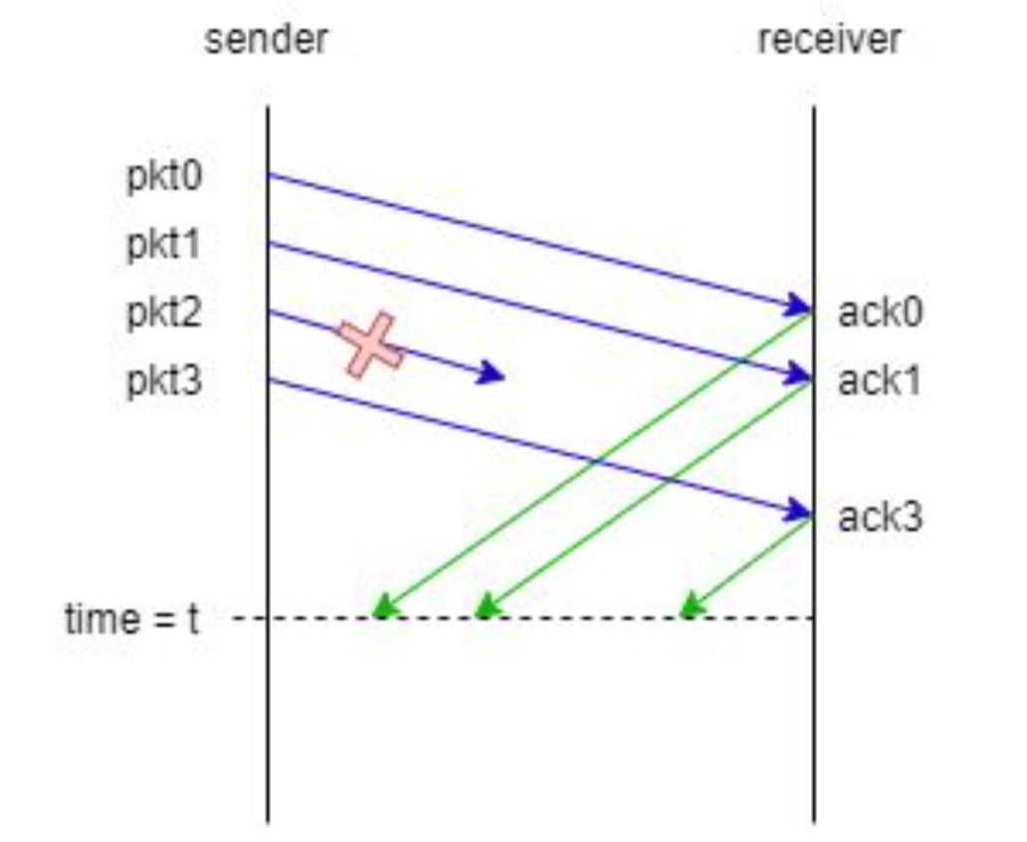
Exercise – Q2 Sliding Window Protocols
Consider the sliding window protocol in the following figure. Does this figure indicate that GBN is being used, SR is being used, or there is not enough information to tell?
This must be the SR protocol since pkt3 is acked even though pkt2 was lost. GBN will discard pkt3 if pkt2 was dropped.

Slide 13
GBN example with errors
Sender Window
Window size = 3 packets
Receiver Window
1
2
3
4
5
Timeout
Packet 4
6
Discard
Discard
4
5
6
Sender
Receiver
Time

Slide 14
SR example with errors
Sender Window
Window size = 3 packets
Receiver Window
{1}
1
{1, 2}
2
{1, 2, 3}
3
{2, 3, 4}
4
{3, 4, 5}
5
Timeout
Packet 4
{4, 5, 6}
6
Buffered
ACK=5
Buffered
{4, 5, 6}
4
ACK=6
{4, 5, 6}
ACK=4
{7, 8, 9}
7
Sender
Receiver

Slide 15
Thanks!

