Slide 1
CSCI4430 Computer Networks Lecture10: Network Layer – Basics
Hong Xu, Henry
CSE@CUHK, 2022
Material with thanks to Patrick Lee, Mosharaf Chowdhury, Aditya Akella, Sugih Jamin, Philip Levis, Sylvia Ratnasamy, Peter Steenkiste, and many other colleagues.

Slide 2
Agenda
Network layer basics
The Internet Protocol (IP)

Slide 3
Network layer
Present everywhere
Performs addressing, forwarding, and routing, among other tasks
Application
Application
Transport
Transport
Network
Network
Network
Datalink
Datalink
Datalink
Physical
Physical
Physical
End system
Switch
End system

Slide 4
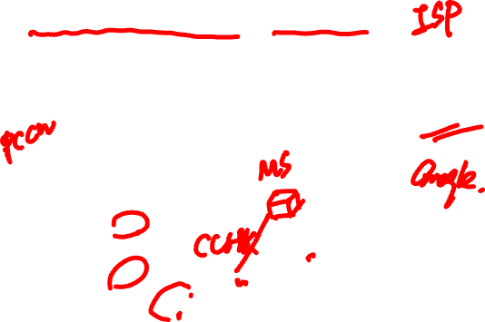
Context and terminology
“Autonomous System (AS)” or “Domain” Region of a network under a single administrative entity
“End hosts”
“Clients”, “Users”
“End points”
“Route” or “Path”
“Border Routers”
“Interior Routers”

Slide 5
Forwarding
111010010
MIT
umich.edu
mit.edu

Slide 6

Forwarding
Forwarding Table
Destination | Next Hop
UMICH | 1
UCB | 3
MIT | 2
NYU | 4
umich.edu
111010010
MIT
#1
#2
#4
#3
mit.edu

Slide 7

Forwarding
Directing a packet to the correct interface so that it progresses to its destination
Local
How?
Read address from packet header
Search forwarding table

Slide 8
Routing
Setting up network-wide forwarding tables to enable end-to-end communication
Global
How?
Using different routing protocols

Slide 9
Forwarding vs. routing
Forwarding: “data plane”
Directing one data packet
Each router using local routing state
Routing: “control plane”
Computing the forwarding tables that guide packets
Jointly computed by routers using a distributed algorithm
Very different timescales!

Slide 10
The IP layer

Slide 11
Lecture 2: Layer encapsulation
host
host
HTTP message
HTTP
HTTP
TCP segment
TCP
TCP
router
router
IP packet
IP packet
IP packet
IP
IP
IP
IP

Slide 12
Recall: IP packet
IP header
IP payload
IP packet
IP packet contains a header and payload
Payload is opaque to the network
Header is what we care about
First end-to-end layer (going bottom-up)

Slide 13
Designing the IP header
Think of the IP header as an interface
Between the source and destination end-systems
Between the source and network (routers)
Designing an interface
What task(s) are we trying to accomplish?
What information is needed to do it?
Header reflects information needed for basic tasks

Slide 14
What are these tasks? (in network)
Parse packet
Carry packet to the destination
Deal with problems along the way
Loops
Corruption
Packet too large
Accommodate evolution
Specify any special handling

Slide 15
What information do we need?
Parse packet
Carry packet to the destination
Deal with problems along the way
Loops
Corruption
Packet too large
Accommodate evolution
Specify any special handling

Slide 16

What information do we need?
Parse packet
IP version number (4 bits), packet length (16 bits)
Carry packet to the destination
Destination’s IP address (32 bits)
Deal with problems along the way
Loops:
Corruption:
Packet too large:

Slide 17

What information do we need?
Parse packet
IP version number (4 bits), packet length (16 bits)
Carry packet to the destination
Destination’s IP address (32 bits)
Deal with problems along the way
Loops: TTL (8 bits)
Corruption: checksum (16 bits)
Packet too large: fragmentation fields (32 bits)

Slide 18
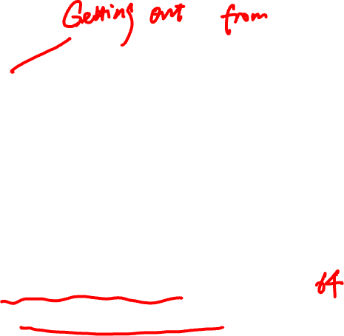
Preventing loops (TTL)
Forwarding loops cause packets to cycle for a long time
Left unchecked would accumulate to consume all capacity
Time-to-Live (TTL) Field (8 bits)
Decremented at each hop; packet discarded if 0
“Time exceeded” message is sent to the source

Slide 19
Header corruption (Checksum)
Checksum (16 bits)
Particular form of checksum over packet header
If not correct, router discards packets
So it doesn’t act on bogus information
Checksum recalculated at every router
Why?
Notes:
TTL

Slide 20
Fragmentation
Every link has a “Maximum Transmission Unit” (MTU)
Largest number of bits it can carry as one unit
A router can split a packet into multiple “fragments” if the packet size exceeds the link’s MTU
Must reassemble to recover original packet
Will return to fragmentation later …

Slide 21

What information do we need?
Parse packet
IP version number (4 bits), packet length (16 bits)
Carry packet to the destination
Destination’s IP address (32 bits)
Deal with problems along the way
TTL (8 bits), checksum (16 bits), frag. (32 bits)
Accommodate evolution
Version number (4 bits) (+ fields for special handling)
Specify any special handling

Slide 22
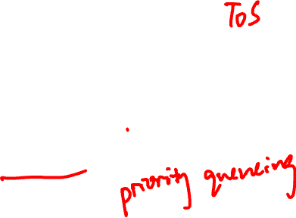
Special handling
“Type of Service” (8 bits)
Allow packets to be treated differently based on needs
e.g., indicate priority, congestion notification
Has been redefined several times
Now called “Differentiated Services Code Point (DSCP)”

Slide 23
Options
Optional directives to the network
Not used very often
16 bits of metadata + option-specific data
Examples of options
Record Route
Strict Source Route
Loose Source Route
Timestamp

Slide 24
What information do we need?
Parse packet
IP version number (4 bits), packet length (16 bits)
Carry packet to the destination
Destination’s IP address (32 bits)
Deal with problems along the way
TTL (8 bits), checksum (16 bits), frag. (32 bits)
Accommodate evolution
Version number (4 bits) (+ fields for special handling)
Specify any special handling
ToS (8 bits), Options (variable length)

Slide 25

IP packet structure
4-bit
Version
4-bit
Header
Len
8-bit
ToS
16-bit
Total Length (Bytes)
8-bit
TTL
16-bit
Header Checksum
32-bit
Destination IP Address
Options (if any)
Payload

Slide 26

Parse packet
Header length (4 bits)
Number of 32-bit words in the header
Typically “5” (for a 20-byte IPv4 header)
Can be more when IP options are used

Slide 27
IP packet structure
4-bit
Version
4-bit
Header
Len
8-bit
ToS
16-bit
Total Length (Bytes)
For Fragmentation
8-bit
TTL
16-bit
Header Checksum
32-bit
Destination IP Address
Options (if any)

Slide 28
Tasks at the destination end-system
Tell destination what to do with the received packet
Get responses to the packet back to the source

Slide 29

Telling end-host how to handle packet
Protocol (8 bits)
Identifies the higher-level protocol
Important for de-multiplexing at receiving host
L7
Application
SMTP
HTTP
DNS
NTP
L4
Transport
TCP
UDP
L3
Network
IP
L2
Data link
Ethernet
FDDI
PPP
L1
Physical
Optical
Copper
Radio
PSTN

Slide 30

Telling end-host how to handle packet
Protocol (8 bits)
Identifies the higher-level protocol
Important for de-multiplexing at receiving host
Most common examples
E.g., “6” for the Transmission Control Protocol (TCP)
E.g., “17” for the User Datagram Protocol (UDP)
protocol=6
protocol=17
IP header
IP header
TCP header
UDP header

Slide 31
Tasks at the destination end-system
Tell destination what to do with the received packet
Transport layer protocol (8 bits)
Get responses to the packet back to the source
Source IP address (32 bits)

Slide 32
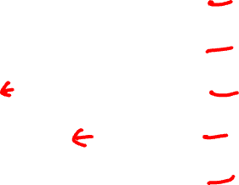

IP packet structure
4-bit
Version
4-bit
Header
Len
8-bit
ToS
16-bit
Total Length (Bytes)
For Fragmentation
8-bit
TTL
8-bit
Protocol
16-bit
Header Checksum
32-bit
Source IP Address
32-bit
Destination IP Address
Options (if any)

Slide 33
Dealing with fragmentation

Slide 34
A closer look at fragmentation
Every link has a “Maximum Transmission Unit” (MTU)
Largest number of bits it can carry as one unit
A router can split a packet into multiple “fragments” if the packet size exceeds the link’s MTU
Must reassemble to recover original packet

Slide 35
Example of fragmentation
A 4000 byte packet crosses a link w/ MTU=1500B
4000B
…
1500B

Slide 36
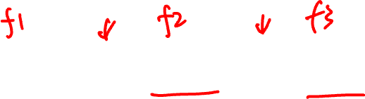
Example of fragmentation
A 4000 byte packet crosses a link w/ MTU=1500B
IP header
4000
20
3980
20
1480
20
1200
20
1300
1500
1220
1320

Slide 37
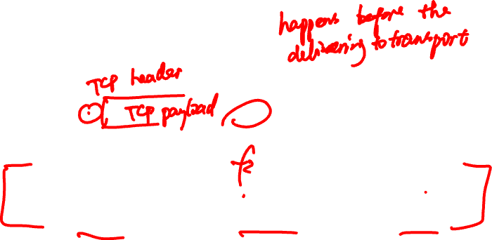
Why reassemble?
IP header
4000
20
3980
TCP
HTTP
20
TCP
HTTP
1480
20
1200
20
1300
1500
1220
1320
20
TCP
HTTP
Must reassemble before sending packet to higher layers!

Slide 38
A few considerations
Where to reassemble?
Fragments can get lost
Fragments can follow different paths
Fragments can get fragmented again

Slide 39
Where should reassembly occur?
Classic case of E2E principle
At next-hop router imposes burden on network
Complicated reassembly algorithm
Must hold onto fragments/state
Any other router may not work
Fragments may take different paths
Little benefit, large cost for network reassembly
Hence, reassembly is done at the destination

Slide 40
Reassembly: What fields?
Need a way to identify fragments of the packet
Introduce an identifier
Fragments can get lost
Need some form of sequence number or offset
Sequence numbers / offset
How do I know when I have them all? (need max seq# / flag)
What if a fragment gets re-fragmented?

Slide 41

IPv4’s fragmentation fields
Identifier: which fragments belong together
Flags:
Reserved: ignore
DF: don’t fragment
May trigger error message back to sender
MF: more fragments coming
Offset: portion of original payload this fragment contains
In 8-byte units

Slide 42
IP packet structure
4-bit
Version
4-bit
Header
Len
8-bit
ToS
16-bit
Total Length (Bytes)
16-bit
Identification
For Fragmentation
3-bit
Flags
13-bit
Fragment Offset
8-bit
TTL
8-bit
Protocol
16-bit
Header Checksum
32-bit
Source IP Address
32-bit
Destination IP Address
Options (if any)

Slide 43
Why this works
Fragment without MF set (last fragment)
Tells host which are the last bits in original payload
All other fragments fill in holes
Can tell when holes are filled, regardless of order
Use offset field
Q: why use a byte-offset for fragments rather than numbering each fragment?
Allows further fragmentation of fragments

Slide 44
Example of fragmentation (contd.)
Packet split into 3 pieces
Example:
4000
20
3980
20
1480
20
1200
20
1300
1500
1220
1320

Slide 45
Example of fragmentation, contd.
4000 byte packet from host 1.2.3.4 to 5.6.7.8 traverses a link with MTU 1,500 bytes
Version
4
Header
Len
5
ToS
0
Total Length (Bytes)
4000
Identification
56273
R/D/M
0/0/0
Fragment Offset
0
TTL
127
Protocol
6
Header Checksum
44019
Source IP Address
1.2.3.4
Destination IP Address
5.6.7.8
(3980 more bytes of payload here)

Slide 46
Example of fragmentation, contd.
Datagram split into 3 pieces. Possible first piece:
Version
4
Header
Len
5
ToS
0
Total Length (Bytes)
1500
Identification
56273
R/D/M
0/0/1
Fragment Offset
0
TTL
127
Protocol
6
Header Checksum
xxx
Source IP Address
1.2.3.4
Destination IP Address
5.6.7.8

Slide 47
Example of fragmentation, contd.
Possible second piece: Frag#1 covered 1480bytes
Version
4
Header
Len
5
ToS
0
Total Length (Bytes)
1220
Identification
56273
R/D/M
0/0/1
Fragment Offset
185 (185 * 8 = 1480)
TTL
127
Protocol
6
Header Checksum
yyy
Source IP Address
1.2.3.4
Destination IP Address
5.6.7.8

Slide 48
Example of fragmentation, contd.
Possible third piece: 1480+1200 = 2680
Version
4
Header
Len
5
ToS
0
Total Length (Bytes)
1320
Identification
56273
R/D/M
0/0/0
Fragment Offset
335 (335 * 8 = 2680)
TTL
127
Protocol
6
Header Checksum
zzz
Source IP Address
1.2.3.4
Destination IP Address
5.6.7.8

Slide 49
A quick look into IPv6

Slide 50
IPv6
Motivated (prematurely) by address exhaustion
Addresses four times as big (128-bit)
Focused on simplifying IP
Got rid of all fields that were not absolutely necessary
Result is an elegant, if unambitious, protocol

Slide 51

What “clean up” would you do?
4-bit
Version
4-bit
Header
Len
8-bit
ToS
16-bit
Total Length (Bytes)
16-bit
Identification
3-bit
Flags
13-bit
Fragment Offset
8-bit
TTL
8-bit
Protocol
16-bit
Header Checksum
32-bit
Source IP Address
32-bit
Destination IP Address
Options (if any)
Payload

Slide 52
IPv4 and IPv6 header comparison
IPv4
IPv6
Version | IHL | Type of Service | Total Length
Identification |  |  | Flags | Fragment Offset
Time to Live |  | Protocol | Header Checksum
Source Address
Destination Address
Options |  |  |  |  | Padding
Version | Traffic Class | Flow Label
Payload Length |  |  | Next Header | Hop Limit
128-bit Source Address
128-bit Destination Address
Field name kept from IPv4 to IPv6
Fields not kept in IPv6
Name & position changed in IPv6
New field in IPv6

Slide 53
Summary of changes
Eliminated fragmentation (why?)
Many hairy security issues; IPv6 requires end-hosts to perform MTU discovery
Eliminated checksum (why?)
Who also has checksum?
New options mechanism (why?)
Eliminated header length (why?)
Expanded addresses
Added Flow Label

Slide 54
Philosophy of changes
Don’t deal with problems: leave to ends
Eliminated fragmentation and checksum
Why retain TTL?
Simplify handling:
New options mechanism (uses next header)
Eliminated header length
Why couldn’t IPv4 do this?
Provide general flow label for packet
Not tied to semantics
Provides great flexibility

Slide 55
Summary
Network layer can be divided into data plane and control plane
Data plane deals with “how?”
Control plane deals with “what?”
IP is simple yet nuanced

